Slide 1



Slide 2



Slide 3
Proverbs 4:23 Keep thy heart with all diligence; for out of it are the issues of life.

Slide 4
My Heart Is MINE, And It’s My Responsibility To ‘Keep’ My Heart!

Slide 5

IT IS MY RESPONSIBILITY TO BELIEVE THIS!

Slide 6
Listen To Jesus…
Matthew 5:8 Blessed are the pure in heart: for they shall see God.

Slide 7
Listen To Jesus…
Matthew 6:21 For where your treasure is, there will your heart be also.

Slide 8
Listen To Jesus…
Matthew 12:35 A good man out of the good treasure of the heart bringeth forth good things: and an evil man out of the evil treasure bringeth forth evil things.

Slide 9
Listen To Jesus…
Matthew 15:18 But those things which proceed out of the mouth come forth from the heart; and they defile the man.

Slide 10
Listen To Jesus…
Mark 11:23 For verily I say unto you, That whosoever shall say unto this mountain, Be thou removed, and be thou cast into the sea; and shall not doubt in his heart, but shall believe that those things which he saith shall come to pass; he shall have whatsoever he saith.

Slide 11
Listen To Jesus…
Mark 12:33 And to love him with all the heart, and with all the understanding, and with all the soul, and with all the strength, and to love his neighbour as himself, is more than all whole burnt offerings and sacrifices.

Slide 12
Listen To Jesus…
John 14:1 Let not your heart be troubled: ye believe in God, believe also in me.

Slide 13
Listen To Jesus…
John 14:27 Peace I leave with you, my peace I give unto you: not as the world giveth, give I unto you. Let not your heart be troubled, neither let it be afraid.

Slide 15

Listen To Others…
…A Dark Heart
Romans 1:21 Because that, when they knew God, they glorified him not as God, neither were thankful; but became vain in their imaginations, and their foolish heart was darkened.

Slide 16
Listen To Others…
…A Blind Heart
Ephesians 4:18 Having the understanding darkened, being alienated from the life of God through the ignorance that is in them, because of the blindness of their heart:

Slide 17

Listen To Others…
…A Condemning Heart
1 John 3:20-21 ²⁰ For if our heart condemn us, God is greater than our heart, and knoweth all things.
²¹ Beloved, if our heart condemn us not, then have we confidence toward God.

Slide 18
Listen To Others…
...A True Heart
Hebrews 10:22 Let us draw near with a true heart in full assurance of faith, having our hearts sprinkled from an evil conscience, and our bodies washed with pure water.

Slide 19
Listen To Others…
...An Established Heart
Hebrews 13:9 Be not carried about with divers and strange doctrines. For it is a good thing that the heart be established with grace; not with meats, which have not profited them that have been occupied therein.

Slide 21
Get That Down In Your Heart!

Slide 22
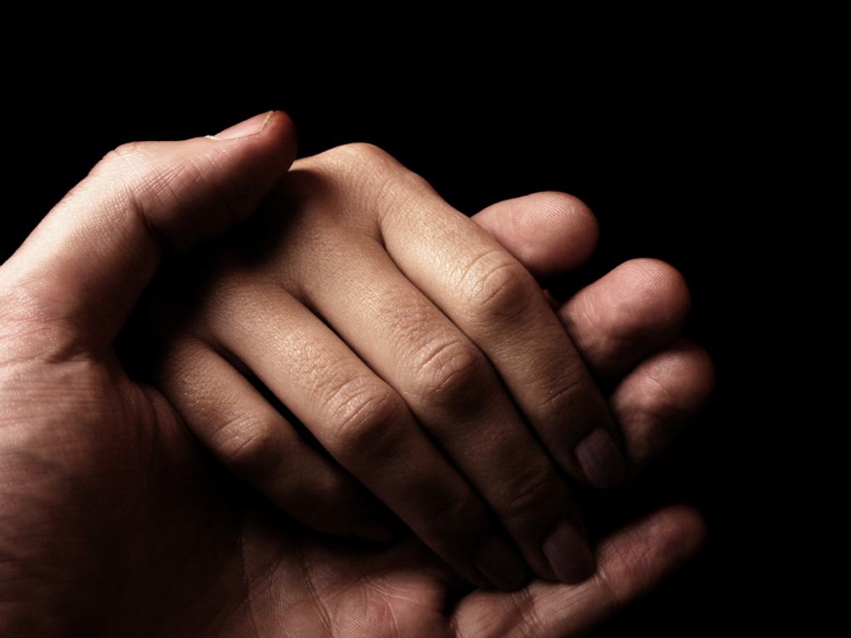
WHY?

Slide 23


Because…
…A Heart Can Be Troubled
Psalms 25:17 The troubles of my heart are enlarged: O bring thou me out of my distresses.

Slide 24
Because…
…A Heart Can Be Heavy
Proverbs 12:25 Heaviness in the heart of a man maketh it stoop: but a good word maketh it glad.

Slide 25
Because…
…A Heart Can Be Sick
Proverbs 13:12 Hope deferred maketh the heart sick: but when the desire cometh, it is a tree of life.

Slide 26
Because…
…A Heart Can Be Wounded
Psalm 109:22 For I am poor and needy, and my heart is wounded within me.

Slide 27
Because…
…A Heart Can Be Wounded
Psalm 102:4 My heart is smitten, and withered like grass; so that I forgot to eat my bread.

Slide 28
Because…
…A Heart Can Be Broken
Psalm 34:18 The LORD is nigh unto them that are of a broken heart; and saveth such as be of a contrite spirit.

Slide 29
Because…
…A Heart Can Be Broken
Psalm 51:17 The sacrifices of God are a broken spirit: a broken and a contrite heart, O God, thou wilt not despise.

Slide 31
MY HEART IS MY RESPONSIBILITY
Proverbs 4:23 Keep thy heart with all diligence; for out of it are the issues of life.

Slide 32
MY HEART IS MY RESPONSIBILITY
Proverbs 23:19 Hear thou, my son, and be wise, and guide thine heart in the way.

Slide 33
MY HEART IS MY RESPONSIBILITY
Proverbs 20:5 Counsel in the heart of man is like deep water; but a man of understanding will draw it out.

Slide 34
WHY?
I Want A Clean Heart!
Psalm 51:10 Create in me a clean heart, O God; and renew a right spirit in me.

Slide 35
WHY?
I Want A Healthy Heart!
Psalm 15:13 A merry heart maketh a cheerful countenance: but by sorrow of the heart the spirit is broken.

Slide 36
WHY?
I Want A Strong Heart!
Psalm 28:7 The LORD is my strength and my shield; my heart trusted in him, and I am helped: therefore my heart greatly rejoiceth; and with my song will I praise him.

Slide 37
WHY?
I Want A Confident Heart!
Psalm 27:3 Though an host should encamp against me, my heart shall not fear: though war should rise against me, in this will I be confident.

Slide 38
WHY?
I Want A Secure Heart!
Psalm 37:31 The law of his God is in his heart; none of his steps shall slide.

Slide 39
WHY?
I Want A Fixed Heart!
Psalm 57:7 My heart is fixed, O God, my heart is fixed: I will sing and give praise.

Slide 41
Get That Down In Your Heart!

Slide 42

HOW?

Slide 43

TALK TO YOUR HEART
1
Psalm 4:4 Stand in awe, and sin not: commune with your own heart upon your bed, and be still. Selah.

Slide 44
TALK TO YOUR HEART
1
Psalm 77:6 I call to remembrance my song in the night: I commune with mine own heart: and my spirit made diligent search.

Slide 45
TALK TO YOUR HEART
1
Psalm 26:2 Examine me, O LORD, and prove me; try my reins and my heart.

Slide 46
TALK TO YOUR HEART
1
Proverbs 15:30 The light of the eyes rejoiceth the heart: and a good report maketh the bones fat.

Slide 47
SPEAK GOD’S TRUTH INTO YOUR HEART
2
Psalm 15:2 He that walketh uprightly, and worketh righteousness, and speaketh the truth in his heart.

Slide 48
SPEAK GOD’S TRUTH INTO YOUR HEART
2
Psalm 19:8 The statutes of the LORD are right, rejoicing the heart: the commandment of the LORD is pure, enlightening the eyes.

Slide 49
SPEAK GOD’S TRUTH INTO YOUR HEART
2
Psalm 119:11 Thy word have I hid in mine heart, that I might not sin against thee.

Slide 50
SPEAK GOD’S TRUTH INTO YOUR HEART
2
Psalm 119:80 Let my heart be sound in thy statutes; that I be not ashamed.

Slide 51
SPEAK GOD’S TRUTH INTO YOUR HEART
2
Proverbs 3:3 Let not mercy and truth forsake thee: bind them about thy neck; write them upon the table of thine heart:

Slide 52
SPEAK GOD’S TRUTH INTO YOUR HEART
2
Proverbs 19:21 There are many devices in a man's heart; nevertheless the counsel of the LORD, that shall stand.

Slide 53
TRUST GOD WITH YOUR HEART
3
Proverbs 3:5-6 ⁵ Trust in the LORD with all thine heart; and lean not unto thine own understanding.
⁶ In all thy ways acknowledge him, and he shall direct thy paths.

Slide 54
TRUST GOD WITH YOUR HEART
3
Proverbs 23:26 My son, give me thine heart, and let thine eyes observe my ways.

Slide 55
TRUST GOD WITH YOUR HEART
3
Proverbs 27:14 Wait on the LORD: be of good courage, and he shall strengthen thine heart: wait, I say, on the LORD.

Slide 56
TRUST GOD WITH YOUR HEART
3
Proverbs 37:4 Delight thyself also in the LORD: and he shall give thee the desires of thine heart.

Slide 57
TRUST GOD WITH YOUR HEART
3
Proverbs 139:23 Search me, O God, and know my heart: try me, and know my thoughts:

Slide 59
IT IS MY RESPONSIBILITY TO BELIEVE THIS!

Slide 60
How’s Your Heart?

