Slide 1




Slide 2
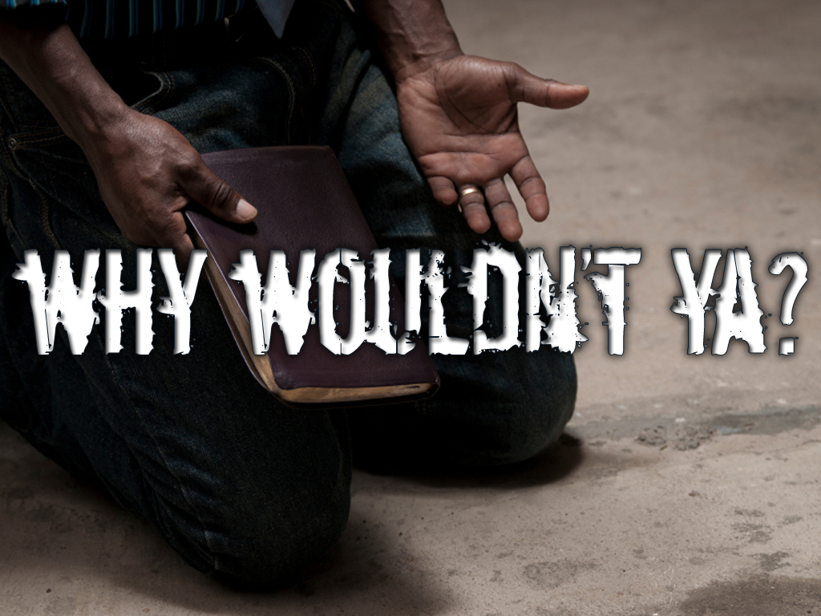


Slide 3



Slide 4



Slide 5
Common sense says…

Slide 6





Slide 7

IF GOD IS GOD
And He is…

Slide 8
IF GOD KNOWS EVERYTHING
And He does…

Slide 9
Then if I can find out what God likes and hates, I can know the absolute best things to like and the things I should not like!

Slide 10
Ya Understand?

Slide 11

So...

Slide 12
Proverbs 6:16-19 ¹⁶These six things doth the LORD hate: yea, seven are an abomination unto him:
¹⁷A proud look, a lying tongue, and hands that shed innocent blood,
¹⁸An heart that deviseth wicked imaginations, feet that be swift in running to mischief,
¹⁹A false witness that speaketh lies, and he that soweth discord among brethren.

Slide 13
WHAT REALLY MATTERS TO GOD?
My Attitude
My Words
My Touch
My Thoughts
My Walk
My Actions
My Heart

Slide 14
These are all
BIG DEALS
to God!

Slide 15
Lets spin this passage around…

Slide 16
Instead Of What God Hates
WHAT GOD LIKES!

Slide 18
MY ATTITUDE
GOD LIKES
GOD HATES
HUMILITY “Self-Less”
PRIDE “Self-Full”
Proverbs 6:17a A proud look, a lying tongue, and hands that shed innocent blood,

Slide 19
MY ATTITUDE
GOD LIKES
GOD HATES
HUMILITY
PRIDE
Proverbs 16:15 Every one that is proud in heart is an abomination to the LORD: though hand join in hand, he shall not be unpunished.

Slide 20
MY ATTITUDE
GOD LIKES
GOD HATES
HUMILITY
PRIDE
Proverbs 28:25 He that is of a proud heart stirreth up strife: but he that putteth his trust in the LORD shall be made fat.

Slide 21
MY ATTITUDE
GOD LIKES
GOD HATES
HUMILITY
PRIDE
Proverbs 13:10 Only by pride cometh contention: but with the well advised is wisdom.

Slide 22
MY ATTITUDE
GOD LIKES
GOD HATES
HUMILITY
PRIDE
Proverbs 16:18 Pride goeth before destruction, and an haughty spirit before a fall.

Slide 23
MY ATTITUDE
GOD LIKES
GOD HATES
HUMILITY
PRIDE
Proverbs 11:2 When pride cometh, then cometh shame: but with the lowly is wisdom.

Slide 24
MY ATTITUDE
GOD LIKES HUMILITY!
Proverbs 29:23 A man's pride shall bring him low: but honour shall uphold the humble in spirit.

Slide 26
MY WORDS
GOD LIKES
GOD HATES
HONESTY
LYING
Proverbs 6:17b A proud look, a lying tongue, and hands that shed innocent blood,

Slide 27
MY WORDS
GOD LIKES
GOD HATES
HONESTY
LYING
Proverbs 12:19 The lip of truth shall be established for ever: but a lying tongue is but for a moment.

Slide 28
MY WORDS
GOD LIKES
GOD HATES
HONESTY
LYING
Proverbs 12:22 Lying lips are an abomination to the LORD: but they that deal truly are His delight.

Slide 29
MY WORDS
GOD LIKES
GOD HATES
HONESTY
LYING
Proverbs 16:28 A froward man soweth strife: and a whisperer separateth chief friends.

Slide 30
MY WORDS
GOD LIKES HONESTY!
Proverbs 19:22 The desire of a man is his kindness: and a poor man is better than a liar.

Slide 32
MY TOUCH
GOD LIKES
GOD HATES
GENTLE HANDS
VIOLENT HANDS
Proverbs 6:17c A proud look, a lying tongue, and hands that shed innocent blood,

Slide 33
MY TOUCH
GOD LIKES
GOD HATES
GENTLE HANDS
VIOLENT HANDS
Proverbs 1:11 If they say, Come with us, let us lay wait for blood, let us lurk privily for the innocent without cause.

Slide 34
MY TOUCH
GOD LIKES
GOD HATES
GENTLE HANDS
VIOLENT HANDS
Numbers 35:31 Moreover ye shall take no satisfaction for the life of a murderer, which is guilty of death: but he shall surely be put to death.

Slide 35
MY TOUCH
GOD LIKES GENTLE HANDS!
Galatians 5:22-23 ²²But the fruit of the Spirit is love, joy, peace, longsuffering, gentleness, goodness, faith,

Slide 36
MY TOUCH
GOD LIKES GENTLE HANDS!
Galatians 5:22-23 ²³Meekness, temperance: against such there is no law.

Slide 38
MY THOUGHTS
GOD LIKES
GOD HATES
GOOD THOUGHTS Thoughts Or Plans For Good “CLEAN”
WICKED THOUGHTS Thoughts Or Plans For Evil “DIRTY”
Proverbs 6:18a An heart that deviseth wicked imaginations, feet that be swift in running to mischief .

Slide 39
MY THOUGHTS
GOD LIKES
GOD HATES
GOOD THOUGHTS
WICKED THOUGHTS
Proverbs 15:26 The thoughts of the wicked are an abomination to the LORD: but the words of the pure are pleasant words.

Slide 40
MY THOUGHTS
GOD LIKES GOOD THOUGHTS!
Philippians 4:8 Finally, brethren, whatsoever things are true, whatsoever things are honest, whatsoever things are just, whatsoever things are pure, whatsoever things are lovely, whatsoever things are of good report; if there be any virtue, and if there be any praise, think on these things.

Slide 42
MY WALK
GOD LIKES
GOD HATES
PEACE MAKERS Seeks To Do Right!
TROUBLE MAKERS Seeks To Do Damage!
Proverbs 6:18b An heart that deviseth wicked imaginations, feet that be swift in running to mischief.

Slide 43
MY WALK
GOD LIKES
GOD HATES
PEACE MAKERS
TROUBLE MAKERS
Proverbs 24:1-2 ¹Be not thou envious against evil men, neither desire to be with them.
²For their heart studieth destruction, and their lips talk of mischief.

Slide 44
MY WALK
GOD LIKES PEACEMAKERS!
Proverbs 16:6-7 ⁶By mercy and truth iniquity is purged: and by the fear of the LORD men depart from evil.
⁷When a man's ways please the LORD, he maketh even his enemies to be at peace with him.

Slide 46
MY ACTIONS
GOD LIKES
GOD HATES
BEING REAL “INTEGRITY”
BEING PHONY “HYPOCRITE”
Proverbs 6:19a A false witness that speaketh lies, and he that soweth discord among the brethren.

Slide 47
MY ACTIONS
GOD LIKES
GOD HATES
BEING REAL
BEING PHONY
Proverbs 23:23 Buy the truth, and sell it not; also wisdom, and instruction, and understanding.

Slide 48
MY ACTIONS
GOD LIKES BEING REAL!
Proverbs 3:3 Let not mercy and truth forsake thee: bind them about thy neck; write upon the table of thine heart:

Slide 50
MY HEART
GOD LIKES
GOD HATES
UNITY “KIND”
DISCORD “GOSSIP”
Proverbs 6:19b A false witness that speaketh lies, and he that soweth discord among the brethren.

Slide 51
MY HEART
GOD LIKES
GOD HATES
UNITY
DISCORD
Galatians 5:14-15 ¹⁴For all the law is fulfilled in one word, even in this; Thou shalt love thy neighbour as thyself.

Slide 52
MY HEART
GOD LIKES
GOD HATES
UNITY
DISCORD
Galatians 5:14-15 ¹⁵But if ye bite and devour one another, take heed that ye be not consumed one of another.

Slide 53
MY HEART
GOD LIKES UNITY!
Psalm 133:1 Behold, how good and how pleasant it is for brethren to dwell together in unity!

Slide 55
WHAT REALLY MATTERS
GOD LIKES
GOD HATES
MY ATTITUDE
humility
pride
MY WORDS
honesty
lying
MY TOUCH
Gentle hands
Violent hands
MY THOUGHTS
Good thoughts
Wicked thoughts
MY WALK
Peace makers
Trouble makers
MY ACTIONS
Being real
Being phony
MY HEART
unity
discord

