Slide 1




Slide 2
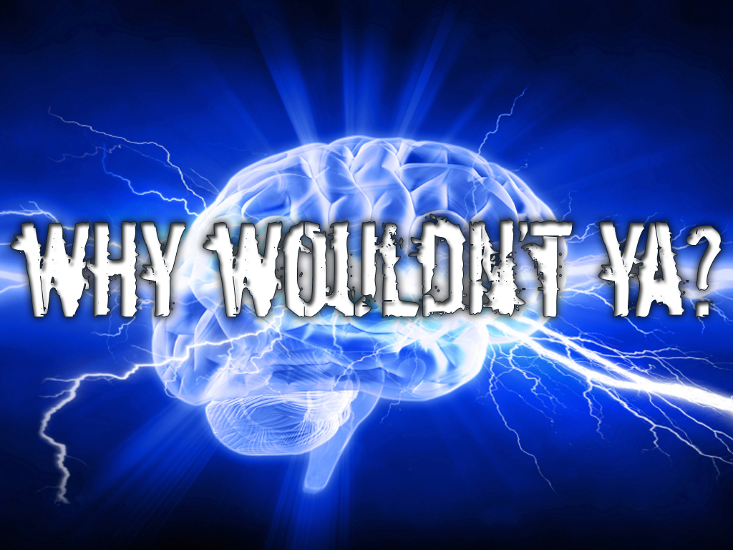
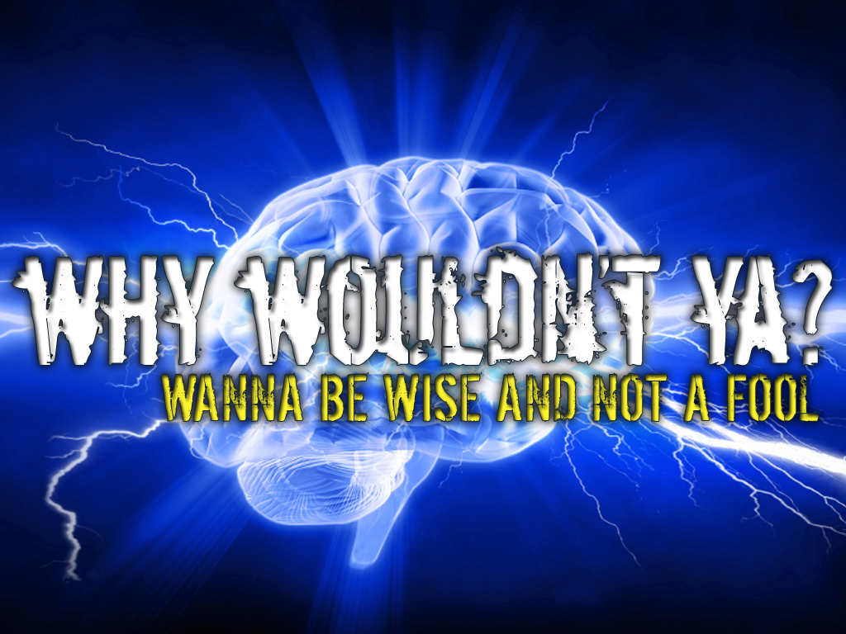


Slide 3
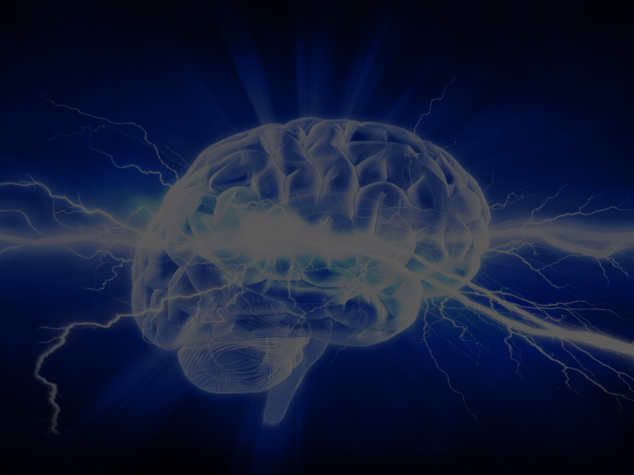
WISE
One who shows knowledge and has good judgment

Slide 4
FOOL
One who is deceived and has bad judgment

Slide 5
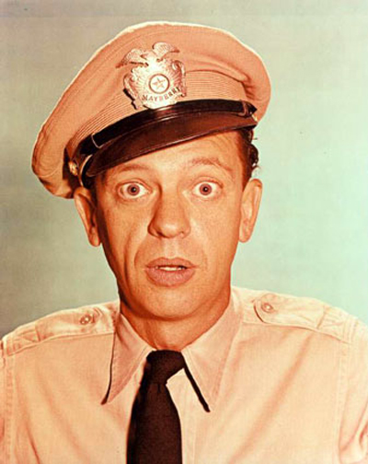
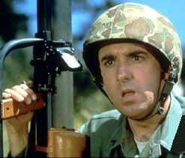
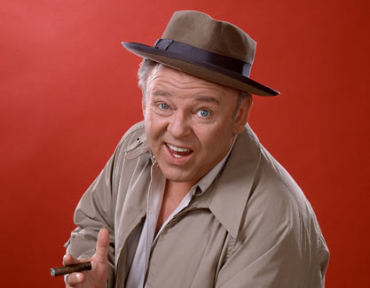
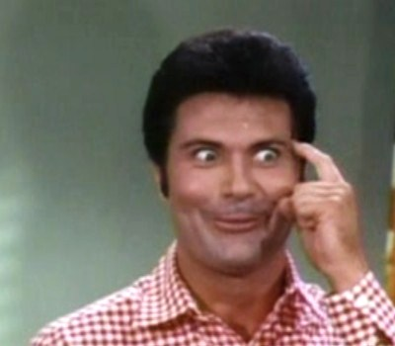
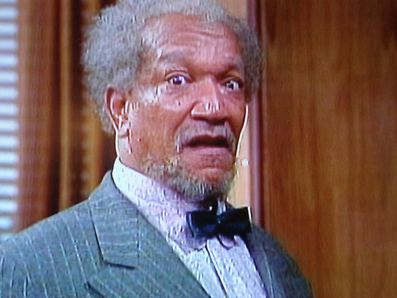
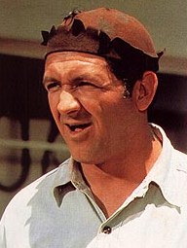
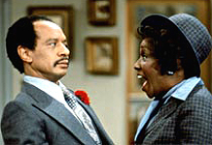
FOOL

Slide 6
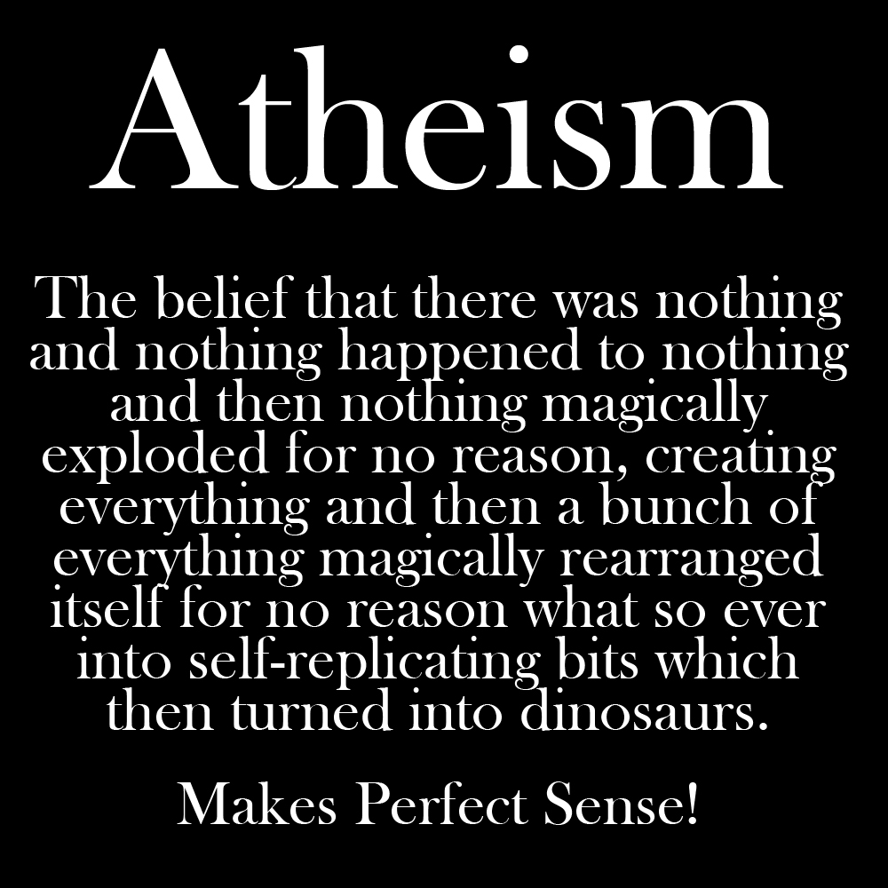
FOOL
Not!

Slide 7
There is no such thing
as a WISE FOOL or a FOOLISH WISE MAN

Slide 8
AIN’T HAPPENING!

Slide 9
It’s one or the other...

Slide 10
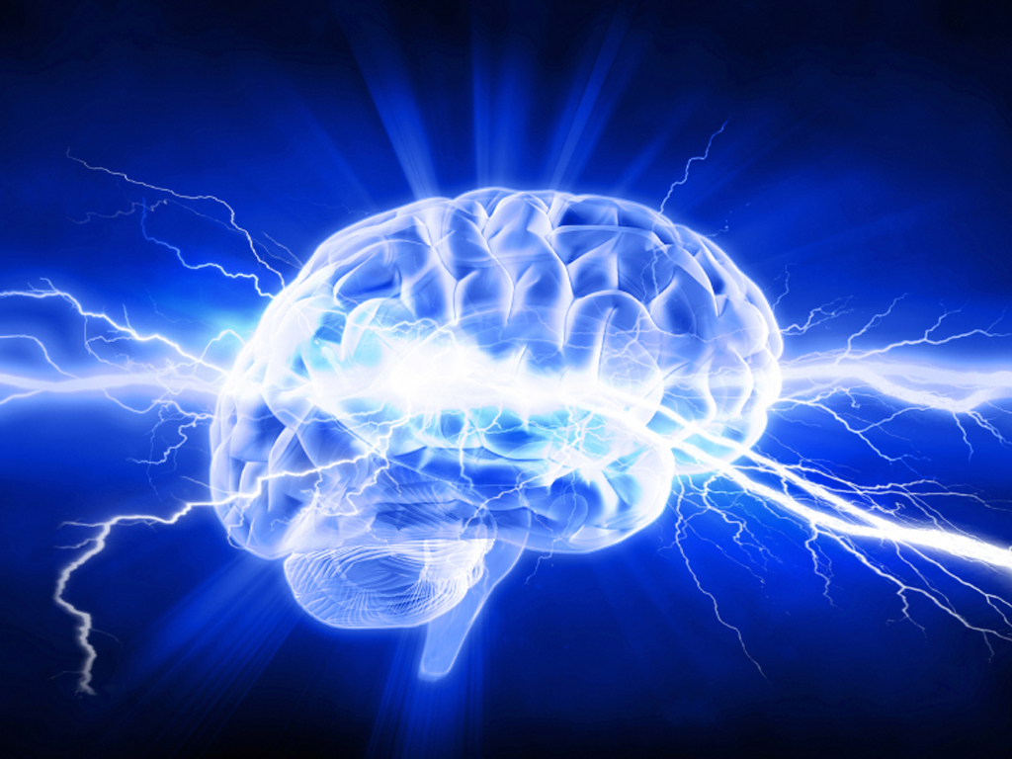
So...

Slide 11
Lets Look At Scriptures In
The Book Of Proverbs, That Mention Both The WISE And The FOOL...

Slide 12
THE MINDSET OF THE WISE & THE FOOL
WISE
FOOL
Accepts Instruction
Rejects
Instruction
Proverbs 1:7
The fear of the LORD is the beginning of knowledge: but fools despise wisdom and instruction.

Slide 13
THE MINDSET OF THE WISE & THE FOOL
WISE
FOOL
Receives Commandments
Debates
Commandments
Proverbs 10:8
The wise in heart will receive commandments: but a prating fool shall fall.

Slide 14
THE MINDSET OF THE WISE & THE FOOL
WISE
FOOL
Increases In Knowledge
Decreases In Knowledge
Proverbs 10:14
Wise men lay up knowledge: but the mouth of the foolish is near destruction.

Slide 15
THE MINDSET OF THE WISE & THE FOOL
WISE
FOOL
Receives Counsel
Rejects Counsel
Proverbs 12:15
The way of a fool is right in his own eyes: but he that hearkeneth unto counsel is wise.

Slide 16
THE MINDSET OF THE WISE & THE FOOL
WISE
FOOL
Receives Correction
Rejects Correction
Proverbs 17:10
A reproof entereth more into a wise man than an hundred stripes into a fool.

Slide 17
THE MINDSET OF THE WISE & THE FOOL
WISE
FOOL
Trusts In God’s Ways
Trusts In His Own Ways
Proverbs 28:26
He that trusteth in his own heart is a fool: but whoso walketh wisely, he shall be delivered.

Slide 18
THE MINDSET OF THE WISE & THE FOOL
WISE
FOOL
Accepts instruction
Rejects
Instruction
Receives Commandments
Debates Commandments
Increases In Knowledge
Decreases In Knowledge
Receives Counsel
Rejects Counsel
Receives Correction
Rejects Correction
Trusts In
God’s Ways
Trusts In His
Own Ways

Slide 20
THE MARKS OF THE WISE & THE FOOL
WISE
FOOL
Glory / promotion
shame
Proverbs 3:35
The wise shall inherit glory: but shame shall be the promotion of fools.

Slide 21
THE MARKS OF THE WISE & THE FOOL
WISE
FOOL
Makes parents glad
Makes parents sad
Proverbs 10:1
The proverbs of Solomon. A wise son maketh a glad father: but a foolish son is the heaviness of his mother.

Slide 22
THE MARKS OF THE WISE & THE FOOL
WISE
FOOL
Encourage many with their words
Destroy themselves and others because they have no common sense
Proverbs 10:21
The lips of the righteous feed many: but fools die for want of wisdom.

Slide 23
THE MARKS OF THE WISE & THE FOOL
WISE
FOOL
Living sensibly brings them pleasure
Doing wrong is their fun
Proverbs 10:23
It is as sport to a fool to do mischief: but a man of understanding hath wisdom.

Slide 24
THE MARKS OF THE WISE & THE FOOL
WISE
FOOL
Will be leaders
Will only be laborers
Proverbs 11:29
He that troubleth his own house shall inherit the wind: and the fool shall be servant to the wise of heart.

Slide 25
THE MARKS OF THE WISE & THE FOOL
WISE
FOOL
Lifestyle blesses others
(wise bless wise)
Lifestyle is destructive to others
(fools destroy fools)
Proverbs 13:20
He that walketh with wise men shall be wise: but a companion of fools shall be destroyed.

Slide 26
THE MARKS OF THE WISE & THE FOOL
WISE
FOOL
Builds up family
Tears down family
Proverbs 14:1
Every wise woman buildeth her house: but the foolish plucketh it down with her hands.

Slide 27
THE MARKS OF THE WISE & THE FOOL
WISE
FOOL
Words protect them
Words bite them
Proverbs 14:3
In the mouth of the foolish is a rod of pride: but the lips of the wise shall preserve them.

Slide 28
THE MARKS OF THE WISE & THE FOOL
WISE
FOOL
Have direction in life
Have no direction in life
Proverbs 14:8
The wisdom of the prudent is to understand his way: but the folly of fools is deceit.

Slide 29
THE MARKS OF THE WISE & THE FOOL
WISE
FOOL
Cautious and avoids danger
Reckless and over confident
Proverbs 14:16
A wise man feareth, and departeth from evil: but the fool rageth, and is confident.

Slide 30
THE MARKS OF THE WISE & THE FOOL
WISE
FOOL
Efforts lead to prosperity
Efforts lead to poverty
Proverbs 14:24
The crown of the wise is their riches: but the foolishness of fools is folly.

Slide 31
THE MARKS OF THE WISE & THE FOOL
WISE
FOOL
Have peace
Have no peace
Proverbs 14:33
Wisdom resteth in the heart of him that hath understanding: but that which is in the midst of fools is made known.

Slide 32
THE MARKS OF THE WISE & THE FOOL
WISE
FOOL
Words of instruction are appealing
Words of instruction are disgusting
Proverbs 15:2
The tongue of the wise useth knowledge aright: but the mouth of fools poureth out foolishness.

Slide 33
THE MARKS OF THE WISE & THE FOOL
WISE
FOOL
Gives out knowledge
Has no knowledge to give
Proverbs 15:7
The lips of the wise disperse knowledge: but the heart of the foolish doeth not so.

Slide 34
THE MARKS OF THE WISE & THE FOOL
WISE
FOOL
Eyes are focused on the right decisions
Eyes cannot focus on what is right
Proverbs 17:24
Wisdom is before him that hath understanding; but the eyes of a fool are in the ends of the earth.

Slide 35
THE MARKS OF THE WISE & THE FOOL
WISE
FOOL
Saves and becomes secure financially
Spends everything and has no financial security
Proverbs 21:26
The fool coveteth greedily all the day long: but the righteous giveth and spareth not.

Slide 36
THE MARKS OF THE WISE & THE FOOL
WISE
FOOL
Controls their tongue and temper when angry
Cannot control their tongue or temper when angry
Proverbs 29:11
A fool uttereth all his mind: but a wise man keepeth it in till afterwards.

Slide 37
THE MARKS OF THE WISE & THE FOOL
WISE
FOOL
Glory / promotion
shame
Glad parents
Sad parents
Encouraging words
No common sense
Sensible pleasures
Fun in Wrong doing
leaders
laborers
Blessing lifestyle
Destructive lifestyle
Builds up families
Tears down families
Words protect
Words bite
Has life direction
No life direction

Slide 38
THE MARKS OF THE WISE & THE FOOL
WISE
FOOL
Avoids danger
Reckless
Prosperous efforts
poverty
Has peace
Has no peace
Instruction appealing
Instruction disgusting
Gives knowledge
No knowledge to give
Eyes focused
Eyes cannot focus
Saves up
Spends everything
Controls tongue/temper when angry
Cannot control tongue/temper when angry

Slide 40

Do The Math!
HERO?
Or ZERO?

Slide 41
Do The Math!
W1SE?
100%
Or FOOL?
0%

Slide 42
WISE
Proverbs 15:24
The way of life is above to the wise, that he may depart from hell beneath.

Slide 43
FOOL
Psalm 14:1a
The fool hath said in his heart, There is no God. They are corrupt, they have done abominable works, there is none that doeth good.

Slide 44
1 John 5:12
He that hath the Son hath life; and he that hath not the Son of God hath not life.

Slide 45
Deuteronomy 30:10-15
¹⁰If thou shalt hearken unto the voice of the LORD thy God, to keep his commandments and his statutes which are written in this book of the law, and if thou turn unto the LORD thy God with all thine heart, and with all thy soul.
¹¹For this commandment which I command thee this day, it is not hidden from thee, neither is it far off.

Slide 46
Deuteronomy 30:10-15
¹²It is not in heaven, that thou shouldest say, Who shall go up for us to heaven, and bring it unto us, that we may hear it, and do it?
¹³Neither is it beyond the sea, that thou shouldest say, Who shall go over the sea for us, and bring it unto us, that we may hear it, and do it?

Slide 47
Deuteronomy 30:10-15
¹⁴But the word is very nigh unto thee, in thy mouth, and in thy heart, that thou mayest do it.
¹⁵See, I have set before thee this day life and good, and death and evil;

Slide 48
Deuteronomy 30:19
I call heaven and earth to record this day against you, that I have set before you life and death, blessing and cursing: therefore choose life, that both thou and thy seed may live:

Slide 49
Romans 10:9
That if thou shalt confess with thy mouth the Lord Jesus, and shalt believe in thine heart that God hath raised him from the dead, thou shalt be saved.

Slide 50
Romans 10:13
For whosoever shall call upon the name of the Lord shall be saved.

