Slide 1




Slide 2




Slide 3

To Put God First
Is the Foundation

Slide 4
To Put God First
It’s the beginning

Slide 5
To Put God First
It’s to give GOD Priority

Slide 6
To Put God First
It’s to give GOD His rightful position

Slide 7
TO TRUST GOD WITH ALL YOUR HEART
Is To Have ABSOLUTE CONFIDENCE IN GOD

Slide 8
TO TRUST GOD WITH ALL YOUR HEART
Is To Have FAITH IN GOD

Slide 9
I Believe God PERIOD!

Slide 10
God Has Never Been Wrong, And God Has Never Done Anybody Wrong, And God Ain’t Gonna Do Me Wrong!

Slide 11
Proverbs 3:5 Trust in the LORD with all thine heart; and lean not unto thine own understanding.

Slide 12
TO PUT GOD FIRST IS THE BEGINNING
To Trust God With All Your Heart Is The BLESSING !

Slide 13
I PUT GOD FIRST BECAUSE HE’S RIGHT
I Trust God With All My Heart Because I KNOW HE’S RIGHT !

Slide 14
I PUT GOD FIRST BECAUSE HE SAYS SO
I Trust God With All My Heart Because I KNOW WHAT HE SAYS IS SO !

Slide 15
I PUT GOD FIRST BECAUSE I KNOW WHAT HAPPENS IF I DON’T
I Trust God With All My Heart Because I KNOW WHAT HAPPENS WHEN I DO !

Slide 17
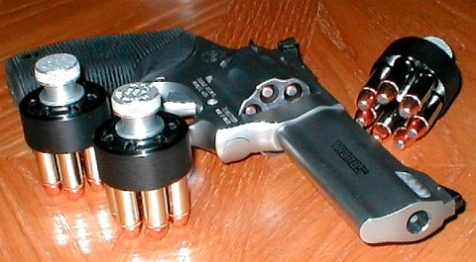


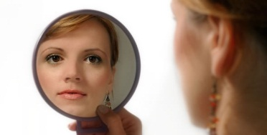



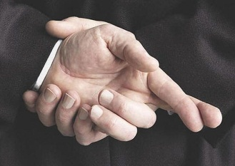
THERE’S A LOT OF PLACES I CAN PUT MY TRUST
Trust in chariots (Psalms 20:7)
Trust in my bow (Psalms 44:6)
Trust in my armor (Luke 11:22)
Trust in government (Psalms 146:3)
Trust in idols (Isaiah 42:17)
Trust in vanity (Isaiah 59:4)
Trust in beauty (Ezekiel 16:15)
Trust in lies (Jeremiah 7:4; 28:15)

Slide 18


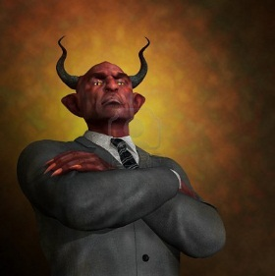

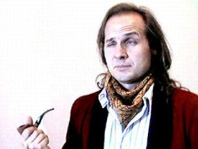
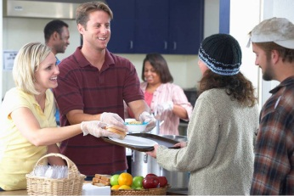

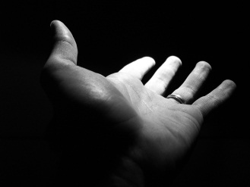

THERE’S A LOT OF PLACES I CAN PUT MY TRUST
Trust in wickedness (Isaiah 47:10)
Trust in my self righteousness (Ez 33:13)
Trust in works (Jeremiah 48:7)
Trust in friends (Micah 7:5)
Trust in riches (Mk 7:5, Prov 11:28, 1 Tim 6:17)
Trust in myself (2 Corinthians 1:9, 10:7)
Trust in the flesh (Philippians 3:4)
Trust in my own heart (Proverbs 28:26)
Trust in man (Jeremiah 17:5)

Slide 19
Proverbs 3:5 Trust in the LORD with all thine heart; and lean not unto thine own understanding.

Slide 21
What Does This Mean?
Give it everything you have… 100%

Slide 22
What Does This Mean?
Don’t hold anything back!

Slide 23
What Does This Mean?
Go all the way in… with both feet!

Slide 24
What Does This Mean?
Believe without reservation or hesitation

Slide 25
What Does This Mean?
Sell out completely to God!!!

Slide 27
How Do I Do It?
DON’T LEAN ON YOUR OWN UNDERSTANDING
Proverbs 3:5 Trust in the LORD with all thine heart; and lean not unto thine own understanding.

Slide 28
How Do I Do It?
IN ALL YOUR WAYS ACKNOWLEDGE HIM
Proverbs 3:6 In all thy ways acknowledge him, and he shall direct thy paths.

Slide 29
How Do I Do It?
DON’T BE WISE IN YOUR OWN EYES
Proverbs 3:7a Be not wise in thine own eyes: fear the LORD, and depart from evil.

Slide 30
How Do I Do It?
DON’T BE WISE IN YOUR OWN EYES
Isaiah 55:8-9 ⁸For my thoughts are not your thoughts, neither are your ways my ways, saith the LORD.
⁹For as the heavens are higher than the earth, so are my ways higher than your ways, and my thoughts than your thoughts.

Slide 31
How Do I Do It?
FEAR THE LORD AND DEPART FROM EVIL
Proverbs 3:7b Be not wise in thine own eyes: fear the LORD, and depart from evil.

Slide 32
How Do I Do It?
HONOR THE LORD WITH THE FIRSTFRUITS OF ALL YOUR INCREASE
Proverbs 3:9 Honour the LORD with thy substance, and with the firstfruits of all thine increase

Slide 33
How Do I Do It?
DON’T DESPISE HIS CHASTENING, OR GET WEARY OF HIS CORRECTION
Proverbs 3:11-12 ¹¹My son, despise not the chastening of the LORD; neither be weary of his correction:
¹²For whom the LORD loveth he correcteth; even as a father the son in whom he delighteth.

Slide 34
How Do I Do It?
DON’T LET KNOWLEDGE DEPART FROM YOU
Proverbs 3:13 My son, let not them depart from thine eyes: keep sound wisdom and discretion:

Slide 36
WHAT WILL THIS DO FOR ME?
1.
I WILL BE HAPPY
Proverbs 3:13 Happy is the man that findeth wisdom, and the man that getteth understanding.

Slide 37
WHAT WILL THIS DO FOR ME?
1.
I WILL BE HAPPY
Proverbs 3:18 She is a tree of life to them that lay hold upon her: and happy is every one that retaineth her.

Slide 38
WHAT WILL THIS DO FOR ME?
2.
I WILL HAVE WISDOM AND UNDERSTANDING
Proverbs 3:13 Happy is the man that findeth wisdom, and the man that getteth understanding.

Slide 39
WHAT WILL THIS DO FOR ME?
3.
I WILL HAVE A LONGER AND HEALTHIER LIFE
Proverbs 3:16 Length of days is in her right hand; and in her left hand riches and honour.

Slide 40
WHAT WILL THIS DO FOR ME?
3.
I WILL HAVE A LONGER AND HEALTHIER LIFE
Proverbs 3:8 It shall be health to thy navel, and marrow to thy bones.

Slide 41
WHAT WILL THIS DO FOR ME?
4.
I WILL HAVE RICHES & HONOR
Proverbs 3:10 So shall thy barns be filled with plenty, and thy presses shall burst out with new wine.

Slide 42
WHAT WILL THIS DO FOR ME?
4.
I WILL HAVE RICHES & HONOR
Proverbs 3:16 Length of days is in her right hand; and in her left hand riches and honour.

Slide 43
WHAT WILL THIS DO FOR ME?
5.
I WILL HAVE PLEASENTNESS AND PEACE
Proverbs 3:17 Her ways are ways of pleasantness, and all her paths are peace.

Slide 44
WHAT WILL THIS DO FOR ME?
6.
I WILL WALK SAFELY AND NOT STUMBLE
Proverbs 3:23 Then shalt thou walk in thy way safely, and thy foot shall not stumble.

Slide 45
WHAT WILL THIS DO FOR ME?
7.
I WILL NOT BE AFRAID & I WILL SLEEP SWEETLY
Proverbs 3:24 When thou liest down, thou shalt not be afraid: yea, thou shalt lie down, and thy sleep shall be sweet.

Slide 46
WHAT WILL THIS DO FOR ME?
8.
GOD WILL BE MY CONFIDENCE
Proverbs 3:26 For the LORD shall be thy confidence, and shall keep thy foot from being taken.

Slide 47
WHAT WILL THIS DO FOR ME?
8.
GOD WILL BE MY CONFIDENCE
Philippians 4:13 I can do all things through Christ which strengtheneth me.

Slide 48
WHAT WILL THIS DO FOR ME?
9.
I WILL BE ABLE TO DO GOOD TO OTHERS
Proverbs 3:27-28 ²⁷Withhold not good from them to whom it is due, when it is in the power of thine hand to do it.
²⁸Say not unto thy neighbour, Go, and come again, and to morrow I will give; when thou hast it by thee.

Slide 49
WHAT WILL THIS DO FOR ME?
10.
I WILL DWELL SECURELY WITH MY NEIGHBORS
Proverbs 3:29-30 ²⁹Devise not evil against thy neighbour, seeing he dwelleth securely by thee.
³⁰Strive not with a man without cause, if he have done thee no harm.

Slide 50
WHAT WILL THIS DO FOR ME?
11.
I WILL NOT ENVY THE WICKED
Proverbs 3:31 Envy thou not the oppressor, and choose none of his ways.

Slide 51
WHAT WILL THIS DO FOR ME?
12.
I WILL INHERIT GLORY AND PROMOTION
Proverbs 3:35 The wise shall inherit glory: but shame shall be the promotion of fools.

Slide 52

Proverbs 3:5 Trust in the LORD with all thine heart; and lean not unto thine own understanding.

