Slide 1




Slide 2




Slide 3

GOD IS HOLY!
Absolutely perfect

Slide 4
GOD IS OMNIPOTENT!
All powerful

Slide 5
GOD IS OMNISCIENT!
All knowing

Slide 6
GOD IS OMNIPRESENT!
Ever present, everywhere

Slide 7
GOD IS IMMUTABLE!
Consistent, never changing

Slide 8
GOD IS ETERNAL!
Free from time

Slide 9
GOD IS INFINITE!
Free From Limitations

Slide 10
GOD IS SELF-EXISTENT!
Free From Dependency

Slide 11
GOD IS SELF-SUFFICIENT!
Free From needs

Slide 12
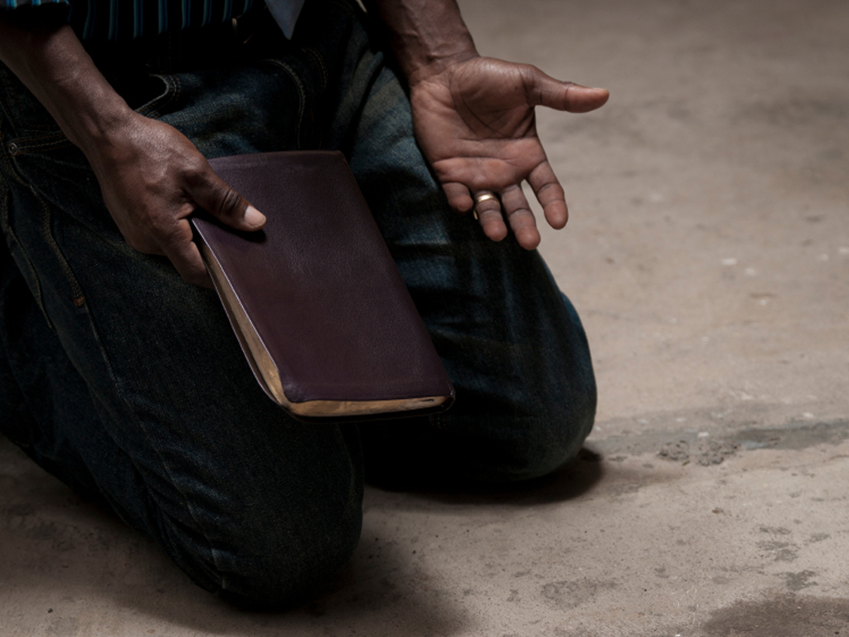

Slide 13
God Has Never Been Wrong!

Slide 14
God Created Everything That Is - EVEN YOU!

Slide 15
God Gave His One And Only Son, So You Could Be Saved!

Slide 16
God Wrote All This Down In A Book So You Could See It And Read It For Yourself!

Slide 18
Proverbs 1:7 The fear of the LORD is the beginning of knowledge: but fools despise wisdom and instruction.

Slide 19
THE FEAR OF THE LORD IS THE BEGINNING OF KNOWLEDGE!

Slide 20
What Does It Mean To PUT GOD FIRST?

Slide 21
FEAR THE LORD!
Reverence!
Respect!

Slide 22
GIVE GOD FIRST PLACE

Slide 23
GIVE GOD PRIORITY

Slide 24
GIVE GOD HIS RIGHTFUL POSITION

Slide 25
Why Should I... Put God First?

Slide 26

WELL...
It’s The Beginning Of Knowledge!

Slide 27
It’s The Foundation Of True Knowledge And Understanding

Slide 28
You Will Be Wise And Not A Fool!

Slide 29
HOW DO I PUT GOD FIRST?
1.
IT TAKES EFFORT
Proverbs 2:1-5
Verse One My son, if thou wilt receive my words, and hide my commandments with thee;
Listen To And Treasure God’s Word

Slide 30
HOW DO I PUT GOD FIRST?
1.
IT TAKES EFFORT
Proverbs 2:1-5
Verse Two So that thou incline thine ear unto wisdom, and apply thine heart to understanding;
Tune In And Concentrate On God’s Word

Slide 31
HOW DO I PUT GOD FIRST?
1.
IT TAKES EFFORT
Proverbs 2:1-5
Verse Three Yea, if thou criest after knowledge, and liftest up thy voice for understanding;
Pray For Insight And Understanding

Slide 32
HOW DO I PUT GOD FIRST?
1.
IT TAKES EFFORT
Proverbs 2:1-5
Verse Four If thou seekest her as silver, and searchest for her as for hid treasures;
Seek And Search For Hidden Treasures

Slide 33
HOW DO I PUT GOD FIRST?
1.
IT TAKES EFFORT
Proverbs 2:1-5
Verse Five Then shalt thou understand the fear of the LORD, and find the knowledge of God.
Then You Will Understand The Fear Of The Lord

Slide 34
LISTEN
CONCENTRATE
PRAY
SEEK

Slide 35
PUTTING GOD FIRST TAKES EFFORT!

Slide 37
HOW DO I PUT GOD FIRST?
2.
IT TAKES HUMILITY
Proverbs 3:7 Be not wise in thine own eyes: fear the LORD, and depart from evil.

Slide 38



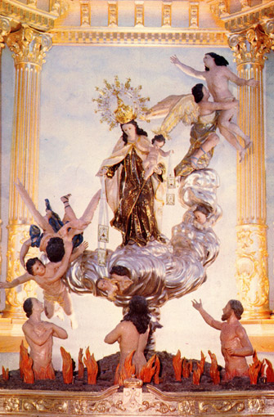

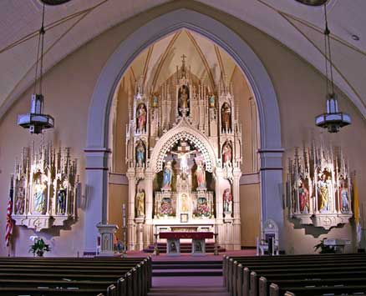
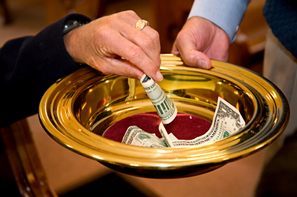

HOW DO I PUT GOD FIRST?
2.
IT TAKES HUMILITY
Don’t be impressed with your own wisdom

Slide 39
HOW DO I PUT GOD FIRST?
2.
IT TAKES HUMILITY
PLAIN ENGLISH:
Don’t be impressed with you!

Slide 40
HOW DO I PUT GOD FIRST?
2.
IT TAKES HUMILITY
Instead…

Slide 41
HOW DO I PUT GOD FIRST?
2.
IT TAKES HUMILITY
Fear The Lord!

Slide 42
HOW DO I PUT GOD FIRST?
3.
IT TAKES HATE!
Proverbs 8:13 The fear of the LORD is to hate evil: pride, and arrogancy, and the evil way, and the froward mouth, do I hate.

Slide 43
HOW DO I PUT GOD FIRST?
3.
IT TAKES HATE!
Hate Evil!

Slide 44
HOW DO I PUT GOD FIRST?
3.
IT TAKES HATE!
Hate Pride!

Slide 45
HOW DO I PUT GOD FIRST?
3.
IT TAKES HATE!
Hate Arrogance!

Slide 46
HOW DO I PUT GOD FIRST?
3.
IT TAKES HATE!
Hate Corruption!

Slide 47
HOW DO I PUT GOD FIRST?
3.
IT TAKES HATE!
Hate Stubbornness!

Slide 49
WHAT WILL PUTTING GOD FIRST DO FOR ME?
1.
I WILL HAVE UNDERSTANDING
Proverbs 9:10 The fear of the LORD is the beginning of wisdom: and the knowledge of the holy is understanding.

Slide 50
WHAT WILL PUTTING GOD FIRST DO FOR ME?
1.
I WILL HAVE UNDERSTANDING
Good judgment and making right decisions

Slide 51
WHAT WILL PUTTING GOD FIRST DO FOR ME?
1.
I WILL HAVE UNDERSTANDING
WHY WOULDN’T YA WANNA MAKE RIGHT DECISIONS?

Slide 52
WHAT WILL PUTTING GOD FIRST DO FOR ME?
2.
I WILL HAVE A LONGER LIFE
Proverbs 10:27 The fear of the LORD prolongeth days: but the years of the wicked shall be shortened.

Slide 53
WHAT WILL PUTTING GOD FIRST DO FOR ME?
2.
I WILL HAVE A LONGER LIFE
I’m gonna live longer!

Slide 54
WHAT WILL PUTTING GOD FIRST DO FOR ME?
2.
I WILL HAVE A LONGER LIFE
WHY WOULDN’T YA WANNA LIVE LONGER?

Slide 55
WHAT WILL PUTTING GOD FIRST DO FOR ME?
3.
I WILL BE SHARP AND ESCAPE THE TRAPS OF THE DEVIL
Proverbs 14:27 The fear of the LORD is a fountain of life, to depart from the snares of death.

Slide 56

WHAT WILL PUTTING GOD FIRST DO FOR ME?
3.
I WILL BE SHARP AND ESCAPE THE TRAPS OF THE DEVIL

Slide 57
WHAT WILL PUTTING GOD FIRST DO FOR ME?
3.
I WILL BE SHARP AND ESCAPE THE TRAPS OF THE DEVIL
I’m gonna escape!

Slide 58
WHAT WILL PUTTING GOD FIRST DO FOR ME?
3.
I WILL BE SHARP AND ESCAPE THE TRAPS OF THE DEVIL
WHY WOULDN’T YA WANNA ESCAPE THE TRAPS OF THE DEVIL?

Slide 59
WHAT WILL PUTTING GOD FIRST DO FOR ME?
4.
I WILL HAVE A BLESSED LIFE, BE SATISFIED, BE SAFE!
Proverbs 19:23 The fear of the LORD tendeth to life: and he that hath it shall abide satisfied; he shall not be visited with evil.

Slide 60
WHAT WILL PUTTING GOD FIRST DO FOR ME?
4.
I WILL HAVE A BLESSED LIFE, BE SATISFIED, BE SAFE!
Blessed, satisfied, safe!

Slide 61
WHAT WILL PUTTING GOD FIRST DO FOR ME?
4.
I WILL HAVE A BLESSED LIFE, BE SATISFIED, BE SAFE!
WHY WOULDN’T YA WANNA BE BLESSED, SATISFIED AND SAFE?

Slide 62
Proverbs 1:7 The fear of the LORD is the beginning of knowledge: but fools despise wisdom and instruction.

