Slide 1
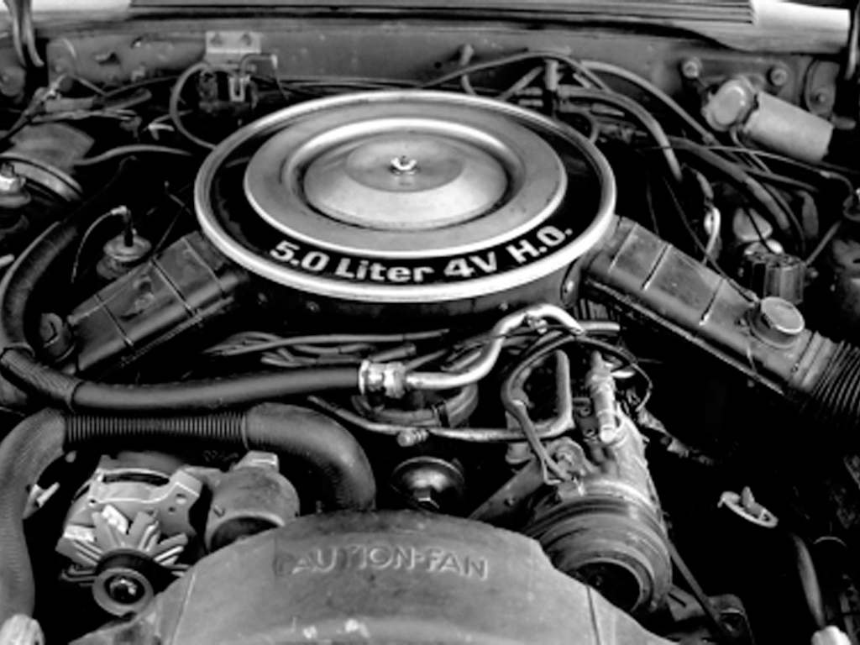




Slide 2
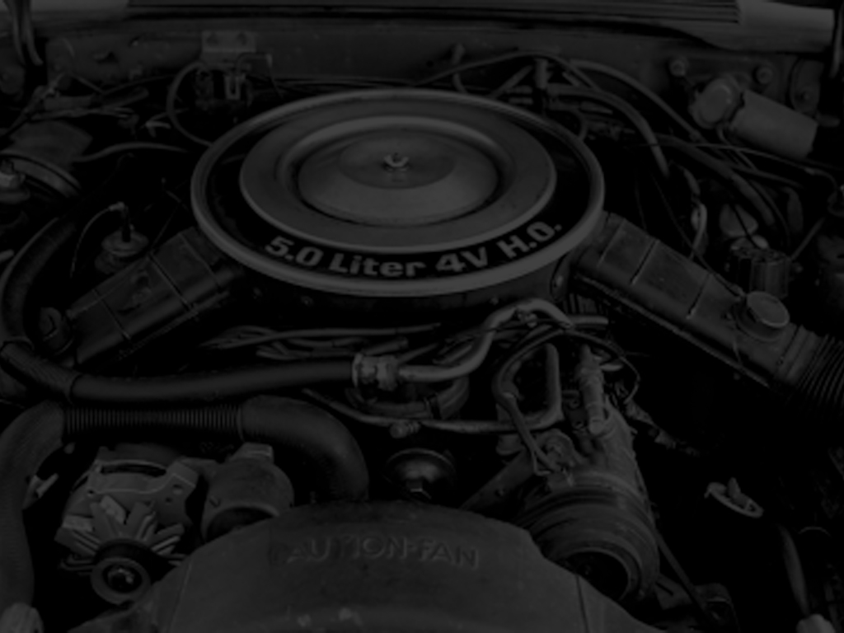
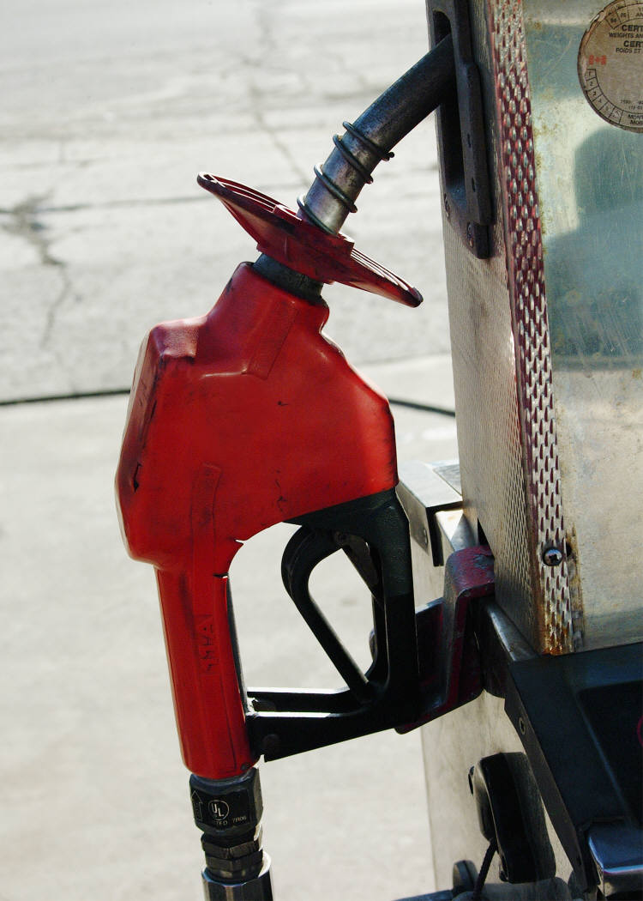
THE JUICE

Slide 3
Ephesians 6:18
Praying always with all prayer and supplication in the Spirit, and watching thereunto with all perseverance and supplication for all saints;

Slide 4
We Are Human Beings But We Have Been Converted
We Are Not What We Were And We Do Not Run On The Same Kind Of Fuel Any More

Slide 5
2 Corinthians 5:17
Therefore if any man be in Christ, he is a new creature: old things are passed away; behold, all things are become new.

Slide 6
The Fuel,
Which Is
HIGH OCTANE SPIRITUAL,
Is Prayer!

Slide 7
Prayer Is The Energy That Makes It Possible For The Christian To Drive On Through Any Situation

Slide 9
Ephesians 6:18
Praying always with all prayer and supplication in the Spirit, and watching thereunto with all perseverance and supplication for all saints;

Slide 10
Ephesians 6:18
Praying ______with all prayer and _________ in the Spirit, and watching thereunto with all __________ and supplication for all _____;

Slide 11

1.
PRAYING ALWAYS
Ephesians 6:18
Praying always with all prayer and supplication in the Spirit, and watching thereunto with all perseverance and supplication for all saints;

Slide 12
1.
PRAYING ALWAYS
If You Try To
Fight The Spiritual Battle On Your Own, You WILL
Be Defeated!

Slide 13
1.
PRAYING ALWAYS
2 Chronicles 32:7-8
⁷Be strong and courageous, be not afraid nor dismayed for the king of Assyria, nor for all the multitude that is with him: for there be more with us than with him:
⁸With him is an arm of flesh; but with us is the LORD our God to help us, and to fight our battles. And the people rested themselves upon the words of Hezekiah king of Judah.

Slide 14
2.
PERSISTENT IN PRAYER
Ephesians 6:18
Praying always with all prayer and supplication in the Spirit, and watching thereunto with all perseverance and supplication for all saints;

Slide 15
2.
PERSISTENT IN PRAYER
Notice How Many Times The Word “ALL” Appears In Ephesians 6:8

Slide 16
2.
PERSISTENT IN PRAYER
1 Thessalonians 5:17
Pray without ceasing.

Slide 17
2.
PERSISTENT IN PRAYER
Keep A Constant Attitude Of Trust & Communication With God At Every Moment

Slide 18
3.
POSSIBILITIES OF PRAYER
Ephesians 6:18
Praying always with all prayer and supplication in the Spirit, and watching thereunto with all perseverance and supplication for all saints;

Slide 19
3.
POSSIBILITIES OF PRAYER
You can pray anywhere at anytime for anything
THE POSSIBILITIES ARE ENDLESS!

Slide 20
3.
POSSIBILITIES OF PRAYER
Luke 1:37
For with God nothing shall be impossible.

Slide 21
4.
PETITION OF PRAYER
Ephesians 6:18
Praying always with all prayer and supplication in the Spirit, and watching thereunto with all perseverance and supplication for all saints;

Slide 22
4.
PETITION OF PRAYER
Supplication means: “TO ASK”
James 4:2
Ye lust, and have not: ye kill, and desire to have, and cannot obtain: ye fight and war, yet ye have not, because ye ask not.

Slide 23
4.
PETITION OF PRAYER
You Will Be Surprised At How Many Times God Says “YES” In The Bible If Someone Simply Asked

Slide 24
5.
POWER OF PRAYER
Ephesians 6:18
Praying always with all prayer and supplication in the Spirit, and watching thereunto with all perseverance and supplication for all saints;

Slide 25
5.
POWER OF PRAYER
Romans 8:26-27
²⁶Likewise the Spirit also helpeth our infirmities: for we know not what we should pray for as we ought: but the Spirit itself maketh intercession for us with groanings which cannot be uttered.
²⁷And he that searcheth the hearts knoweth what is the mind of the Spirit, because he maketh intercession for the saints according to the will of God.

Slide 26
5.
POWER OF PRAYER
Pray In The Spirit, Not In Your Own Strength

Slide 27
5.
POWER OF PRAYER
Spend Time With God In His Word

Slide 28
5.
POWER OF PRAYER
Agree With God And Yield To The Spirit

Slide 29
6.
PRECISION IN PRAYER
Ephesians 6:18
Praying always with all prayer and supplication in the Spirit, and watching thereunto with all perseverance and supplication for all saints;

Slide 30
6.
PRECISION IN PRAYER
The Word “WATCH” Is A Military Term Which Means To
“BE AWAKE”

Slide 31
6.
PRECISION IN PRAYER
Mark 14:38
Watch ye and pray, lest ye enter into temptation. The spirit truly is ready, but the flesh is weak.
GUARD YOUR HEART!

Slide 32
7.
PERSEVERANCE IN PRAYER
Ephesians 6:18
Praying always with all prayer and supplication in the Spirit, and watching thereunto with all perseverance and supplication for all saints;

Slide 33
7.
PERSEVERANCE IN PRAYER
When You Stop Praying, You’re Heading For Trouble

Slide 34
7.
PERSEVERANCE IN PRAYER
Prayer Takes Discipline And Is Critical For Your Survival In The Spiritual Battle

Slide 35
7.
PERSEVERANCE IN PRAYER
Romans 12:12
Rejoicing in hope; patient in tribulation; continuing instant in prayer;

Slide 36
8.
PURPOSE OF PRAYER
Ephesians 6:18
Praying always with all prayer and supplication in the Spirit, and watching thereunto with all perseverance and supplication for all saints;

Slide 37
8.
PURPOSE OF PRAYER
The Word “Saints” Always Appears
In Plural
It Is Never Singular

Slide 38
8.
PURPOSE OF PRAYER
WE NEED
EACH OTHER!
We Are Not On This Road Alone!

Slide 39
1 Peter 5:8-9
⁸Be sober, be vigilant; because your adversary the devil, as a roaring lion, walketh about, seeking whom he may devour:
⁹Whom resist stedfast in the faith, knowing that the same afflictions are accomplished in your brethren that are in the world.

Slide 40
PRAYING ALWAYS
PERSISTENT IN PRAYER
POSSIBILITIES OF PRAYER
PETITION OF PRAYER
POWER OF PRAYER
PRECISION IN PRAYER
PERSEVERENCE IN PRAYER
PURPOSE OF PRAYER

Slide 42


