Slide 1
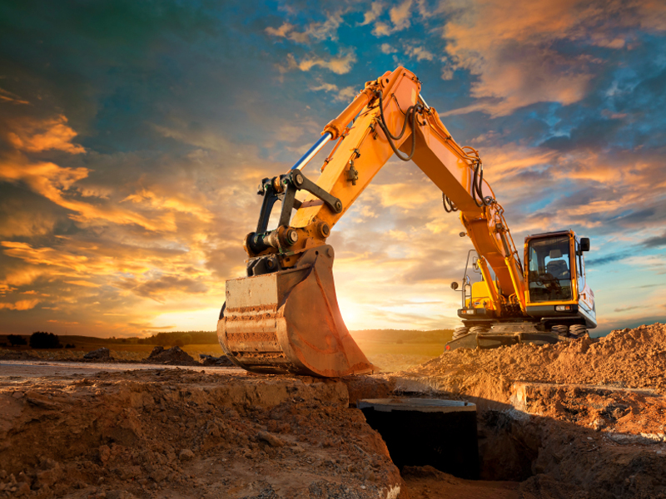



Slide 2

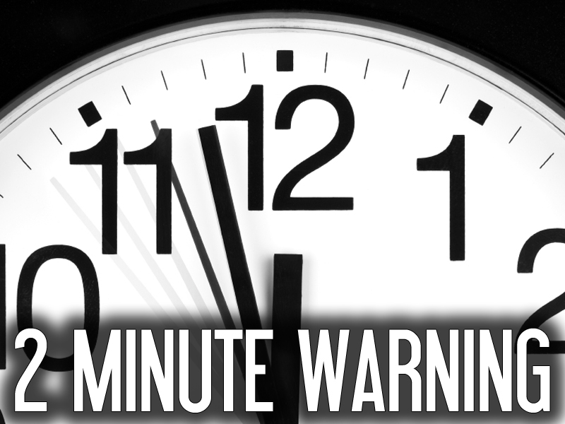
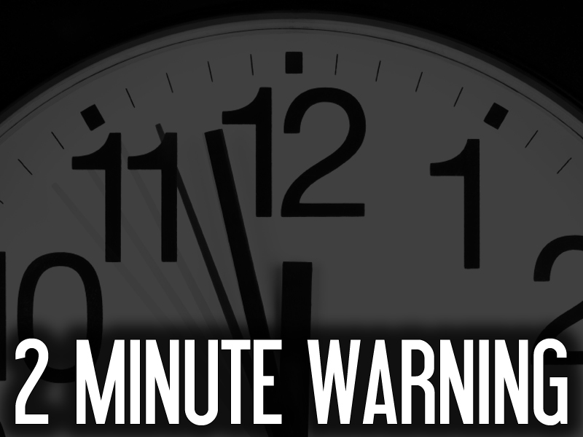

Slide 3

Nehemiah 4:6 So built we the wall; and all the wall was joined together unto the half thereof: for the people had a mind to work.
So We Built The Wall
The People Had A Mind To Work

Slide 4
Nehemiah 4:9 Nevertheless we made our prayer unto our God, and set a watch against them day and night, because of them.
We Made Our Prayer To God
We Set A Watch Against Them Day And Night

Slide 5
I LOOKED UP AND ROSE UP!
Nehemiah 4:14 And I looked, and rose up, and said unto the nobles, and to the rulers, and to the rest of the people, Be not ye afraid of them: remember the LORD, which is great and terrible, and fight for your brethren, your sons, and your daughters, your wives, and your houses.
Be Not Afraid Of Them
Remember The Lord Who Is Great And Terrible
Fight For Your Family

Slide 6
IN ONE HAND WORK IN THE OTHER A WEAPON
Nehemiah 4:17 They which builded on the wall, and they that bare burdens, with those that laded, every one with one of his hands wrought in the work, and with the other hand held a weapon.

Slide 7
OUR GOD SHALL FIGHT FOR US
Nehemiah 4:20 In what place therefore ye hear the sound of the trumpet, resort ye thither unto us: our God shall fight for us.

Slide 8
NONE OF US PUT OFF OUR CLOTHES
Nehemiah 4:23 So neither I, nor my brethren, nor my servants, nor the men of the guard which followed me, none of us put off our clothes, saving that every one put them off for washing.

Slide 9
This Kind Of Victorious Attitude Can Radically Change Things, But You Will Face Intense Opposition From The Enemy

Slide 11
THE ENEMY WANTS YOU DISTRACTED
Nehemiah 6:1-2 1 Now it came to pass when Sanballat, and Tobiah, and Geshem the Arabian, and the rest of our enemies, heard that I had builded the wall, and that there was no breach left therein; (though at that time I had not set up the doors upon the gates;)

Slide 12
THE ENEMY WANTS YOU DISTRACTED
Nehemiah 6:1-2 2 That Sanballat and Geshem sent unto me, saying, Come, let us meet together in some one of the villages in the plain of Ono. But they thought to do me mischief.

Slide 13
SATAN WANTS YOU TO LOSE YOUR FOCUS!

Slide 14
NEHEMIAH’S RESPONSE
Nehemiah 6:3-4 3 And I sent messengers unto them, saying, I am doing a great work, so that I cannot come down: why should the work cease, whilst I leave it, and come down to you?
4 Yet they sent unto me four times after this sort; and I answered them after the same manner.

Slide 15
NEHEMIAH’S RESPONSE
I Am Doing Great Work!
I Cannot Come Down!
Why Should I Stop And Come Down?

Slide 16
NEHEMIAH’S RESPONSE
I’M GONNA STAY UP!

Slide 18
THE ENEMY WANTS YOU DISCREDITED
Nehemiah 6:5-7 5 Then sent Sanballat his servant unto me in like manner the fifth time with an open letter in his hand;

Slide 19
THE ENEMY WANTS YOU DISCREDITED
Nehemiah 6:5-7 6 Wherein was written, It is reported among the heathen, and Gashmu saith it, that thou and the Jews think to rebel: for which cause thou buildest the wall, that thou mayest be their king, according to these words.

Slide 20
THE ENEMY WANTS YOU DISCREDITED
Nehemiah 6:5-7 7 And thou hast also appointed prophets to preach of thee at Jerusalem, saying, There is a king in Judah: and now shall it be reported to the king according to these words. Come now therefore, and let us take counsel together.

Slide 21
SATAN WANTS YOU TO WRECK YOUR FAITH!

Slide 22
NEHEMIAH’S RESPONSE
Nehemiah 6:8-9 8 Then I sent unto him, saying, There are no such things done as thou sayest, but thou feignest them out of thine own heart.
9 For they all made us afraid, saying, Their hands shall be weakened from the work, that it be not done. Now therefore, O God, strengthen my hands.

Slide 23
NEHEMIAH’S RESPONSE
What You Say Is Not Right
This Comes From Your Own Wicked Heart
O’ God – Strengthen My Hands

Slide 24
NEHEMIAH’S RESPONSE
I’M GONNA PRAY UP!

Slide 26
THE ENEMY WANTS YOU DISFUNCTIONAL
Nehemiah 6:10 Afterward I came unto the house of Shemaiah the son of Delaiah the son of Mehetabeel, who was shut up; and he said, Let us meet together in the house of God, within the temple, and let us shut the doors of the temple: for they will come to slay thee; yea, in the night will they come to slay thee.

Slide 27
THE ENEMY WANTS YOU DISFUNCTIONAL
TRUST MAN INSTEAD OF GOD

Slide 28
SATAN WANTS YOU PARALYZED WITH FEAR!

Slide 29
NEHEMIAH’S RESPONSE
Nehemiah 6:11-14 11 And I said, Should such a man as I flee? and who is there, that, being as I am, would go into the temple to save his life? I will not go in.
12 And, lo, I perceived that God had not sent him; but that he pronounced this prophecy against me: for Tobiah and Sanballat had hired him.

Slide 30
NEHEMIAH’S RESPONSE
Nehemiah 6:11-14 13 Therefore was he hired, that I should be afraid, and do so, and sin, and that they might have matter for an evil report, that they might reproach me.
14 My God, think thou upon Tobiah and Sanballat according to these their works, and on the prophetess Noadiah, and the rest of the prophets, that would have put me in fear.

Slide 31
NEHEMIAH’S RESPONSE
I Will Not Run And Hide
I Will Not Be Afraid

Slide 32
NEHEMIAH’S RESPONSE
I’M NOT GONNA GIVE UP!

Slide 34
SATAN WANTS YOU TO LOSE YOUR FOCUS
Tell Him “I’M GONNA STAY UP!”

Slide 35
SATAN WANTS TO WRECK YOUR FAITH
Tell Him “I’M GONNA PRAY UP!”

Slide 36
SATAN WANTS YOU PARALYZED WITH FEAR
Tell Him “I’M NOT GONNA GIVE UP!”

Slide 37
A WINNING ATTITUDE CAN TURN THINGS AROUND QUICKLY!

Slide 38
Nehemiah 6:15 So the wall was finished in the twenty and fifth day of the month Elul, in fifty and two days.

Slide 39
52 Days?

Slide 40
What Can You Do In 52 Days?

