Slide 1
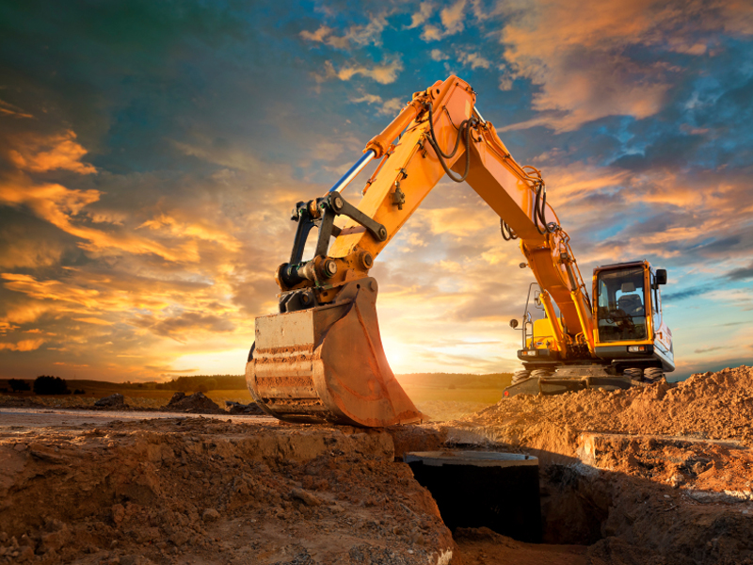



Slide 2




Slide 3

WE CANNOT CHANGE OUR PAST... WE CANNOT CHANGE THE FACT THAT PEOPLE WILL ACT IN A CERTAIN WAY. WE CANNOT CHANGE THE INEVITABLE.

Slide 4
THE ONLY THING WE CAN DO IS PLAY ON THE ONE STRING WE HAVE, AND THAT IS OUR ATTITUDE!

Slide 5
ATTITUDE
WEBSTERS: An Internal Position Or Feeling With Regard To Something Else

Slide 6
ATTITUDE
words used to describe
Disposition, Feeling, Mood, Opinion, Sentiment, Temper, Tone, Perspective, Frame Of Mind, Outlook, View Or Morale

Slide 7
Pilots Use The Word “Attitude” To Describe Their Horizontal Relationship With The Runway During Landings

Slide 8

If the plane’s attitude is not properly aligned, it will make contact with the ground at the wrong angle and crash!

Slide 9
Your inward disposition or ‘attitude’ toward people, circumstances or situations determines your final outcome

Slide 10
Are you going to land smoothly, or crash?
Are you a winner or a whiner?
Are you positive or negative?

Slide 12
“ATTITUDE” by John Maxwell
It’s The “Advance Man” Of Our True Selves
It’s Roots Are Inward, But It’s Fruit Is Outward
It’s Our Best Friend Or Worst Enemy
It’s More Honest And More Consistent Than Our Words
It’s Our Outlook Based On Past Experiences

Slide 13
“ATTITUDE” by John Maxwell
It Draws People To Us, Or Repels People From Us
It Is Never Content Until It Is Expressed
It Is The Librarian Of Our Past
It Is The Speaker Of Our Present
It Is The Prophet Of Our Future

Slide 14
The Difference Between Winners And Whiners Is The Attitude They Have And The Way They Respond To Their Problems

Slide 15
WINNERS See Problems As Challenges And Opportunities That Will Take Them To The Next Level

Slide 16
WHINERS See Problems As Threats Which Undermine Their Potential To Be, To Have, And To Do More

Slide 18

THE ENEMY
Nehemiah 2:19 But when Sanballat the Horonite, and Tobiah the servant, the Ammonite, and Geshem the Arabian, heard it, they laughed us to scorn, and despised us, and said, What is this thing that ye do? will ye rebel against the king?
They Laughed At Us
They Despised Us
They Ridiculed Us

Slide 19
THE ENEMY
Nehemiah 4:1-3 1 But it came to pass, that when Sanballat heard that we builded the wall, he was wroth, and took great indignation, and mocked the Jews.

Slide 20
THE ENEMY
Nehemiah 4:1-3 2 And he spake before his brethren and the army of Samaria, and said, What do these feeble Jews? will they fortify themselves? will they sacrifice? will they make an end in a day? will they revive the stones out of the heaps of the rubbish which are burned?

Slide 21
THE ENEMY
Nehemiah 4:1-3 3 Now Tobiah the Ammonite was by him, and he said, Even that which they build, if a fox go up, he shall even break down their stone wall.

Slide 22
BUILDER’S RESPONSE
Nehemiah 2:20 Then answered I them, and said unto them, The God of heaven, he will prosper us; therefore we his servants will arise and build: but ye have no portion, nor right, nor memorial, in Jerusalem.
God Will Prosper Us
We His Servants Will Arise & Build
You Have No Part, Have No Right, Have No Memorial

Slide 23
It’s Surprising At How Quickly A Winning Attitude Can Turn Things Around

Slide 24
Nehemiah 4:6 So built we the wall; and all the wall was joined together unto the half thereof: for the people had a mind to work.
So We Built The Wall
The People Had A MIND To Work

Slide 25
Philippians 2:5 Let this mind be in you, which was also in Christ Jesus.

Slide 26
2 Corinthians 5:17 Therefore if any man be in Christ, he is a new creature: old things are passed away; behold, all things are become new.

Slide 27
Matthew 5:16 Let your light so shine before men, that they may see your good works, and glorify your Father which is in heaven.

