Slide 1
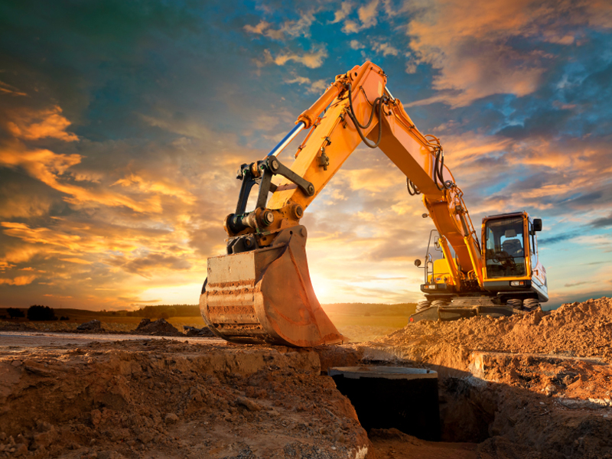



Slide 2


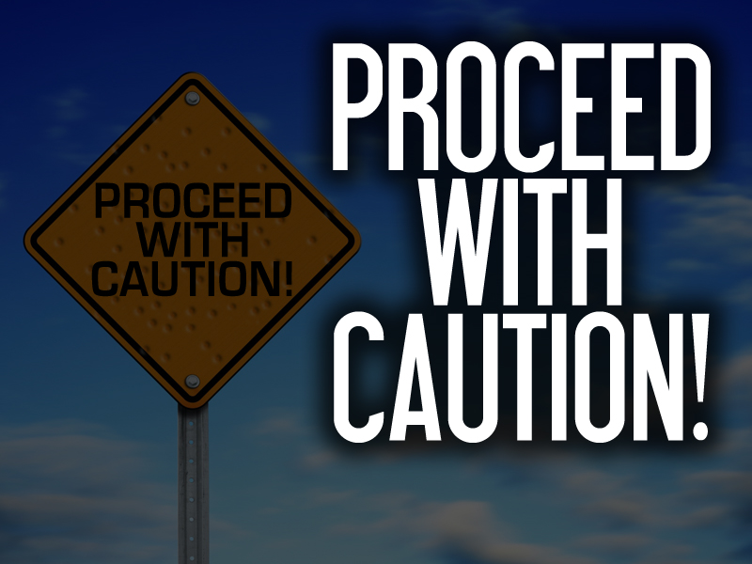

Slide 3

Nehemiah 1:1-3 ¹The words of Nehemiah the son of Hachaliah. And it came to pass in the month Chisleu, in the twentieth year, as I was in Shushan the palace,
²That Hanani, one of my brethren, came, he and certain men of Judah; and I asked them concerning the Jews that had escaped, which were left of the captivity, and concerning Jerusalem.

Slide 4
Nehemiah 1:1-3 ³And they said unto me, The remnant that are left of the captivity there in the province are in great affliction and reproach: the wall of Jerusalem also is broken down, and the gates thereof are burned with fire.

Slide 5
Nehemiah asked the right question

Slide 6
Nehemiah asked the right person the question

Slide 7
Nehemiah received the right information

Slide 8
Nehemiah was prepared to do the right thing

Slide 9
Nehemiah 1:4 And it came to pass, when I heard these words, that I sat down and wept, and mourned certain days, and fasted, and prayed before the God of heaven,

Slide 10
1. NEHEMIAH PRAYED
THE 4C’s

Slide 11
1. NEHEMIAH PRAYED
Character Of God
Nehemiah 1:5 And said, I beseech thee, O LORD God of heaven, the great and terrible God, that keepeth covenant and mercy for them that love him and observe his commandments:

Slide 12
1. NEHEMIAH PRAYED
Confession To God
Nehemiah 1:6-7 ⁶Let thine ear now be attentive, and thine eyes open, that thou mayest hear the prayer of thy servant, which I pray before thee now, day and night, for the children of Israel thy servants, and confess the sins of the children of Israel, which we have sinned against thee: both I and my father's house have sinned.

Slide 13
1. NEHEMIAH PRAYED
Confession To God
Nehemiah 1:6-7 ⁷We have dealt very corruptly against thee, and have not kept the commandments, nor the statutes, nor the judgments, which thou commandedst thy servant Moses.

Slide 14
1. NEHEMIAH PRAYED
Confidence In God & His Promises
Nehemiah 1:8-10 ⁸Remember, I beseech thee, the word that thou commandedst thy servant Moses, saying, If ye transgress, I will scatter you abroad among the nations:

Slide 15
1. NEHEMIAH PRAYED
Confidence In God & His Promises
Nehemiah 1:8-10 ⁹But if ye turn unto me, and keep my commandments, and do them; though there were of you cast out unto the uttermost part of the heaven, yet will I gather them from thence, and will bring them unto the place that I have chosen to set my name there.

Slide 16
1. NEHEMIAH PRAYED
Confidence In God & His Promises
Nehemiah 1:8-10 ¹⁰Now these are thy servants and thy people, whom thou hast redeemed by thy great power, and by thy strong hand.

Slide 17
1. NEHEMIAH PRAYED
Commitment To God
Nehemiah 1:11 O LORD, I beseech thee, let now thine ear be attentive to the prayer of thy servant, and to the prayer of thy servants, who desire to fear thy name: and prosper, I pray thee, thy servant this day, and grant him mercy in the sight of this man. For I was the king's cupbearer.

Slide 19
2. NEHEMIAH PLANNED
He Had Thought About The Task At Hand

Slide 20
2. NEHEMIAH PLANNED
He Weighed The Costs And Consequences

Slide 21
2. NEHEMIAH PLANNED
He Knew This Was Risky Business... Approaching The King

Slide 22
2. NEHEMIAH PLANNED
He Didn’t Go In Half-Cocked!

Slide 23
3. NEHEMIAH PROCEEDED
Nehemiah 2:1-3 ¹And it came to pass in the month Nisan, in the twentieth year of Artaxerxes the king, that wine was before him: and I took up the wine, and gave it unto the king. Now I had not been beforetime sad in his presence.

Slide 24
3. NEHEMIAH PROCEEDED
Nehemiah 2:1-3 ²Wherefore the king said unto me, Why is thy countenance sad, seeing thou art not sick? this is nothing else but sorrow of heart. Then I was very sore afraid,

Slide 25
3. NEHEMIAH PROCEEDED
Nehemiah 2:1-3 ³And said unto the king, Let the king live for ever: why should not my countenance be sad, when the city, the place of my fathers' sepulchres, lieth waste, and the gates thereof are consumed with fire?

Slide 26
3. NEHEMIAH PROCEEDED
Nehemiah 2:4 Then the king said unto me, For what dost thou make request? So I prayed to the God of heaven.

Slide 28
4. NEHEMIAH PETITIONED THE KING
He Asked For Help
Nehemiah 2:5-9 ⁵And I said unto the king, If it please the king, and if thy servant have found favour in thy sight, that thou wouldest send me unto Judah, unto the city of my fathers' sepulchres, that I may build it.

Slide 29
4. NEHEMIAH PETITIONED THE KING
He Asked For Help
Nehemiah 2:5-9 ⁶And the king said unto me, (the queen also sitting by him,) For how long shall thy journey be? and when wilt thou return? So it pleased the king to send me; and I set him a time.

Slide 30
4. NEHEMIAH PETITIONED THE KING
He Asked For Help
Nehemiah 2:5-9 ⁷Moreover I said unto the king, If it please the king, let letters be given me to the governors beyond the river, that they may convey me over till I come into Judah;

Slide 31
4. NEHEMIAH PETITIONED THE KING
He Asked For Help
Nehemiah 2:5-9 ⁸And a letter unto Asaph the keeper of the king's forest, that he may give me timber to make beams for the gates of the palace which appertained to the house, and for the wall of the city, and for the house that I shall enter into. And the king granted me, according to the good hand of my God upon me.

Slide 32
4. NEHEMIAH PETITIONED THE KING
He Asked For Help
Nehemiah 2:5-9 ⁹Then I came to the governors beyond the river, and gave them the king's letters. Now the king had sent captains of the army and horsemen with me.

Slide 34
5. NEHEMIAH PREPARED HIMSELF
Nehemiah 2:11-18 ¹¹So I came to Jerusalem, and was there three days.
¹²And I arose in the night, I and some few men with me; neither told I any man what my God had put in my heart to do at Jerusalem: neither was there any beast with me, save the beast that I rode upon.

Slide 35
5. NEHEMIAH PREPARED HIMSELF
Nehemiah 2:11-18 ¹³And I went out by night by the gate of the valley, even before the dragon well, and to the dung port, and viewed the walls of Jerusalem, which were broken down, and the gates thereof were consumed with fire.

Slide 36
5. NEHEMIAH PREPARED HIMSELF
Nehemiah 2:11-18 ¹⁴Then I went on to the gate of the fountain, and to the king's pool: but there was no place for the beast that was under me to pass.
¹⁵Then went I up in the night by the brook, and viewed the wall, and turned back, and entered by the gate of the valley, and so returned.

Slide 37
5. NEHEMIAH PREPARED HIMSELF
Nehemiah 2:11-18 ¹⁶And the rulers knew not whither I went, or what I did; neither had I as yet told it to the Jews, nor to the priests, nor to the nobles, nor to the rulers, nor to the rest that did the work.

Slide 38
5. NEHEMIAH PREPARED HIMSELF
Nehemiah 2:11-18 ¹⁷Then said I unto them, Ye see the distress that we are in, how Jerusalem lieth waste, and the gates thereof are burned with fire: come, and let us build up the wall of Jerusalem, that we be no more a reproach.

Slide 39
5. NEHEMIAH PREPARED HIMSELF
Nehemiah 2:11-18 ¹⁸Then I told them of the hand of my God which was good upon me; as also the king's words that he had spoken unto me. And they said, Let us rise up and build. So they strengthened their hands for this good work.

Slide 40
5. NEHEMIAH PREPARED HIMSELF
He Took A Midnight Ride To Check The Situation Out For Himself

Slide 41
5. NEHEMIAH PREPARED HIMSELF
Notice That He Didn’t Come In On A White Horse, Saying “The Lone Ranger Is Here To Save The Day!”

Slide 42
5. NEHEMIAH PREPARED HIMSELF
It’s About Prayer, Planning, Moving Forward And Work!

Slide 43
6. NEHEMIAH WAS OPPOSED
There Were Enemies
There Always Will Be!
Nehemiah 2:10 When Sanballat the Horonite, and Tobiah the servant, the Ammonite, heard of it, it grieved them exceedingly that there was come a man to seek the welfare of the children of Israel.

Slide 44
6. NEHEMIAH WAS OPPOSED
There Were Enemies
There Always Will Be!
Nehemiah 2:19 But when Sanballat the Horonite, and Tobiah the servant, the Ammonite, and Geshem the Arabian, heard it, they laughed us to scorn, and despised us, and said, What is this thing that ye do? will ye rebel against the king?

Slide 45
6. NEHEMIAH WAS OPPOSED
There Were Enemies
There Always Will Be!
Nehemiah 2:20 Then answered I them, and said unto them, The God of heaven, he will prosper us; therefore we his servants will arise and build: but ye have no portion, nor right, nor memorial, in Jerusalem.

Slide 47
Remember... Asking for help is OK!

Slide 48
But Remember... Whining Isn’t!

Slide 49
Also Remember, It’s Going To Take You Doing Your Part

Slide 50
You Are Going To Have To Take The Lead!

Slide 51
Get Prepared!

Slide 52
Don’t Be Unrealistic!

Slide 53
BE READY FOR satan AND his FOES TO OPPOSE YOU!

Slide 54
REMEMBER... IT WILL BE WORTH THE EFFORT!

