Slide 1




Slide 2
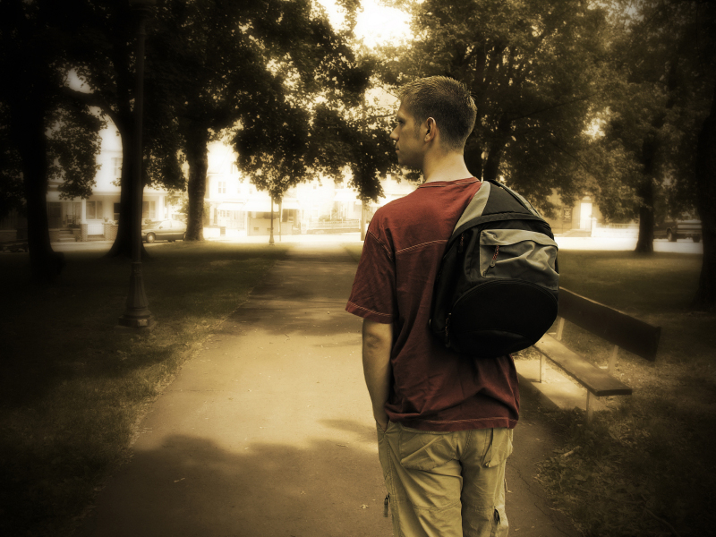
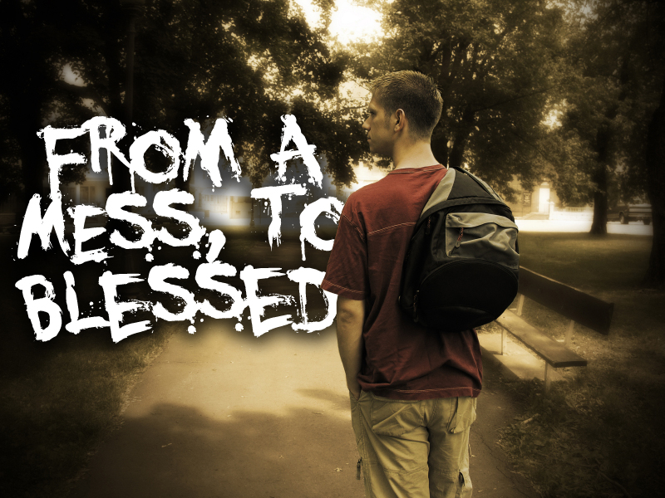

Slide 3
Luke 19:10
For the Son of man is come to seek and to save that which was lost.

Slide 4

Luke 15:1
Then drew near unto him all the publicans and sinners for to hear him.

Slide 5
Who Did Jesus Draw Close To Himself To Hear What He Was About To Say?

Slide 6
Publicans & Sinners
Tax collectors and other low-life
Losers!

Slide 7
Luke 15:2
And the Pharisees and scribes murmured, saying, This man receiveth sinners, and eateth with them.

Slide 8
Who Was Also Watching And Listening And
Even Murmuring?

Slide 9
Pharisees
Self-Righteous
Religious
Leaders!

Slide 10
Luke 15:3
And he spake this parable unto them, saying,

Slide 11
So, Who Was Jesus Talking To?

Slide 12
THEM!
Publicans
Sinners
Pharisees

Slide 13
Jesus Sets Up The “BIG STORY”
By Telling Two
‘little stories’

Slide 14
1st Little Story
One Lost Sheep
Luke 15:4-7
⁴What man of you, having an hundred sheep, if he lose one of them, doth not leave the ninety and nine in the wilderness, and go after that which is lost, until he find it?

Slide 15
1st Little Story
One Lost Sheep
Luke 15:4-7
⁵And when he hath found it, he layeth it on his shoulders, rejoicing.
⁶And when he cometh home, he calleth together his friends and neighbours, saying unto them, Rejoice with me; for I have found my sheep which was lost.

Slide 16
1st Little Story
One Lost Sheep
Luke 15:4-7
⁷I say unto you, that likewise joy shall be in heaven over one sinner that repenteth, more than over ninety and nine just persons, which need no repentance.

Slide 17

2nd Little Story
One Lost Coin
Luke 15:8-10
⁸Either what woman having ten pieces of silver, if she lose one piece, doth not light a candle, and sweep the house, and seek diligently till she find it?

Slide 18
2nd Little Story
One Lost Coin
Luke 15:8-10
⁹And when she hath found it, she calleth her friends and her neighbours together, saying, Rejoice with me; for I have found the piece which I had lost.

Slide 19
2nd Little Story
One Lost Coin
Luke 15:8-10
¹⁰ Likewise, I say unto you, there is joy in the presence of the angels of God over one sinner that repenteth.

Slide 21
now the
BIG STORY
The Prodigal Son
The Prodigal’s Dad

Slide 22
THE PRODIGAL SON
Sinner
Luke 15:11-16
¹¹And he said, A certain man had two sons:
¹²And the younger of them said to his father, Father, give me the portion of goods that falleth to me. And he divided unto them his living.

Slide 23
THE PRODIGAL SON
Sinner
Luke 15:11-16
¹³And not many days after the younger son gathered all together, and took his journey into a far country, and there wasted his substance with riotous living.
¹⁴And when he had spent all, there arose a mighty famine in that land; and he began to be in want.

Slide 24
THE PRODIGAL SON
Sinner
Luke 15:11-16
¹⁵And he went and joined himself to a citizen of that country; and he sent him into his fields to feed swine.
¹⁶And he would fain have filled his belly with the husks that the swine did eat: and no man gave unto him.

Slide 25
THE PRODIGAL SON
Sinner
He Lost His Senses
He Had No Spiritual Sense
“Give Me”

Slide 26
THE PRODIGAL SON
Sinner
He Lost His Senses
He Had No Spiritual Sense
“Far Country”

Slide 27
THE PRODIGAL SON
Sinner
He Lost His Senses
He Had No Spiritual Sense
“Wasted”

Slide 28
THE PRODIGAL SON
Sinner
He Lost His Senses
He Had No Spiritual Sense
“Famine”

Slide 29
THE PRODIGAL SON
Sinner
He Lost His Senses
He Had No Spiritual Sense
“Joined Himself”

Slide 30
THE PRODIGAL SON
Sinner
He Lost His Senses
He Had No Spiritual Sense
“Husks That
Pigs Eat”

Slide 31
THE PRODIGAL SON
Sinner
Luke 15:17-19
¹⁷And when he came to himself, he said, How many hired servants of my father's have bread enough and to spare, and I perish with hunger!

Slide 32
THE PRODIGAL SON
Sinner
Luke 15:17-19
¹⁸I will arise and go to my father, and will say unto him, Father, I have sinned against heaven, and before thee,
¹⁹And am no more worthy to be called thy son: make me as one of thy hired servants.

Slide 33
THE PRODIGAL SON
Sinner
When He Came To Himself
He Regained His Senses
He Had Spiritual Sense
“I Will Arise”

Slide 34
THE PRODIGAL SON
Sinner
When He Came To Himself
He Regained His Senses
He Had Spiritual Sense
“I Will Go”

Slide 35
THE PRODIGAL SON
Sinner
When He Came To Himself
He Regained His Senses
He Had Spiritual Sense
“I Will Say…”

Slide 36
THE PRODIGAL SON
Sinner
When He Came To Himself
He Regained His Senses
He Had Spiritual Sense
“I HAVE SINNED!”
“I Am Not Worthy”

Slide 37
THE PRODIGAL SON
Sinner
When He Came To Himself
He Regained His Senses
He Had Spiritual Sense
“I HAVE SINNED!”
“Make Me A Servant”

Slide 39
THE PRODIGAL’S DAD
The Forgiving Father
Luke 15:20
And he arose, and came to his father. But when he was yet a great way off, his father saw him, and had compassion, and ran, and fell on his neck, and kissed him.

Slide 40
THE PRODIGAL’S DAD
The Forgiving Father
He Arose
And Came To
His Father

Slide 41
THE PRODIGAL’S DAD
The Forgiving Father
AND WHEN HE WAS A GREAT
WAY OFF, HIS FATHER...
Saw Him
Had Compassion On Him
Ran To Him (why?)
Because His Father Loved Him
Because He Would Have Been Stoned

Slide 42
THE PRODIGAL’S DAD
The Forgiving Father
Deuteronomy 21:18-21
¹⁸If a man have a stubborn and rebellious son, which will not obey the voice of his father, or the voice of his mother, and that, when they have chastened him, will not hearken unto them:

Slide 43
THE PRODIGAL’S DAD
The Forgiving Father
Deuteronomy 21:18-21
¹⁹Then shall his father and his mother lay hold on him, and bring him out unto the elders of his city, and unto the gate of his place;

Slide 44
THE PRODIGAL’S DAD
The Forgiving Father
Deuteronomy 21:18-21
²⁰And they shall say unto the elders of his city, This our son is stubborn and rebellious, he will not obey our voice; he is a glutton, and a drunkard.

Slide 45
THE PRODIGAL’S DAD
The Forgiving Father
Deuteronomy 21:18-21
²¹And all the men of his city shall stone him with stones, that he die: so shalt thou put evil away from among you; and all Israel shall hear, and fear.

Slide 46
THE PRODIGAL’S DAD
The Forgiving Father
HIS FATHER...
Fell On His Neck
Kissed Him

Slide 47
THE PRODIGAL’S DAD
The Forgiving Father
Luke 15:21
And the son said unto him, Father, I have sinned against heaven, and in thy sight, and am no more worthy to be called thy son.

Slide 48
THE PRODIGAL’S DAD
The Forgiving Father
“Father, I
HAVE SINNED!”
Repentance

Slide 49
THE PRODIGAL’S DAD
The Forgiving Father
The Father Responds...
Luke 15:22-23
²²But the father said to his servants, Bring forth the best robe, and put it on him; and put a ring on his hand, and shoes on his feet:
²³And bring hither the fatted calf, and kill it; and let us eat, and be merry:

Slide 50
THE PRODIGAL’S DAD
The Forgiving Father
The Father Responds...
Bring The BEST Robe (the father’s robe)
Put A Ring On His Hand
Put Shoes On His Feet
Bring The Fatted Calf (he kept one ready!)
Let Us Eat And Be Merry

Slide 51
THE PRODIGAL’S DAD
The Forgiving Father
Luke 15:24
For this my son was dead, and is alive again; he was lost, and is found. And they began to be merry.

Slide 52
THE PRODIGAL’S DAD
The Forgiving Father
“My Son Was Dead And Is Alive Again!”

Slide 53
THE PRODIGAL’S DAD
The Forgiving Father
“he was lost and is found!”

