Slide 1




Slide 2




Slide 3

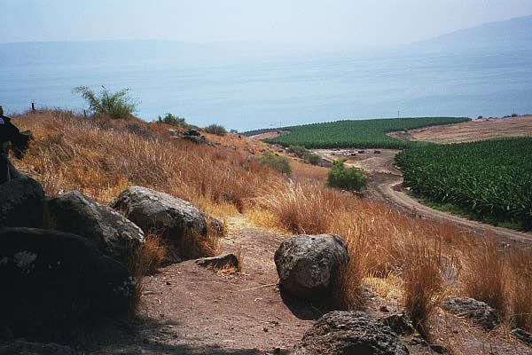
Matthew 5:1-2 1 And seeing the multitudes, he went up into a mountain: and when he was set, his disciples came unto him:
2 And he opened his mouth, and taught them, saying,

Slide 4
Jesus Taught His Disciples How To Be Blessed

Slide 5
BLESSED
Happy Or Fortunate

Slide 6
1 Timothy 6:6-8 6 But godliness with contentment is great gain.
7 For we brought nothing into this world, and it is certain we can carry nothing out.
8 And having food and raiment let us be therewith content.

Slide 7
The “Being Blessed” That Jesus Teaches In This Passage Of Scripture Is Internal, Not External

Slide 8
1 Samuel 16:7 But the LORD said unto Samuel, Look not on his countenance, or on the height of his stature; because I have refused him: for the LORD seeth not as man seeth; for man looketh on the outward appearance, but the LORD looketh on the heart.

Slide 9
“Being Blessed” Will ONLY Come About When You Are Properly Related To God Through Faith, And When You Have Complete Trust In Him

Slide 10
Hebrews 11:6 But without faith it is impossible to please him: for he that cometh to God must believe that he is, and that he is a rewarder of them that diligently seek him.

Slide 12


Slide 13

Matthew 5:3 Blessed are the poor in spirit: for theirs is the kingdom of heaven.
Blessed Are The Poor In Spirit

Slide 14
Matthew 5:3 Blessed are the poor in spirit: for theirs is the kingdom of heaven.
Here’s The Attitude…
I Will Depend On God And Not Myself
James 1:17 Every good gift and every perfect gift is from above, and cometh down from the Father of lights, with whom is no variableness, neither shadow of turning.

Slide 15
Matthew 5:3 Blessed are the poor in spirit: for theirs is the kingdom of heaven.
For Theirs Is The Kingdom Of Heaven

Slide 16
Matthew 5:3 Blessed are the poor in spirit: for theirs is the kingdom of heaven.
Here’s The Blessing…
This World Is Not My Home, And satan, The god Of This World, Ain’t My Daddy!
Ephesians 2:2 Wherein in time past ye walked according to the course of this world, according to the prince of the power of the air, the spirit that now worketh in the children of disobedience:

Slide 17
Matthew 5:3 Blessed are the poor in spirit: for theirs is the kingdom of heaven.
Here’s The Blessing…
This World Is Not My Home, And satan, The god Of This World, Ain’t My Daddy!
Ephesians 2:4-7 4 But God, who is rich in mercy, for his great love wherewith he loved us,

Slide 18
Matthew 5:3 Blessed are the poor in spirit: for theirs is the kingdom of heaven.
Here’s The Blessing…
This World Is Not My Home, And satan, The god Of This World, Ain’t My Daddy!
Ephesians 2:4-7 5 Even when we were dead in sins, hath quickened us together with Christ, (by grace ye are saved;)

Slide 19
Matthew 5:3 Blessed are the poor in spirit: for theirs is the kingdom of heaven.
Here’s The Blessing…
This World Is Not My Home, And satan, The god Of This World, Ain’t My Daddy!
Ephesians 2:4-7 6 And hath raised us up together, and made us sit together in heavenly places in Christ Jesus:

Slide 20
Matthew 5:3 Blessed are the poor in spirit: for theirs is the kingdom of heaven.
Here’s The Blessing…
This World Is Not My Home, And satan, The god Of This World, Ain’t My Daddy!
Ephesians 2:4-7 7 That in the ages to come he might shew the exceeding riches of his grace in his kindness toward us through Christ Jesus

Slide 22

Matthew 5:4 Blessed are they that mourn: for they shall be comforted.
Blessed Are They That Mourn

Slide 23
Matthew 5:4 Blessed are they that mourn: for they shall be comforted.
Here’s The Attitude…
I Will Recognize My Needs, Hurts And Struggles, And Will Present Them To The One Who Truly Cares For Me
1 Peter 5:7 Casting all your care upon him; for he careth for you.

Slide 24
Matthew 5:4 Blessed are they that mourn: for they shall be comforted.
For They Shall Be Comforted

Slide 25
Matthew 5:4 Blessed are they that mourn: for they shall be comforted.
Here’s The Blessing…
God Will Comfort Me!
2 Corinthians 1:3-4 3 Blessed be God, even the Father of our Lord Jesus Christ, the Father of mercies, and the God of all comfort;

Slide 26
Matthew 5:4 Blessed are they that mourn: for they shall be comforted.
Here’s The Blessing…
God Will Comfort Me!
2 Corinthians 1:3-4 4 Who comforteth us in all our tribulation, that we may be able to comfort them which are in any trouble, by the comfort wherewith we ourselves are comforted of God.

Slide 28

Matthew 5:5 Blessed are the meek: for they shall inherit the earth.
Blessed Are The Meek

Slide 29
Matthew 5:5 Blessed are the meek: for they shall inherit the earth.
Here’s The Attitude…
I Will Be Humble, Gentle And Have A Proper Appreciation Of Who I Am And Who God Is
GOD IS GOD AND I AM NOT!

Slide 30
Matthew 5:5 Blessed are the meek: for they shall inherit the earth.
For They Shall Inherit The Earth

Slide 31
Matthew 5:5 Blessed are the meek: for they shall inherit the earth.
Here’s The Blessing…
I Am An Heir Of God Through Jesus Christ And I Have A Future Destiny That Is Out Of This World
Galatians 4:4-7 4 But when the fulness of the time was come, God sent forth his Son, made of a woman, made under the law,

Slide 32
Matthew 5:5 Blessed are the meek: for they shall inherit the earth.
Here’s The Blessing…
I Am An Heir Of God Through Jesus Christ And I Have A Future Destiny That Is Out Of This World
Galatians 4:4-7 5 To redeem them that were under the law, that we might receive the adoption of sons.

Slide 33
Matthew 5:5 Blessed are the meek: for they shall inherit the earth.
Here’s The Blessing…
I Am An Heir Of God Through Jesus Christ And I Have A Future Destiny That Is Out Of This World
Galatians 4:4-7 6 And because ye are sons, God hath sent forth the Spirit of his Son into your hearts, crying, Abba, Father.

Slide 34
Matthew 5:5 Blessed are the meek: for they shall inherit the earth.
Here’s The Blessing…
I Am An Heir Of God Through Jesus Christ And I Have A Future Destiny That Is Out Of This World
Galatians 4:4-7 7 Wherefore thou art no more a servant, but a son; and if a son, then an heir of God through Christ.

Slide 36
I WANT THIS TO
BE MY ATTITUDE!
I WILL DEPEND ON GOD AND NOT MYSELF

Slide 37
I WANT THIS TO
BE MY ATTITUDE!
I WILL RECOGNIZE MY NEEDS, AND HURTS, AND STRUGGLES, AND WILL PRESENT THEM TO THE ONE WHO TRULY CARES FOR ME!

Slide 38
I WANT THIS TO
BE MY ATTITUDE!
I WILL BE HUMBLE AND GENTLE AND HAVE A PROPER APPRECIATION OF WHO I AM AND WHO GOD IS

