Slide 1




Slide 2
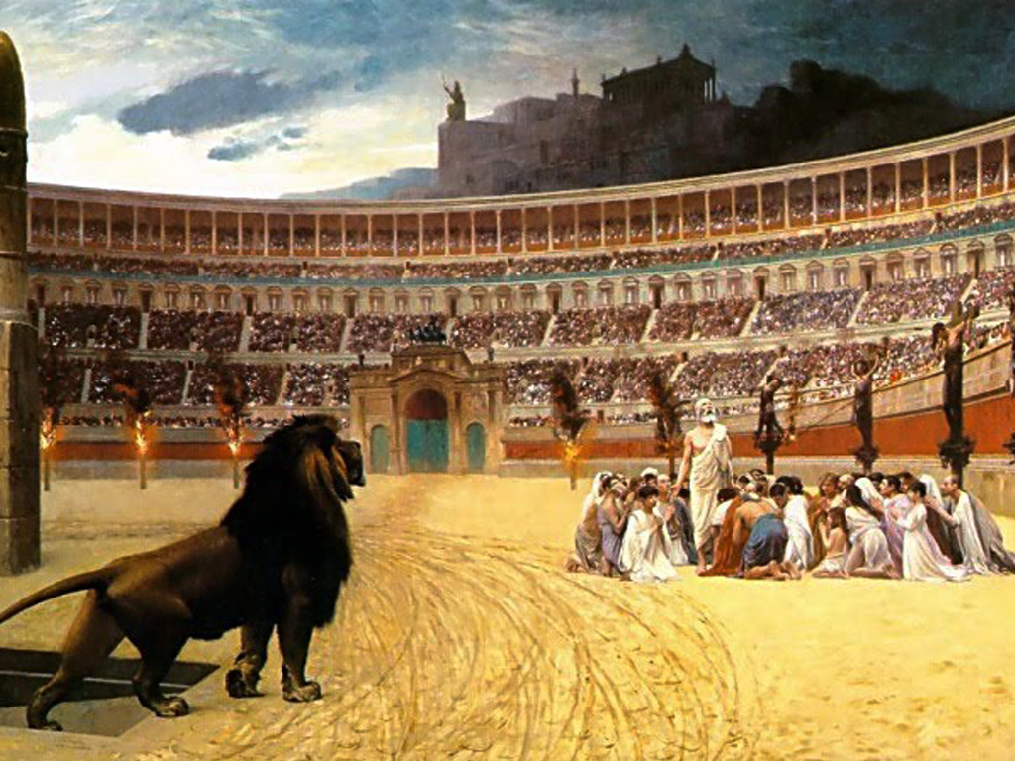
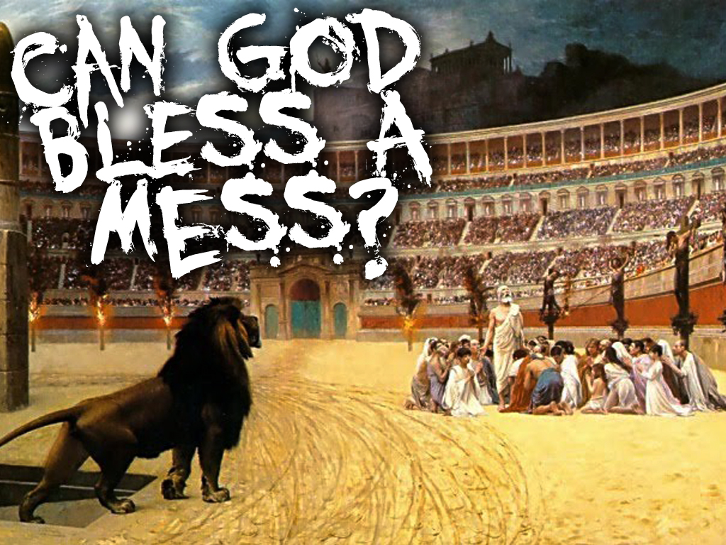

Slide 3
It shouldn’t surprise us that God is good at blessing messes!

Slide 4
oh yes!

Slide 5
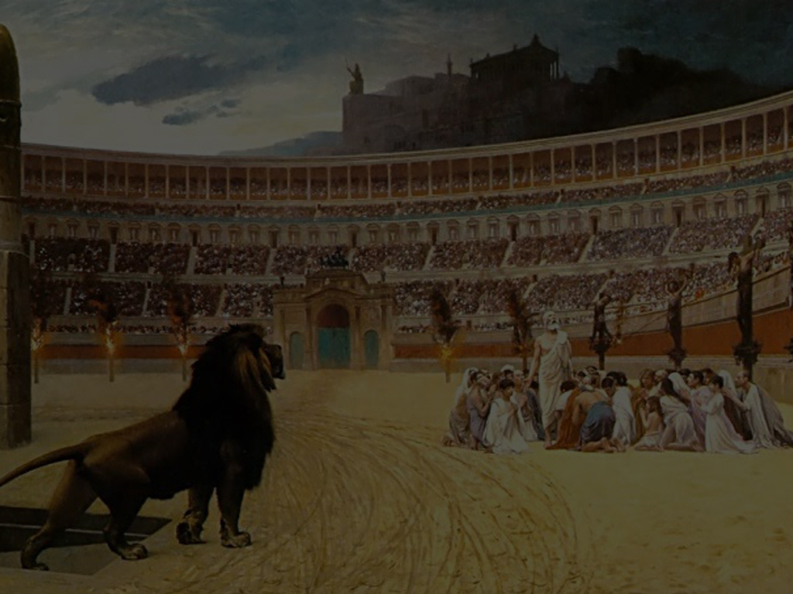
Lets go all the way back to the first church…

Slide 6
You Talk About A Mess!

Slide 7
Their leader Jesus had just been killed!

Slide 8
Though resurrected, Jesus now was gone back to His Father in Heaven

Slide 9
Most of their families had turned against them

Slide 10
Many had lost their homes and their livelihoods

Slide 11
The religious establishment opposed them violently

Slide 12
They were being hunted down like dogs

Slide 13
The “true colors” of many of the followers began revealing themselves

Slide 14
Many were more interested in overthrowing Rome, than following Jesus

Slide 15
Opportunistic false teachers used this time to “piggy back and hijack” the movement of God

Slide 16
A void of leadership lead to jockeying for position
and power

Slide 17
Phonies and hypocrites were in it for themselves and recognition

Slide 18
Things Were A Mess!

Slide 19
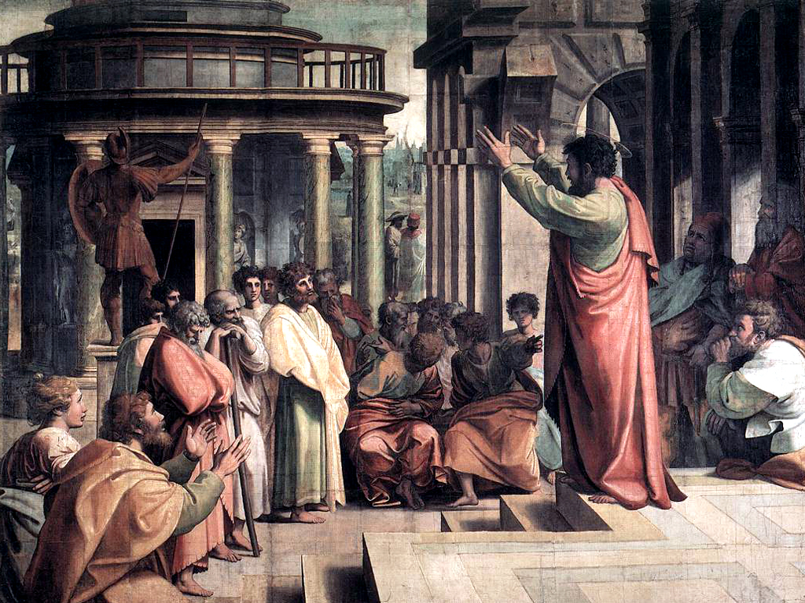
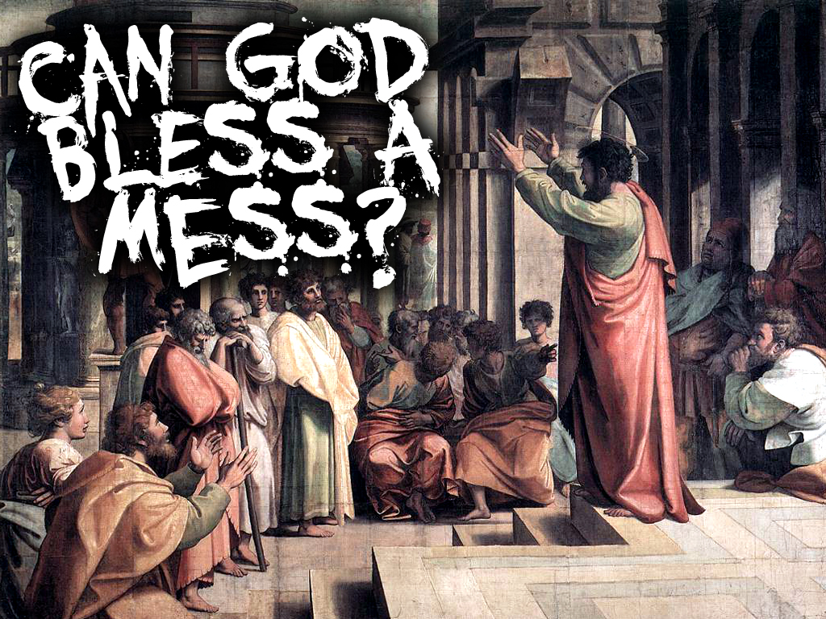
oh yes!

Slide 20
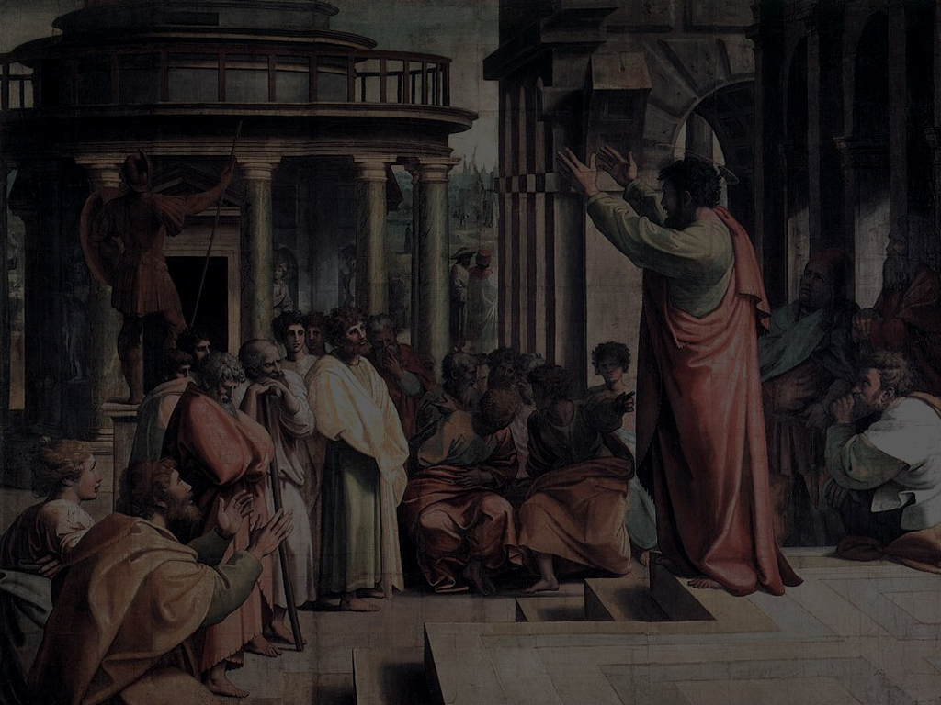
Lets go to the book of Acts chapter two...

Slide 21
Acts 2:14 But Peter, standing up with the eleven, lifted up his voice, and said unto them, Ye men of Judea, and all ye that dwell at Jerusalem, be this known unto you, and hearken to my words:

Slide 22
Acts 2:37-40 ³⁷Now when they heard this, they were pricked in their heart, and said unto Peter and to the rest of the apostles, Men and brethren, what shall we do?
³⁸Then Peter said unto them, Repent, and be baptized every one of you in the name of Jesus Christ for the remission of sins, and ye shall receive the gift of the Holy Ghost.

Slide 23
Acts 2:37-40 ³⁹For the promise is unto you, and to your children, and to all that are afar off, even as many as the LORD our God shall call.
⁴⁰And with many other words did he testify and exhort, saying, Save yourselves from this untoward generation.

Slide 24
oh yes!

Slide 25
CHECK IT OUT!

Slide 26
Acts 2:41 Then they that gladly received his word were baptized: and the same day there were added unto them about three thousand souls.
They Gladly Received His Word
They Were Baptized

Slide 27
Acts 2:42 And they continued stedfastly in the apostles' doctrine and fellowship, and in breaking of bread, and in prayers.
They Continued Steadfastly
In The Apostle’s Doctrine
In Fellowship
In The Breaking Of Bread
In Prayers

Slide 28
Acts 2:43 And fear came upon every soul: and many wonders and signs were done by the apostles.
They Feared The Lord

Slide 29
Acts 2:44 And all that believed were together, and had all things common;
They Were Together
They Had All Things Common

Slide 30
Acts 2:45 And sold their possessions and goods, and parted them to all men, as every man had need.
They Sold Their Possessions
And Goods, And Gave Them
To Those In Need

Slide 31
Acts 2:46 And they, continuing daily with one accord in the temple, and breaking bread from house to house, did eat their meat with gladness and singleness of heart,
They Continued Daily With
One Accord
In The Temple
In The Breaking Of Bread
From House To House
With Gladness And Singleness Of Heart

Slide 32
Acts 2:47 Praising God, and having favour with all the people. And the Lord added to the church daily such as should be saved.
They Praised God
They Had Favor With Everyone

Slide 33
Acts 2:47 Praising God, and having favour with all the people. And the Lord added to the church daily such as should be saved.
And…
“The Lord Added To The Church Daily Such As Should Be Saved!”

Slide 34
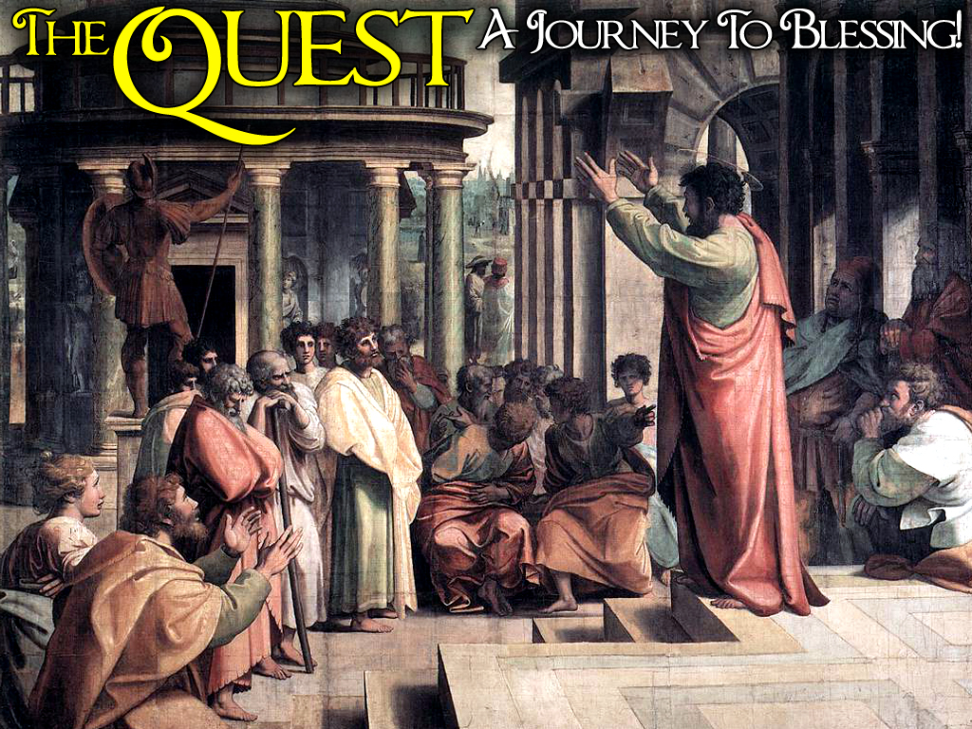

Slide 35
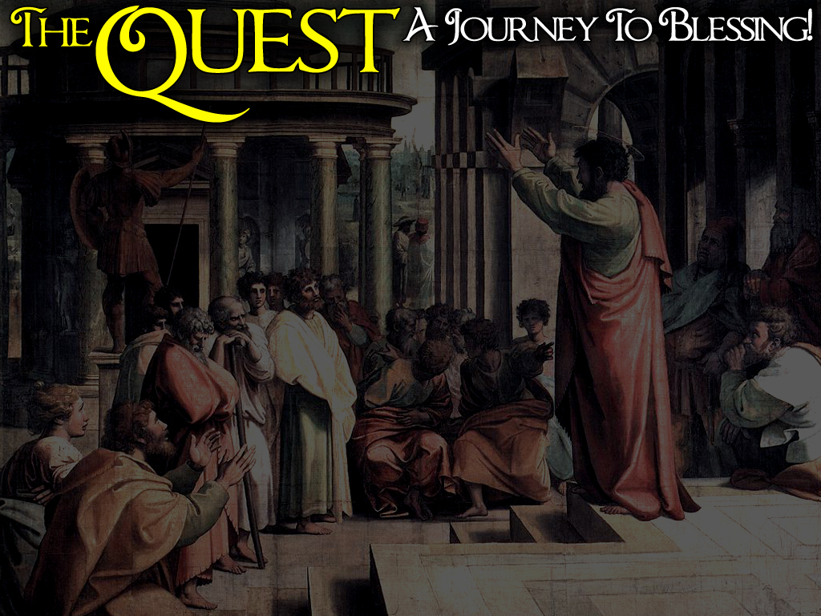
1. GLADLY RECEIVE GOD’S WORD
2. BE OBEDIENT To The Lord’s Commands
3. BE STEADFAST
4. FEAR THE LORD “Awe And Reverence”
5. VOLUNTARILY SERVE The Lord
6. FREELY GIVE To The Work Of The Lord
7. CONTINUE IN UNITY, Every Day
8. PRAISE THE LORD, Regardless
9. WALK IN FAVOR Of The Lord

Slide 36
oh yes!

Slide 37
Galatians 5:22-23 ²²But the fruit of the Spirit is love, joy, peace, longsuffering, gentleness, goodness, faith,
²³Meekness, temperance: against such there is no law.

Slide 38
Say This With Me Church...

Slide 39
I Gladly Receive God’s Word Because I Have FAITH
I BELIEVE GOD PERIOD!

Slide 40
I Am Obedient To The Lord’s Commands, Because I Am MEEK
I AM HIS WAR HORSE!

Slide 41
I Am Steadfast In The Lord, Because I Have TEMPERANCE
I DO NOT LIVE MY LIFE OUT OF CONTROL!

Slide 42
I Fear The Lord, Because I LOVE Him
I WILL SACRIFICE BECAUSE OF HIS SACRIFICE

Slide 43
I Will Voluntarily Serve The Lord, Because I Have GENTLENESS
I AM RESPECTABLE AND KIND!

Slide 44
I Freely Give To The Work Of The Lord, Because I Have GOODNESS
I WILL GO THE EXTRA MILE!

Slide 45
I Will Continue In Unity Every Day, Because I Am LONGSUFFERING
I WILL ENDURE THE UNENDURABLE!

Slide 46
I Praise The Lord Regardless, Because I Have JOY
GOD LIVES IN MY HOUSE!

Slide 47
I Walk In The Favor Of The Lord, Because I Have PEACE
I’M FORGIVEN, IT’S FORGOTTEN, FOREVER!

