Slide 1
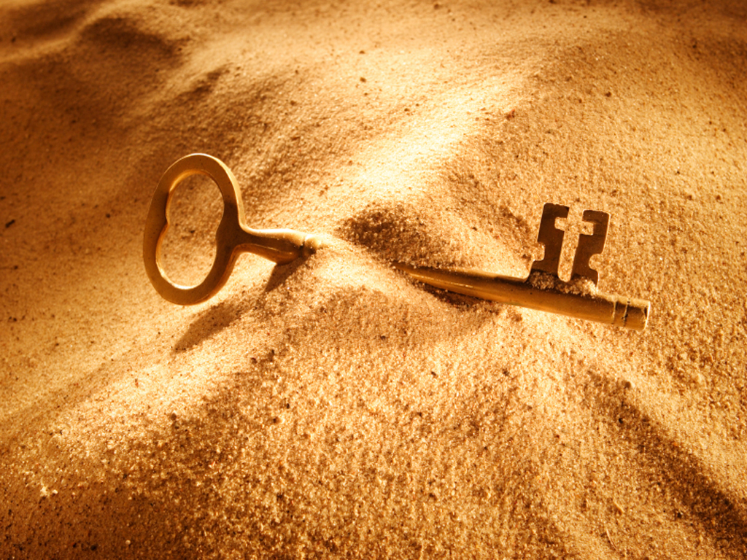


Slide 2
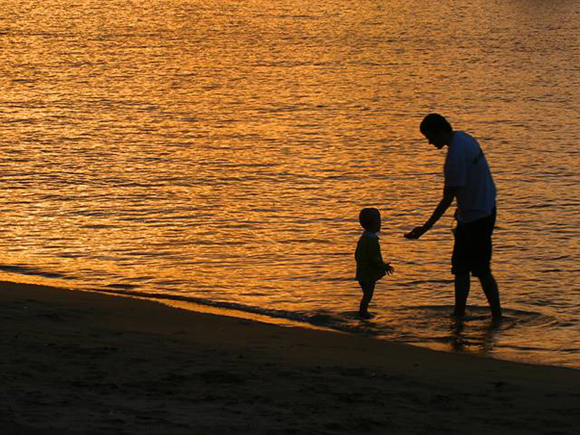

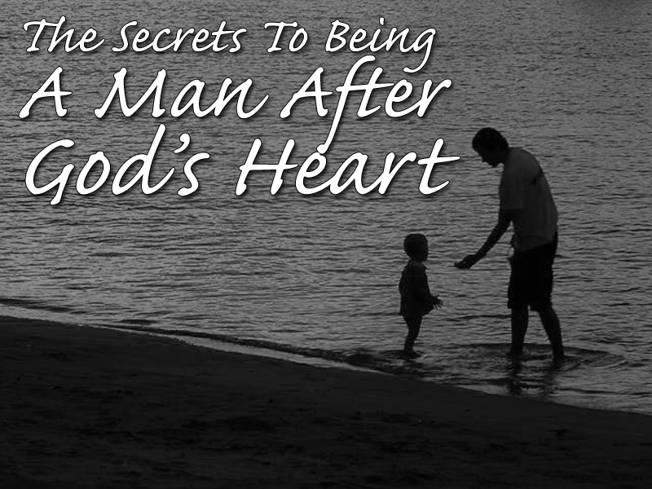

Slide 3
1 Samuel 13:1
Saul reigned one year; and when he had reigned two years over Israel,

Slide 4
1 Samuel 13:5-6
5 And the Philistines gathered themselves together to fight with Israel, thirty thousand chariots, and six thousand horsemen, and people as the sand which is on the sea shore in multitude: and they came up, and pitched in Michmash, eastward from Bethaven.

Slide 5
1 Samuel 13:5-6
6 When the men of Israel saw that they were in a strait, (for the people were distressed,) then the people did hide themselves in caves, and in thickets, and in rocks, and in high places, and in pits.

Slide 6
1 Samuel 13:9-14
9 And Saul said, Bring hither a burnt offering to me, and peace offerings. And he offered the burnt offering.
10 And it came to pass, that as soon as he had made an end of offering the burnt offering, behold, Samuel came; and Saul went out to meet him, that he might salute him.

Slide 7
1 Samuel 13:9-14
11 And Samuel said, What hast thou done? And Saul said, Because I saw that the people were scattered from me, and that thou camest not within the days appointed, and that the Philistines gathered themselves together at Michmash;

Slide 8
1 Samuel 13:9-14
12 Therefore said I, The Philistines will come down now upon me to Gilgal, and I have not made supplication unto the LORD: I forced myself therefore, and offered a burnt offering.

Slide 9
1 Samuel 13:9-14
13 And Samuel said to Saul, Thou hast done foolishly: thou hast not kept the commandment of the LORD thy God, which he commanded thee: for now would the LORD have established thy kingdom upon Israel for ever.

Slide 10
1 Samuel 13:9-14
14 But now thy kingdom shall not continue: the LORD hath sought him a man after his own heart, and the LORD hath commanded him to be captain over his people, because thou hast not kept that which the LORD commanded thee.

Slide 13
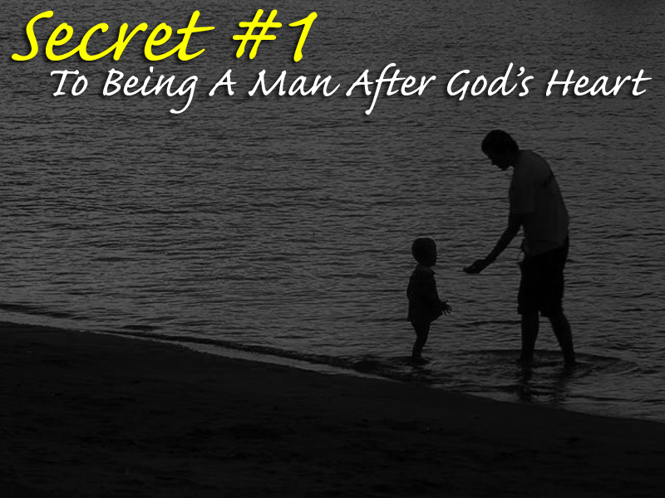
YOU MUST BE SPIRITUAL!

Slide 14
Phony Ain’t Gonna Fly!

Slide 15
Offering must
come from the heart
Prayer must come
from the heart
Works must come
from the heart

Slide 16
Luke 11:37-42
37 And as he spake, a certain Pharisee besought him to dine with him: and he went in, and sat down to meat.
38 And when the Pharisee saw it, he marvelled that he had not first washed before dinner.
39 And the Lord said unto him, Now do ye Pharisees make clean the outside of the cup and the platter; but your inward part is full of ravening and wickedness.

Slide 17
Luke 11:37-42
40 Ye fools, did not he that made that which is without make that which is within also?
41 But rather give alms of such things as ye have; and, behold, all things are clean unto you.
42 But woe unto you, Pharisees! for ye tithe mint and rue and all manner of herbs, and pass over judgment and the love of God: these ought ye to have done, and not to leave the other undone.

Slide 19
A Nobody, That Nobody Noticed…

Slide 20
1 Samuel 16:1-10
1 And the LORD said unto Samuel, How long wilt thou mourn for Saul, seeing I have rejected him from reigning over Israel? fill thine horn with oil, and go, I will send thee to Jesse the Bethlehemite: for I have provided me a king among his sons.

Slide 21
1 Samuel 16:1-10
2 And Samuel said, How can I go? if Saul hear it, he will kill me. And the LORD said, Take an heifer with thee, and say, I am come to sacrifice to the LORD.
3 And call Jesse to the sacrifice, and I will shew thee what thou shalt do: and thou shalt anoint unto me him whom I name unto thee.

Slide 22
1 Samuel 16:1-10
4 And Samuel did that which the LORD spake, and came to Bethlehem. And the elders of the town trembled at his coming, and said, Comest thou peaceably?
5 And he said, Peaceably: I am come to sacrifice unto the LORD: sanctify yourselves, and come with me to the sacrifice. And he sanctified Jesse and his sons, and called them to the sacrifice.

Slide 23
1 Samuel 16:1-10
6 And it came to pass, when they were come, that he looked on Eliab, and said, Surely the LORD's anointed is before him.
7 But the LORD said unto Samuel, Look not on his countenance, or on the height of his stature; because I have refused him: for the LORD seeth not as man seeth; for man looketh on the outward appearance, but the LORD looketh on the heart.

Slide 24
1 Samuel 16:1-10
8 Then Jesse called Abinadab, and made him pass before Samuel. And he said, Neither hath the LORD chosen this.
9 Then Jesse made Shammah to pass by. And he said, Neither hath the LORD chosen this.
10 Again, Jesse made seven of his sons to pass before Samuel. And Samuel said unto Jesse, The LORD hath not chosen these.

Slide 25
MAN FORGETS, BUT GOD REMEMBERS!

Slide 26
1 Samuel 16:11-12
11 And Samuel said unto Jesse, Are here all thy children? And he said, There remaineth yet the youngest, and, behold, he keepeth the sheep. And Samuel said unto Jesse, Send and fetch him: for we will not sit down till he come hither.
12 And he sent, and brought him in. Now he was ruddy, and withal of a beautiful countenance, and goodly to look to. And the LORD said, Arise, anoint him: for this is he.

Slide 27
Three Words For David’s Life
SOLITUDE – Alone
OBSCURITY – Unknown
MONOTONY – So Long!

Slide 28
1 Samuel 16:13-14
13 Then Samuel took the horn of oil, and anointed him in the midst of his brethren: and the Spirit of the LORD came upon David from that day forward. So Samuel rose up, and went to Ramah.
14 But the Spirit of the LORD departed from Saul, and an evil spirit from the LORD troubled him.

Slide 30
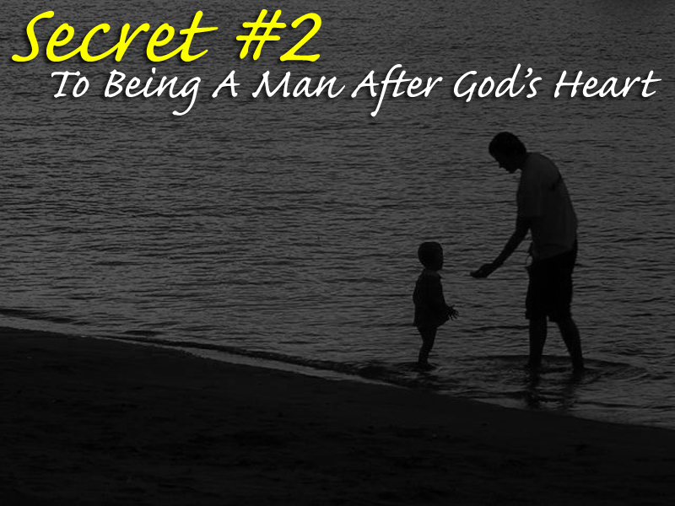
YOU MUST BE HUMBLE!

Slide 31
David Was Unaware Of Himself
James 4:6
But he giveth more grace. Wherefore he saith, God resisteth the proud, but giveth grace unto the humble.

Slide 32
David Was Unaware Of Himself
1 Peter 5:6-7
6 Humble yourselves therefore under the mighty hand of God, that he may exalt you in due time:
7 Casting all your care upon him; for he careth for you.

Slide 33
People who are humble are unconcerned about who gets the glory

Slide 34
People who are humble are also unconcerned about what people might say about them

Slide 35
The seeds of a servant’s heart are best grown in the soil of humility and they usually need to be sprinkled with solitude, obscurity, monotony and hard knocks!

Slide 37
KING DAVID
Youngest of seven sons
A shepherd boy
The King’s musician & armor bearer
Killed Goliath the giant
Married King Saul’s daughter
Best friend was Saul’s son, Jonathan
Hunted down like a dog by Saul
Spared Saul’s life on two occasions
Spared Nabal’s life
Israel’s second King (ruled for 40 years)
Seized Jerusalem and made it the capital
Brought back the Ark of the Covenant
Wrote hundreds of songs to God

Slide 38
Psalm 78:70-72
70 He chose David also his servant, and took him from the sheepfolds:
71 From following the ewes great with young he brought him to feed Jacob his people, and Israel his inheritance.
72 So he fed them according to the integrity of his heart; and guided them by the skilfulness of his hands.

Slide 40

YOU MUST HAVE INTEGRITY!
[Firmness of Character, Honesty]

Slide 41
Character Trumps Charisma Every Time With God!

Slide 42
WHY?

Slide 43
Because
MAN LOOKS, BUT GOD SEES!

Slide 45


Slide 46


Slide 47


Slide 49
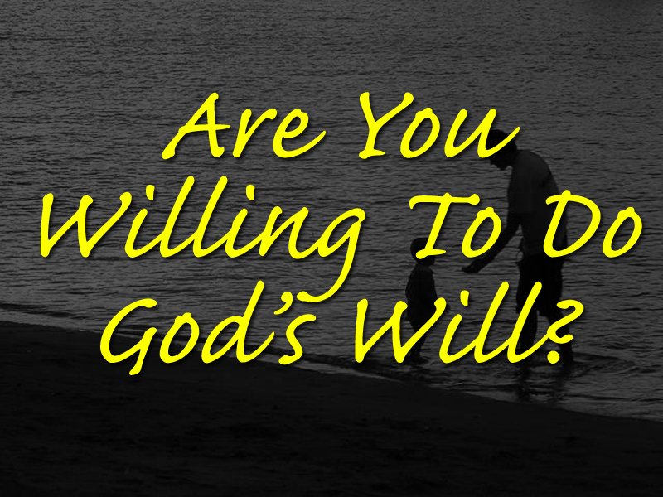

Slide 51
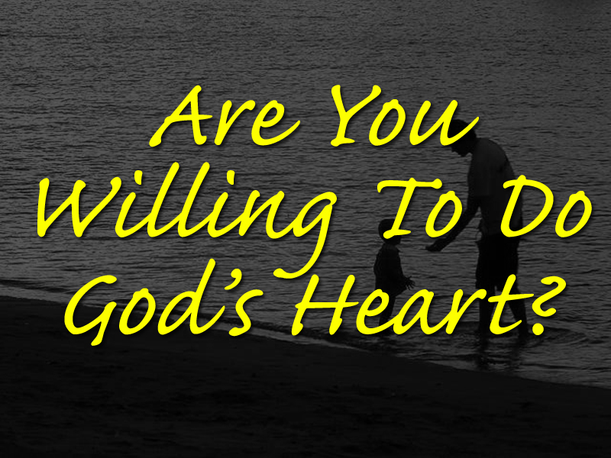

Slide 53


Slide 54


