Slide 1



Slide 2




Slide 3

TEMPTATION
Being drawn to something or someone with a desire to do something (evil) because we think there will be pleasure in obtaining it, or doing it

Slide 4
Temptation And Lust Usually Go Hand In Hand

Slide 5
James 1:14
But every man is tempted, when he is drawn away of his own lust, and enticed.

Slide 6
LUST
To eagerly desire and long for any worldly thing

Slide 7
1 Corinthians 10:13
There hath no temptation taken you but such as is common to man: but God is faithful, who will not suffer you to be tempted above that ye are able; but will with the temptation also make a way to escape, that ye may be able to bear it.

Slide 8
1 Corinthians 16:13
Watch ye, stand fast in the faith, quit you like men, be strong.

Slide 10
When You Fool Around With Temptation, You Are Gambling!

Slide 11
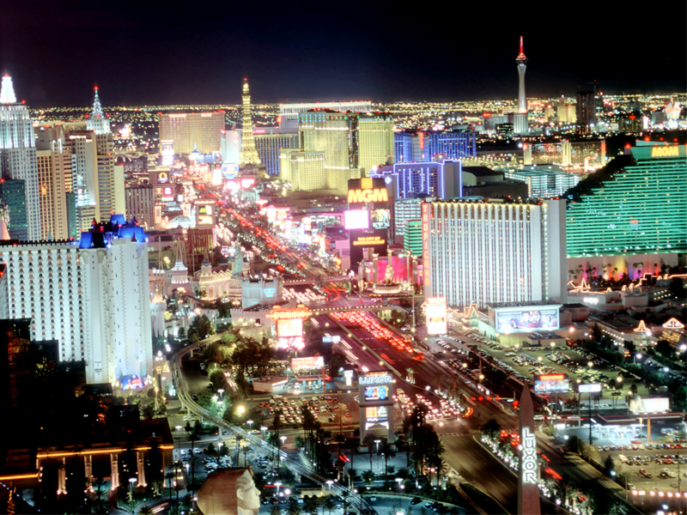
So Let’s Go To
Las Vegas…

Slide 12
SIN CITY!

Slide 13


EIGHT SECRETS TO
AVOIDING TEMPTATION
1.
ACE OF SPADES
What Does God’s Word Say?
Psalm 119:11
Thy word have I hid in mine heart, that I might not sin against thee.

Slide 14
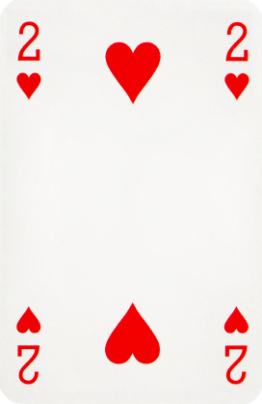
EIGHT SECRETS TO
AVOIDING TEMPTATION
2.
Deuces Are Wild
Be Terrified Of It!
Proverbs 16:25
There is a way that seemeth right unto a man, but the end thereof are the ways of death.

Slide 15
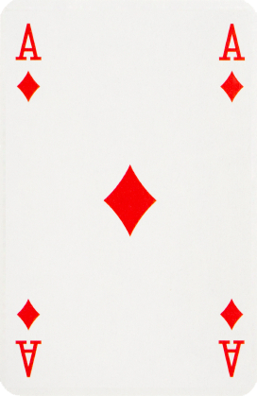

EIGHT SECRETS TO
AVOIDING TEMPTATION
3.
Three of A Kind
Consider God The Father, God
The Son & God The Holy Spirit!
Psalm 66:18
If I regard iniquity in my heart, the Lord will not hear me:

Slide 16
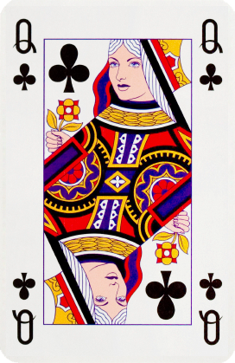
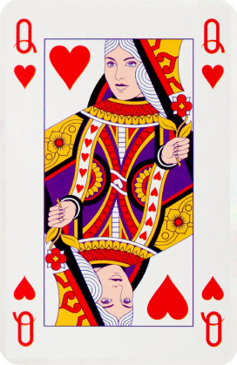
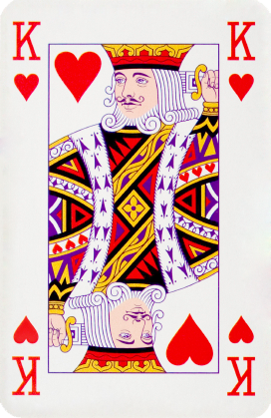
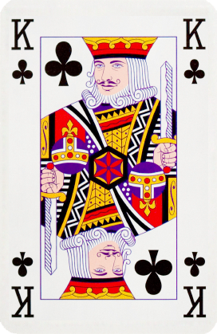
EIGHT SECRETS TO
AVOIDING TEMPTATION
4.
Two Pair
Consider Your Family!
Proverbs 5:15
Drink waters out of thine own cistern, and running waters out of thine own well.

Slide 17

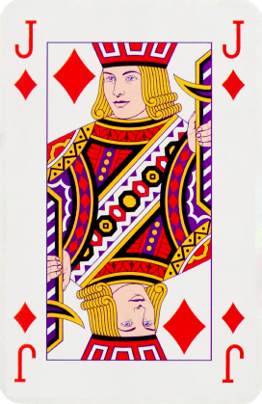
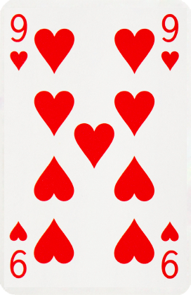
EIGHT SECRETS TO
AVOIDING TEMPTATION
5.
A Straight
Pray That You Stay Straight!
Matthew 6:13
And lead us not into temptation, but deliver us from evil: For thine is the kingdom, and the power, and the glory, for ever. Amen.

Slide 18

EIGHT SECRETS TO
AVOIDING TEMPTATION
6.
House Of Cards
Know Your Testimony Will
Be Shot!
2 Samuel 12:12
For thou didst it
secretly: but I will do
this thing before all
Israel, and before the sun.
Number Six, Pick Up Your Sticks

Slide 19
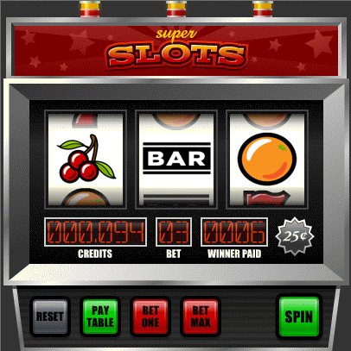
EIGHT SECRETS TO
AVOIDING TEMPTATION
7.
Lucky Sevens (the slots)
Don’t Feel Lucky!

Slide 20
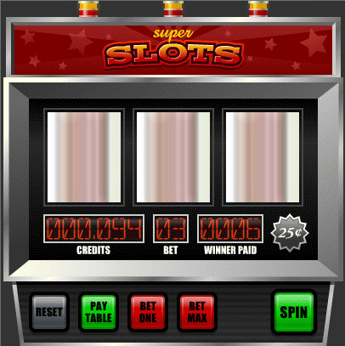
EIGHT SECRETS TO
AVOIDING TEMPTATION
7.
Lucky Sevens (the slots)
Don’t Feel Lucky!

Slide 21
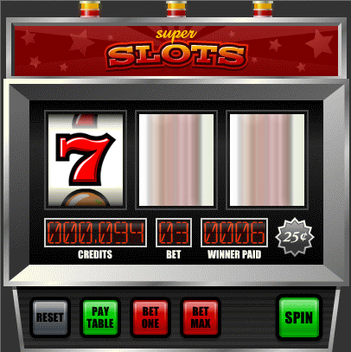
EIGHT SECRETS TO
AVOIDING TEMPTATION
7.
Lucky Sevens (the slots)
Don’t Feel Lucky!

Slide 22
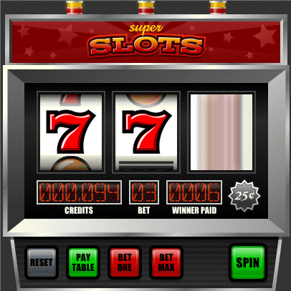
EIGHT SECRETS TO
AVOIDING TEMPTATION
7.
Lucky Sevens (the slots)
Don’t Feel Lucky!

Slide 23
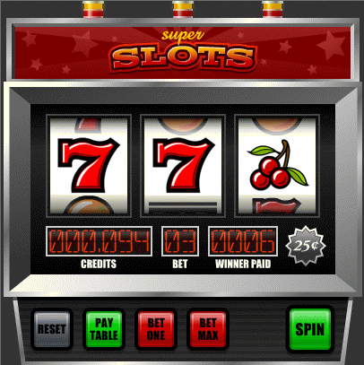
EIGHT SECRETS TO
AVOIDING TEMPTATION
7.
Lucky Sevens (the slots)
Don’t Feel Lucky!

Slide 24
EIGHT SECRETS TO
AVOIDING TEMPTATION
7.
Lucky Sevens (the slots)
Don’t Feel Lucky!

Slide 25
EIGHT SECRETS TO
AVOIDING TEMPTATION
7.
Lucky Sevens (the slots)
Don’t Feel Lucky!

Slide 26
EIGHT SECRETS TO
AVOIDING TEMPTATION
7.
Lucky Sevens (the slots)
Don’t Feel Lucky!

Slide 27
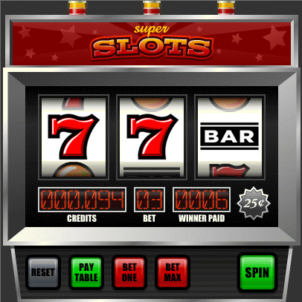
EIGHT SECRETS TO
AVOIDING TEMPTATION
7.
Lucky Sevens (the slots)
Don’t Feel Lucky!

Slide 28
EIGHT SECRETS TO
AVOIDING TEMPTATION
7.
Lucky Sevens (the slots)
Don’t Feel Lucky!

Slide 29
EIGHT SECRETS TO
AVOIDING TEMPTATION
7.
Lucky Sevens (the slots)
Don’t Feel Lucky!

Slide 30
EIGHT SECRETS TO
AVOIDING TEMPTATION
7.
Lucky Sevens (the slots)
Don’t Feel Lucky!

Slide 31
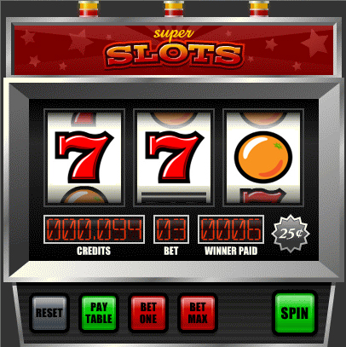
EIGHT SECRETS TO
AVOIDING TEMPTATION
7.
Lucky Sevens (the slots)
Don’t Feel Lucky!
1 Corinthians 10:12
Wherefore let him that thinketh he standeth take heed lest he fall.

Slide 32
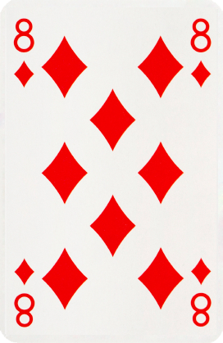
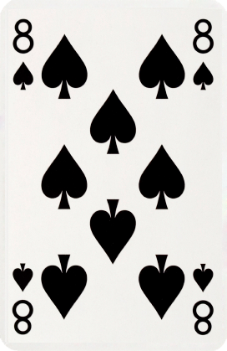
EIGHT SECRETS TO
AVOIDING TEMPTATION
8.
Crazy Eights
Know You Are Crazy! (weak)
Matthew 26:41
Watch and pray, that ye enter not into temptation: the spirit indeed is willing, but the flesh is weak.

Slide 41
AVOID
SIN
CITY!

Slide 42
…Because,
What Happens In Vegas, Doesn’t Stay In Vegas!

