Slide 1



Slide 3


Slide 4
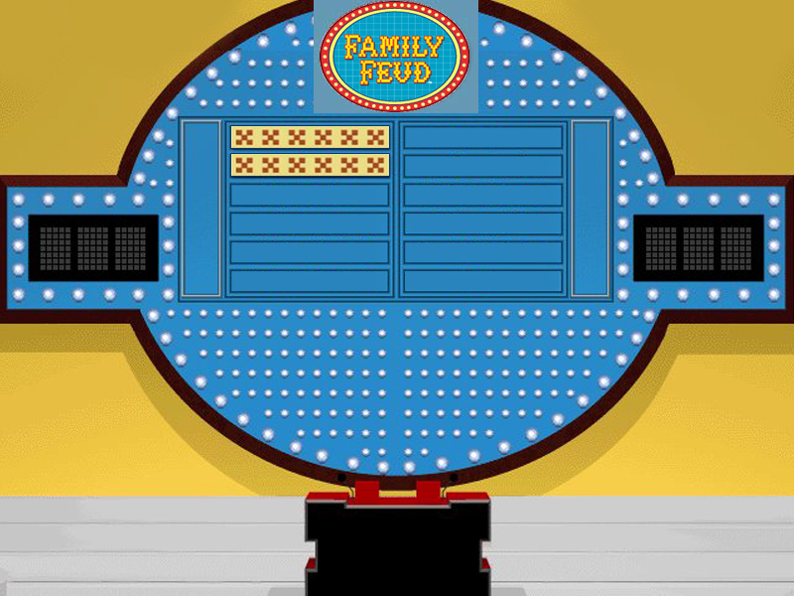
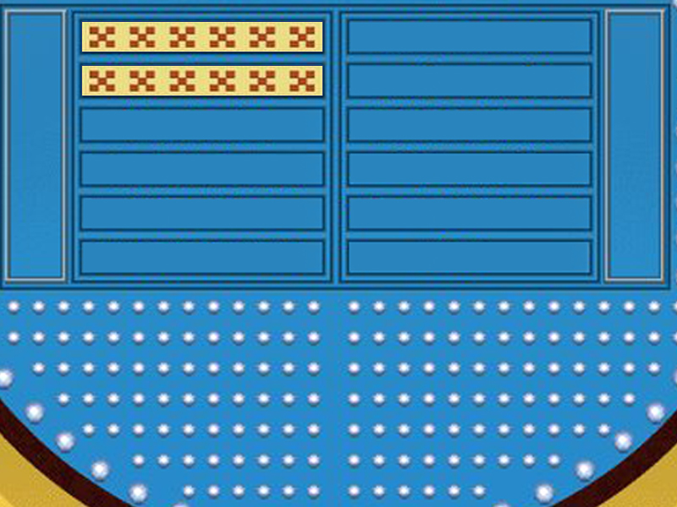
Top Two Answers To The Most Difficult Thing A Mother Or Wife Must Ever Endure?

Slide 5
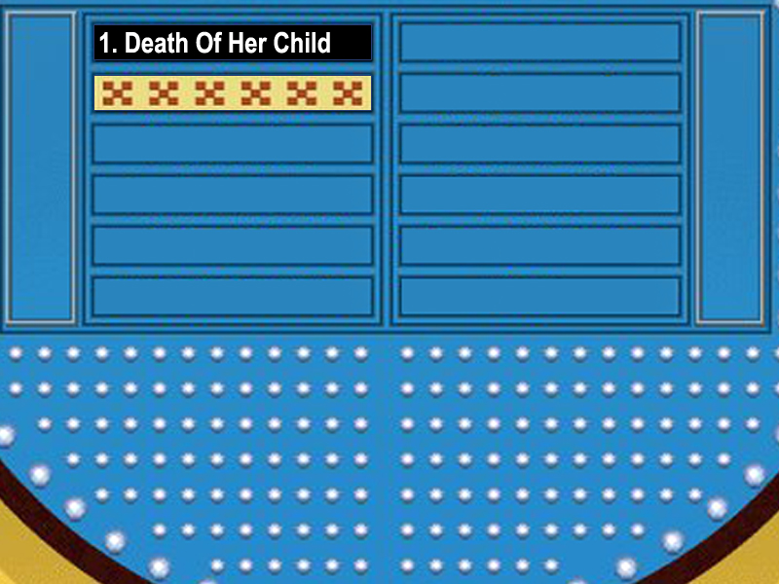
Top Two Answers To The Most Difficult Thing A Mother Or Wife Must Ever Endure?

Slide 6
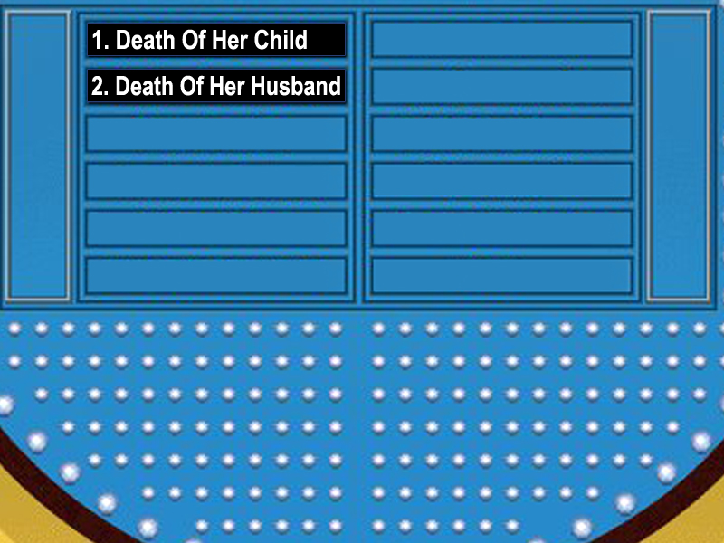
Top Two Answers To The Most Difficult Thing A Mother Or Wife Must Ever Endure?

Slide 8
Ruth 1:1 Now it came to pass in the days when the judges ruled, that there was a famine in the land. And a certain man of Bethlehemjudah went to sojourn in the country of Moab, he, and his wife, and his two sons.

Slide 9
JUDGES RULED!
Judges 21:25 In those days there was no king in Israel: every man did that which was right in his own eyes.

Slide 10
THERE WAS FAMINE IN THE LAND!
1 Timothy 5:8 But if any provide not for his own, and specially for those of his own house, he hath denied the faith, and is worse than an infidel.

Slide 11
Ruth 1:2 And the name of the man was Elimelech, and the name of his wife Naomi, and the name of his two sons Mahlon and Chilion, Ephrathites of Bethlehemjudah. And they came into the country of Moab, and continued there.

Slide 12
ELIMELECH
“My God Is King”

Slide 13
NAOMI
“Sweet & Pleasant”

Slide 14
Ruth 1:3-4 3 And Elimelech Naomi's husband died; and she was left, and her two sons.
4 And they took them wives of the women of Moab; the name of the one was Orpah, and the name of the other Ruth: and they dwelled there about ten years.

Slide 15
Three Dead Husbands And Two Dead Sons
Ruth 1:5 And Mahlon and Chilion died also both of them; and the woman was left of her two sons and her husband.

Slide 17
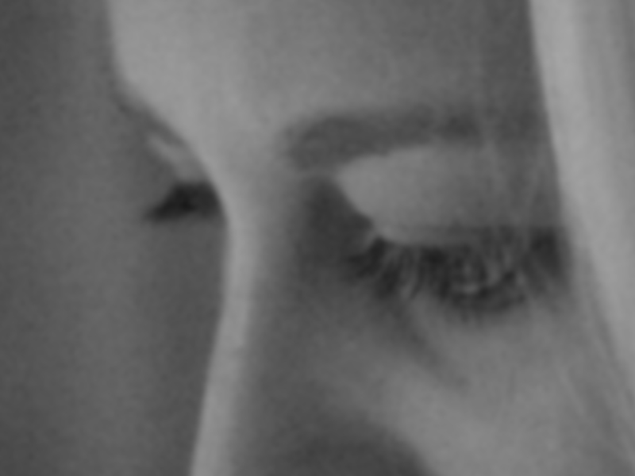

Slide 18


Slide 19

Know that God STILL LOVES YOU!
Ruth 1:6-7 6 Then she arose with her daughters in law, that she might return from the country of Moab: for she had heard in the country of Moab how that the LORD had visited his people in giving them bread.

Slide 20
Know that God STILL LOVES YOU!
Ruth 1:6-7
7 Wherefore she went forth out of the place where she was, and her two daughters in law with her; and they went on the way to return unto the land of Judah.

Slide 21
Be careful not to overlook the people THAT LOVE YOU AND CARE ABOUT YOU!
Ruth 1:8-15 8 And Naomi said unto her two daughters in law, Go, return each to her mother's house: the LORD deal kindly with you, as ye have dealt with the dead, and with me.

Slide 22
Be careful not to overlook the people THAT LOVE YOU AND CARE ABOUT YOU!
Ruth 1:8-15 9 The LORD grant you that ye may find rest, each of you in the house of her husband. Then she kissed them; and they lifted up their voice, and wept.

Slide 23
Be careful not to overlook the people THAT LOVE YOU AND CARE ABOUT YOU!
Ruth 1:8-15 10 And they said unto her, Surely we will return with thee unto thy people.
11 And Naomi said, Turn again, my daughters: why will ye go with me? are there yet any more sons in my womb, that they may be your husbands?

Slide 24
Be careful not to overlook the people THAT LOVE YOU AND CARE ABOUT YOU!
Ruth 1:8-15 12 Turn again, my daughters, go your way; for I am too old to have an husband. If I should say, I have hope, if I should have an husband also to night, and should also bear sons;

Slide 25
Be careful not to overlook the people THAT LOVE YOU AND CARE ABOUT YOU!
Ruth 1:8-15 13 Would ye tarry for them till they were grown? would ye stay for them from having husbands? nay, my daughters; for it grieveth me much for your sakes that the hand of the LORD is gone out against me.

Slide 26
Be careful not to overlook the people THAT LOVE YOU AND CARE ABOUT YOU!
Ruth 1:8-15 14 And they lifted up their voice, and wept again: and Orpah kissed her mother in law; but Ruth clave unto her.

Slide 27
Be careful not to overlook the people THAT LOVE YOU AND CARE ABOUT YOU!
Ruth 1:8-15 15 And she said, Behold, thy sister in law is gone back unto her people, and unto her gods: return thou after thy sister in law.

Slide 28
Don’t allow disappointments to blind you to the OPPORTUNITIES FOR HEALING!
Ruth 1:16-18 16 And Ruth said, Intreat me not to leave thee, or to return from following after thee: for whither thou goest, I will go; and where thou lodgest, I will lodge: thy people shall be my people, and thy God my God:

Slide 29
Don’t allow disappointments to blind you to the OPPORTUNITIES FOR HEALING!
Ruth 1:16-18 17 Where thou diest, will I die, and there will I be buried: the LORD do so to me, and more also, if ought but death part thee and me.

Slide 30
Don’t allow disappointments to blind you to the OPPORTUNITIES FOR HEALING!
Ruth 1:16-18 18 When she saw that she was stedfastly minded to go with her, then she left speaking unto her.

Slide 31
DON’T HIDE YOUR PAIN!
Ruth 1:19-20 19 So they two went until they came to Bethlehem. And it came to pass, when they were come to Bethlehem, that all the city was moved about them, and they said, Is this Naomi?

Slide 32
DON’T HIDE YOUR PAIN!
Ruth 1:19-20 20 And she said unto them, Call me not Naomi, call me Mara: for the Almighty hath dealt very bitterly with me.

Slide 33
DON’T HIDE YOUR PAIN!
The Secret Is Not To Hide Your Secret!
(pain)

Slide 34
TAKE PERSONAL RESPONSIBILITY!
Ruth 1:21 I went out full and the LORD hath brought me home again empty: why then call ye me Naomi, seeing the LORD hath testified against me, and the Almighty hath afflicted me?

Slide 35
TAKE PERSONAL RESPONSIBILITY!
Do your part
Remember your Ruths

Slide 36
Let’s Look At Them Again…
1. Know That God Still Loves You
2. Be Careful Not To Overlook The People That Love You & Care About You!
3. Don’t Allow Disappointments To Blind You To The Opportunities For Healing!
4. Don’t Hide Your Pain!
5. Take Personal Responsibility!

Slide 38


Slide 39


Slide 40

Ruth 1:22 So Naomi returned, and Ruth the Moabitess, her daughter in law, with her, which returned out of the country of Moab: and they came to Bethlehem in the beginning of barley harvest.

Slide 42


