Slide 1
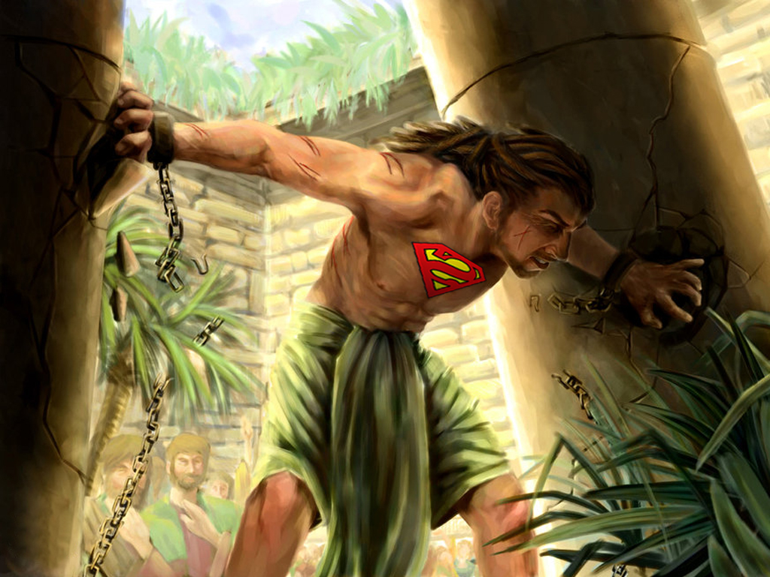



Slide 2
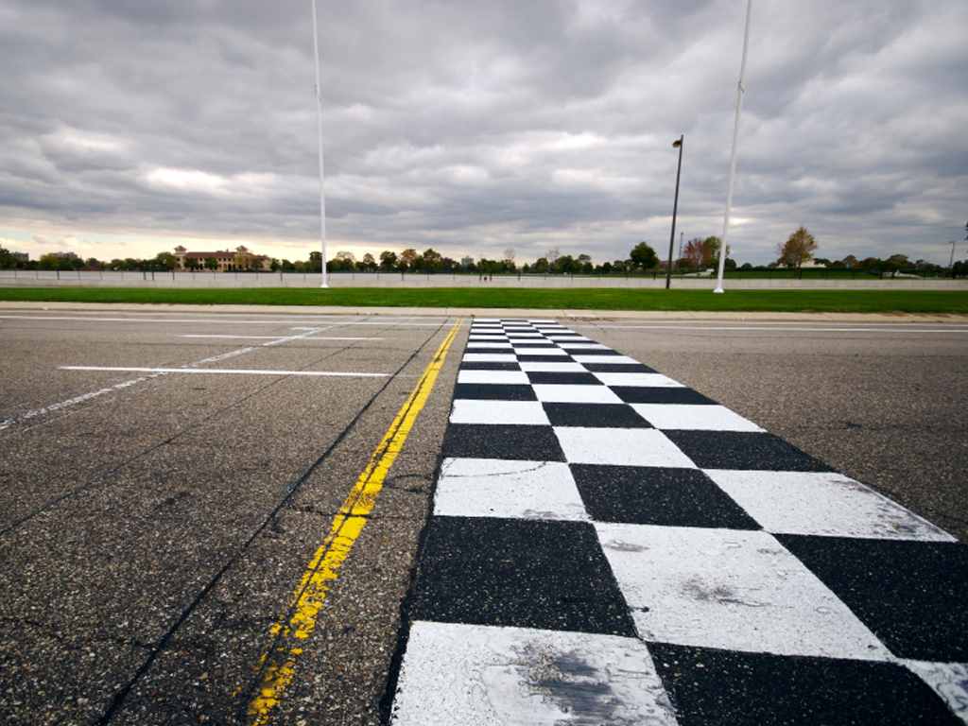




Slide 3

FINISH
To Bring To An End

Slide 4

FINISH DOESN’T ALWAYS MEAN TAKING THE CHECKERED FLAG

Slide 5
Finish Also Means:
The Gig Is Up
The Party’s Over
You’re History
You’re Toast
You’re Done
You’re Finished!

Slide 6
FINISHED
In German FERTIE STELLEN

Slide 7
FINISHED
In Greek TELEIOS

Slide 8
FINISHED
In French FINITION

Slide 9
FINISHED
In Portuguese ACABAMENTO

Slide 10
FINISHED
In Spanish TERMINAR

Slide 11
FINISHED
In Italian FINITURA

Slide 13
No Person Ever Born Had More Potential To Be A Spiritual Leader, Than Samson!

Slide 14
Physically, Samson Was The Strongest Man Who Ever Lived

Slide 15
Yet Samson Was One Of The Weakest Men Who Ever Lived…

Slide 16
SAMSON...
Was Self-Centered
Lacked Spiritual Commitment
Played Mind Games
Could Easily Be Played
Was Emotional And Given To Fits Of Anger And Rage

Slide 17
STRONG & WEAK AT THE SAME TIME!

Slide 18
Judges 16:1-3 ¹Then went Samson to Gaza, and saw there an harlot, and went in unto her.
²And it was told the Gazites, saying, Samson is come hither. And they compassed him in, and laid wait for him all night in the gate of the city, and were quiet all the night, saying, In the morning, when it is day, we shall kill him.

Slide 19
Judges 16:1-3 ³And Samson lay till midnight, and arose at midnight, and took the doors of the gate of the city, and the two posts, and went away with them, bar and all, and put them upon his shoulders, and carried them up to the top of an hill that is before Hebron.

Slide 21
1. HE GAVE HIS HEART AWAY
Proverbs 4:23 Keep thy heart with all diligence; for out of it are the issues of life.

Slide 22
1. HE GAVE HIS HEART AWAY
Who Did He Give It To?
Judges 16:4 And it came to pass afterward, that he loved a woman in the valley of Sorek, whose name was Delilah.

Slide 23
1. HE GAVE HIS HEART AWAY
Who Did He Give It To?
DELILAH...
Her Name Means “Lady Of The Night!”
Probably A High-Class Prostitute

Slide 24
1. HE GAVE HIS HEART AWAY
SAMSON...
His Name Means “Son Of The Morning!”

Slide 25
1. HE GAVE HIS HEART AWAY
So, The Son Of The Morning, Loved The Lady Of The Night!

Slide 26
1. HE GAVE HIS HEART AWAY
And Delilah Was From The Valley Of Sorek, Or “The Valley Of Wine”

Slide 27

1. HE GAVE HIS HEART AWAY
LETS TO THE MATH!
Samson
+ A Wild Woman
+ Wine
= A Big Haircut!

Slide 28
1. HE GAVE HIS HEART AWAY
Samson Gave His Heart Away…

Slide 29
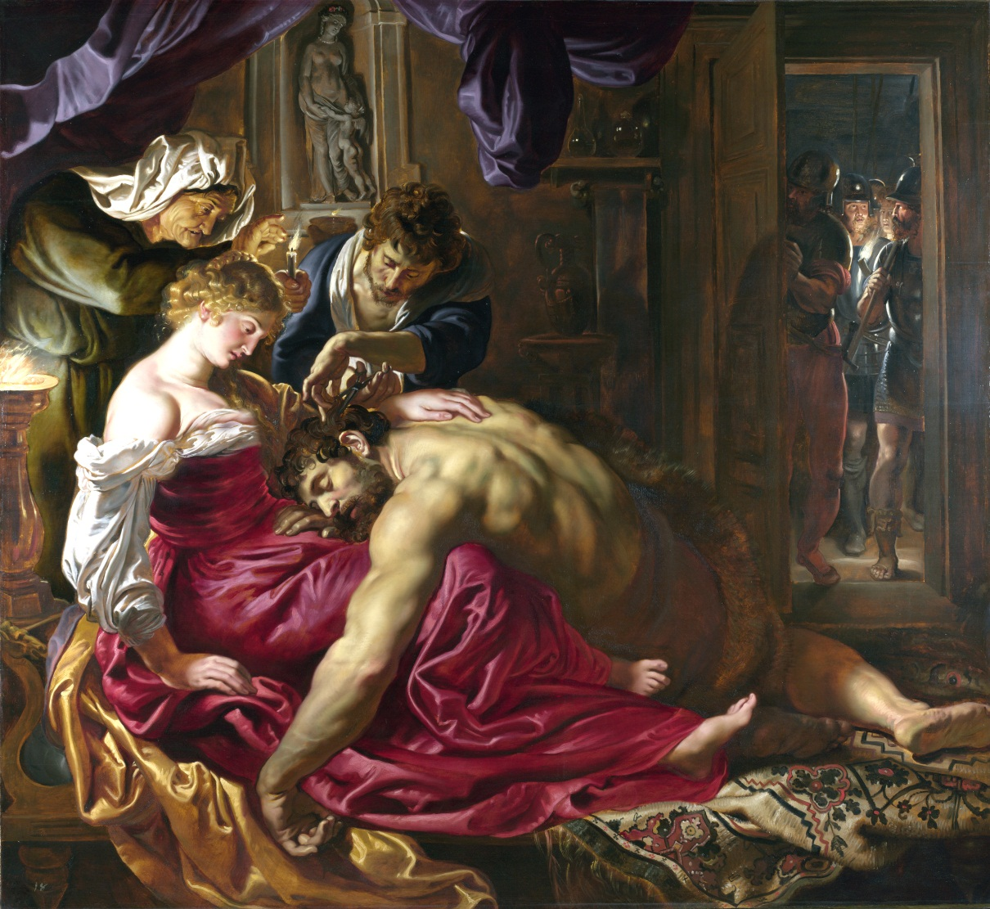
1. HE GAVE HIS HEART AWAY
She Sold Him Out, Because That’s What She Was All About!

Slide 30
1. HE GAVE HIS HEART AWAY
Judges 16:5-19 ⁵And the lords of the Philistines came up unto her, and said unto her, Entice him, and see wherein his great strength lieth, and by what means we may prevail against him, that we may bind him to afflict him; and we will give thee every one of us eleven hundred pieces of silver.

Slide 31
1. HE GAVE HIS HEART AWAY
Judges 16:5-19 ⁶And Delilah said to Samson, Tell me, I pray thee, wherein thy great strength lieth, and wherewith thou mightest be bound to afflict thee.
⁷And Samson said unto her, If they bind me with seven green withs that were never dried, then shall I be weak, and be as another man.

Slide 32
1. HE GAVE HIS HEART AWAY
Judges 16:5-19 ⁸Then the lords of the Philistines brought up to her seven green withs which had not been dried, and she bound him with them.

Slide 33
1. HE GAVE HIS HEART AWAY
Judges 16:5-19 ⁹Now there were men lying in wait, abiding with her in the chamber. And she said unto him, The Philistines be upon thee, Samson. And he brake the withs, as a thread of tow is broken when it toucheth the fire. So his strength was not known.

Slide 34
1. HE GAVE HIS HEART AWAY
Judges 16:5-19 ¹⁰And Delilah said unto Samson, Behold, thou hast mocked me, and told me lies: now tell me, I pray thee, wherewith thou mightest be bound.
¹¹And he said unto her, If they bind me fast with new ropes that never were occupied, then shall I be weak, and be as another man.

Slide 35
1. HE GAVE HIS HEART AWAY
Judges 16:5-19 ¹²Delilah therefore took new ropes, and bound him therewith, and said unto him, The Philistines be upon thee, Samson. And there were liers in wait abiding in the chamber. And he brake them from off his arms like a thread.

Slide 36
1. HE GAVE HIS HEART AWAY
Judges 16:5-19 ¹³And Delilah said unto Samson, Hitherto thou hast mocked me, and told me lies: tell me wherewith thou mightest be bound. And he said unto her, If thou weavest the seven locks of my head with the web.

Slide 37
1. HE GAVE HIS HEART AWAY
Judges 16:5-19 ¹⁴And she fastened it with the pin, and said unto him, The Philistines be upon thee, Samson. And he awaked out of his sleep, and went away with the pin of the beam, and with the web.

Slide 38
1. HE GAVE HIS HEART AWAY
Judges 16:5-19 ¹⁵And she said unto him, How canst thou say, I love thee, when thine heart is not with me? thou hast mocked me these three times, and hast not told me wherein thy great strength lieth.
¹⁶And it came to pass, when she pressed him daily with her words, and urged him, so that his soul was vexed unto death;

Slide 39
1. HE GAVE HIS HEART AWAY
Judges 16:5-19 ¹⁷That he told her all his heart, and said unto her, There hath not come a razor upon mine head; for I have been a Nazarite unto God from my mother's womb: if I be shaven, then my strength will go from me, and I shall become weak, and be like any other man.

Slide 40
1. HE GAVE HIS HEART AWAY
Judges 16:5-19 ¹⁸And when Delilah saw that he had told her all his heart, she sent and called for the lords of the Philistines, saying, Come up this once, for he hath shewed me all his heart. Then the lords of the Philistines came up unto her, and brought money in their hand.

Slide 41
1. HE GAVE HIS HEART AWAY
Judges 16:5-19 ¹⁹And she made him sleep upon her knees; and she called for a man, and she caused him to shave off the seven locks of his head; and she began to afflict him, and his strength went from him.

Slide 42


Slide 44
2. HE GAVE HIS FAITH AWAY
Judges 16:20 And she said, The Philistines be upon thee, Samson. And he awoke out of his sleep, and said, I will go out as at other times before, and shake myself. And he wist not that the LORD was departed from him.

Slide 45
2. HE GAVE HIS FAITH AWAY
ICHABOD...
The Glory Of The Lord Has Departed

Slide 46
2. HE GAVE HIS FAITH AWAY
1 Samuel 4:21a And she named the child Ichabod, saying, The glory is departed from Israel: because the ark of God was taken, and because of her father in law and her husband.

Slide 47
2. HE GAVE HIS FAITH AWAY
Samson Thought That He Could Do What He Had Always Done…

Slide 48
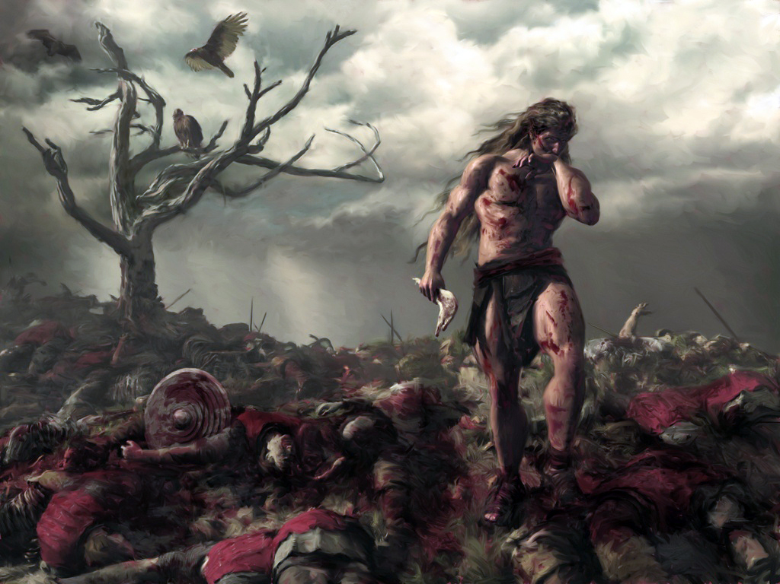
2. HE GAVE HIS FAITH AWAY
“I’ll Go Out And Shake Myself”

Slide 49
2. HE GAVE HIS FAITH AWAY
Remember What General Joshua Said...
Joshua 23:12-13 ¹²Else if ye do in any wise go back, and cleave unto the remnant of these nations, even these that remain among you, and shall make marriages with them, and go in unto them, and they to you:

Slide 50
2. HE GAVE HIS FAITH AWAY
Remember What General Joshua Said...
Joshua 23:12-13 ¹³Know for a certainty that the LORD your God will no more drive out any of these nations from before you; but they shall be snares and traps unto you, and scourges in your sides, and thorns in your eyes, until ye perish from off this good land which the LORD your God hath given you.

Slide 51
2. HE GAVE HIS FAITH AWAY
WHAT HAPPENED?
Judges 16:21 But the Philistines took him, and put out his eyes, and brought him down to Gaza, and bound him with fetters of brass; and he did grind in the prison house.
They Seized Him
They Gouged Out His Eyes
They Took Him To Gaza
They Bound Him In Shackles
They Set Him Grinding Like An Animal

Slide 52
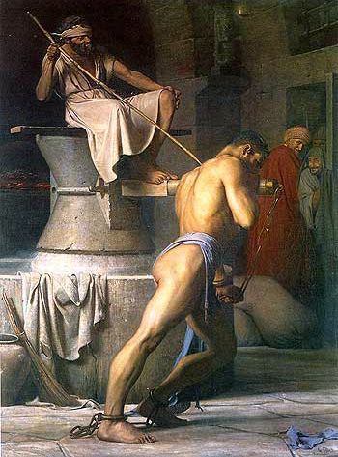
2. HE GAVE HIS FAITH AWAY
WHAT HAPPENED?
NO STRENGTH
NO VISION
NO DIRECTION
NO FREEDOM

Slide 53
2. HE GAVE HIS FAITH AWAY
John 15:5 I am the vine, ye are the branches: He that abideth in me, and I in him, the same bringeth forth much fruit: FOR WITHOUT ME YE CAN DO NOTHING.

Slide 54


Slide 56
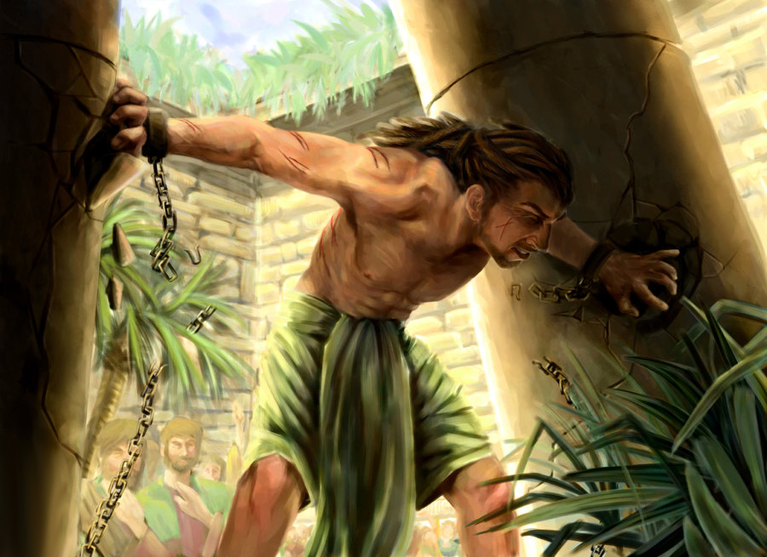
3. HE GAVE HIS LIFE AWAY

Slide 57
3. HE GAVE HIS LIFE AWAY
Judges 16:22-31 ²²Howbeit the hair of his head began to grow again after he was shaven.
²³Then the lords of the Philistines gathered them together for to offer a great sacrifice unto Dagon their god, and to rejoice: for they said, Our god hath delivered Samson our enemy into our hand.

Slide 58
3. HE GAVE HIS LIFE AWAY
Judges 16:22-31 ²⁴And when the people saw him, they praised their god: for they said, Our god hath delivered into our hands our enemy, and the destroyer of our country, which slew many of us.

Slide 59
3. HE GAVE HIS LIFE AWAY
Judges 16:22-31 ²⁵And it came to pass, when their hearts were merry, that they said, Call for Samson, that he may make us sport. And they called for Samson out of the prison house; and he made them sport: and they set him between the pillars.

Slide 60
3. HE GAVE HIS LIFE AWAY
Judges 16:22-31 ²⁶And Samson said unto the lad that held him by the hand, Suffer me that I may feel the pillars whereupon the house standeth, that I may lean upon them.

Slide 61
3. HE GAVE HIS LIFE AWAY
Judges 16:22-31 ²⁷Now the house was full of men and women; and all the lords of the Philistines were there; and there were upon the roof about three thousand men and women, that beheld while Samson made sport.

Slide 62
3. HE GAVE HIS LIFE AWAY
Judges 16:22-31 ²⁸And Samson called unto the LORD, and said, O Lord God, remember me, I pray thee, and strengthen me, I pray thee, only this once, O God, that I may be at once avenged of the Philistines for my two eyes.

Slide 63
3. HE GAVE HIS LIFE AWAY
Judges 16:22-31 ²⁹And Samson took hold of the two middle pillars upon which the house stood, and on which it was borne up, of the one with his right hand, and of the other with his left.

Slide 64
3. HE GAVE HIS LIFE AWAY
Judges 16:22-31 ³⁰And Samson said, Let me die with the Philistines. And he bowed himself with all his might; and the house fell upon the lords, and upon all the people that were therein. So the dead which he slew at his death were more than they which he slew in his life.

Slide 65
3. HE GAVE HIS LIFE AWAY
Judges 16:22-31 ³¹Then his brethren and all the house of his father came down, and took him, and brought him up, and buried him between Zorah and Eshtaol in the buryingplace of Manoah his father. And he judged Israel twenty years.

Slide 66


Slide 68
DO YOU WANT TO FINISH STRONG?
KEEP YOUR HEART
KEEP THE FAITH
KEEP LIVING FOR JESUS CHRIST

Slide 69
A STRONG FINISH!

