Slide 1
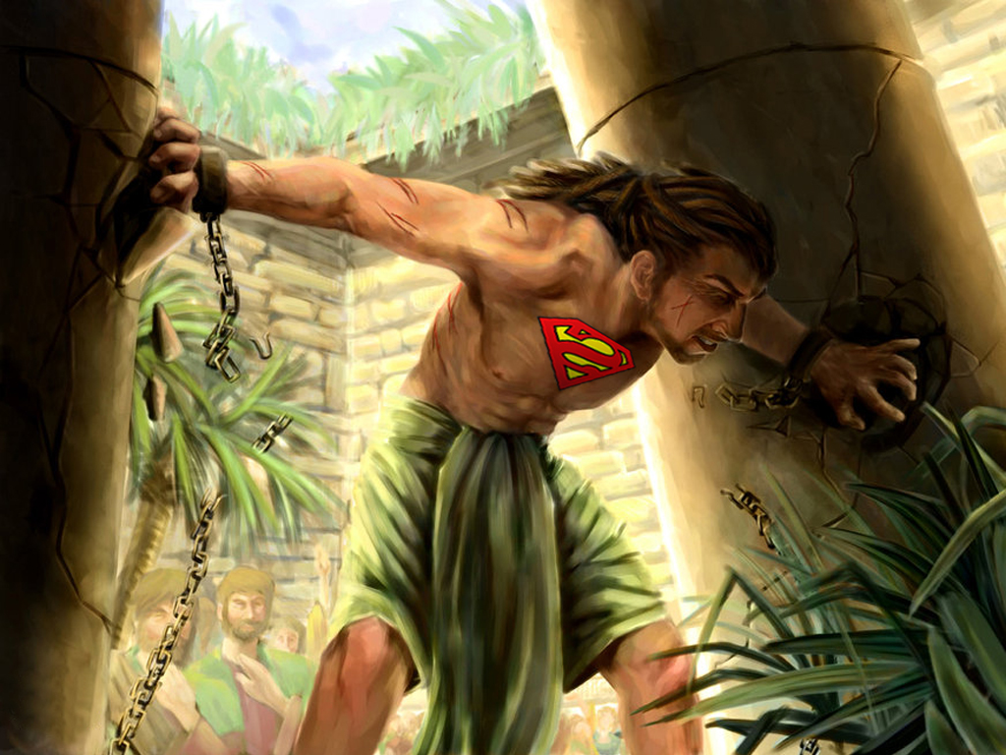



Slide 2
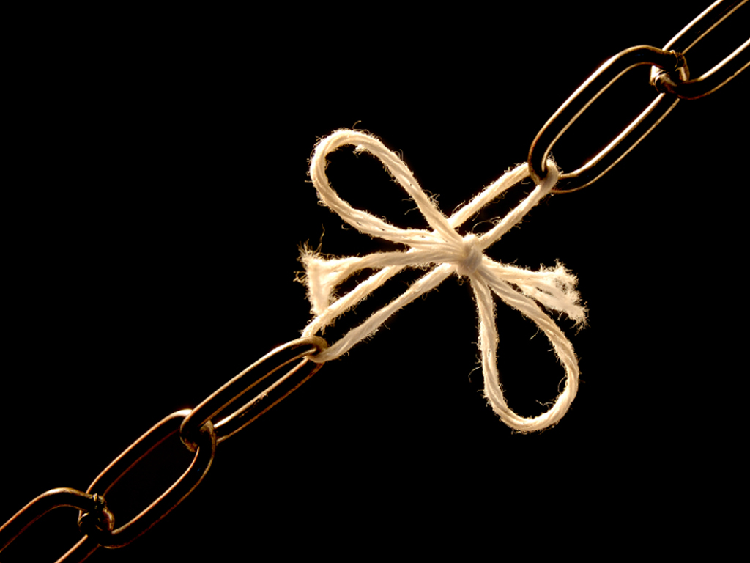




Slide 3

SAMSON HAD A STRONG BEGINNING!

Slide 4
No Child Ever Born Had A Better Start And More Potential To Be A Spiritual Leader, Than Samson!

Slide 5
SAMSON:
Was A Child Born Of Prayer
His Birth Came As A Direct Result Of A Visit From The Angel Of The Lord
He Was Raised By A Mom & Dad Who Were Sensitive & Obedient To God
He Was A Nazarite, Set Apart For A Particular Spiritual (Righteous) Purpose

Slide 6
NOT TOO GOOD!
Well… How Did He Do?

Slide 8
Judges 14:1-4 ¹And Samson went down to Timnath, and saw a woman in Timnath of the daughters of the Philistines.
²And he came up, and told his father and his mother, and said, I have seen a woman in Timnath of the daughters of the Philistines: now therefore get her for me to wife.

Slide 9
Judges 14:1-4 ³Then his father and his mother said unto him, Is there never a woman among the daughters of thy brethren, or among all my people, that thou goest to take a wife of the uncircumcised Philistines? And Samson said unto his father, Get her for me; for she pleaseth me well.

Slide 10
Judges 14:1-4 ⁴But his father and his mother knew not that it was of the LORD, that he sought an occasion against the Philistines: for at that time the Philistines had dominion over Israel.

Slide 11
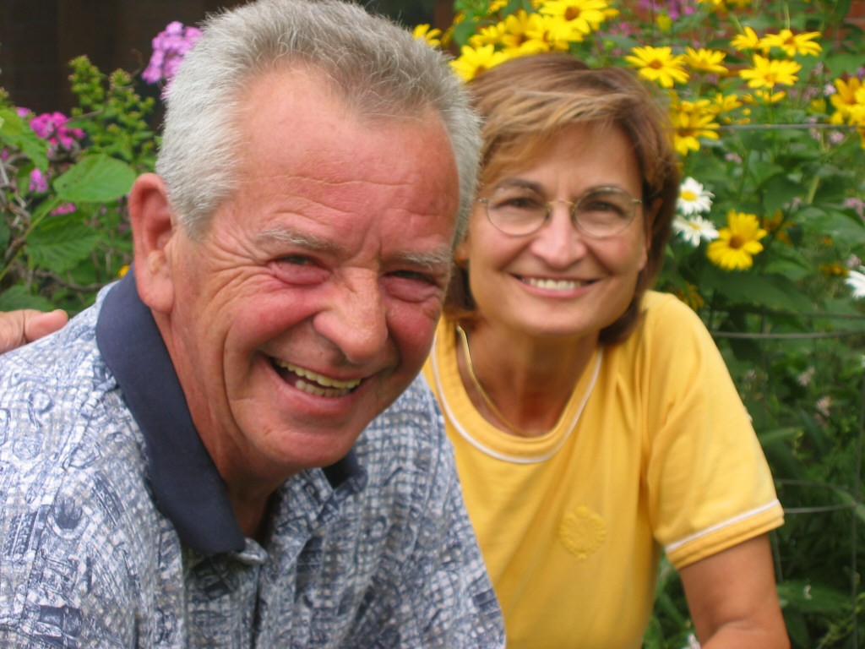

A
STRONG
WEAKNESS
PARENTS
SELF-CENTERED
I’ll Do What I Want And I’ll Get What I Want!!!

Slide 12
Judges 14:5-10 ⁵Then went Samson down, and his father and his mother, to Timnath, and came to the vineyards of Timnath: and, behold, a young lion roared against him.
⁶And the Spirit of the LORD came mightily upon him, and he rent him as he would have rent a kid, and he had nothing in his hand: but he told not his father or his mother what he had done.

Slide 13
Judges 14:5-10 ⁷And he went down, and talked with the woman; and she pleased Samson well.
⁸And after a time he returned to take her, and he turned aside to see the carcase of the lion: and, behold, there was a swarm of bees and honey in the carcase of the lion.

Slide 14
Judges 14:5-10 ⁹And he took thereof in his hands, and went on eating, and came to his father and mother, and he gave them, and they did eat: but he told not them that he had taken the honey out of the carcase of the lion.
¹⁰So his father went down unto the woman: and Samson made there a feast; for so used the young men to do.

Slide 15
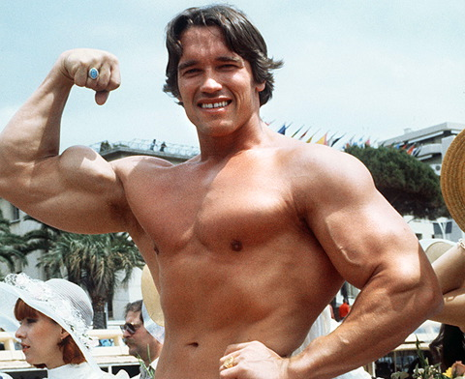
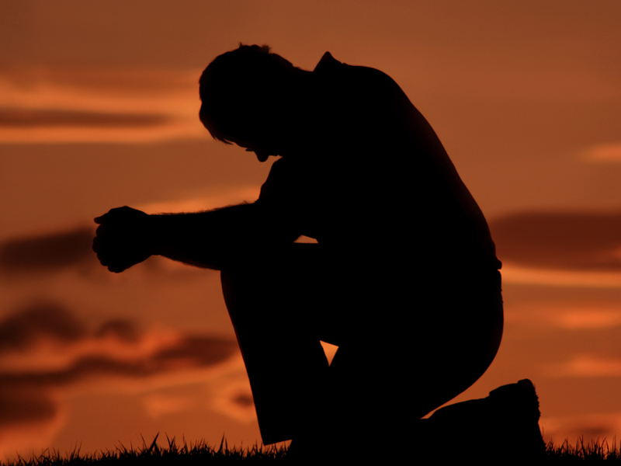
A
STRONG
WEAKNESS
PHYSICALLY
SPIRITUALLY
Carnally Minded And Lacking Spiritual Commitment

Slide 16
Judges 14:11-14 ¹¹And it came to pass, when they saw him, that they brought thirty companions to be with him.
¹²And Samson said unto them, I will now put forth a riddle unto you: if ye can certainly declare it me within the seven days of the feast, and find it out, then I will give you thirty sheets and thirty change of garments:

Slide 17
Judges 14:11-14 ¹³But if ye cannot declare it me, then shall ye give me thirty sheets and thirty change of garments. And they said unto him, Put forth thy riddle, that we may hear it.
¹⁴And he said unto them, Out of the eater came forth meat, and out of the strong came forth sweetness. And they could not in three days expound the riddle.

Slide 18

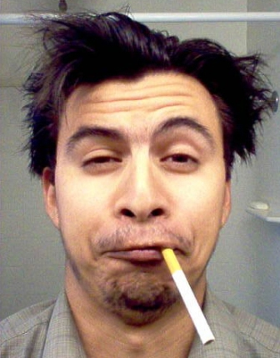
A
STRONG
WEAKNESS
INTELLECTUALLY
FOOLISH
Playing Mind Games

Slide 19
Judges 14:15-18 ¹⁵And it came to pass on the seventh day, that they said unto Samson's wife, Entice thy husband, that he may declare unto us the riddle, lest we burn thee and thy father's house with fire: have ye called us to take that we have? is it not so?

Slide 20
Judges 14:15-18 ¹⁶And Samson's wife wept before him, and said, Thou dost but hate me, and lovest me not: thou hast put forth a riddle unto the children of my people, and hast not told it me. And he said unto her, Behold, I have not told it my father nor my mother, and shall I tell it thee?

Slide 21
Judges 14:15-18 ¹⁷And she wept before him the seven days, while their feast lasted: and it came to pass on the seventh day, that he told her, because she lay sore upon him: and she told the riddle to the children of her people.

Slide 22
Judges 14:15-18 ¹⁸And the men of the city said unto him on the seventh day before the sun went down, What is sweeter than honey? And what is stronger than a lion? and he said unto them, If ye had not plowed with my heifer, ye had not found out my riddle.

Slide 23
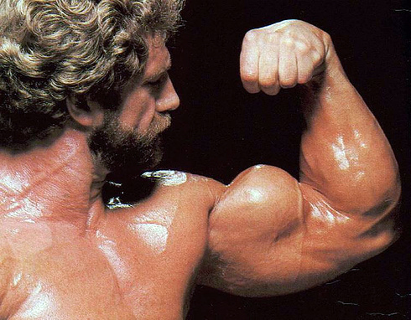
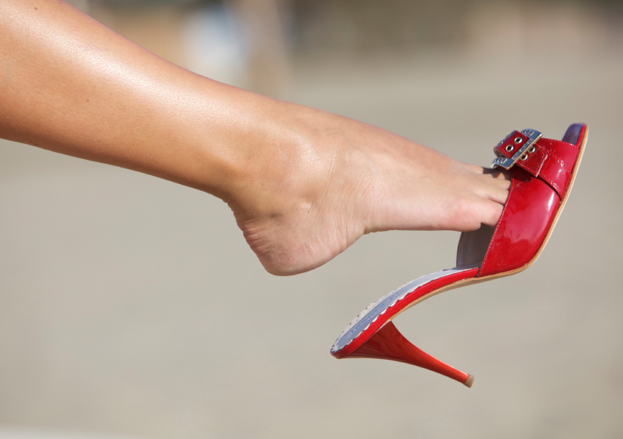
A
STRONG
WEAKNESS
OUTWARDLY
INWARDLY
He Could Be Played… Especially By A Woman

Slide 24

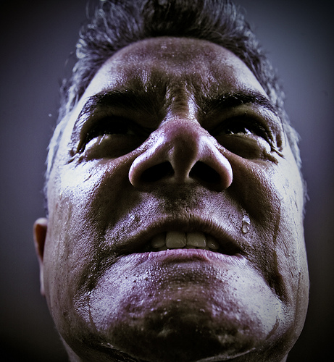
A
STRONG
WEAKNESS
POWER
SELF-CONTROL
Emotional And Given To Fits Of Anger And Rage

Slide 25
STRONG
WEAKNESS
POWER
SELF-CONTROL
Judges 14:19-20 ¹⁹And the Spirit of the LORD came upon him, and he went down to Ashkelon, and slew thirty men of them, and took their spoil, and gave change of garments unto them which expounded the riddle. And his anger was kindled, and he went up to his father's house.

Slide 26
STRONG
WEAKNESS
POWER
SELF-CONTROL
Judges 14:19-20 ²⁰But Samson's wife was given to his companion, whom he had used as his friend.

Slide 27
STRONG
WEAKNESS
POWER
SELF-CONTROL
Judges 15:1-8 ¹But it came to pass within a while after, in the time of wheat harvest, that Samson visited his wife with a kid; and he said, I will go in to my wife into the chamber. But her father would not suffer him to go in.

Slide 28
STRONG
WEAKNESS
POWER
SELF-CONTROL
Judges 15:1-8 ²And her father said, I verily thought that thou hadst utterly hated her; therefore I gave her to thy companion: is not her younger sister fairer than she? take her, I pray thee, instead of her.

Slide 29
STRONG
WEAKNESS
POWER
SELF-CONTROL
Judges 15:1-8 ³And Samson said concerning them, Now shall I be more blameless than the Philistines, though I do them a displeasure.
⁴And Samson went and caught three hundred foxes, and took firebrands, and turned tail to tail, and put a firebrand in the midst between two tails.

Slide 30
STRONG
WEAKNESS
POWER
SELF-CONTROL
Judges 15:1-8 ⁵And when he had set the brands on fire, he let them go into the standing corn of the Philistines, and burnt up both the shocks, and also the standing corn, with the vineyards and olives.

Slide 31
STRONG
WEAKNESS
POWER
SELF-CONTROL
Judges 15:1-8 ⁶Then the Philistines said, Who hath done this? And they answered, Samson, the son in law of the Timnite, because he had taken his wife, and given her to his companion. And the Philistines came up, and burnt her and her father with fire.

Slide 32
STRONG
WEAKNESS
POWER
SELF-CONTROL
Judges 15:1-8 ⁷And Samson said unto them, Though ye have done this, yet will I be avenged of you, and after that I will cease.
⁸And he smote them hip and thigh with a great slaughter: and he went down and dwelt in the top of the rock Etam.

Slide 33
STRONG
WEAKNESS
POWER
SELF-CONTROL
Judges 15:9-11 ⁹Then the Philistines went up, and pitched in Judah, and spread themselves in Lehi.
¹⁰And the men of Judah said, Why are ye come up against us? And they answered, To bind Samson are we come up, to do to him as he hath done to us.

Slide 34
STRONG
WEAKNESS
POWER
SELF-CONTROL
Judges 15:9-11 ¹¹Then three thousand men of Judah went to the top of the rock Etam, and said to Samson, Knowest thou not that the Philistines are rulers over us? what is this that thou hast done unto us? And he said unto them, As they did unto me, so have I done unto them.

Slide 35
STRONG
WEAKNESS
POWER
SELF-CONTROL
Judges 15:12-20 ¹²And they said unto him, We are come down to bind thee, that we may deliver thee into the hand of the Philistines. And Samson said unto them, Swear unto me, that ye will not fall upon me yourselves.

Slide 36
STRONG
WEAKNESS
POWER
SELF-CONTROL
Judges 15:12-20 ¹³And they spake unto him, saying, No; but we will bind thee fast, and deliver thee into their hand: but surely we will not kill thee. And they bound him with two new cords, and brought him up from the rock.

Slide 37
STRONG
WEAKNESS
POWER
SELF-CONTROL
Judges 15:12-20 ¹⁴And when he came unto Lehi, the Philistines shouted against him: and the Spirit of the LORD came mightily upon him, and the cords that were upon his arms became as flax that was burnt with fire, and his bands loosed from off his hands.

Slide 38
STRONG
WEAKNESS
POWER
SELF-CONTROL
Judges 15:12-20 ¹⁵And he found a new jawbone of an ass, and put forth his hand, and took it, and slew a thousand men therewith.
¹⁶And Samson said, With the jawbone of an ass, heaps upon heaps, with the jaw of an ass have I slain a thousand men.

Slide 39
STRONG
WEAKNESS
POWER
SELF-CONTROL
Judges 15:12-20 ¹⁷And it came to pass, when he had made an end of speaking, that he cast away the jawbone out of his hand, and called that place Ramathlehi.

Slide 40
STRONG
WEAKNESS
POWER
SELF-CONTROL
Judges 15:12-20 ¹⁸And he was sore athirst, and called on the LORD, and said, Thou hast given this great deliverance into the hand of thy servant: and now shall I die for thirst, and fall into the hand of the uncircumcised?

Slide 41
STRONG
WEAKNESS
POWER
SELF-CONTROL
Judges 15:12-20 ¹⁹But God clave an hollow place that was in the jaw, and there came water thereout; and when he had drunk, his spirit came again, and he revived: wherefore he called the name thereof Enhakkore, which is in Lehi unto this day.
²⁰And he judged Israel in the days of the Philistines twenty years.

Slide 43
A
STRONG
WEAKNESS
PARENTS
SELF-CENTERED
Good Advice And Good Direction
I’ll Do What I Want And I’ll Get What I Want!!!

Slide 44
STRONG
WEAKNESS
PHYSICALLY
SPIRITUALLY
Carnally Minded And Lacking Spiritual Commitment
In Excellent Shape

Slide 45
STRONG
WEAKNESS
INTELLECTUALLY
FOOLISH
Bright And Knowledgeable
Playing Mind Games

Slide 46
STRONG
WEAKNESS
OUTWARDLY
INWARDLY
Incredibly Attractive
Can Easily Be Played

Slide 47
STRONG
WEAKNESS
POWER
SELF-CONTROL
Mighty And Strong
Emotional And Given To Fits Of Anger And Rage

Slide 48
Ephesians 6:10-13 ¹⁰Finally, my brethren, be strong in the Lord, and in the power of his might.
¹¹Put on the whole armour of God, that ye may be able to stand against the wiles of the devil.
¹²For we wrestle not against flesh and blood, but against principalities, against powers, against the rulers of the darkness of this world, against spiritual wickedness in high places.

Slide 49
Ephesians 6:10-13 ¹³Wherefore take unto you the whole armour of God, that ye may be able to withstand in the evil day, and having done all, to stand.

Slide 51
BE STRONG!

Slide 52


