Slide 1
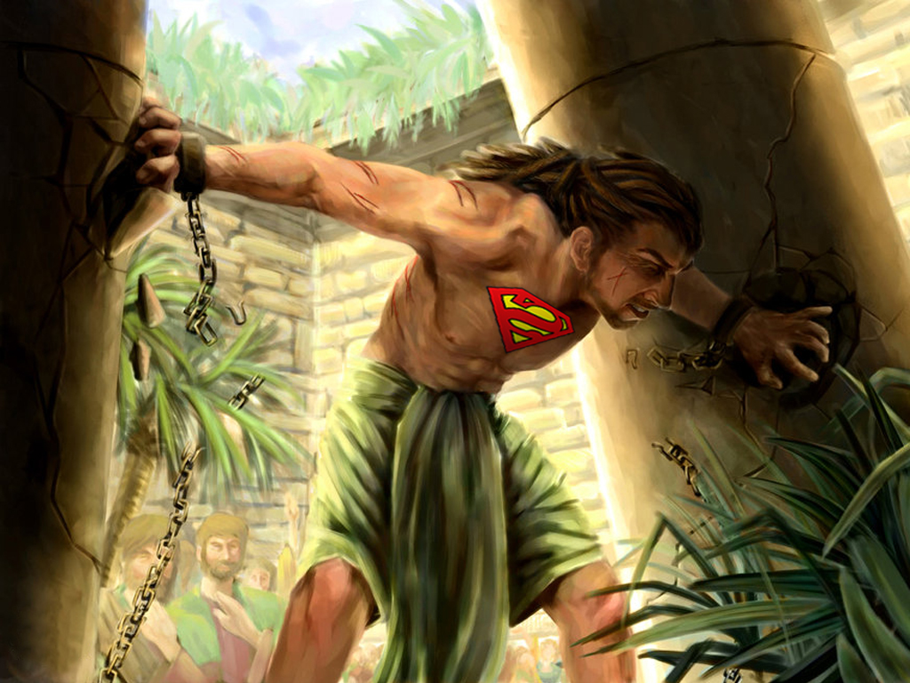



Slide 2
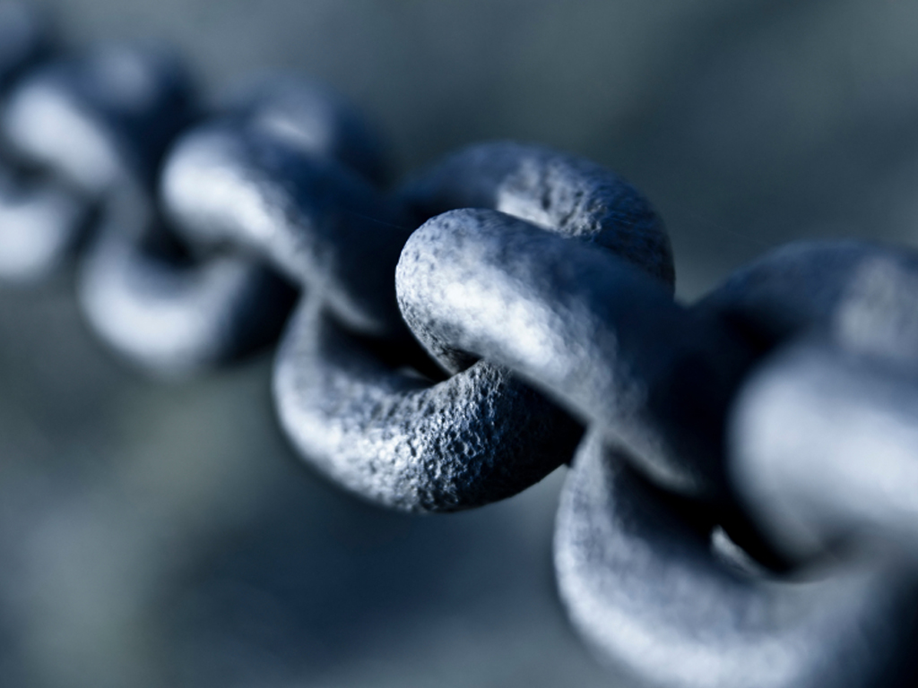



Slide 3
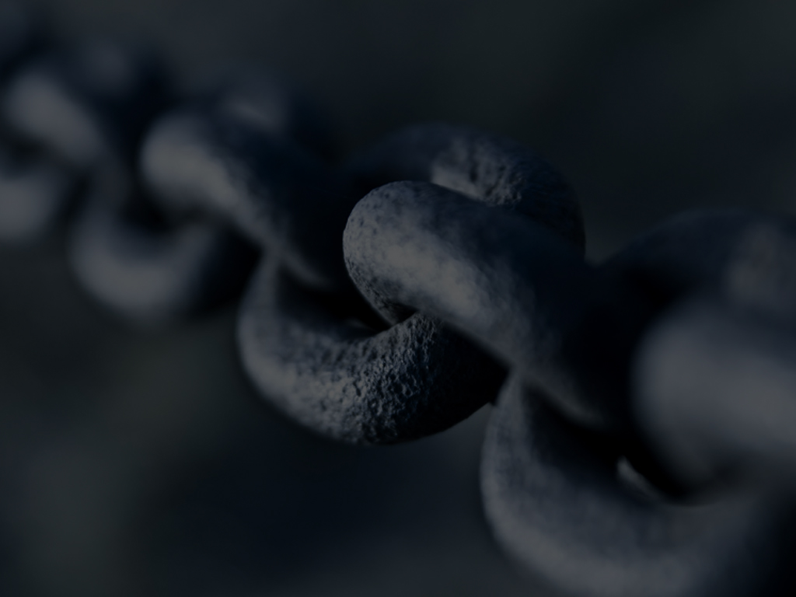
CHOOSE TO DO IT!
What Did Joshua Tell The Children Of Israel?

Slide 4
Joshua 23:12-13 ¹²Else if ye do in any wise go back, and cleave unto the remnant of these nations, even these that remain among you, and shall make marriages with them, and go in unto them, and they to you:

Slide 5
Joshua 23:12-13 ¹³KNOW for a certainty that the LORD your God will no more drive out any of these nations from before you; but they shall be snares and traps unto you, and scourges in your sides, and thorns in your eyes, until ye perish from off this good land which the LORD your God hath given you.

Slide 6

Know If You Go Back…
God WILL NOT Fight For You
God WILL Fight Against You

Slide 7
Joshua 23:14-15 ¹⁴And, behold, this day I am going the way of all the earth: and ye know in all your hearts and in all your souls, that not one thing hath failed of all the good things which the LORD your God spake concerning you; all are come to pass unto you, and not one thing hath failed thereof.

Slide 8
Joshua 23:14-15 ¹⁵Therefore it shall come to pass, that as all good things are come upon you, which the LORD your God promised you; so shall the LORD bring upon you all evil things, until he have destroyed you from off this good land which the LORD your God hath given you.

Slide 9
Joshua 23:16 When ye have transgressed the covenant of the LORD your God, which he commanded you, and have gone and served other gods, and bowed yourselves to them; then shall the anger of the LORD be kindled against you, and ye shall perish quickly from off the good land which he hath given unto you.

Slide 10
CHOOSE TO DO IT!

Slide 11
Its Your Move!

Slide 12
Joshua 24:15 And if it seem evil unto you to serve the LORD, choose you this day whom ye will serve; whether the gods which your fathers served that were on the other side of the flood, or the gods of the Amorites, in whose land ye dwell: but as for me and my house, we will serve the LORD.

Slide 13
YOUR CHOICE WILL BE A WITNESS AGAINST YOU!

Slide 14
Joshua 24:21-22 ²¹And the people said unto Joshua, Nay; but we will serve the LORD.
²²And Joshua said unto the people, Ye are witnesses against yourselves that ye have chosen you the LORD, to serve Him. And they said, WE ARE WITNESSES.

Slide 15
Judges 13:1 And the children of Israel did evil again in the sight of the LORD; and the LORD delivered them into the hand of the Philistines forty years.

Slide 16
THE CYCLES OF THE BOOK OF JUDGES
Each Cycle Is Complete In Itself And Contains The Same Six Things!
1. Israel would sin, and begin worshiping idols

Slide 17
THE CYCLES OF THE BOOK OF JUDGES
Each Cycle Is Complete In Itself And Contains The Same Six Things!
2. God would allow their neighboring enemies to dominate and rule over them

Slide 18
THE CYCLES OF THE BOOK OF JUDGES
Each Cycle Is Complete In Itself And Contains The Same Six Things!
3. Israel would cry out to God for deliverance and repent of their sins

Slide 19
THE CYCLES OF THE BOOK OF JUDGES
Each Cycle Is Complete In Itself And Contains The Same Six Things!
4. God would raise up a deliverer (Judge) who would enjoy peace and prosperity

Slide 20
THE CYCLES OF THE BOOK OF JUDGES
Each Cycle Is Complete In Itself And Contains The Same Six Things!
5. Israel would enjoy peace and prosperity until the deliverer (Judge) would die

Slide 21
THE CYCLES OF THE BOOK OF JUDGES
Each Cycle Is Complete In Itself And Contains The Same Six Things!
6. Israel would then fall back into sin, back into idolatry, and back into bondage

Slide 22
SOUND FAMILIAR?

Slide 23
Romans 8:5-9 ⁵For they that are after the flesh do mind the things of the flesh; but they that are after the Spirit the things of the Spirit.
⁶For to be carnally minded is death; but to be spiritually minded is life and peace.
⁷Because the carnal mind is enmity against God: for it is not subject to the law of God, neither indeed can be.

Slide 24
Romans 8:5-9 ⁸So then they that are in the flesh cannot please God.
⁹But ye are not in the flesh, but in the Spirit, if so be that the Spirit of God dwell in you. Now if any man have not the Spirit of Christ, he is none of his.

Slide 25
Galatians 5:16-17 ¹⁶This I say then, Walk in the Spirit, and ye shall not fulfil the lust of the flesh.
¹⁷For the flesh lusteth against the Spirit, and the Spirit against the flesh: and these are contrary the one to the other: so that ye cannot do the things that ye would.

Slide 27
SAMSON IS THE SEVENTH & LAST CYCLE OF JUDGES
Judges 13:1 And the children of Israel did evil again in the sight of the LORD; and the LORD delivered them into the hand of the Philistines forty years.

Slide 28
PHILISTINES
A War-Like People Who Migrated From The Land Of Egypt
They Settled Along The Coastline Of The Mediterranean Sea
They Were Seamingly Impossible To Defeat And Remained Israel’s Enemy For Centuries

Slide 29
TWO WAYS THE PHILISTINES CONTINUED TO OVERCOME ISRAEL
Through Trade
Through Intermarriage

Slide 30
They Dominated Them Through Economic And Physical Seduction

Slide 31
MONEY & SEX STILL DOES THAT TODAY!

Slide 33
No Child Ever Born Had A Better Start And More Potential To Be A Spiritual Leader, Than Samson!

Slide 34
Judges 13:2-3 ²And there was a certain man of Zorah, of the family of the Danites, whose name was Manoah; and his wife was barren, and bare not.
³And the angel of the LORD appeared unto the woman, and said unto her, Behold now, thou art barren, and bearest not: but thou shalt conceive, and bear a son.

Slide 35
SAMSON:
Was A Child Born Of Prayer
Came As A Direct Result Of A Visit From The Angel Of The Lord
Would Be Raised By Parents Who Were Sensitive & Obedient To God
His Family Was Blessed And Uniquely Visited By The Lord

Slide 36
If Samson’s Life Teaches Us Anything, It’s That Children (Even With The Strongest Spiritual Beginning ) Can Plunge Headlong Into Carnality And Immorality, IF THEY SO CHOOSE!

Slide 37
Samson Would Be A NAZARITE From Conception

Slide 38
Even Momma Had To “BEWARE”
Judges 13:4 Now therefore beware, I pray thee, and drink not wine nor strong drink, and eat not any unclean thing:

Slide 39
A NAZARITE Was A Form Of Sanctification “A Setting Apart For A Particular Spiritually RIGHTEOUS Purpose”

Slide 40
Judges 13:5-7 ⁵For, lo, thou shalt conceive, and bear a son; and no razor shall come on his head: for the child shall be a Nazarite unto God from the womb: and he shall begin to deliver Israel out of the hand of the Philistines.

Slide 41
Judges 13:5-7 ⁶Then the woman came and told her husband, saying, A man of God came unto me, and his countenance was like the countenance of an angel of God, very terrible: but I asked him not whence he was, neither told he me his name:

Slide 42
Judges 13:5-7 ⁷But he said unto me, Behold, thou shalt conceive, and bear a son; and now drink no wine nor strong drink, neither eat any unclean thing: for the child shall be a Nazarite to God from the womb to the day of his death.

Slide 43
A NAZARITE OBSERVED THREE PARTICULAR RULES
1. Cannot Touch A Dead Body Of Any Kind
2. Cannot Drink Wine, Strong Drink, Or Have Contact With Fruit Of The Vine
3 . Cannot Cut Their Hair

Slide 44
A NAZARITE OBSERVED THREE PARTICULAR RULES
This Was Usually Not For Life, But For A Specific Time Period And Purpose

Slide 45
FOR SAMSON IT WAS FOR LIFE!
From The Womb To The Tomb!

Slide 47
DADDY PRAYS...
Judges 13:8 Then Manoah intreated the LORD, and said, O my Lord, let the man of God which thou didst send come again unto us, and teach us what we shall do unto the child that shall be born.

Slide 48
GOD ANSWERS DADDY’S PRAYER...
Judges 13:9-14 ⁹And God hearkened to the voice of Manoah; and the angel of God came again unto the woman as she sat in the field: but Manoah her husband was not with her.
¹⁰And the woman made haste, and ran, and shewed her husband, and said unto him, Behold, the man hath appeared unto me, that came unto me the other day.

Slide 49
GOD ANSWERS DADDY’S PRAYER...
Judges 13:9-14 ¹¹And Manoah arose, and went after his wife, and came to the man, and said unto him, Art thou the man that spakest unto the woman? And he said, I am.
¹²And Manoah said, Now let thy words come to pass. How shall we order the child, and how shall we do unto him?

Slide 50
GOD ANSWERS DADDY’S PRAYER...
Judges 13:9-14 ¹³And the angel of the LORD said unto Manoah, Of all that I said unto the woman let her beware.
¹⁴She may not eat of any thing that cometh of the vine, neither let her drink wine or strong drink, nor eat any unclean thing: all that I commanded her let her observe.

Slide 51
DADDY OFFERS A SACRIFICE TO THE LORD...
Judges 13:15-21 ¹⁵And Manoah said unto the angel of the LORD, I pray thee, let us detain thee, until we shall have made ready a kid for thee.
¹⁶And the angel of the LORD said unto Manoah, Though thou detain me, I will not eat of thy bread: and if thou wilt offer a burnt offering, thou must offer it unto the LORD. For Manoah knew not that he was an angel of the LORD.

Slide 52
DADDY OFFERS A SACRIFICE TO THE LORD...
Judges 13:15-21 ¹⁷And Manoah said unto the angel of the LORD, What is thy name, that when thy sayings come to pass we may do thee honour?
¹⁸And the angel of the LORD said unto him, Why askest thou thus after my name, seeing it is secret?
¹⁹So Manoah took a kid with a meat offering, and offered it upon a rock unto the LORD: and the angel did wonderously; and Manoah and his wife looked on.

Slide 53
DADDY OFFERS A SACRIFICE TO THE LORD...
Judges 13:15-21 ²⁰For it came to pass, when the flame went up toward heaven from off the altar, that the angel of the LORD ascended in the flame of the altar. And Manoah and his wife looked on it, and fell on their faces to the ground.
²¹But the angel of the LORD did no more appear to Manoah and to his wife. Then Manoah knew that he was an angel of the LORD.

Slide 54
MOMMA HELPS DADDY CALM DOWN…
Judges 13:22-23 ²²And Manoah said unto his wife, We shall surely die, because we have seen God.
²³But his wife said unto him, If the LORD were pleased to kill us, he would not have received a burnt offering and a meat offering at our hands, neither would he have shewed us all these things, nor would as at this time have told us such things as these.

Slide 55
SAMSON IS BORN...
Judges 13:24-25 ²⁴And the woman bare a son, and called his name Samson: and the child grew, and the LORD blessed him.
²⁵And the Spirit of the LORD began to move him at times in the camp of Dan between Zorah and Eshtaol.

Slide 56
IT’S YOUR CHOICE!

Slide 57
BEWARE Of The Seduction Of Money & Sex!

Slide 58
AVOID The Vicious Cycle Of Judgment

Slide 59
SET Yourself Apart For God

Slide 60
KNOW God Isn’t Out To Kill You, But To Bless You!

