Slide 1
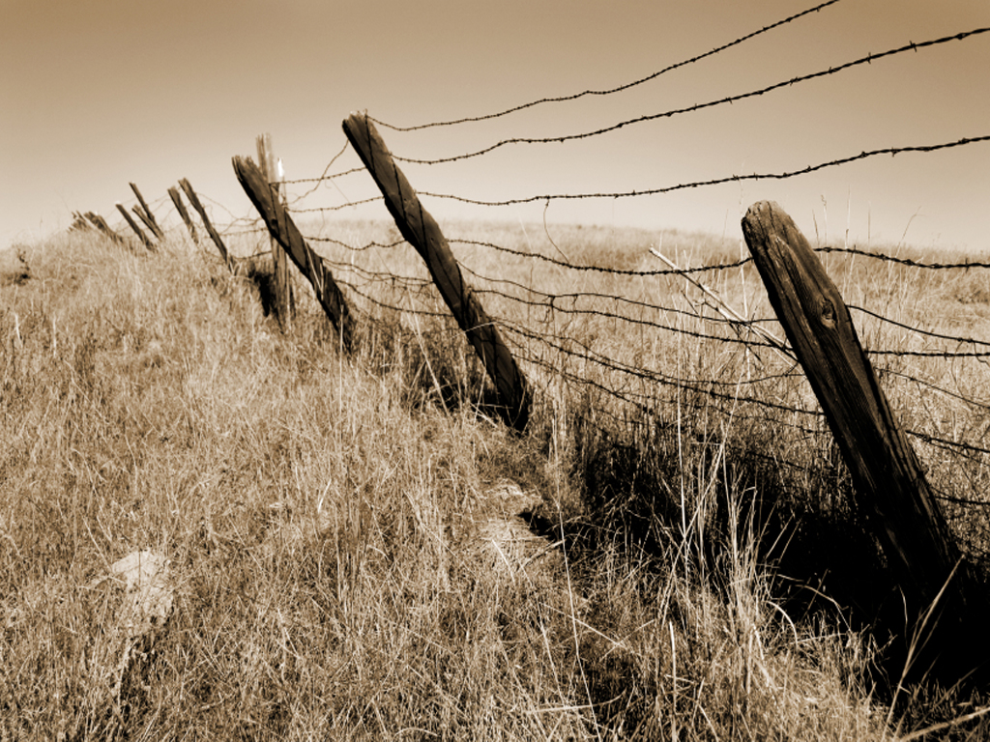
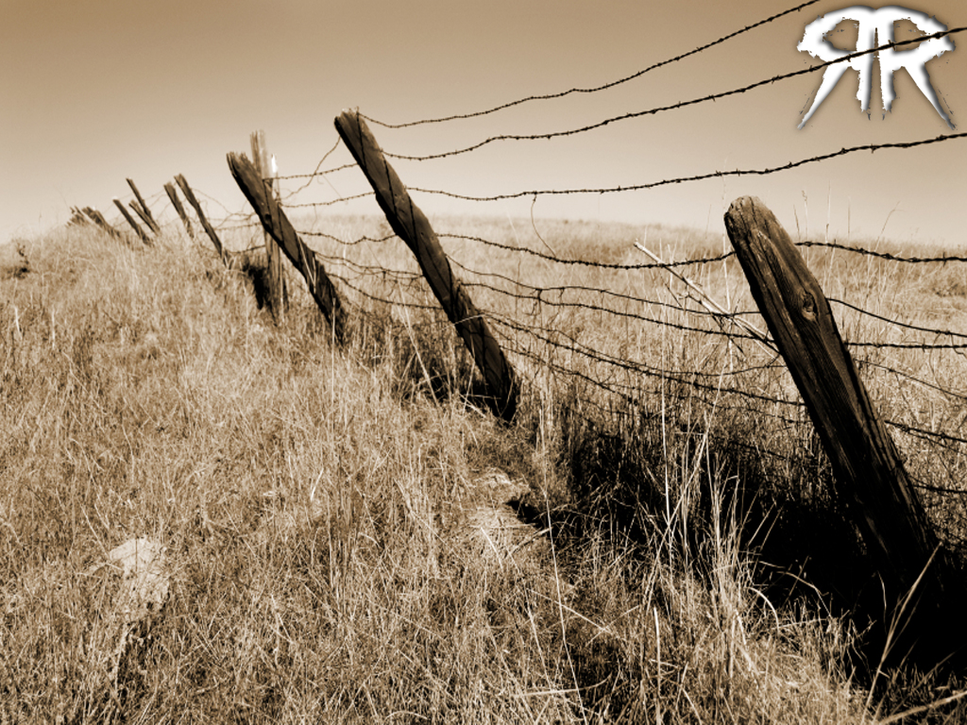



Slide 2
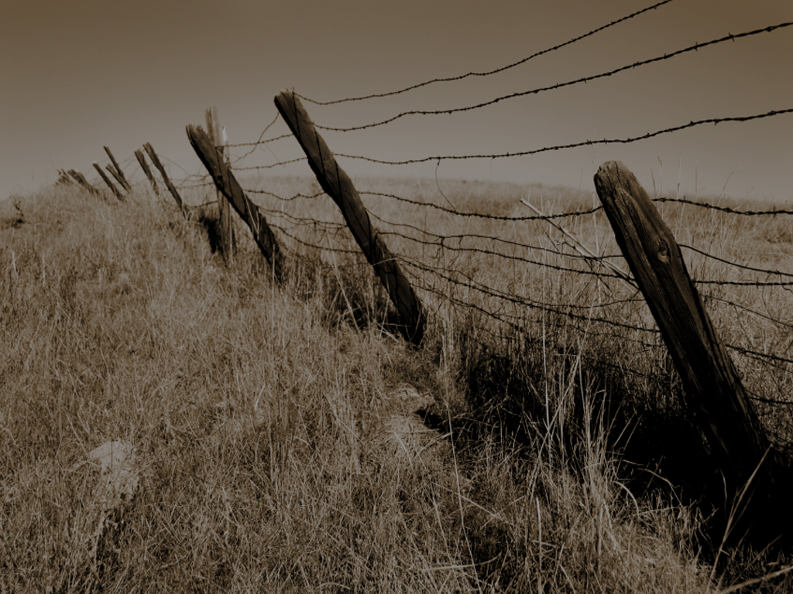



Slide 3

James 4:13-14 ¹³ Go to now, ye that say, To day or to morrow we will go into such a city, and continue there a year, and buy and sell, and get gain:
¹⁴ Whereas ye know not what shall be on the morrow. For what is your life? It is even a vapour, that appeareth for a little time, and then vanisheth away.

Slide 4
we don’t know what’s going to happen tomorrow…

Slide 5
we don’t even know if we’re gonna be here tomorrow!

Slide 6
James 4:15 For that ye ought to say, If the Lord will, we shall live, and do this, or that.
Today is all we’ve been given

Slide 7
James 4:16 But now ye rejoice in your boastings: all such rejoicing is evil.
Presuming On Tomorrow Is Evil

Slide 8
James 4:17 Therefore to him that knoweth to do good, and doeth it not, to him it is sin.
Not Doing Good Today Is Sin!

Slide 9
life becomes so much more precious to people when they are about to lose it!

Slide 10
WHY?
Because They Don’t Have Much Time Left!

Slide 11
what makes you think you do?

Slide 12
You Don’t Have To Lose It To Live It
This is the only day I know I have
I’m alive, so I know I’ve got this one!

Slide 14
BE SAVED TODAY!
2 Corinthians 6:2 (For he saith, I have heard thee in a time accepted, and in the day of salvation have I succoured thee: behold, now is the accepted time; behold, now is the day of salvation.)

Slide 15
GET RIGHT WITH GOD TODAY!
1 John 1:9 If we confess our sins, He is faithful and just to forgive us our sins, and to cleanse us from all unrighteousness.

Slide 16
GET RIGHT WITH OTHERS TODAY!
Matthew 5:23-24 ²³ Therefore if thou bring thy gift to the altar, and there rememberest that thy brother hath ought against thee;

Slide 17
GET RIGHT WITH OTHERS TODAY!
Matthew 5:23-24 ²⁴ Leave there thy gift before the altar, and go thy way; first be reconciled to they brother, and then come and offer thy gift.

Slide 18
LOVE FAMILY & FRIENDS TODAY
1 John 4:7 Beloved, let us love one another: for love is of God; and every one that loveth is born of God, and knoweth God.

Slide 19
LOVE FAMILY & FRIENDS TODAY
1 John 4:11 Beloved, if God so loved us, we ought also to love one another.

Slide 20
ENCOURAGE SOMEONE TODAY!
3 John 2 Beloved, I wish above all things that thou mayest prosper and be in health, even as thy soul prosperous.

Slide 21
GIVE SOMETHING AWAY TODAY!
2 Corinthians 9:7 Every man according as he purposeth in his heart, so let him give; not grudgingly, or of necessity: for God loveth a cheerful giver.

Slide 22
TOMORROW REALLY NEVER COMES…

