Slide 1
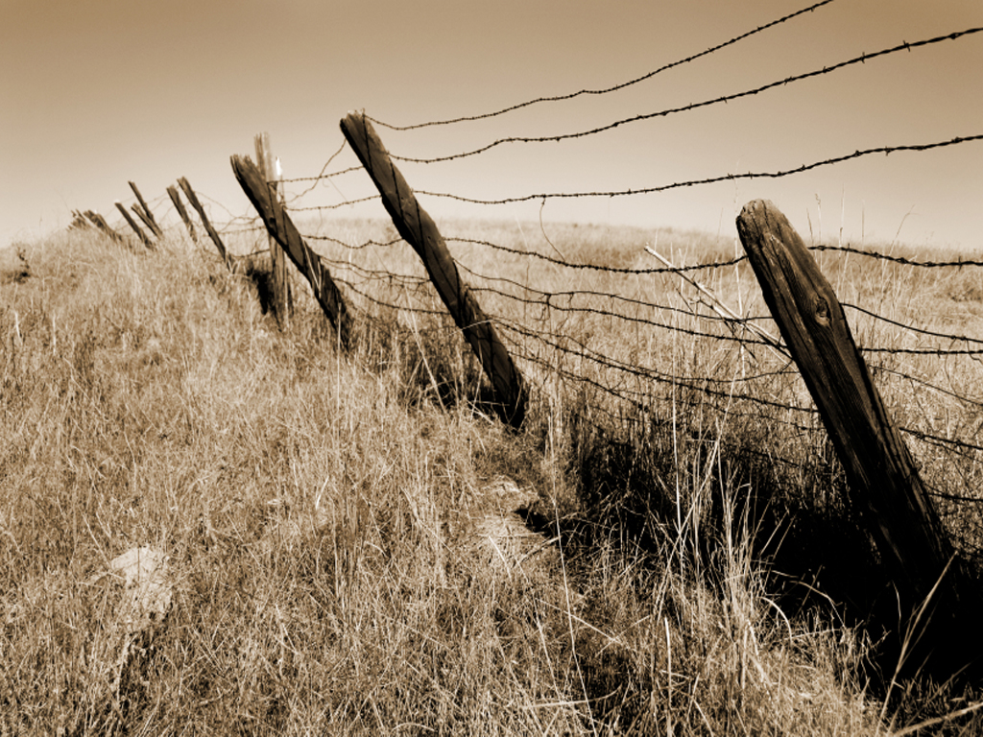
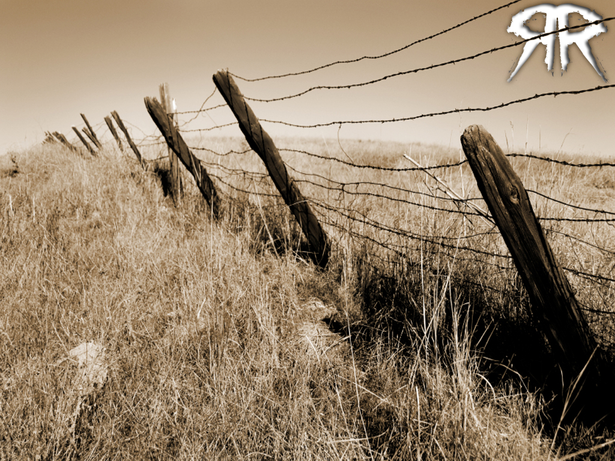
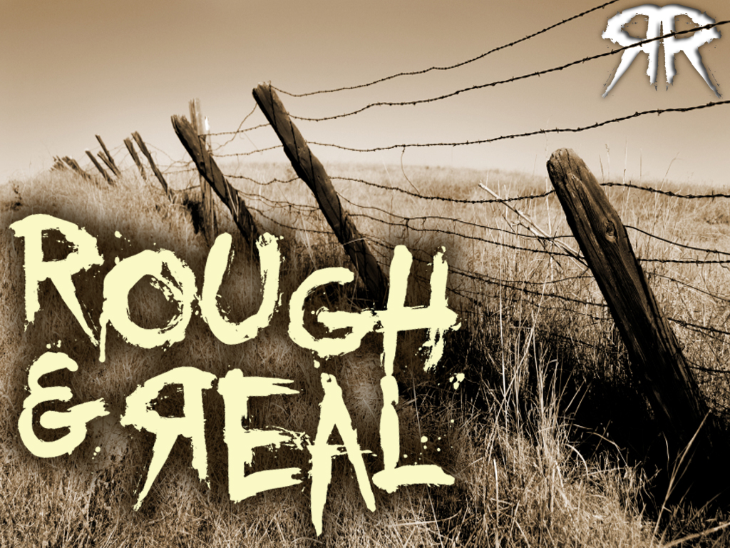


Slide 2
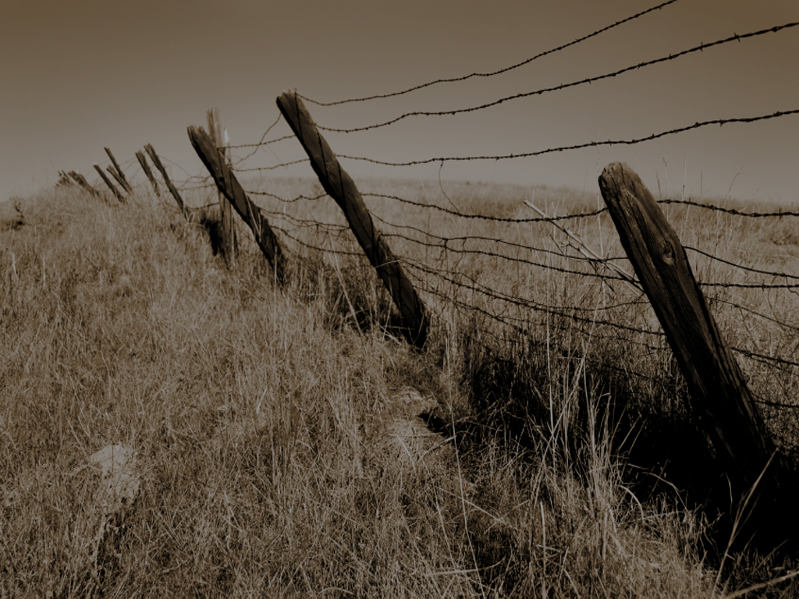



Slide 3
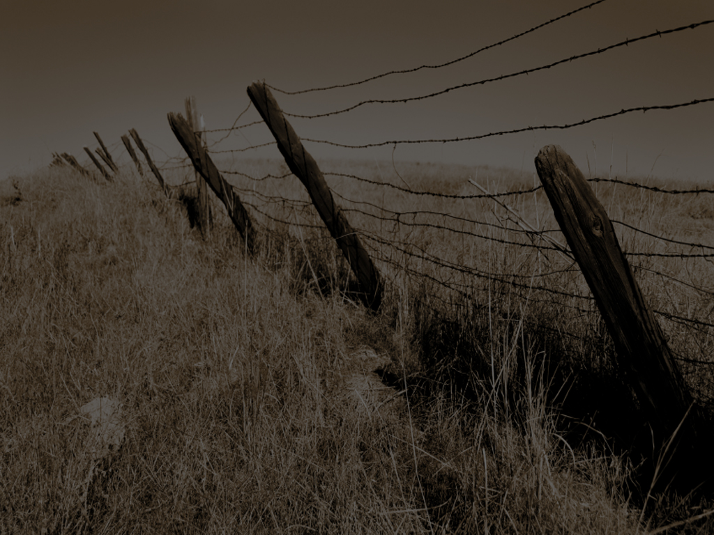
1
THE WAR THAT RAGES
The Fighting And Personal Wars We Face Are From Within

Slide 4
1
THE WAR THAT RAGES
James 4:1
From whence come wars and fightings among you? Come they not hence, even your lusts that war in your members.

Slide 5
1
THE WAR THAT RAGES
OUR FLESH (sin nature)
1 Peter 2:11
Dearly beloved, I beseech you as strangers and pilgrims, abstain from fleshly lusts, which war against the soul;

Slide 6
1
THE WAR THAT RAGES
OUR FLESH (sin nature)
Galatians 5:17
For the flesh lusteth against the Spirit, and the Spirit against the flesh: and these are contrary the one to the other: so that ye cannot do the things that ye would.

Slide 7
1
THE WAR THAT RAGES
Our Biggest Problem Is Us!

Slide 8
1
THE WAR THAT RAGES
Our Own Members, Our Eyes, Our Ears, Our Feet, Our Mind, Our Desires, Our Will, Our Emotions…

Slide 9
1
THE WAR THAT RAGES
The Person We Have The Most Trouble With, Spiritually,
IS US!

Slide 10
1
THE WAR THAT RAGES
There Is A War Going On And It Is Within Us…

Slide 11
1
THE WAR THAT RAGES
IT IS RAGING!

Slide 12
1
THE WAR THAT RAGES
Yielding To The Flesh
Is A Dead-End
James 4:2
Ye lust, and have not: ye kill, and desire to have, and cannot obtain: ye fight and war, yet ye have not, because ye ask not.

Slide 13
1
THE WAR THAT RAGES
Yielding To The Flesh
Is A Dead-End
We Lust, We Kill, We Desire, We Fight, We War…

Slide 14
1
THE WAR THAT RAGES
Yielding To The Flesh
Is A Dead-End
You Name It, We Do It – And We Still Aren’t Happy!

Slide 15
1
THE WAR THAT RAGES
Yielding To The Flesh
Is A Dead-End
THE FLESH
WILL NEVER BE SATISFIED!

Slide 16
1
THE WAR THAT RAGES
Yielding To The Flesh
Is A Dead-End
The Flesh Says Fight, Lust And Struggle…

Slide 17
1
THE WAR THAT RAGES
Yielding To The Flesh
Is A Dead-End
The Spirit Says Pray!
Jesus Said “Pray Ye Enter Not Into Temptation”

Slide 18
1
THE WAR THAT RAGES
We Even Pray In The Flesh
James 4:3
Ye ask, and receive not, because ye ask amiss, that ye may consume it upon your lusts.

Slide 19
1
THE WAR THAT RAGES
We Even Pray In The Flesh
Our Motives
When We Pray Are Often Not Pure

Slide 20
1
THE WAR THAT RAGES
We Even Pray In The Flesh
Our Prayers Are So Often Misguided And Selfish

Slide 21
1
THE WAR THAT RAGES
We Even Pray In The Flesh
Just Saying A Little ‘Lay Me Down To Sleep’ Prayer Ain’t Gonna Cut It!

Slide 22
1
THE WAR THAT RAGES
We Choose To Obey The Flesh
James 4:4
Ye adulterers and adulteresses, know ye not that the friendship of the world is enmity with God? Whoseover, therefore will be a friend of the world is the enemy of God.

Slide 23
1
THE WAR THAT RAGES
We Choose To Obey The Flesh
When We Choose To Obey The Flesh And Desire This World’s System Over A Real Friendship And Intimacy With God, God Calls This Spiritual Adultery!
(two-timing on God!)

Slide 24
1
THE WAR THAT RAGES
We Choose To Obey The Flesh
CHEATING ON
OUR SO-CALLED RELATIONSHIP
WITH THE LORD JESUS CHRIST

Slide 25
1
THE WAR THAT RAGES
Our Own Spirit, Not THE
HOLY SPIRIT, Lusts To Envy
James 4:5
Do ye think that the scripture saith in vain, the spirit that dwelleth in us lusteth to envy?

Slide 26
1
THE WAR THAT RAGES
Our Own Spirit, Not THE
HOLY SPIRIT, Lusts To Envy
The Idea Is,
That Out Own Imaginations Are Evil Continually

Slide 27
1
THE WAR THAT RAGES
Our Own Spirit, Not THE
HOLY SPIRIT, Lusts To Envy
Genesis 6:5
And God saw that the wickedness of man was great in the earth, and that every imagination of the thoughts of his heart was only evil continually.

Slide 28
1
THE WAR THAT RAGES
Our Own Spirit, Not THE
HOLY SPIRIT, Lusts To Envy
Genesis 8:21
And the LORD smelled a sweet savour; and the LORD said in his heart, I will not again curse the ground any more for man’s sake; for the imagination of man’s heart is evil from his youth; neither will I again smite any more every thing living, as I have done.

Slide 29
1
THE WAR THAT RAGES
Our Own Spirit, Not THE
HOLY SPIRIT, Lusts To Envy
There Is A War That Rages Within Us
ACCEPT THIS FACT!

Slide 30
2
THERE IS A WAY OUT
AND IT IS REPENTANCE
How Can I Fight This Battle?

Slide 31
2
THERE IS A WAY OUT
AND IT IS REPENTANCE
How Can I
Be Spiritually Victorious?

Slide 32
2
THERE IS A WAY OUT
AND IT IS REPENTANCE
Stop Thinking You Are Big Stuff – Humble Yourself Before The Lord
James 4:6
But He giveth more grace. Wherefore He saith, God resisteth the proud, but giveth grace unto the humble.

Slide 33
2
THERE IS A WAY OUT
AND IT IS REPENTANCE
Submit Yourself, Your Life, Your Future, Your Everything To The Lord – Turn Totally To God
James 4:7a
Submit yourselves therefore to God. Resist the devil, and he will flee from you.

Slide 34
2
THERE IS A WAY OUT
AND IT IS REPENTANCE
Resist The Devil
James 4:7b
Submit yourselves therefore to God. Resist the devil, and he will flee from you.

Slide 35
2
THERE IS A WAY OUT
AND IT IS REPENTANCE
Resist The Devil
Your Conscious, Everyday Submission To God Is Resisting
The devil!

Slide 36
2
THERE IS A WAY OUT
AND IT IS REPENTANCE
Resist The Devil
When You Turn To God, You Are Turning Your Back On satan

Slide 37
2
THERE IS A WAY OUT
AND IT IS REPENTANCE
Resist The Devil
THEY ARE TOTALLY OPPOSITE!

Slide 38
2
THERE IS A WAY OUT
AND IT IS REPENTANCE
Get Real Close To God
James 4:8
Draw nigh to God, and he will draw nigh to you. Cleanse your hands, ye sinners; and purify your hearts, ye double minded.

Slide 39
2
THERE IS A WAY OUT
AND IT IS REPENTANCE
Get Real Close To God
This Is Done Through The Word, Prayer
And Worship!

Slide 40
2
THERE IS A WAY OUT
AND IT IS REPENTANCE
Get Real Close To God
BE ABSOLUTELY REAL AND SINCERE!

Slide 41
2
THERE IS A WAY OUT
AND IT IS REPENTANCE
Repent Of Known Sin And Areas Of Weakness In Your Life
James 4:9
Be afflicted, and mourn, and weep: let your laughter be turned to mourning, and your joy to heaviness.

Slide 42
2
THERE IS A WAY OUT
AND IT IS REPENTANCE
Repent Of Known Sin And Areas Of Weakness In Your Life
Call It Sin
Weep Over Your Sin
Stop Thinking It’s Funny! CRY!

Slide 43
2
THERE IS A WAY OUT
AND IT IS REPENTANCE
Repent Of Known Sin And Areas Of Weakness In Your Life
SAD AIN’T BAD WHEN YOU’RE SAD OVER SIN!

Slide 44
2
THERE IS A WAY OUT
AND IT IS REPENTANCE
Continue To Stay Humble
Down Before The
Feet Of The Lord, Under His Authority

Slide 45
2
THERE IS A WAY OUT
AND IT IS REPENTANCE
Continue To Stay Humble
James 4:10
Humble yourselves in the sight of the Lord, and He shall lift you up.

Slide 46
2
THERE IS A WAY OUT
AND IT IS REPENTANCE
Continue To Stay Humble
Job 22:29
when men are cast down, they though shalt say, There is a lifting upl and He shall save the humble person.

Slide 47
2
THERE IS A WAY OUT
AND IT IS REPENTANCE
Continue To Stay Humble
THE WAY UP IS ALWAYS DOWN!

Slide 48
3
THE WRONG RESPONSES
DON’T JUDGE OTHERS
James 4:11-12
¹¹ Speak not evil one of another, brethren. He that speaketh evil of his brother, and judgeth his brother, speaketh evil of the law, and judgeth the law: but if thou judge the law, thou art not a doer of the law, but a judge.
¹² There is one lawgiver, who is able to save and to destroy: who art thou that judgest another?

Slide 49
3
THE WRONG RESPONSES
DON’T JUDGE OTHERS
Don’t Lose Focus By Looking At The Failures Of Others!

Slide 50
3
THE WRONG RESPONSES
DON’T PUT OFF GETTING
RIGHT WITH GOD
James 4:13-16
¹³ Go to now, ye that say, To day or to morrow we will go into such a city, and continue there a year, and buy and sell, and get gain:
¹⁴ Whereas ye know not what shall be on the morrow. For what is your life? It is even a vapour, that appeareth for a little time, and then vanisheth away.

Slide 51
3
THE WRONG RESPONSES
DON’T PUT OFF GETTING
RIGHT WITH GOD
James 4:13-16
¹⁵ For that ye ought to say, If the Lord will, we shall live, and do this, or that.
¹⁶ But now ye rejoice in your boastings: all such rejoicing is evil.

Slide 52
3
THE WRONG RESPONSES
DON’T PUT OFF GETTING
RIGHT WITH GOD
Face Your Problems!
DO IT TODAY!

Slide 53
3
THE WRONG RESPONSES
DON’T PUT OFF GETTING
RIGHT WITH GOD
Procrastination Will Kill You In War…

Slide 54
3
THE WRONG RESPONSES
DON’T PUT OFF GETTING
RIGHT WITH GOD
ACT DECISIVELY
AND ACT
RIGHT AWAY!

Slide 55
3
THE WRONG RESPONSES
DON’T “DO NOTHING!”
James 4:17
Therefore to him that knoweth to do good, and doeth it not, to him it is sin.

Slide 56
3
THE WRONG RESPONSES
DON’T “DO NOTHING!”
“oh well, that’s life!”

Slide 57
3
THE WRONG RESPONSES
DON’T “DO NOTHING!”
THERE’S A WAR THAT’S RAGING
Doing Nothing Is Spiritual Suicide!

