Slide 1
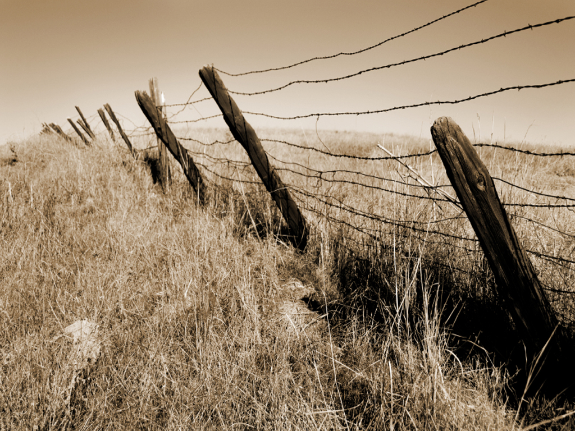
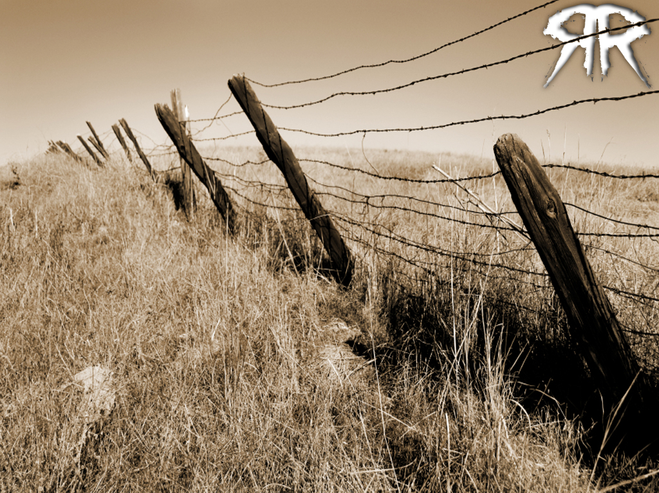



Slide 2
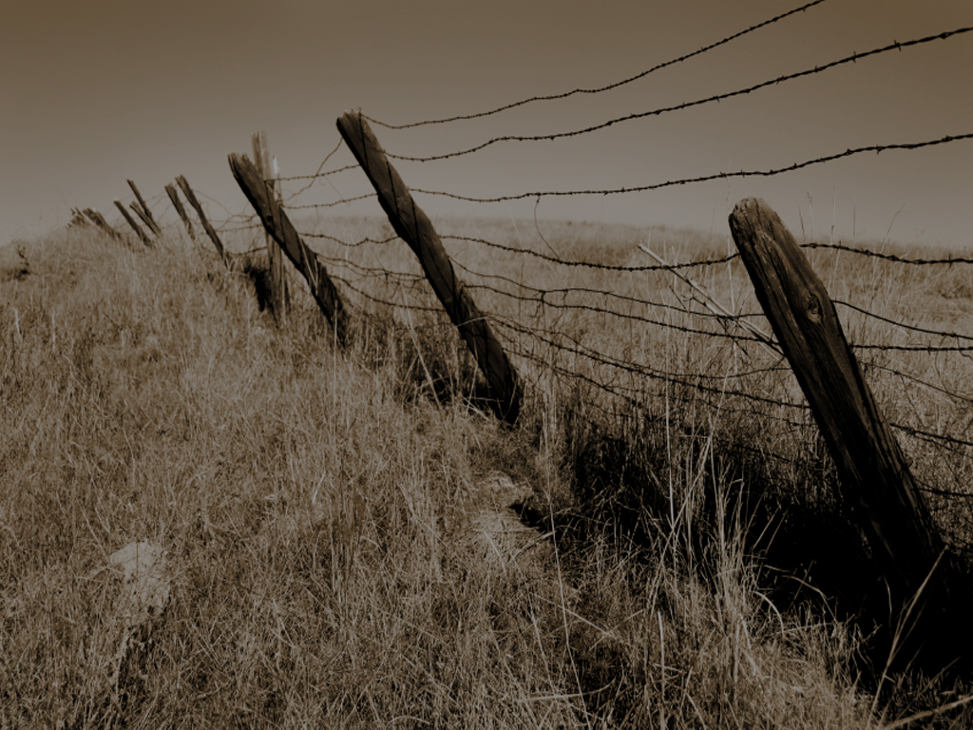
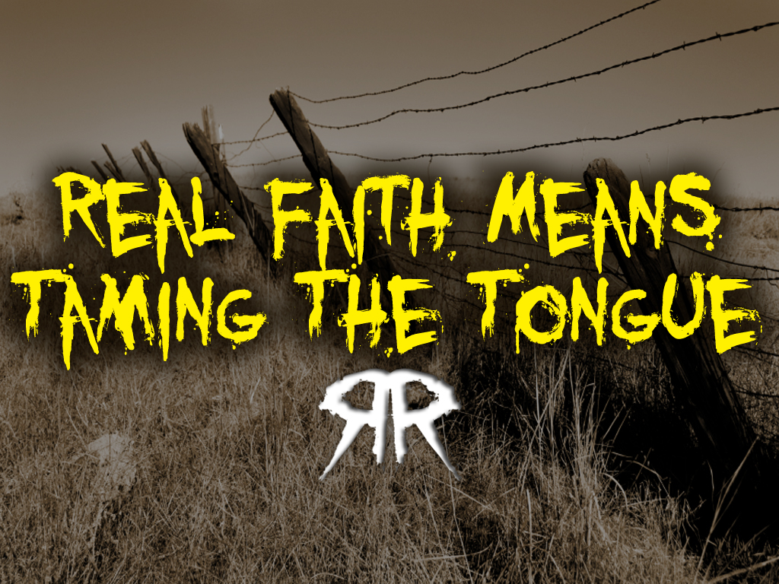
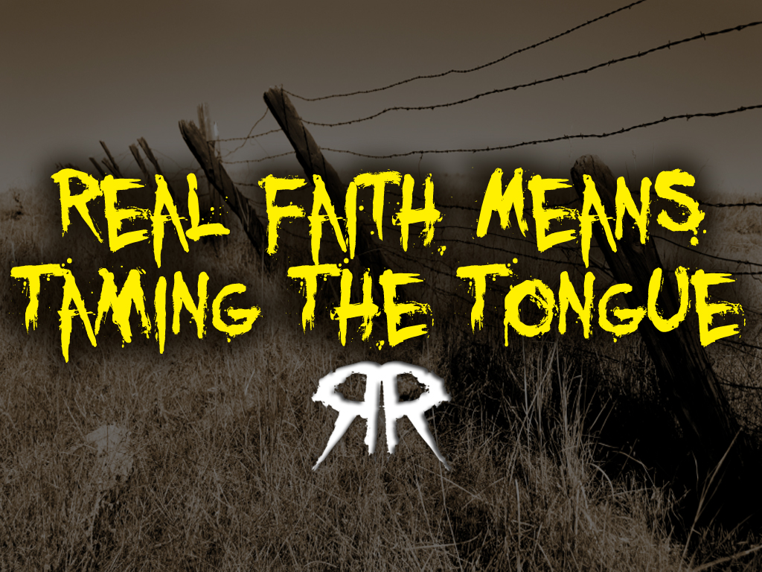

Slide 3
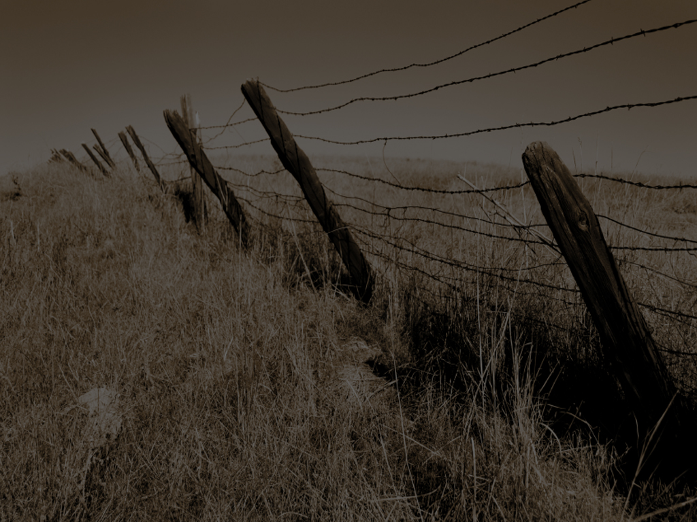
Nothing Speaks More Loudly About Our Faith Than Do Our WORDS

Slide 4
When We Say That We Love God, But Out Of The Same Mouth We Show Forth Hate To Our Brother – The Love Of God We Say We Have, IS NOT IN US!

Slide 5
What We Say With Our Mouth/Tongue Is A Big Deal To God!

Slide 6
It Is The Evidence Of What Is Really Way Down Deep Inside Our Hearts, The Place Where Real Faith Abides

Slide 7
James 3:1
My brethren, be not many masters, knowing that we shall receive the greater condemnation.

Slide 8
1
Don’t Desire Position Just So You Can Talk!
Those who are in a teaching position,
whose words are used to convey thought and understanding, will receive the greater condemnation

Slide 9
1
Don’t Desire Position Just So You Can Talk!
The more you speak, the greater chance you’ll say something wrong

Slide 10
1
Don’t Desire Position Just So You Can Talk!
It is a very serious warning to me as a pastor, but it is great advice to us all!

Slide 11
James 3:2-4
² For in many things we offend all. If any man offend not in word, the same is a perfect man, and able also to bridle the whole body.
³ Behold, we put bits in the horses' mouths, that they may obey us; and we turn about their whole body.

Slide 12
James 3:2-4
⁴ Behold also the ships, which though they be so great, and are driven of fierce winds, yet are they turned about with a very small helm, whithersoever the governor listeth.

Slide 13
2
The Tongue Is The
Steering Wheel For Your Relationships With Others
You are to offend not (sin not) with your words

Slide 14
2
The Tongue Is The
Steering Wheel For Your Relationships With Others
There is a kind of maturity of speech, which acts as a catalyst for growth and maturity in everything you do

Slide 15
2
The Tongue Is The
Steering Wheel For Your Relationships With Others
Psalm 32:9
Be ye not as the horse, or as the mule, which have no understanding: whose mouth must be held in with a bit and bridle, lest they come near unto thee.

Slide 16
2
The Tongue Is The
Steering Wheel For Your Relationships With Others
Proverbs 26:3
A whip for the horse, a bridle for the ass, and a rod for the fool’s back.

Slide 17
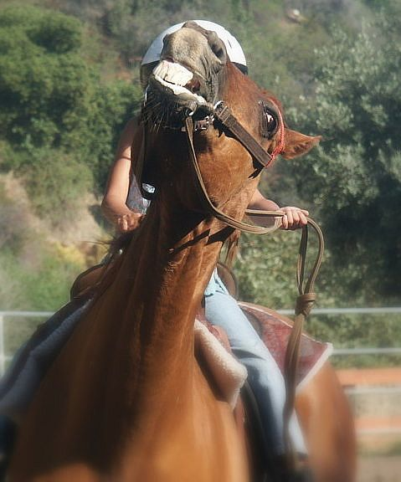
2
The Tongue Is The
Steering Wheel For Your Relationships With Others
A small bit in a horse’s mouth, can control and direct that very large animal

Slide 18
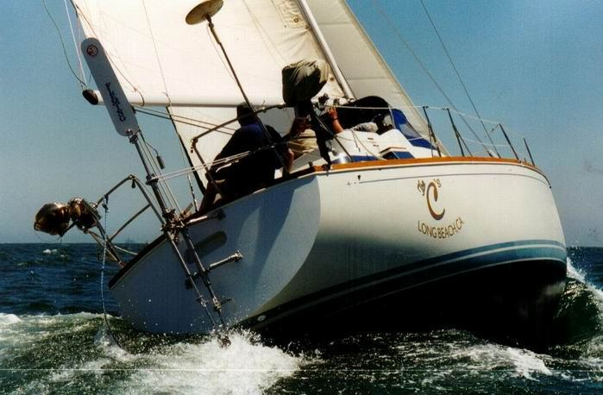
2
The Tongue Is The
Steering Wheel For Your Relationships With Others
A small rudder controls the direction of a huge ship

Slide 19
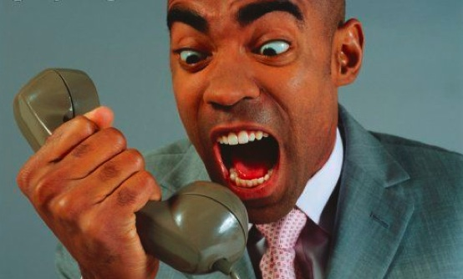
2
The Tongue Is The
Steering Wheel For Your Relationships With Others
The tongue,
though small compared to your head, arms, legs and belly, plays a controlling factor in your life

Slide 20
2
The Tongue Is The
Steering Wheel For Your Relationships With Others
But how you use it,
and what you say, will have more to do with directing your relationships with others, your successes and pitfalls in life, more than anything else

Slide 21
James 3:5-8
⁵ Even so the tongue is a little member, and boasteth great things. Behold, how great a matter a little fire kindleth!
⁶ And the tongue is a fire, a world of iniquity: so is the tongue among our members, that it defileth the whole body, and setteth on fire the course of nature; and it is set on fire of hell.

Slide 22
James 3:5-8
⁷ For every kind of beasts, and of birds, and of serpents, and of things in the sea, is tamed, and hath been tamed of mankind:
⁸ But the tongue can no man tame; it is an unruly evil, full of deadly poison.

Slide 23
3
Words Can Kill!
The Tongue Is Little… But It Is Dangerous!

Slide 24
3
Words Can Kill!
It Is Fire!
It Will Burn Down A Church
It Will Burn Down A Marriage
It Will Burn Down Families
It Will Burn Down Friendships

Slide 25
3
Words Can Kill!
Though little, the tongue will destroy the whole body!

Slide 26
3
Words Can Kill!
Proverbs 16:27
An ungodly man diggeth up evil: and in his lips there is as a burning fire.

Slide 27
3
Words Can Kill!
satan wants you to use your tongue to burn people up

Slide 28
3
Words Can Kill!
The Holy Spirit wants you to grow in Grace and use your tongue to encourage and bless one another

Slide 29
3
Words Can Kill!
HE WANTS YOU TO BUILD PEOPLE UP, NOT TEAR PEOPLE DOWN!

Slide 30
3
Words Can Kill!
Psalm 140:3
They have sharpened their tongues like a serpent; adders’ poison is under their lips. Selah.

Slide 31
3
Words Can Kill!
Words can kill.
They burn. They cut. They poison….

Slide 32
3
Words Can Kill!
DOESN’T SOUND LIKE JESUS, DOES IT?

Slide 33
James 3:9-12
⁹ Therewith bless we God, even the Father; and therewith curse we men, which are made after the similitude of God.
¹⁰ Out of the same mouth proceedeth blessing and cursing. My brethren, these things ought not so to be.

Slide 34
James 3:9-12
¹¹ Doth a fountain send forth at the same place sweet water and bitter?
¹² Can the fig tree, my brethren, bear olive berries? either a vine, figs? so can no fountain both yield salt water and fresh.

Slide 35
4
The hypocrisy
of the tongue
We bless God and curse men out of the same mouth

Slide 36
4
The hypocrisy
of the tongue
Man is made in
the likeness and image of God!

Slide 37
4
The hypocrisy
of the tongue
Genesis 1:26-27
²⁶ And God said, Let us make man in our image, after our likeness: and let them have dominion over the fish of the sea, and over the fowl of the air, and over the cattle, and over all the earth, and over every creeping thing that creepeth upon the earth.

Slide 38
4
The hypocrisy
of the tongue
Genesis 1:26-27
²⁷ So God created man in his own image, in the image of God created he him; male and female created he them.

Slide 39
4
The hypocrisy
of the tongue
Water cannot be bitter and sweet at the same time!

Slide 40
4
The hypocrisy
of the tongue
Do the math… Neither can a Christian that is truly controlled
by the Spirit

Slide 41
James 3:13-18
¹³ Who is a wise man and endued with knowledge among you? let him shew out of a good conversation his works with meekness of wisdom.
¹⁴ But if ye have bitter envying and strife in your hearts, glory not, and lie not against the truth.

Slide 42
James 3:13-18
¹⁵ This wisdom descendeth not from above, but is earthly, sensual, devilish.
¹⁶ For where envying and strife is, there is confusion and every evil work.

Slide 43
James 3:13-18
¹⁷ But the wisdom that is from above is first pure, then peaceable, gentle, and easy to be intreated, full of mercy and good fruits, without partiality, and without hypocrisy.
¹⁸ And the fruit of righteousness is sown in peace of them that make peace.

Slide 44
5
The Real Wisdom
of the tongue
WISE MAN
Good conversation, good words
His words are meekness
The very word meekness comes from the picture of a giant horse, who is brought under control by the small bit in his mouth

Slide 45
5
The Real Wisdom
of the tongue
FOOLISH MAN
Thinks he is wise
Bitterness, envying and strife
These kinds of words are devilish

Slide 47
Philippians 3:19
Whose end is destruction, whose God is their belly, and whose glory is their shame, who mind earthly things.

Slide 48
You can say anything with the tongue (words are cheap),
but if what you say smells of envy,
strife & confusion…
THEN IT IS EVIL!

Slide 49
It Is Devilish!

Slide 50
satan’s Very Name Means “liar” And “slanderer!”

Slide 51
he is the diabolical one

Slide 52
He wants to steal, kill and destroy

Slide 53
BE A Wise Man!

Slide 54
Use real Godly wisdom in
your words!

Slide 55
YOUR WORDS SHOULD BE…
PURE
PEACEABLE
GENTLE
APPROACHABLE
COMPASSIONATE
PRODUCTIVE
UNBIASED
SINCERE

