Slide 1
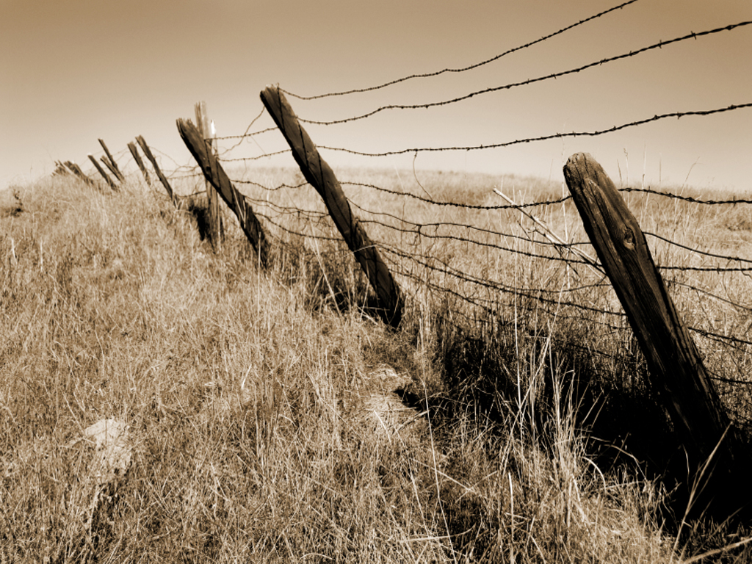
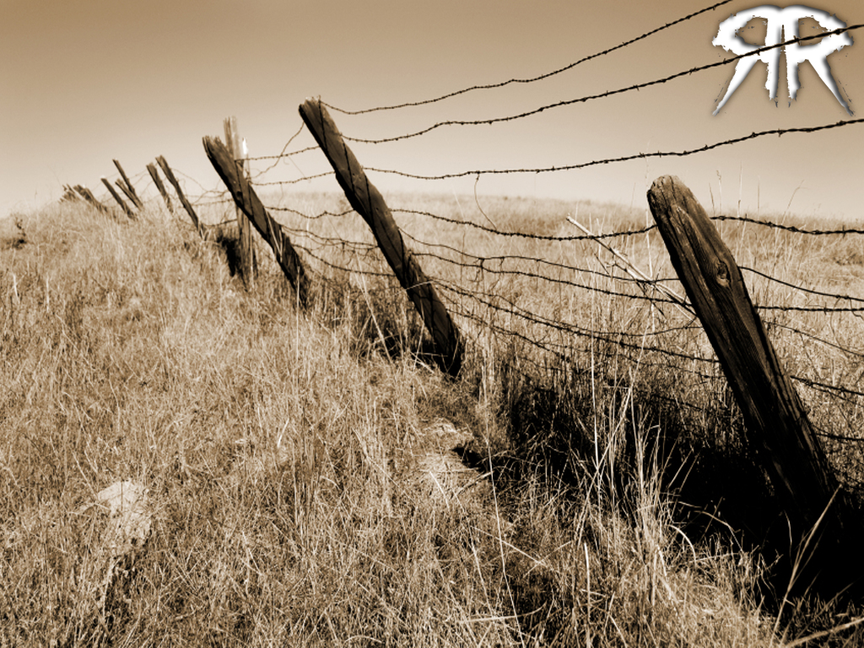



Slide 2
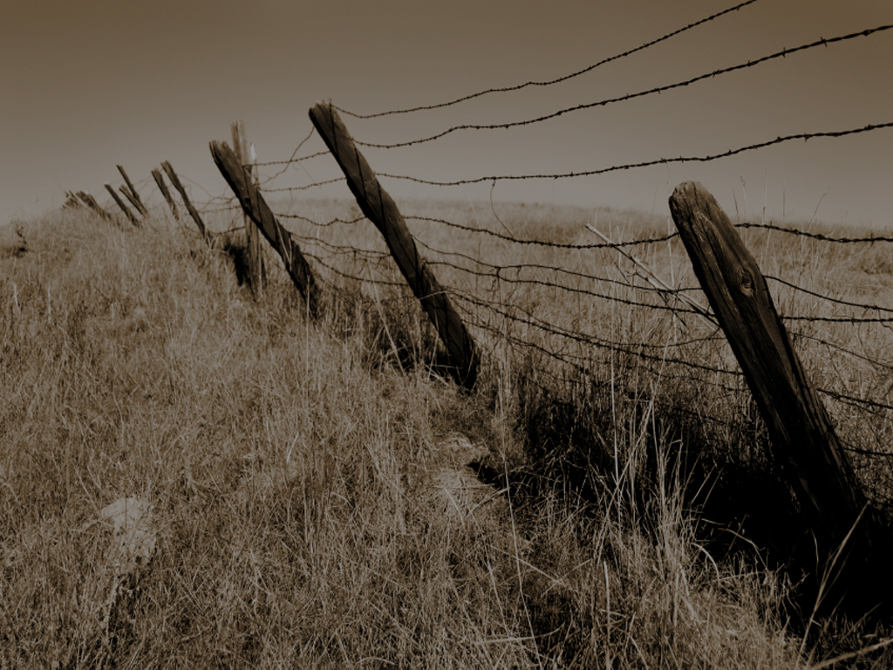



Slide 3
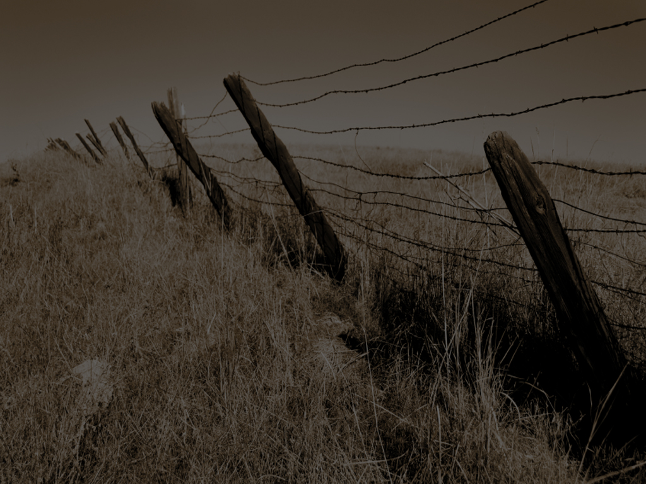
Prejudice
“To cause injury or damage to someone”

Slide 4
So, what’s
the big deal?

Slide 5
I don’t like a certain class or color of people!

Slide 6
That’s the way
I was raised!

Slide 7
WHAT’S THE PROBLEM???

Slide 8
The problem is
YOU AIN’T LIKE JESUS!

Slide 9
James 2:1
My brethren, have not the faith of our Lord Jesus Christ, the Lord of Glory, with respect of persons.

Slide 10
MY BRETHREN (talking to Christians… supposedly)
HAVE NOT (do not) call yourself a Christ follower with respect of persons (prejudice towards people)

Slide 11
1
Real Faith Demands That
You Not Be Prejudiced!
Stop Playing
A Game!
IT IS DISRESPECTFUL!

Slide 12
1
Real Faith Demands That
You Not Be Prejudiced!
2 Corinthians 8:9
For ye know the Grace of our Lord Jesus Christ, that, though He was rich, yet for our sakes He became poor, that ye through His poverty might be rich.

Slide 13
1
Real Faith Demands That
You Not Be Prejudiced!
Matthew 8:20
And Jesus saith unto him, the foxes have holes and the birds of the air have nests; but the Son of man hath no where to lay His head.

Slide 14
1
Real Faith Demands That
You Not Be Prejudiced!
James is saying:
“Don’t even say you are a Christ follower if you look down your nose at poor folks!”

Slide 15
1
Real Faith Demands That
You Not Be Prejudiced!
Don’t Do It!

Slide 16
1
Real Faith Demands That
You Not Be Prejudiced!
This Is A Command!

Slide 17
1
Real Faith Demands That
You Not Be Prejudiced!
…Not An Option!

Slide 18
1
Real Faith Demands That
You Not Be Prejudiced!
If It Is An Option To
You, Then DON’T CALL Yourself A Christian – And DON’T SAY You Attend Fellowship Church Either!

Slide 19
1
Real Faith Demands That
You Not Be Prejudiced!
James 2:2-4
²For if there come unto your assembly a man with a gold ring, in goodly apparel, and there come in also a poor man in vile raiment;

Slide 20
1
Real Faith Demands That
You Not Be Prejudiced!
James 2:2-4
³And ye have respect to him that weareth the gay clothing, and say unto him, Sit thou here in a good place; and say to the poor, Stand thou there, or sit here under my footstool:

Slide 21
1
Real Faith Demands That
You Not Be Prejudiced!
James 2:2-4
⁴Are ye not then partial in yourselves, and are become judges of evil thoughts?

Slide 22
2
Prejudicial Thoughts Are Evil Thoughts!
RICH HERE…
POOR THERE!

Slide 23
2
Prejudicial Thoughts Are Evil Thoughts!
SIT HERE…
STAND THERE…
OR SIT ON THE FLOOR!
(lower than my feet)

Slide 24
2
Prejudicial Thoughts Are Evil Thoughts!
This Kind Of Thinking
Is Allowed To Enter Your Mind By YOU!

Slide 25
2
Prejudicial Thoughts Are Evil Thoughts!
This Kind Of Judgment Is YOUR Problem!

Slide 26
2
Prejudicial Thoughts Are Evil Thoughts!
God’s Holy Word calls it
evil!
v4

Slide 27
2
Prejudicial Thoughts Are Evil Thoughts!
James 2:5-8
⁵Hearken, my beloved brethren, Hath not God chosen the poor of this world rich in faith, and heirs of the Kingdom which He hath promised to them that love Him?

Slide 28
2
Prejudicial Thoughts Are Evil Thoughts!
James 2:5-8
⁶But ye have despised the poor. Do not rich men oppress you, and draw you before the judgment seats?

Slide 29
2
Prejudicial Thoughts Are Evil Thoughts!
James 2:5-8
⁷Do not they blaspheme that worthy name by which ye are called?
⁸If ye fulfil the royal law according to the scripture, Thou shalt love they neighbor as thyself, ye do well:

Slide 30
3
If you are prejudiced, you can’t understand grace
Ephesians 2:4-5
⁴But God, who is rich in mercy, for His great love wherewith He loved us,
⁵Even when we were dead in sins, hath quickened us together with Christ, (by Grace ye are saved;)

Slide 31
3
If you are prejudiced, you can’t understand grace
Ephesians 2:7-9
⁷That in the ages to come He might shew the exceeding riches of His Grace in His kindness toward us through Christ Jesus
⁸For by Grace are ye saved through faith; and that not of yourselves: it is the gift of God:
⁹Not of works, lest any man should boast.

Slide 32
3
If you are prejudiced, you can’t understand grace
Ephesians 2:12-13
¹²That at that time ye were without Christ, being aliens from the commonwealth of Israel, and strangers from the covenants of promise, having no hope, and without God in the world:
¹³But now in Christ Jesus ye who sometimes were far off are made nigh by the blood of Christ

Slide 33
3
If you are prejudiced, you can’t understand grace
Ephesians 2:18-22
¹⁸ For through Him we both have access by one Spirit unto the Father.
¹⁹ Now therefor ye are no more strangers and foreigners, but fellowcitizens with the saints, and of the household of God;

Slide 34
3
If you are prejudiced, you can’t understand grace
Ephesians 2:18-22
²⁰ And are built upon the foundation of the apostles and prophets, Jesus Christ Himself being the cornerstone;
²¹ In whom all the building fitly framed together groweth unto a holy temple in the Lord:

Slide 35
3
If you are prejudiced, you can’t understand grace
Ephesians 2:18-22
²²In whom ye also are builded together for an habitation of God through the Spirit.

Slide 36
3
If you are prejudiced, you can’t understand grace
God Has Chosen
The Rich In Faith

Slide 37
3
If you are prejudiced, you can’t understand grace
The Poor Who Are Saved Are Heirs
With Jesus Christ

Slide 38
3
If you are prejudiced, you can’t understand grace
Riches In This Life Cannot Be Taken With You

Slide 39
3
If you are prejudiced, you can’t understand grace
Everything Down Here Will One
Day Burn Up

Slide 40
James 2:9-13
⁹ But if ye have respect to persons, ye commit sin, and are convinced of the law as transgressors.
¹⁰ For whosoever shall keep the whole law, and yet offend in one point, he is guilty of all.

Slide 41
James 2:9-13
¹¹ For he that said, Do not commit adultery, said also, Do not kill. Now if thou commit no adultery, yet if thou kill, thou art become a transgressor of the law.

Slide 42
James 2:9-13
¹² So speak ye, and so do, as they that shall be judged by the law of liberty.
¹³ For he shall have judgment without mercy, that hath shewed no mercy; and mercy rejoices against judgment.

Slide 43
4
Being Prejudiced Is Sin!
v9
It Is Sin And We Will Be Convicted By God’s Law!

Slide 44
4
Being Prejudiced Is Sin!
v9
It Might Be Cool Down Here, But It Won’t Be
Fly Up There!

Slide 45
4
Being Prejudiced Is Sin!
V10-11
He Lists A Couple Of Comparable Sins To Prejudice…
ADULTERY & MURDER!

Slide 46
4
Being Prejudiced Is Sin!
V10-11
This Is Not A Small
Issue With God!

Slide 47
4
Being Prejudiced Is Sin!
v12
You Want To Be Judged With Liberty Then Extend That Liberty To Others And Not Predisposed Bias!

Slide 48
4
Being Prejudiced Is Sin!
v12
NOT INJURY & DAMAGE!

Slide 49
4
Being Prejudiced Is Sin!
v13
You Want Mercy… Then Show It To Others!

Slide 50
4
Being Prejudiced Is Sin!
v13
You Will Be Judged Without Mercy If You Do Not Extend It To Others!

Slide 51
Luke 18:10-17
¹⁰Two men went up into the temple to pray; the one a Pharisee, and the other a publican.
¹¹The Pharisee stood and prayed thus with himself, God, I thank thee, that I am not as other men are, extortioners, unjust, adulterers, or even as this publican.
¹²I fast twice in the week, I give tithes of all that I possess.

Slide 52
Luke 18:10-17
¹³And the publican, standing afar off, would not lift up so much as his eyes unto heaven, but smote upon his breast, saying, God be merciful to me a sinner.
¹⁴I tell you, this man went down to his house justified rather than the other: for every one that exalteth himself shall be abased; and he that humbleth himself shall be exalted.

Slide 53
Luke 18:10-17
¹⁵And they brought unto him also infants, that he would touch them: but when his disciples saw it, they rebuked them.
¹⁶But Jesus called them unto him, and said, Suffer little children to come unto me, and forbid them not: for of such is the kingdom of God.

Slide 54
Luke 18:10-17
¹⁷Verily I say unto you, Whosoever shall not receive the kingdom of God as a little child shall in no wise enter therein.

Slide 55
The Key Is
Love & Humility!
When We Are Prejudiced Towards Someone Else, We Are Filled With Pride

Slide 56
The Key Is
Love & Humility!
WE ARE PUTTING THEM DOWN TO PUT US UP!

Slide 57
The Key Is
Love & Humility!
James 4:10
Humble yourselves in the sight of the Lord, and he shall lift you up.

Slide 58
Prejudice Is Part Of Our Sin Nature
Romans 12:1-3
¹ I beseech you therefore, brethren, by the mercies of God, that ye present your bodies a living sacrifice, holy, acceptable unto God, which is your reasonable service.

Slide 59
Prejudice Is Part Of Our Sin Nature
Romans 12:1-3
² And be not conformed to this world: but be ye transformed by the renewing of your mind, that ye may prove what is that good, and acceptable, and perfect, will of God.

Slide 60
Prejudice Is Part Of Our Sin Nature
Romans 12:1-3
³ For I say, through the grace given unto me, to every man that is among you, not to think of himself more highly than he ought to think; but to think soberly, according as God hath dealt to every man the measure of faith.

Slide 61
We Must Present Ourselves A
Living Sacrifice Before The Lord
We Need To Renew Our Minds
Through God’s Precious Word
We Need To Not Think More
Highly Of Ourselves Than Others

