Slide 1










Slide 2





Slide 3







Slide 4




Slide 5




Slide 6



HEART

Slide 7

ATTITUDE

Slide 8

WORDS

Slide 9

PLANS

Slide 10


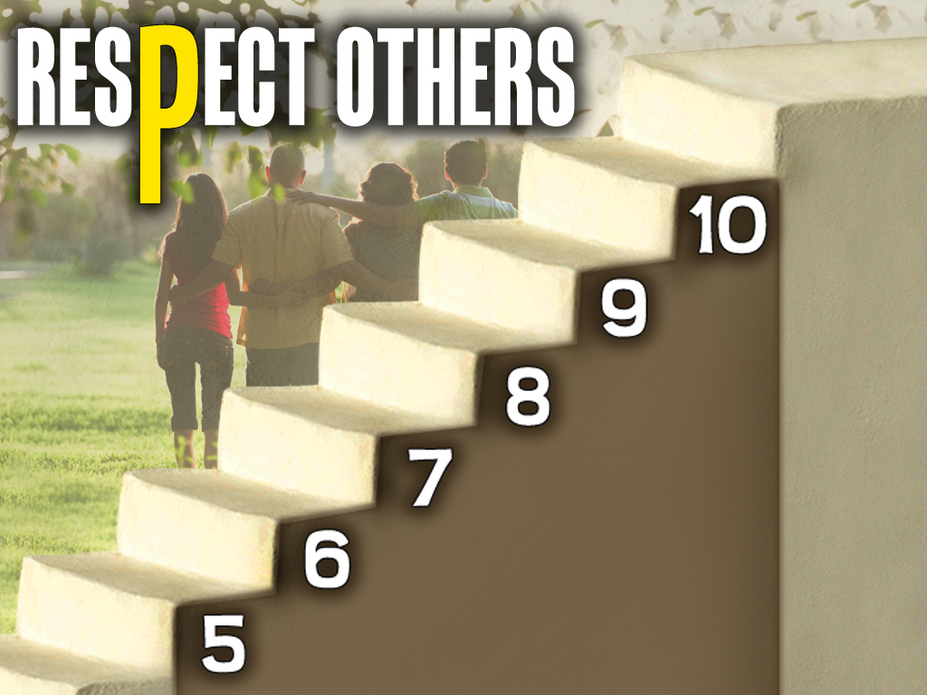

Slide 11
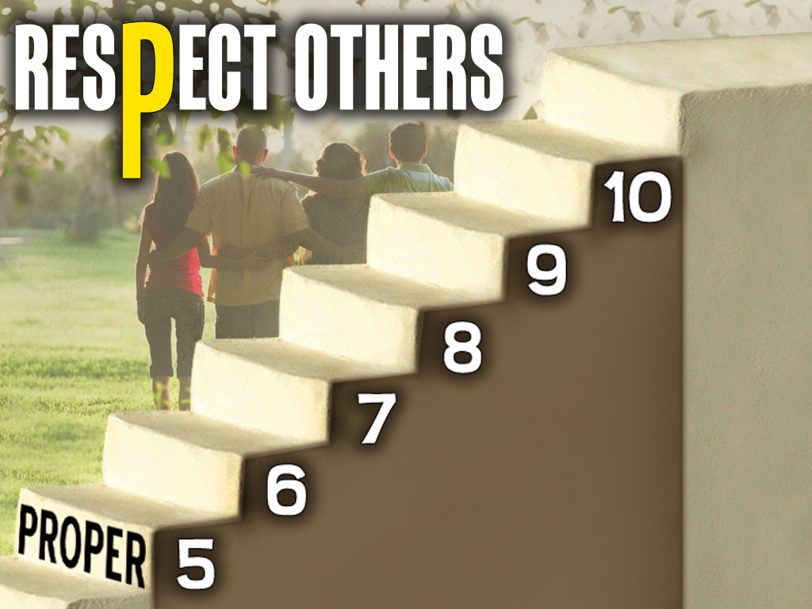
PARENTS

Slide 12
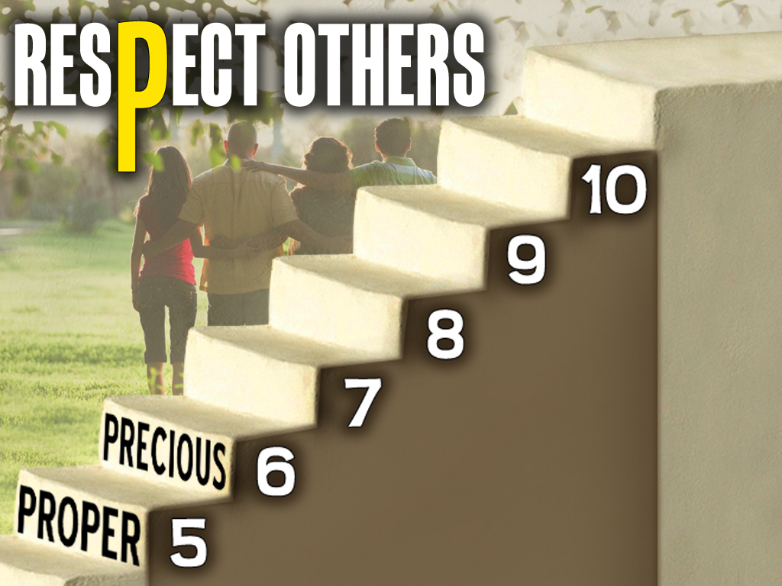
LIFE

Slide 13
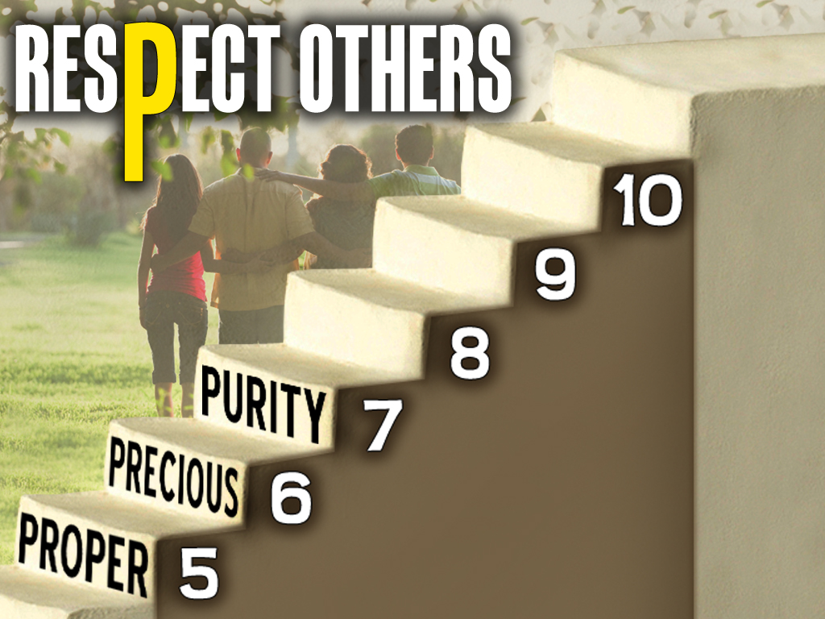
MARRIAGE & RELATIONSHIPS

Slide 14
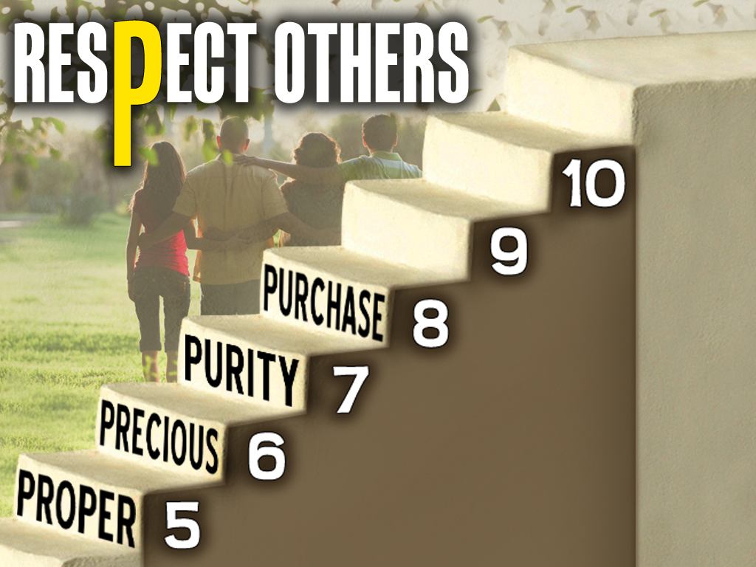
PROSPERITY

Slide 15
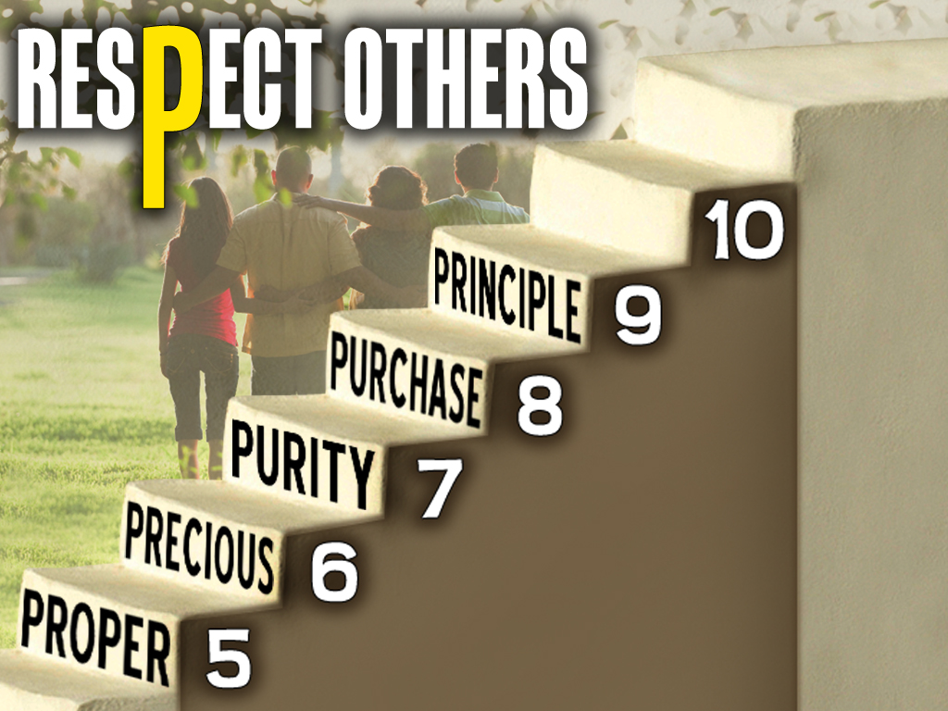
TRUTH

Slide 16
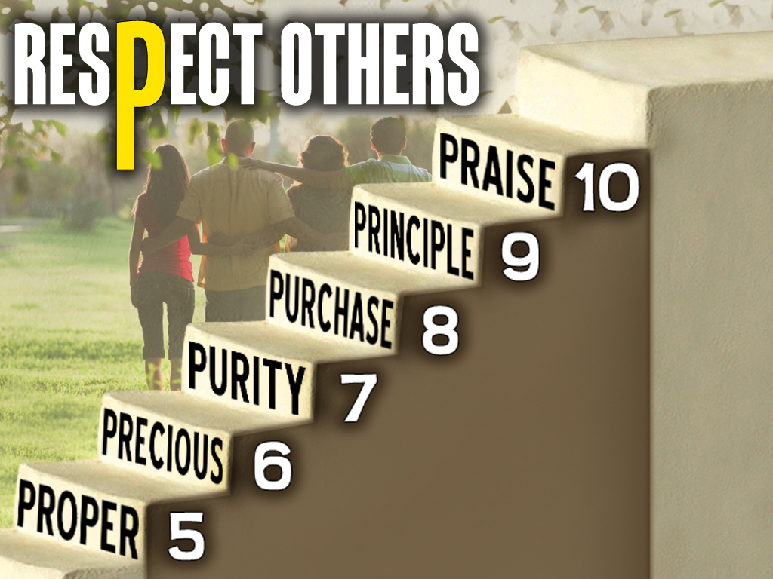
CONTENTMENT

Slide 17
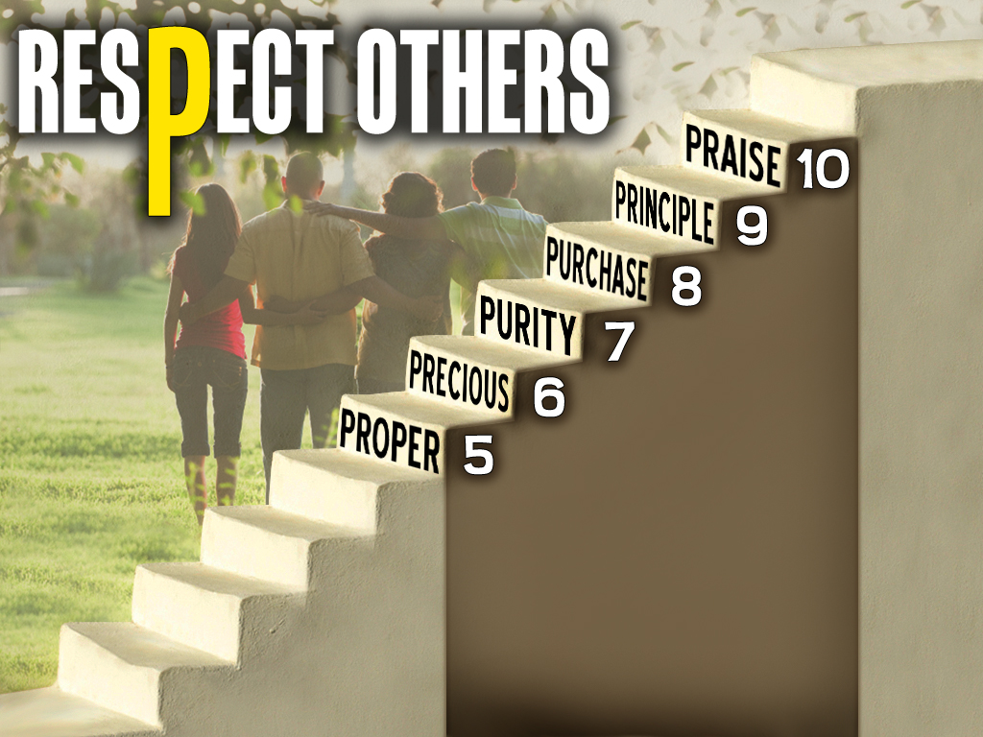



FAVORED

Slide 18




Slide 19

Matthew 22:37-39 ³⁷Jesus said unto him, Thou shalt love the Lord thy God with all thy heart, and with all thy soul, and with all thy mind.
³⁸This is the first and great commandment.
³⁹And the second is like unto it, Thou shalt love thy neighbour as thyself.

Slide 20
Love your neighbor as YOURSELF!

Slide 21
Luke 6:31 And as ye would that men should do to you, do ye also to them likewise.

Slide 22
Do unto others as you would have them do unto YOU!

Slide 23

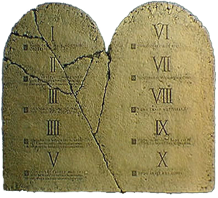
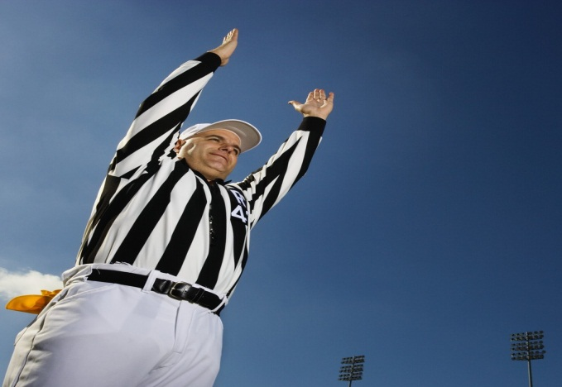
THE ELEVENTH COMMANDMENT
IT’S GOOD...
...To love your neighbor as YOURSELF
...To do to others as YOU would have them do to YOU!

Slide 24
it’s good to do to others what I expect to be done to me!

Slide 25
IT’S GOOD!
#11

Slide 26
it’s called…

Slide 27
Ephesians 5:28-29 ²⁸So ought men to love their wives as their own bodies. He that loveth his wife loveth himself.
²⁹For no man ever yet hated his own flesh; but nourisheth and cherisheth it, even as the Lord the church:

Slide 28
Love Yourself
Nourish Yourself
Cherish Yourself
LOVE | CARE | PROTECT

Slide 29
it’s not egotistical IT’S BIBLICAL!

Slide 30
IT’S GOOD!
...For me to expect others to do good to me
...For me to expect others to treat me right
...For me to expect others to NOT hurt or abuse me

Slide 32
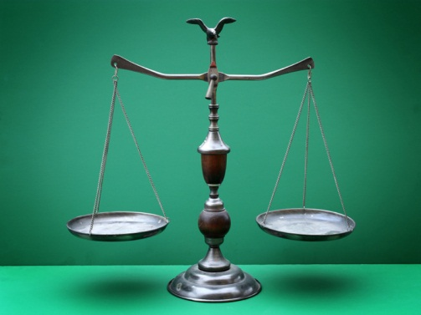
BALANCE
it’s about…
God
Others
You

Slide 33
Matthew 22:37-39 ³⁷Jesus said unto him, Thou shalt love the Lord thy God with all thy heart, and with all thy soul, and with all thy mind.
³⁸This is the first and great commandment.
³⁹And the second is like unto it, Thou shalt love thy neighbour as thyself.

Slide 34
Faith
Hope
Love

Slide 35
1 Corinthians 13:13 And now abideth faith, hope, love, these three; but the greatest of these is love.

Slide 36
Law
Grace
Truth

Slide 37
John 1:17 For the law was given by Moses, but grace and truth came by Jesus Christ.

Slide 38

The Trinity Effect

Slide 39
God The Father
God The Son
God The . Spirit

Slide 40
Matthew 3:16-17 ¹⁶And Jesus, when he was baptized, went up straightway out of the water: and, lo, the heavens were opened unto him, and he saw the Spirit of God descending like a dove, and lighting upon him:
¹⁷And lo a voice from heaven, saying, This is my beloved Son, in whom I am well pleased.

Slide 41
Respect God
Respect Others
Respect Yourself

Slide 42
it’s called…

Slide 43
I HAVE BEEN BOUGHT WITH A VERY HIGH PRICE!
1 Corinthians 6:20 For ye are bought with a price: therefore glorify God in your body, and in your spirit, which are God's.

Slide 44
I HAVE BEEN CRUCIFIED WITH CHRIST!
Galatians 2:20 I am crucified with Christ: nevertheless I live; yet not I, but Christ liveth in me: and the life which I now live in the flesh I live by the faith of the Son of God, who loved me, and gave himself for me.

Slide 45
I AM A NEW CREATION IN CHRIST!
2 Corinthians 5:17 Therefore if any man be in Christ, he is a new creature: old things are passed away; behold, all things are become new.

Slide 46
I AM AN OVERCOMER AND HAVE VICTORY IN CHRIST!
1 John 5:4 For whatsoever is born of God overcometh the world: and this is the victory that overcometh the world, even our faith.

Slide 47



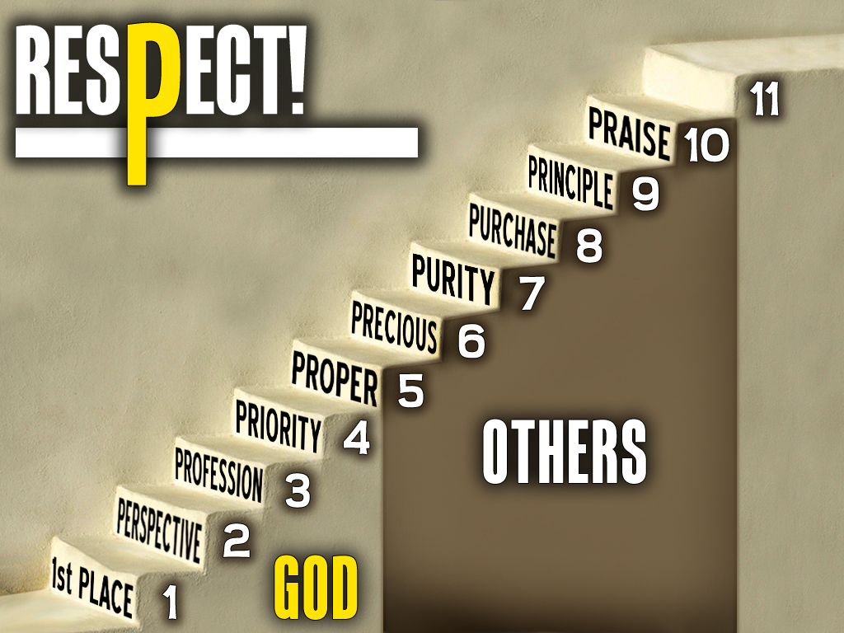

Slide 48
I MATTER BIG TIME!

Slide 49
How Much?

Slide 50
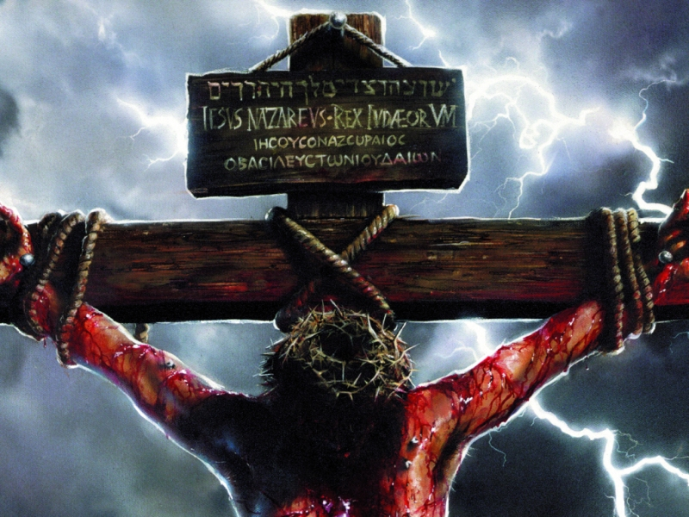
John 3:16 For God so loved the world, that He gave His only begotten Son, that whosoever believeth in Him should not perish, but have everlasting life.
THIS MUCH!

Slide 51


