Slide 1










Slide 2




Slide 3

or
Attitude + Actions
= RES_{P}ECT

Slide 4
Attitude + Actions
= DISRES_{P}ECT

Slide 5
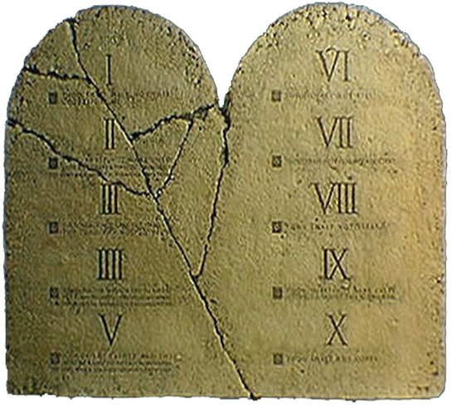
The first four of the TEN COMMANDMENTS deal with our ATTITUDE & ACTIONS (resPect) toward GOD

Slide 6
The last six of the TEN COMMANDMENTS deal with our ATTITUDE & ACTIONS (resPect) toward OTHERS

Slide 7


Slide 8
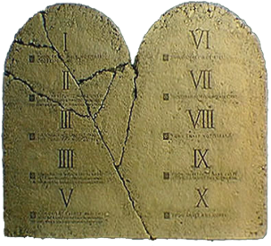
THE FIFTH COMMANDMENT
Exodus 20:12 Honour thy father and thy mother: that thy days may be long upon the land which the LORD thy God giveth thee.

Slide 9

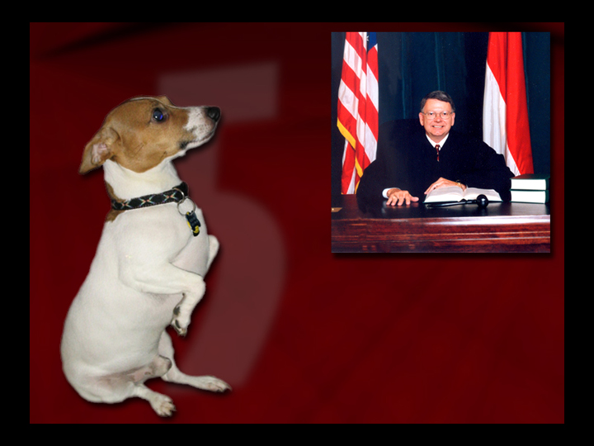

THE FIFTH COMMANDMENT
Honor Thy Father And Mother!

Slide 10



PROPER Means - Correct, Wise, “The Right Thing To Do!”

Slide 11
To Honor is PROPER!

Slide 12
To Dishonor is POISON!

Slide 13
Hebrews 12:14-15 ¹⁴Follow peace with all men, and holiness, without which no man shall see the Lord:
¹⁵Looking diligently lest any man fail of the grace of God; lest any root of bitterness springing up trouble you, and thereby many be defiled;

Slide 14
RESPECT PARENTS!

Slide 16
THE SIXTH COMMANDMENT
Exodus 20:13 Thou shalt not kill.

Slide 17
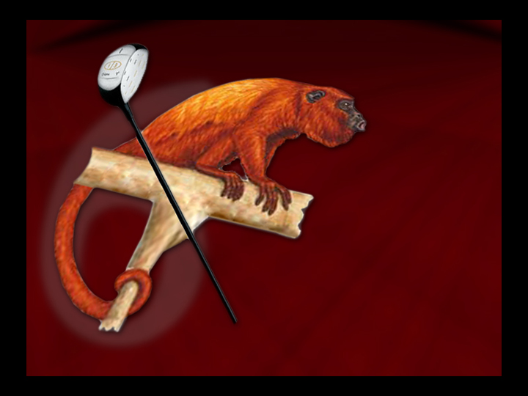

THE SIXTH COMMANDMENT
Do Not Kill!

Slide 18


Life Is Precious!

Slide 19
Genesis 2:7 And the LORD God formed man of the dust of the ground, and breathed into his nostrils the breath of life; and man became a living soul.

Slide 20
Deuteronomy 30:19 I call heaven and earth to record this day against you, that I have set before you life and death, blessing and cursing: therefore choose life, that both thou and thy seed may live:

Slide 21
Psalm 139:13-17 ¹³For thou hast possessed my reins: thou hast covered me in my mother's womb.
¹⁴I will praise thee; for I am fearfully and wonderfully made: marvellous are thy works; and that my soul knoweth right well.

Slide 22
Psalm 139:13-17 ¹⁵My substance was not hid from thee, when I was made in secret, and curiously wrought in the lowest parts of the earth.

Slide 23
Psalm 139:13-17 ¹⁶Thine eyes did see my substance, yet being unperfect; and in thy book all my members were written, which in continuance were fashioned, when as yet there was none of them.

Slide 24
Psalm 139:13-17 ¹⁷How precious also are thy thoughts unto me, O God! how great is the sum of them!

Slide 25
RESPECT LIFE!

Slide 27
THE SEVENTH COMMANDMENT
Exodus 20:14 Thou shalt not commit adultery.

Slide 28


THE SEVENTH COMMANDMENT
Do Not Commit Adultery!

Slide 29


Respect Your Husband
Respect Your Wife
Respect Your Kids

Slide 30
Ephesians 5:28-33 ²⁸So ought men to love their wives as their own bodies. He that loveth his wife loveth himself.
²⁹For no man ever yet hated his own flesh; but nourisheth and cherisheth it, even as the Lord the church:

Slide 31
Ephesians 5:28-33 ³⁰For we are members of his body, of his flesh, and of his bones.
³¹For this cause shall a man leave his father and mother, and shall be joined unto his wife, and they two shall be one flesh.

Slide 32
Ephesians 5:28-33 ³²This is a great mystery: but I speak concerning Christ and the church.
³³Nevertheless let every one of you in particular so love his wife even as himself; and the wife see that she reverence her husband.

Slide 33
RESPECT MARRIAGE!

Slide 35
THE EIGHTH COMMANDMENT
Exodus 20:15 Thou shalt not steal.

Slide 36
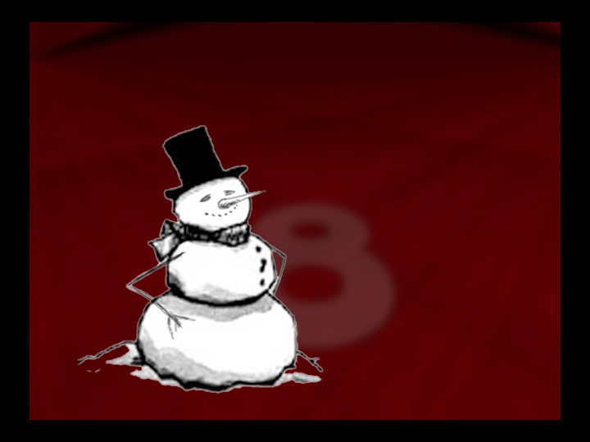
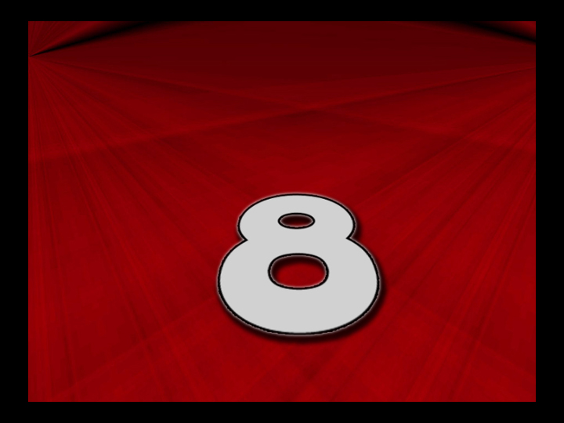
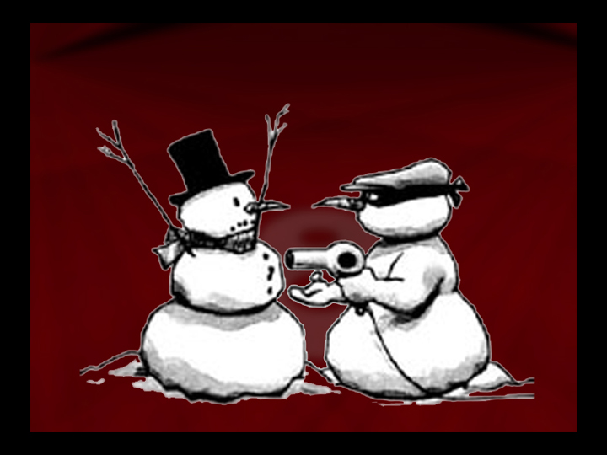
THE EIGHTH COMMANDMENT
Do Not Steal!

Slide 37


“Buy It Fool!”
Pay For It!
Work For It!

Slide 38
Ephesians 4:28 Let him that stole steal no more: but rather let him labour, working with his hands the thing which is good, that he may have to give to him that needeth.

Slide 39
1 Thessalonians 4:11-12 ¹¹And that ye study to be quiet, and to do your own business, and to work with your own hands, as we commanded you;
¹²That ye may walk honestly toward them that are without, and that ye may have lack of nothing.

Slide 40
RESPECT PROSPERITY!

Slide 42
THE NINETH COMMANDMENT
Exodus 20:16 Thou shalt bear false witness against they neighbor.

Slide 43



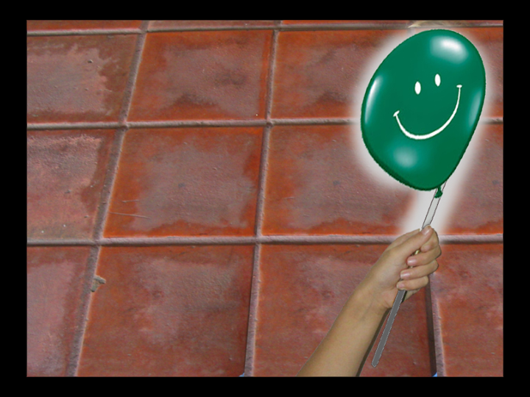
THE NINETH COMMANDMENT
Do Not Lie!

Slide 44



TELL THE TRUTH!
The Whole Truth!
And Nothing But The Truth!
SO HELP ME GOD!

Slide 45
John 8:43-45 ⁴³Why do ye not understand my speech? even because ye cannot hear my word.

Slide 46
John 8:43-45 ⁴⁴Ye are of your father the devil, and the lusts of your father ye will do. He was a murderer from the beginning, and abode not in the truth, because there is no truth in him. When he speaketh a lie, he speaketh of his own: for he is a liar, and the father of it.

Slide 47
John 8:43-45 ⁴⁵And because I tell you the truth, ye believe me not.

Slide 48
Colossians 3:9-10 ⁹Lie not one to another, seeing that ye have put off the old man with his deeds;
¹⁰And have put on the new man, which is renewed in knowledge after the image of him that created him:

Slide 49
RESPECT TRUTH!

Slide 51
THE TENTH COMMANDMENT
Exodus 20:17 Thou shalt not covet thy neighbour's house, thou shalt not covet thy neighbour's wife, nor his manservant, nor his maidservant, nor his ox, nor his ass, nor any thing that is thy neighbour's.

Slide 52


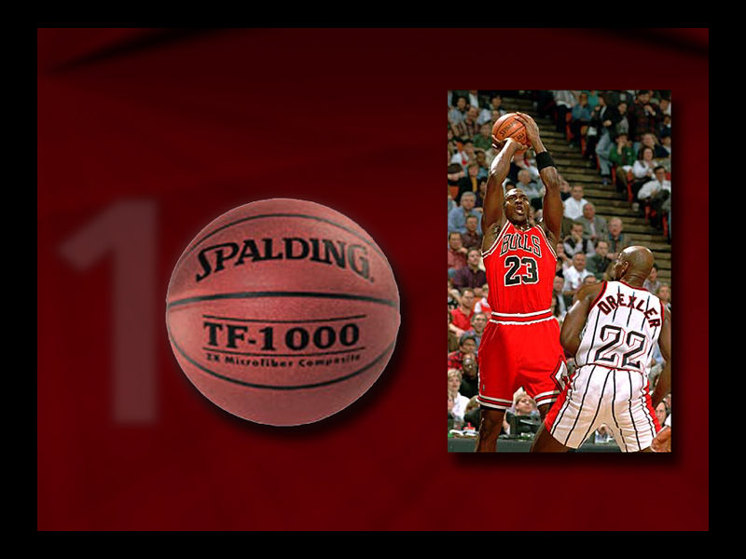
THE TENTH COMMANDMENT
Do Not Covet!

Slide 53


COVET
• To want something someone else has
• To feel sorry for yourself because you don’t have what they have
• To think you deserve it and they don’t

Slide 54
COVET
It Is Being A Total Ingrate!

Slide 55
Philippians 4:11 Not that I speak in respect of want: for I have learned, in whatsoever state I am, therewith to be content.

Slide 56
1 Timothy 6:6-10 ⁶But godliness with contentment is great gain.
⁷For we brought nothing into this world, and it is certain we can carry nothing out.
⁸And having food and raiment let us be therewith content.

Slide 57
1 Timothy 6:6-10 ⁹But they that will be rich fall into temptation and a snare, and into many foolish and hurtful lusts, which drown men in destruction and perdition.

Slide 58
1 Timothy 6:6-10 ¹⁰For the love of money is the root of all evil: which while some coveted after, they have erred from the faith, and pierced themselves through with many sorrows.

Slide 59
Hebrews 13:5 Let your conversation be without covetousness; and be content with such things as ye have: for he hath said, I will never leave thee, nor forsake thee.

Slide 60
RESPECT CONTENTMENT!

Slide 61







Slide 62








Slide 63



