Slide 1










Slide 2




Slide 3

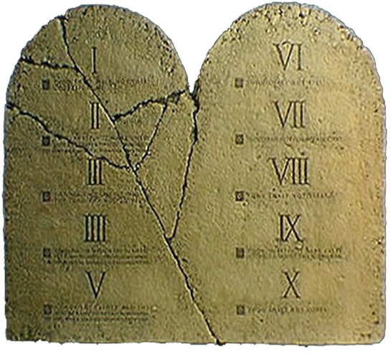
The Ten Commandments Really Deal With Our ATTITUDE And ACTIONS Toward God And Others

Slide 4
or
Attitude + Actions
= RES_{P}ECT

Slide 5
Attitude + Actions
= DISRES_{P}ECT

Slide 6


Slide 7
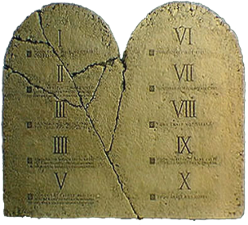
THE FIRST COMMANDMENT
Exodus 20:3 Thou shalt have no other gods before me.

Slide 8


THE FIRST COMMANDMENT
Thou Shalt Have No Other Gods Before Me!

Slide 9



Give God First Place! #1

Slide 10
John 14:6 Jesus saith unto him, I am the Way, the Truth, and the Life: no man cometh to the Father, but by Me.

Slide 11
Psalm 14:1 The fool hath said in his heart, there is no God. They are corrupt, they have done abominable works, there none that doeth good.

Slide 12
God is God, and I am not!

Slide 13
It’s God’s way, not my way!

Slide 14
God deserves the benefit of EVERY doubt!
Genesis 1:1 In the beginning God created the heaven and the earth.

Slide 16
THE SECOND COMMANDMENT
Exodus 20:4 Thou shalt not make unto thee any graven image, or any likeness of any thing that is in heaven above, or that is in the earth beneath, or that is in the water under the earth

Slide 17
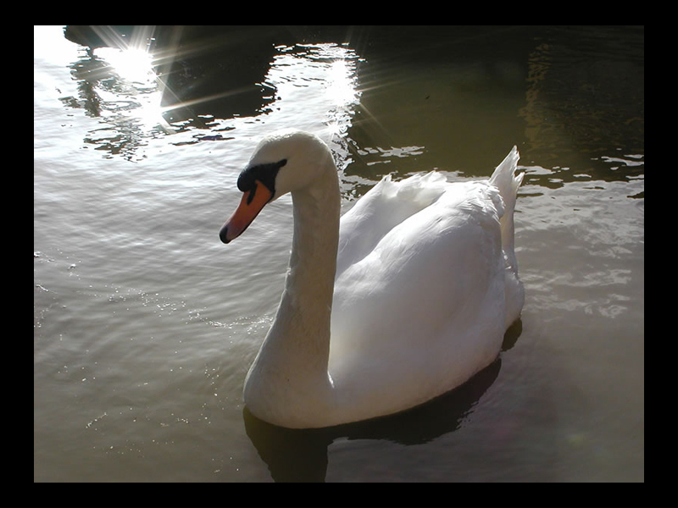
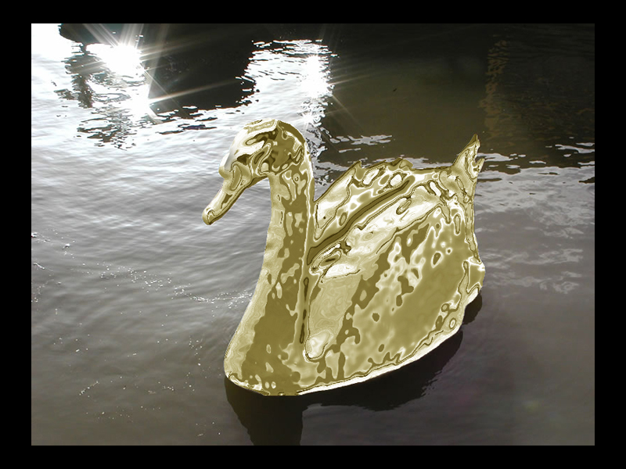


THE SECOND COMMANDMENT
Make No Idols!

Slide 18


God is big on God, He ain’t big on me!

Slide 19
Romans 1:21 Because that, when they knew God, they glorified him not as God, neither were thankful; but became vain in their imaginations, and their foolish heart was darkened.

Slide 20
James 1:17 Every good gift and every perfect gift is from above, and cometh down from the Father of lights, with whom is no variableness, neither shadow of turning.

Slide 21
Romans 3:10 As it is written, there is none righteous, no not one.

Slide 22
Romans 3:23 For all have sinned, and come short of the Glory of God;

Slide 23
Romans 6:23 For the wages of sin is death; but the gift of God is eternal life through Jesus Christ our Lord.

Slide 24
God is big on Jesus!

Slide 25
It’s all about Him!

Slide 26
It’s not about ME!
myself
my feelings
my job
my stuff
my education
my religion
my philosophy

Slide 27
2 Corinthians 10:5 Casting down imaginations, and every high thing that exalteth itself against the knowledge of God, and bringing into captivity every thought to the obedience of Christ;

Slide 29
THE THIRD COMMANDMENT
Exodus 20:7 Thou shalt not take the name of the LORD thy God in vain; for the LORD will not hold him guiltless that taketh his name in vain.

Slide 30



THE THIRD COMMANDMENT
Don’t Take God’s Name In Vain!

Slide 31


PROFESS MEANS TO SPEAK OR PROCLAIM

Slide 32
Matthew 15:18 But those things which proceed out of the mouth come forth from the heart; and they defile the man.

Slide 33
Romans 10:9-10 ⁹That if thou shalt confess with thy mouth the Lord Jesus, and shalt believe in thine heart that God hath raised him from the dead, thou shalt be saved.

Slide 34
Romans 10:9-10 ¹⁰For with the heart man believeth unto righteousness; and with the mouth confession is made unto salvation.

Slide 35
What I say is what I believe!

Slide 36
What I Speak, Is Who I Am!

Slide 37
2 Corinthians 5:17 Therefore if any man be in Christ, he is a new creature: old things are passed away; behold, all things are become new.

Slide 39
THE FORTH COMMANDMENT
Exodus 20:8 Remember the Sabbath day, to keep it holy.

Slide 40
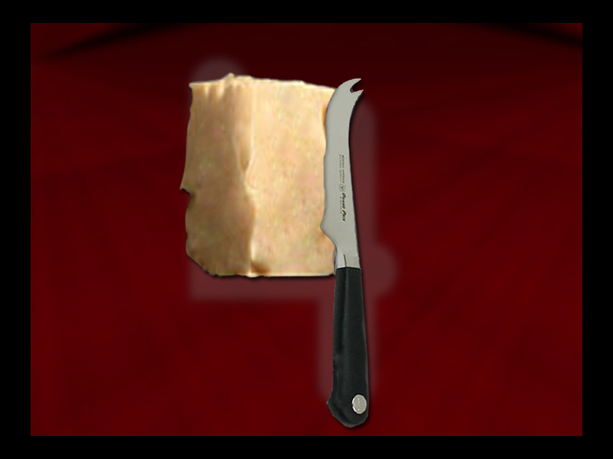

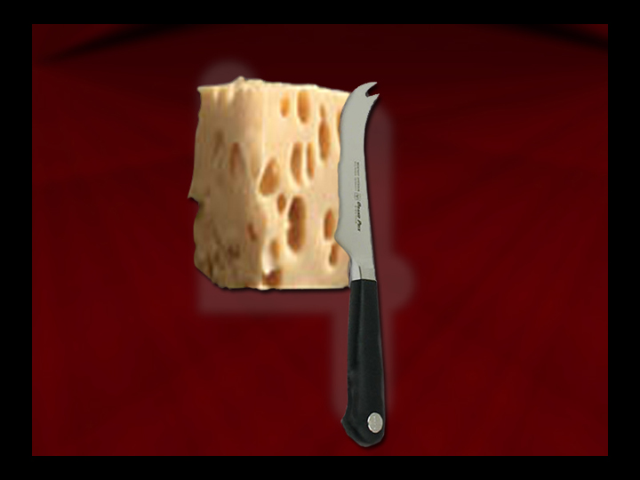
THE FORTH COMMANDMENT
Keep The Sabbath Holy!

Slide 41


Matthew 16:16 And Simon Peter answered and said, Thou art the Christ, the Son of the living God.

Slide 42
Matthew 16:18 And I say also unto thee, That thou art Peter, and upon this rock I will build my church; and the gates of hell shall not prevail against it.

Slide 43
Hebrews 10:25 Not forsaking the assembling of ourselves together, as the manner of some is; but exhorting one another: and so much more, as ye see the day approaching.

Slide 44
Worship must be a priority to me!

Slide 45
Showing up shows RESPECT!!!

Slide 46
My plans should come under his plan!

Slide 47
Isaiah 55:8 For my thoughts are not your thoughts, neither are your ways my ways, saith the LORD.

Slide 48






Slide 49
PLACE
NO Other Gods
KNOW God Is #1

Slide 50
PERSPECTIVE
NO Idols
KNOW Idols Ain’t Gonna Cut It

Slide 51
PROFESSION
NO Profanity
KNOW Profanity Isn’t Acceptable Speech

Slide 52
PRIORITY
NO Forsaking
KNOW Forsaking Is Not In God’s Plan

