Slide 1





Slide 3
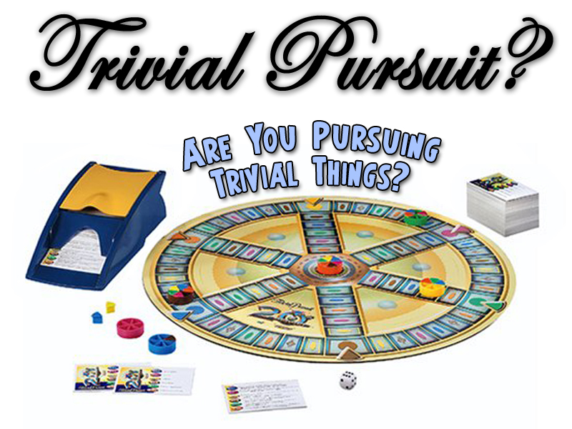

Slide 5
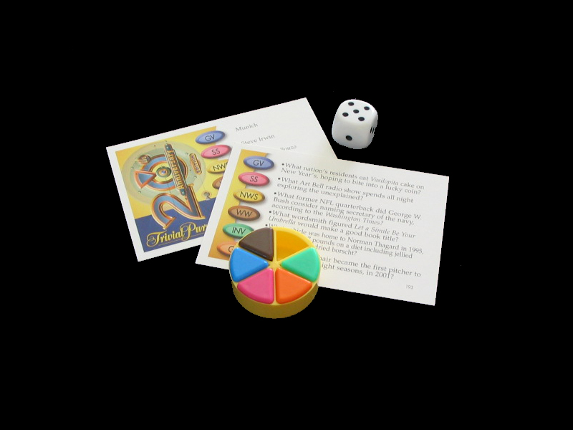
In the real game of life, most people live their lives pursuing TRIVIAL THINGS?

Slide 6
TRIVIAL Comes from a Latin word meaning THREE ROADS

Slide 7
The idea was that in ancient times, when travelers met at the crossroads, they would talk & gossip about unimportant issues of the day.
TRIVIAL STUFF!

Slide 8
Much Of The Stuff We Deem Important Is Trivial
• We want to be important
• We want to look important
• We want to act important
• We want to be treated as though we are important

Slide 9
This kind of Trivial Thinking is rooted in PRIDE!

Slide 10
God Has An Abundant Life For Us
John 10:10 The thief cometh not, but for to steal, and to kill, and to destroy: I am come that they might have life, and that they might have it more abundantly.

Slide 11
But the abundant life is short-circuited by the Trivialities of Pride!

Slide 12
Let’s journey back 2000 years and meet a man who was experiencing the Abundant Life…
…WHILE LOCKED UP IN PRISON!

Slide 13
Let’s journey back 2000 years and meet a man who was experiencing the Abundant Life…
…AWAITING HIS EXECUTION!

Slide 14
PAUL Was not focused on “trivial things,” but on what really mattered!

Slide 15
Philippians 1:1 Paul and Timotheus, the servants of Jesus Christ, to all the saints in Christ Jesus which are at Philippi, with the bishops and deacons:

Slide 16


Slide 17
BOND SLAVE
Literally BY NATURE
Humbling yourself and being a Servant really matters!

Slide 18
BOND SLAVE
Literally BY NATURE
James 4:6 But he giveth more grace. Wherefore he saith, God resisteth the proud, but giveth grace unto the humble.

Slide 19
BOND SLAVE
Literally BY NATURE
James 4:10 Humble yourselves in the sight of the Lord, and he shall lift you up.

Slide 20
BOND SLAVE
Literally BY NATURE
God Rejects Pride!
I Am To Humble Myself!
Before God & Others

Slide 21
BOND SLAVE
Literally BY NATURE
My focus should not be on trivial “My Way” things, but rather on “His Way” things, with others in mind…

Slide 22
BOND SLAVE
Literally BY NATURE
Being A Servant
REALLY MATTERS!

Slide 23
Philippians 1:2 Grace be unto you, and peace, from God our Father, and from the Lord Jesus Christ.

Slide 24


Slide 25
SANCTIFIED
Ephesians 2:8-9 ⁸ For by grace are ye saved through faith; and that not of yourselves: it is the gift of God: ⁹ Not of works, lest any man should boast.

Slide 26
TRANQUELIZED
Philippians 4:7 And the peace of God, which passeth all understanding, shall keep your hearts and minds through Christ Jesus.

Slide 27
TRANQUELIZED
PEACE The Shadrach, Meshach & Abendigo Thing!

Slide 28
Being forgiven and being free REALLY MATTERS!

Slide 29
Knowing your sins are forgiven, and that you have a friend in Jesus, who sticks closer than a brother, REALLY MATTERS!

Slide 30
Philippians 1:3 I thank my God upon every remembrance of you,

Slide 31


Slide 32
The tense of the word is:
I’m CONSTANTLY thanking God for you!

Slide 33
Generally speaking, focusing on Trivial Things diminishes a Grateful Spirit!

Slide 34
Not being Thankful is being Selfish!
YOU LOSE EVERY TIME!

Slide 35
Having a grateful spirit toward God & Others
REALLY MATTERS!

Slide 36
Philippians 1:4 Always in every prayer of mine for you all making request with joy,

Slide 37


Slide 38
Praying for others REALLY MATTERS!

Slide 39
I do it with Joy!
I’m Glad to do it!
I’m Happy to pray for you!

Slide 40
I’m convinced that self- centered, trivial minded people DON’T pray for others.

Slide 41
PUBLICAN PRAYER
“I’m glad I’m not like so and so…”
PITIFUL!

Slide 42
Pray for People
THAT REALLY MATTERS!

Slide 43
Philippians 1:5 For your fellowship in the gospel from the first day until now;

Slide 44


Slide 45
JOINT PARTICIPATION
Having a part in other people’s lives
REALLY MATTERS!

Slide 46
JOINT PARTICIPATION
“I Just Like To Be By Myself…”

Slide 47
JOINT PARTICIPATION
If you were locked up in prison, you just might change your tune!

Slide 48
JOINT PARTICIPATION
Reaching out, caring and sharing
REALLY MATTERS!

Slide 49
JOINT PARTICIPATION
IRON SHARPENS IRON

Slide 50
JOINT PARTICIPATION
YOU NEED OTHERS & OTHERS NEED YOU

Slide 51

JOINT PARTICIPATION
That’s why at Fellowship Church, EVERYONE is welcome!
EVERYONE PERIOD!

Slide 52

JOINT PARTICIPATION
Our fellowship here is based on our mission:
That we love Jesus Christ & we love people!

Slide 53
Philippians 1:6 Being confident of this very thing, that he which hath begun a good work in you will perform it until the day of Jesus Christ:

Slide 54


Slide 55
SETTLED & FIRM PERSUASION
In God, working in their life
“Good Work” was actually Giving!

Slide 56
SETTLED & FIRM PERSUASION
In God, working in their life
2 Corinthians 8:1-5 ¹ Moreover, brethren, we do you to wit of the grace of God bestowed on the churches of Macedonia;

Slide 57
SETTLED & FIRM PERSUASION
In God, working in their life
2 Corinthians 8:1-5 ² How that in a great trial of affliction the abundance of their joy and their deep poverty abounded unto the riches of their liberality.

Slide 58
SETTLED & FIRM PERSUASION
In God, working in their life
2 Corinthians 8:1-5 ³ For to their power, I bear record, yea, and beyond their power they were willing of themselves;

Slide 59
SETTLED & FIRM PERSUASION
In God, working in their life
2 Corinthians 8:1-5 ⁴ Praying us with much intreaty that we would receive the gift, and take upon us the fellowship of the ministering to the saints.

Slide 60
SETTLED & FIRM PERSUASION
In God, working in their life
2 Corinthians 8:1-5 ⁵ And this they did, not as we hoped, but first gave their own selves to the Lord, and unto us by the will of God.

Slide 61
SETTLED & FIRM PERSUASION
In God, working in their life
Are you hopeful and positive about what God will do through others?
Or when you look at other believers, are you critical?

Slide 62
SETTLED & FIRM PERSUASION
In God, working in their life
Being Hopeful & Confident
REALLY MATTERS!

Slide 63
SETTLED & FIRM PERSUASION
In God, working in their life
POSITIVE or NEGATIVE
We’re usually negative because they’re not doing it like I do it, and I’M RIGHT!

Slide 64
SETTLED & FIRM PERSUASION
In God, working in their life
Sounds Like Pride!

Slide 65
SETTLED & FIRM PERSUASION
In God, working in their life
BACK TO START!

Slide 66
Philippians 1:7-9 ⁷ Even as it is meet for me to think this of you all, because I have you in my heart; inasmuch as both in my bonds, and in the defense and confirmation of the gospel, ye all are partakers of my grace. ⁸ For God is my record, how greatly I long after you all in the bowels of Jesus Christ. ⁹ And this I pray, that your love may abound yet more and more in knowledge and in all judgment;

Slide 67


Slide 68
A DEVINE SELF-SACRIFICING LOVE
God-Like Love
1 Corinthians 13:1-3 ¹ Though I speak with the tongues of men and of angels, and have not love, I am become as sounding brass, or a tinkling cymbal.

Slide 69
A DEVINE SELF-SACRIFICING LOVE
God-Like Love
1 Corinthians 13:1-3 ² And though I have the gift of prophecy, and understand all mysteries, and all knowledge; and though I have all faith, so that I could remove mountains, and have not love, I am nothing.

Slide 70
A DEVINE SELF-SACRIFICING LOVE
God-Like Love
1 Corinthians 13:1-3 ³ And though I bestow all my goods to feed the poor, and though I give my body to be burned, and have not love, it profiteth me nothing.

Slide 71
A DEVINE SELF-SACRIFICING LOVE
God-Like Love
LOVE REALLY MATTERS!

Slide 72
A DEVINE SELF-SACRIFICING LOVE
God-Like Love
Sacrificing for others is not Trivial IT REALLY MATTERS!
You Win & They Win!

Slide 73
A DEVINE SELF-SACRIFICING LOVE
God-Like Love
Love requires action…
…Talk doesn’t!

Slide 74
A DEVINE SELF-SACRIFICING LOVE
God-Like Love
If people don’t know you love them, then you have failed as a Christian!

Slide 75
A DEVINE SELF-SACRIFICING LOVE
God-Like Love
WE MUST
LOVE EACH OTHER
Unconditionally
Without Trivialities

Slide 76
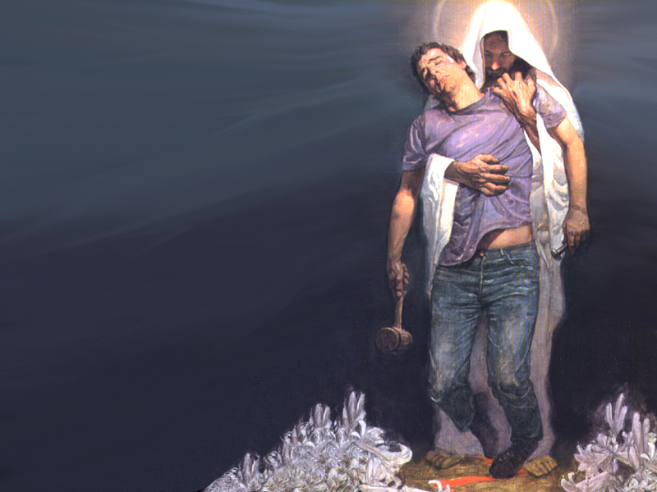
TAKING A STAND IS GREAT!
It may save a nation, but it won’t save a soul!

Slide 77
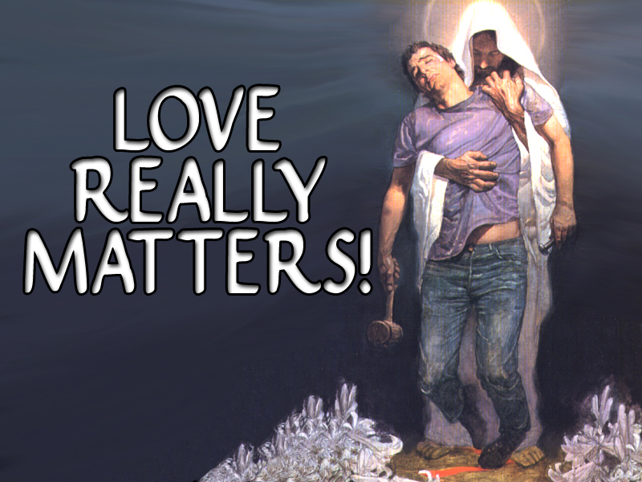

Slide 78
Philippians 1:10-11 ¹⁰ That ye may approve things that are excellent; that ye may be sincere and without offence till the day of Christ. ¹¹ Being filled with the fruits of righteousness, which are by Jesus Christ, unto the glory and praise of God.

Slide 79


Slide 80
PURE The Real Deal
Putting Things To The Test
Being Real REALLY MATTERS!

Slide 81
PURE The Real Deal
Putting Things To The Test
It is offensive to others when you are not who and what you say you are!

Slide 82
PURE The Real Deal
Putting Things To The Test
It is TRIVIAL PURSUIT being PHONEY BOLONEY!

Slide 83
PURE The Real Deal
Putting Things To The Test
YOU JUST GAME PLAYIN’

Slide 84
PURE The Real Deal
Putting Things To The Test
Being Real REALLY MATTERS!

Slide 85
Philippians 1:12-14 ¹² But I would ye should understand, brethren, that the things which happened unto me have fallen out rather unto the furtherance of the gospel; ¹³ So that my bonds in Christ are manifest in all the palace, and in all other places; ¹⁴ And many of the brethren in the Lord, waxing confident by my bonds, are much more bold to speak the word without fear.

Slide 86
Philippians 1:20-21 ²⁰ According to my earnest expectation and my hope, that in nothing I shall be ashamed, but that with all boldness, as always, so now also Christ shall be magnified in my body, whether it be by life, or by death. ²¹ For to me to live is Christ, and to die is gain.

Slide 87
Philippians 1:28-29 ²⁸ And in nothing terrified by your adversaries: which is to them an evident token of perdition, but to you of salvation, and that of God. ²⁹ For unto you it is given in the behalf of Christ, not only to believe on him, but also to suffer for his sake;

Slide 88


Slide 89
It was an Honor for Paul to be imprisoned for preaching the Gospel of Jesus Christ!

Slide 90
When you and I struggle and suffer (if we do it gratefully & joyfully), it isn’t Trivial and usually speaks a lot louder and clearer than anything we could ever say…
Don’t Trivialize Suffering By Whining!

Slide 91


Slide 92
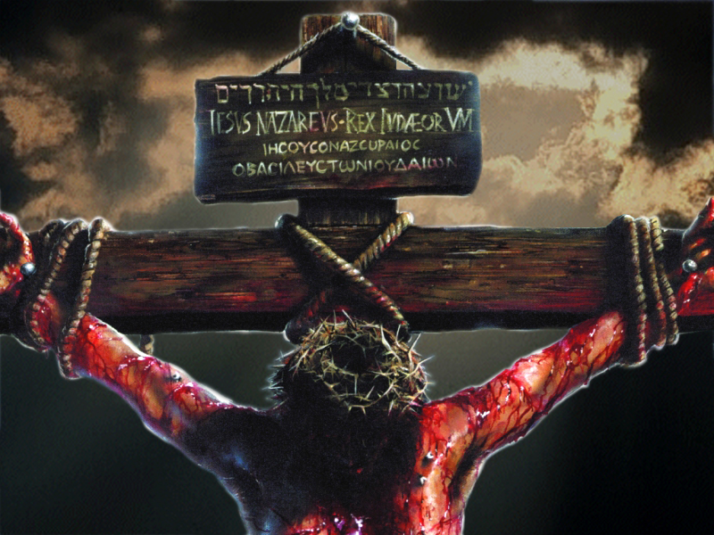

Slide 93
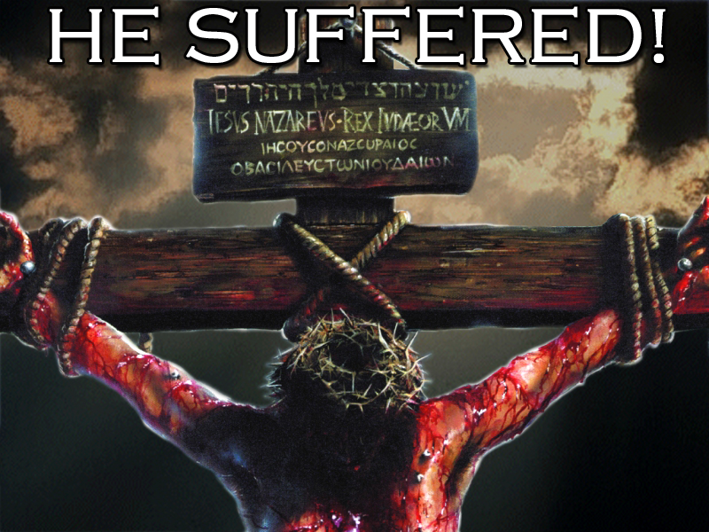

Slide 94


Slide 95


Slide 96


