Slide 1



Slide 2
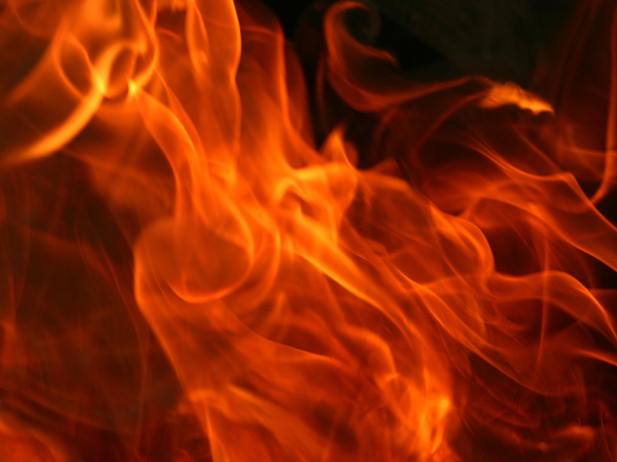


Slide 3
The Bible Declares Unequivocally That There Is A Place Called Hell!

Slide 4
Matthew 3:12
Mark 9:43
Matthew 5:22
Luke 16:19-31
Matthew 5:29-30
2 Thessalonians 1:9
Matthew 8:12
Jude 7
Matthew 13:41-42
Revelation 14:9-11
Matthew 13:50
Revelation 19:3
Matthew 18:8-9
Revelation 20:10
Matthew 25:41&46
Revelation 20:15

Slide 5
One Must Utterly Reject The Bible And The God Of The Bible If He Rejects That There Is A Hell

Slide 6
If There Is No Hell, The Bible Absolutely Cannot Be Trusted, PERIOD!
There Can Be No Fence Straddling!

Slide 7
The Same Bible That Said “God Is Love” Also Says There Is A Place Called Hell!
You Must Reject Both If You Reject Either!

Slide 8
Jesus Christ Spoke Of Hell More Than Any Other Figure
In The Bible

Slide 9
You Must Conclude That If You Do Not Believe In Hell, That Jesus Was A Liar!

Slide 10
You Must Also Conclude That He Was Mentally Disturbed For Placing Such “Fear” In The Minds Of People!

Slide 11
You Must Also Conclude That He Came And Died A Cruel And Torturous Death For Something He Made Up To Simply Deceive The People!

Slide 12
You Must Also Conclude That He Convinced His Followers To Believe In Such An Awful Place, That Many Gave Their Own Lives In
The Preaching And
Rescuing Of Souls!

Slide 13
NONE OF
THE PREVIOUS IS LOGICAL!

Slide 14
But Wait,
I’m Not Done!

Slide 15
You May Say God Is A God Of Love And Would Never Send His Child To A Place Called Hell

Slide 16
But…
God Would Send His Only Son Jesus To This Earth, To Live A Life Of Obscurity And Poverty

Slide 17
But…
God Would Allow Him To Be Ridiculed And Tortured, To Be Nailed To A Cross, To Die A Horrible Death!

Slide 18
Why? So That We Could Be Saved From Nothing???

Slide 19
Luke 16:19-21
19 There was a certain rich man, which was clothed in purple and fine linen, and fared sumptuously every day:
20 And there was a certain beggar named Lazarus, which was laid at his gate, full of sores,
21 And desiring to be fed with the crumbs which fell from the rich man's table: moreover the dogs came and licked his sores.

Slide 20
Luke 16:22-23
22 And it came to pass, that the beggar died, and was carried by the angels into Abraham's bosom: the rich man also died, and was buried;
23 And in hell he lift up his eyes, being in torments, and seeth Abraham afar off, and Lazarus in his bosom.

Slide 21
You Don’t Hang Around When You Die…
You Go Where You’re Goin’!

Slide 22

Here We Go…

Slide 24


Slide 25


Slide 26

Yes, Hell Is A Real Place!
Luke 16:23
And in hell he lift up his eyes, being in torments, and seeth Abraham afar off, and Lazarus in his bosom.

Slide 27
Yes, In Hell There Is Real Pain!
Luke 16:23
And in hell he lift up his eyes, being in torments, and seeth Abraham afar off, and Lazarus in his bosom.

Slide 28
Yes, In Hell There Is
Real Perception!
Luke 16:23
And in hell he lift up his eyes, being in torments, and seeth Abraham afar off, and Lazarus in his bosom.

Slide 29
Yes, In Hell There
Is Real Prayer!
Luke 16:24
And he cried and said, Father Abraham, have mercy on me, and send Lazarus, that he may dip the tip of his finger in water, and cool my tongue; for I am tormented in this flame.

Slide 30
Yes, Hell Is Really Permanent!
Luke 16:25-26
25 But Abraham said, Son, remember that thou in thy lifetime receivedst thy good things, and likewise Lazarus evil things: but now he is comforted, and thou art tormented.

Slide 31
Yes, Hell Is Really Permanent!
Luke 16:25-26
26 And beside all this, between us and you there is a great gulf fixed: so that they which would pass from hence to you cannot; neither can they pass to us, that would come from thence.

Slide 32
Yes, In Hell There
Is Real Passion!
Luke 16:27
Then he said, I pray thee therefore, father, that thou wouldest send him to my father's house:

Slide 34


Slide 35

No Money Will Buy Anyone A Way Out!

Slide 36
No Mercy Will Be Given To Anyone That Is There!

Slide 37
No Missionaries Are Coming Back From Hell To Warn Anyone Of It’s Horror!

Slide 38
Luke 16:28-31
28 For I have five brethren; that he may testify unto them, lest they also come into this place of torment.
29 Abraham saith unto him, They have Moses and the prophets; let them hear them.

Slide 39
Luke 16:28-31
30 And he said, Nay, father Abraham: but if one went unto them from the dead, they will repent.
31 And he said unto him, If they hear not Moses and the prophets, neither will they be persuaded, though one rose from the dead.

Slide 41


Slide 42

Know That You
Are A Sinner!

Slide 43
Know That Jesus Died On The Cross And Rose From The Dead For You!

Slide 44
Know That You Know, That You Know,
That You Know, That
You Believe In Jesus Christ As Your Own Personal
Lord And Savior!

Slide 45
If Anybody Ever Says To You…
GO TO
HELL!

Slide 46
Just Tell Them…
Hell Know(s)
I Can’t Go!

Slide 47
If Christians Went To Hell, They’d Put The Place Out!

Slide 48
John 4:10-14
10 Jesus answered and said unto her, If thou knewest the gift of God, and who it is that saith to thee, Give me to drink; thou wouldest have asked of him, and he would have given thee living water.
11 The woman saith unto him, Sir, thou hast nothing to draw with, and the well is deep: from whence then hast thou that living water?

Slide 49
John 4:10-14
12 Art thou greater than our father Jacob, which gave us the well, and drank thereof himself, and his children, and his cattle?
13 Jesus answered and said unto her, Whosoever drinketh of this water shall thirst again:
14 But whosoever drinketh of the water that I shall give him shall never thirst; but the water that I shall give him shall be in him a well of water springing up into everlasting life.

Slide 50
We Have A Spring Of Living Water In Us That Springs Up Into Eternal Life

Slide 51
WE SHALL NEVER THIRST AGAIN!

Slide 52
Jesus Calls Me By Name Because I Know Him

Slide 53
If You Do Not Know Jesus As Your Lord And Savior, Then He Will Not Call You By Name

Slide 54
Matthew 7:21-23
21 Not every one that saith unto me, Lord, Lord, shall enter into the kingdom of heaven; but he that doeth the will of my Father which is in heaven.

Slide 55
Matthew 7:21-23
22 Many will say to me in that day, Lord, Lord, have we not prophesied in thy name? and in thy name have cast out devils? and in thy name done many wonderful works?
23 And then will I profess unto them, I never knew you: depart from me, ye that work iniquity.

Slide 56


