Slide 1



Slide 2
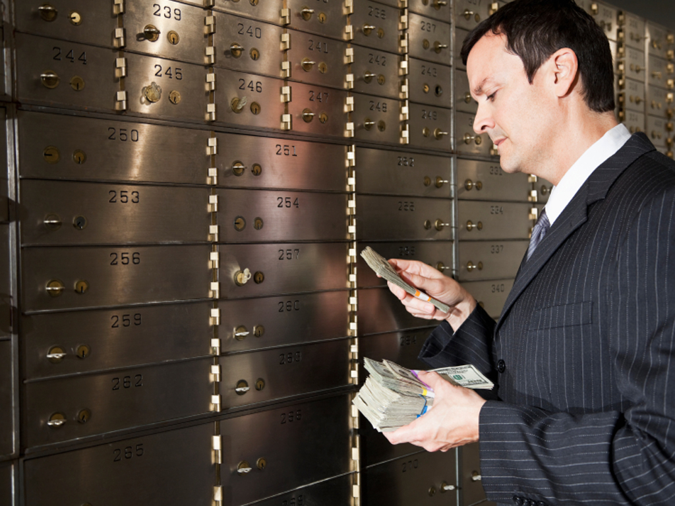



Slide 3
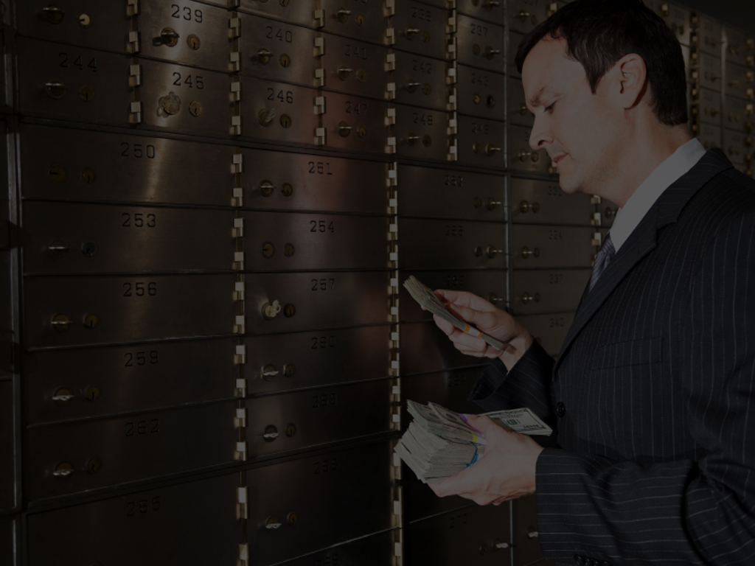
Luke 12:16-32 ¹⁶And he spake a parable unto them, saying, The ground of a certain rich man brought forth plentifully:
¹⁷And he thought within himself, saying, What shall I do, because I have no room where to bestow my fruits?
¹⁸And he said, This will I do: I will pull down my barns, and build greater; and there will I bestow all my fruits and my goods.

Slide 4
Luke 12:16-32 ¹⁹And I will say to my soul, Soul, thou hast much goods laid up for many years; take thine ease, eat, drink, and be merry.
²⁰But God said unto him, Thou fool, this night thy soul shall be required of thee: then whose shall those things be, which thou hast provided?
²¹So is he that layeth up treasure for himself, and is not rich toward God.

Slide 5
Luke 12:16-32 ²²And he said unto his disciples, Therefore I say unto you, Take no thought for your life, what ye shall eat; neither for the body, what ye shall put on.
²³The life is more than meat, and the body is more than raiment.
²⁴Consider the ravens: for they neither sow nor reap; which neither have storehouse nor barn; and God feedeth them: how much more are ye better than the fowls?

Slide 6
Luke 12:16-32 ²⁵And which of you with taking thought can add to his stature one cubit?
²⁶If ye then be not able to do that thing which is least, why take ye thought for the rest?
²⁷Consider the lilies how they grow: they toil not, they spin not; and yet I say unto you, that Solomon in all his glory was not arrayed like one of these.

Slide 7
Luke 12:16-32 ²⁸If then God so clothe the grass, which is to day in the field, and to morrow is cast into the oven; how much more will he clothe you, O ye of little faith?
²⁹And seek not ye what ye shall eat, or what ye shall drink, neither be ye of doubtful mind.
³⁰For all these things do the nations of the world seek after: and your Father knoweth that ye have need of these things.

Slide 8
Luke 12:16-32 ³¹But rather seek ye the kingdom of God; and all these things shall be added unto you.
³²Fear not, little flock; for it is your Father's good pleasure to give you the kingdom.

Slide 9
God Has Promised To Provide For You, If You Only Leave It Up To Him

Slide 10
Are You Willing To “GIVE IT UP FOR HIM?”

Slide 11
What If Today Was Your Last Day On This Earth?

Slide 12
Proverbs 27:1 Boast not thyself of to morrow; for thou knowest not what a day may bring forth.

Slide 13
James 4:14 Whereas ye know not what shall be on the morrow. For what is your life? It is even a vapour, that appeareth for a little time, and then vanisheth away.

Slide 14
Would What You’ve Stored Up, Saved Up, And Used Up, Make A Difference For God’s Work?

Slide 15
Are You Storing Up Your Gifts, Your Abilities, Or Your Surplus For Something Else?

Slide 16
What If You Knew That Tonight, Your Soul Would Be Required Of You?

Slide 17
WHERE WOULD YOU GO?
WHAT ABOUT YOUR SINS?
WHAT ABOUT YOUR PRIORITIES?
HOW ABOUT THE DEBTS YOU OWE?
WHAT ABOUT YOUR PRIDE?
WHAT WOULD YOU LIKE TO SAY TO FRIENDS AND FAMILY?
WHAT ABOUT YOUR ATTITUDE?
WHAT ABOUT YOUR RELIGION?
WHAT WOULD YOU CHANGE?
WOULD YOU BE READY TO MEET GOD?
WHAT ABOUT YOUR RELATIONSHIPS?

Slide 18
Where Would You Go?
What About God?
What About Your Sin?
What Would You Change?

Slide 19
What If Today Was Your Last Day On This Earth?

Slide 20
Are You Going To Be Like The Rich Fool?

Slide 21
Or Do You Want To Be Used As God’s Tool?

Slide 22
A Precise Instrument Guided By His Hands…

Slide 23
God Has Promised To Provide For You, If Only You Give Your Life To Him

Slide 24
GIVE YOUR LIFE TO HIM!

