Slide 1




Slide 2

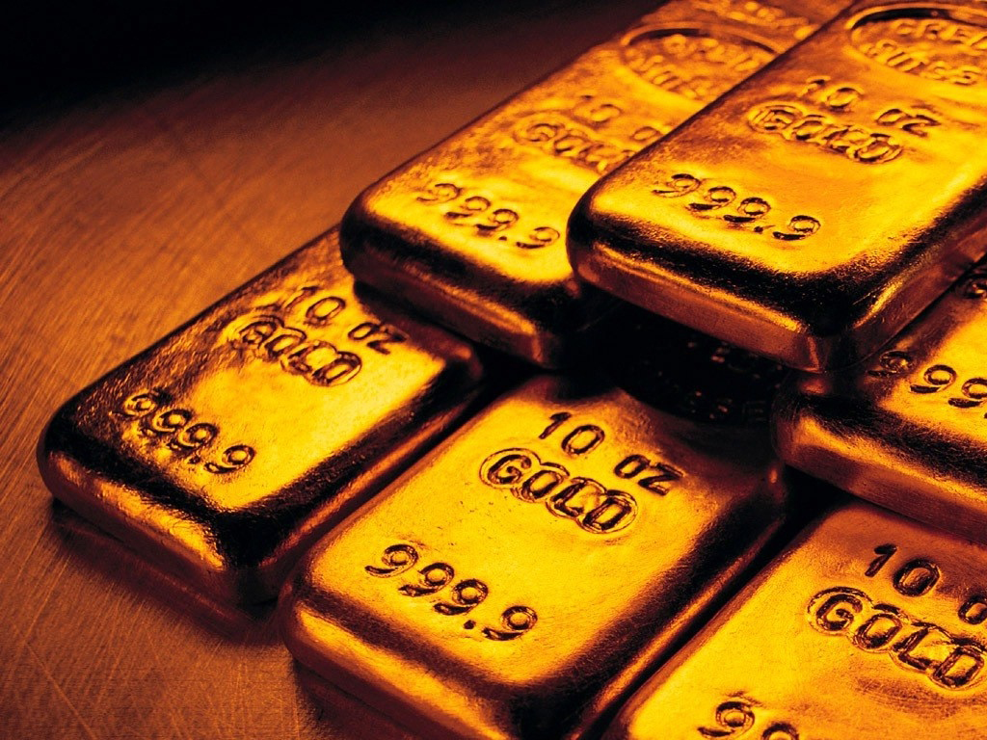



Slide 3
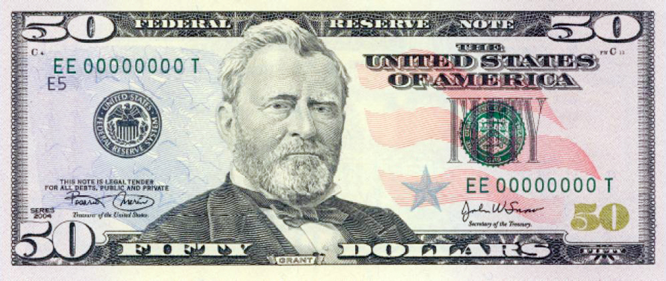
Matthew 18:21-35 21 Then came Peter to him, and said, Lord, how oft shall my brother sin against me, and I forgive him? till seven times?

Slide 4
Matthew 18:21-35 22 Jesus saith unto him, I say not unto thee, Until seven times: but, Until seventy times seven.

Slide 5
Matthew 18:21-35 23 Therefore is the kingdom of heaven likened unto a certain king, which would take account of his servants.

Slide 6
Matthew 18:21-35 24 And when he had begun to reckon, one was brought unto him, which owed him ten thousand talents.

Slide 7
Matthew 18:21-35 25 But forasmuch as he had not to pay, his lord commanded him to be sold, and his wife, and children, and all that he had, and payment to be made.

Slide 8
Matthew 18:21-35 26 The servant therefore fell down, and worshipped him, saying, Lord, have patience with me, and I will pay thee all.

Slide 9
Matthew 18:21-35 27 Then the lord of that servant was moved with compassion, and loosed him, and forgave him the debt.

Slide 10
In Jesus’ day, a talent would be equivalent to about 20 years worth of savings

Slide 11
A talent equaled about $500,000 in today’s money

Slide 12
This one man owed the King 10,000 Talents!

Slide 13
If one talent is about $500,000 in today’s money, then this man owed the King around $5,000,000,000!

Slide 14
That’s $5 Billion, PEOPLE!!!

Slide 15
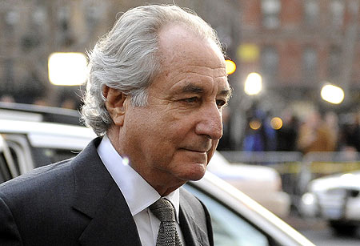
BERNIE MADOFF
Swindled almost $30 Billion

Slide 16
Matthew 18:21-35 28 But the same servant went out, and found one of his fellowservants, which owed him an hundred pence: and he laid hands on him, and took him by the throat, saying, Pay me that thou owest.

Slide 17
Matthew 18:21-35 29 And his fellowservant fell down at his feet, and besought him, saying, Have patience with me, and I will pay thee all.

Slide 18
Matthew 18:21-35 30 And he would not: but went and cast him into prison, till he should pay the debt.

Slide 20
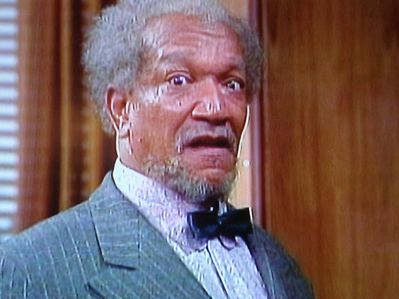
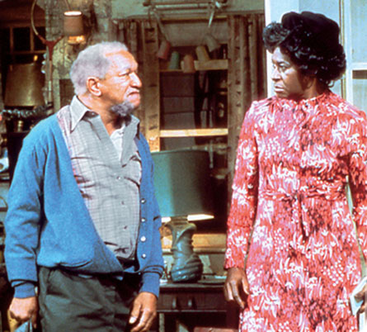
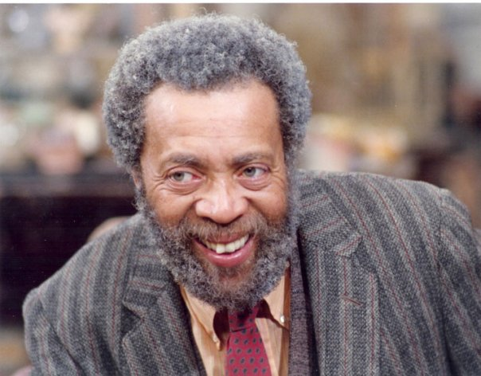

Slide 21
Matthew 18:21-35 31 So when his fellowservants saw what was done, they were very sorry, and came and told unto their lord all that was done.

Slide 22
Matthew 18:21-35 32 Then his lord, after that he had called him, said unto him, O thou wicked servant, I forgave thee all that debt, because thou desiredst me.

Slide 23
Matthew 18:21-35 33 Shouldest not thou also have had compassion on thy fellowservant, even as I had pity on thee?

Slide 24
Matthew 18:21-35 34 And his lord was wroth, and delivered him to the tormentors, till he should pay all that was due unto him.

Slide 25
Matthew 18:21-35 35 So likewise shall my heavenly Father do also unto you, if ye from your hearts forgive not every one his brother their trespasses.

Slide 26


