Slide 1



Slide 2
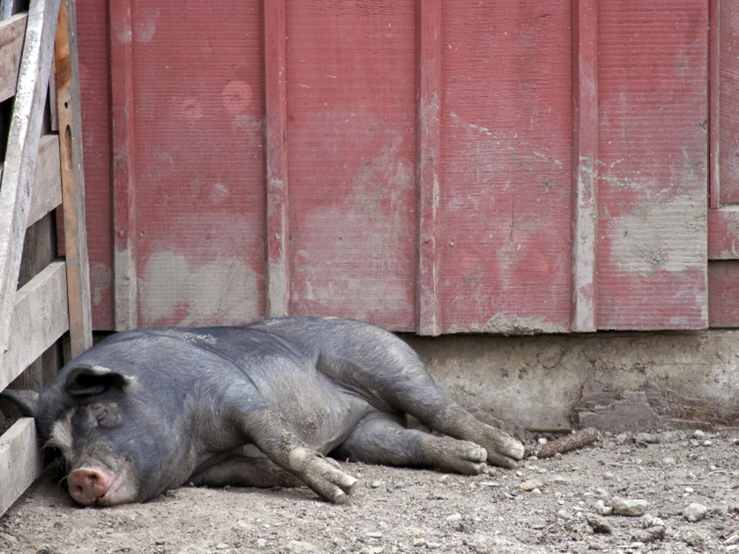
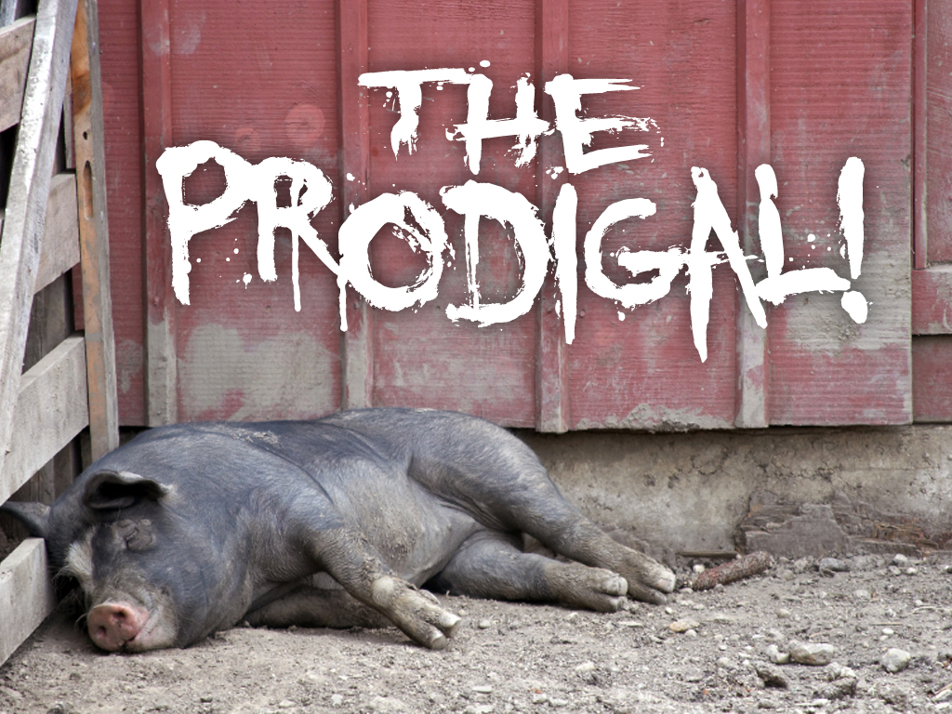

Slide 3
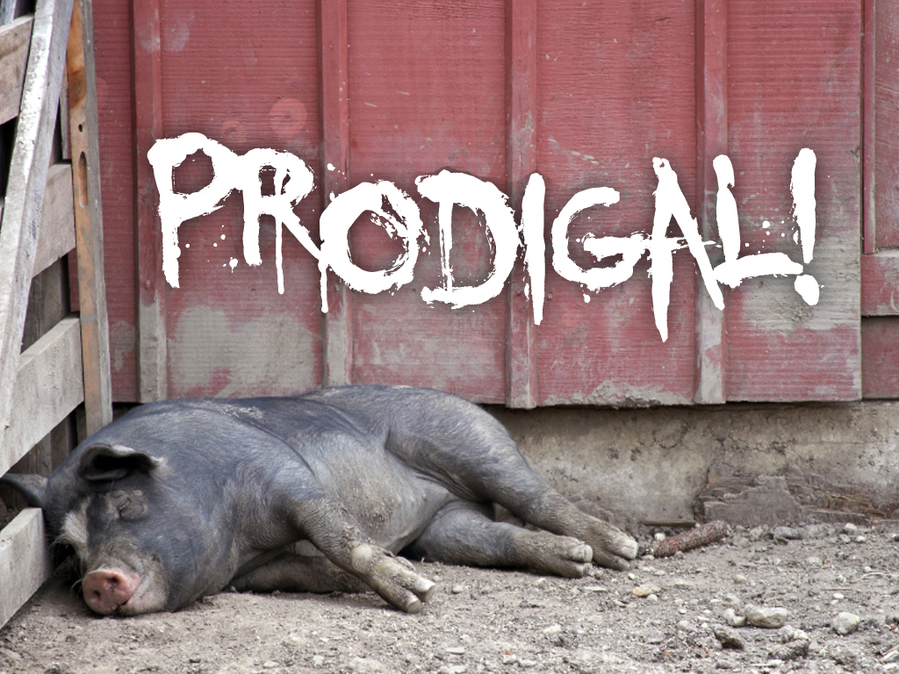
Adjective [prod-i-guhl]
Reckless
Undisciplined

Slide 4
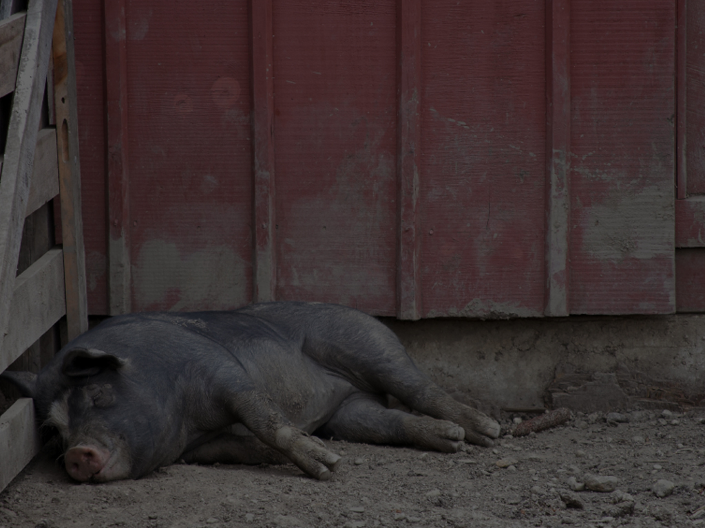
THE PRODIGAL SON
Sinner
Luke 15:11-16
¹¹And he said, A certain man had two sons:
¹²And the younger of them said to his father, Father, give me the portion of goods that falleth to me. And he divided unto them his living.

Slide 5
THE PRODIGAL SON
Sinner
Luke 15:11-16
¹³And not many days after the younger son gathered all together, and took his journey into a far country, and there wasted his substance with riotous living.
¹⁴And when he had spent all, there arose a mighty famine in that land; and he began to be in want.

Slide 6
THE PRODIGAL SON
Sinner
Luke 15:11-16
¹⁵And he went and joined himself to a citizen of that country; and he sent him into his fields to feed swine.
¹⁶And he would fain have filled his belly with the husks that the swine did eat: and no man gave unto him.

Slide 7
THE PRODIGAL SON
Sinner
He Lost His Senses
He Had No Spiritual Sense
“Give Me”

Slide 8
THE PRODIGAL SON
Sinner
He Lost His Senses
He Had No Spiritual Sense
“Far Country”

Slide 9
THE PRODIGAL SON
Sinner
He Lost His Senses
He Had No Spiritual Sense
“Wasted”

Slide 10
THE PRODIGAL SON
Sinner
He Lost His Senses
He Had No Spiritual Sense
“Famine”

Slide 11
THE PRODIGAL SON
Sinner
He Lost His Senses
He Had No Spiritual Sense
“Joined Himself”

Slide 12
THE PRODIGAL SON
Sinner
He Lost His Senses
He Had No Spiritual Sense
“Husks That
Pigs Eat”

Slide 13
THE PRODIGAL SON
Sinner
Luke 15:17-19
¹⁷And when he came to himself, he said, How many hired servants of my father's have bread enough and to spare, and I perish with hunger!

Slide 14
THE PRODIGAL SON
Sinner
Luke 15:17-19
¹⁸I will arise and go to my father, and will say unto him, Father, I have sinned against heaven, and before thee,
¹⁹And am no more worthy to be called thy son: make me as one of thy hired servants.

Slide 15
THE PRODIGAL SON
Sinner
When He Came To Himself
He Regained His Senses
He Had Spiritual Sense
“I Will Arise”

Slide 16
THE PRODIGAL SON
Sinner
When He Came To Himself
He Regained His Senses
He Had Spiritual Sense
“I Will Go”

Slide 17
THE PRODIGAL SON
Sinner
When He Came To Himself
He Regained His Senses
He Had Spiritual Sense
“I Will Say…”

Slide 18
THE PRODIGAL SON
Sinner
When He Came To Himself
He Regained His Senses
He Had Spiritual Sense
“I HAVE SINNED!”
“I Am Not Worthy”

Slide 19
THE PRODIGAL SON
Sinner
When He Came To Himself
He Regained His Senses
He Had Spiritual Sense
“I HAVE SINNED!”
“Make Me A Servant”

Slide 21
THE PRODIGAL’S DAD
The Forgiving Father
Luke 15:20
And he arose, and came to his father. But when he was yet a great way off, his father saw him, and had compassion, and ran, and fell on his neck, and kissed him.

Slide 22
THE PRODIGAL’S DAD
The Forgiving Father
He Arose
And Came To
His Father

Slide 23
THE PRODIGAL’S DAD
The Forgiving Father
AND WHEN HE WAS A GREAT
WAY OFF, HIS FATHER...
Saw Him
Had Compassion On Him
Ran To Him (why?)
Because His Father Loved Him
Because He Would Have Been Stoned

Slide 24
THE PRODIGAL’S DAD
The Forgiving Father
Deuteronomy 21:18-21
¹⁸If a man have a stubborn and rebellious son, which will not obey the voice of his father, or the voice of his mother, and that, when they have chastened him, will not hearken unto them:

Slide 25
THE PRODIGAL’S DAD
The Forgiving Father
Deuteronomy 21:18-21
¹⁹Then shall his father and his mother lay hold on him, and bring him out unto the elders of his city, and unto the gate of his place;

Slide 26
THE PRODIGAL’S DAD
The Forgiving Father
Deuteronomy 21:18-21
²⁰And they shall say unto the elders of his city, This our son is stubborn and rebellious, he will not obey our voice; he is a glutton, and a drunkard.

Slide 27
THE PRODIGAL’S DAD
The Forgiving Father
Deuteronomy 21:18-21
²¹And all the men of his city shall stone him with stones, that he die: so shalt thou put evil away from among you; and all Israel shall hear, and fear.

Slide 28
THE PRODIGAL’S DAD
The Forgiving Father
HIS FATHER...
Fell On His Neck
Kissed Him

Slide 29
THE PRODIGAL’S DAD
The Forgiving Father
Luke 15:21
And the son said unto him, Father, I have sinned against heaven, and in thy sight, and am no more worthy to be called thy son.

Slide 30
THE PRODIGAL’S DAD
The Forgiving Father
“Father, I
HAVE SINNED!”
Repentance

Slide 31
THE PRODIGAL’S DAD
The Forgiving Father
The Father Responds...
Luke 15:22-23
²²But the father said to his servants, Bring forth the best robe, and put it on him; and put a ring on his hand, and shoes on his feet:
²³And bring hither the fatted calf, and kill it; and let us eat, and be merry:

Slide 32
THE PRODIGAL’S DAD
The Forgiving Father
The Father Responds...
Bring The BEST Robe (the father’s robe)
Put A Ring On His Hand
Put Shoes On His Feet
Bring The Fatted Calf (he kept one ready!)
Let Us Eat And Be Merry

Slide 33
THE PRODIGAL’S DAD
The Forgiving Father
Luke 15:24
For this my son was dead, and is alive again; he was lost, and is found. And they began to be merry.

Slide 34
THE PRODIGAL’S DAD
The Forgiving Father
“My Son Was Dead And Is Alive Again!”

Slide 35
THE PRODIGAL’S DAD
The Forgiving Father
“he was lost and is found!”

Slide 37
THE PRODIGAL’S BROTHER
Pharisee
Luke 15:25-28
²⁵Now his elder son was in the field: and as he came and drew nigh to the house, he heard musick and dancing.
²⁶And he called one of the servants, and asked what these things meant.

Slide 38
THE PRODIGAL’S BROTHER
Pharisee
Luke 15:25-28
²⁷And he said unto him, Thy brother is come; and thy father hath killed the fatted calf, because he hath received him safe and sound.
²⁸And he was angry, and would not go in: therefore came his father out, and intreated him.

Slide 39
THE PRODIGAL’S BROTHER
Pharisee
He Was Angry!

Slide 40
THE PRODIGAL’S BROTHER
Pharisee
He Would Not Go In!!

Slide 41
THE PRODIGAL’S BROTHER
Pharisee
Luke 15:29
And he answering said to his father, Lo, these many years do I serve thee, neither transgressed I at any time thy commandment: and yet thou never gavest me a kid, that I might make merry with my friends:

Slide 42
THE PRODIGAL’S BROTHER
Pharisee
I SERVED!
I NEVER TRANSGRESSED!
These are
Commendable

Slide 43
THE PRODIGAL’S BROTHER
Pharisee
“YOU NEVER!”
This Is
Pathetic!!!

Slide 44
THE PRODIGAL’S BROTHER
Pharisee
“I, I; You Never”
IS NEVER GOOD!

Slide 45
THE PRODIGAL’S BROTHER
Pharisee
Luke 15:30
But as soon as this thy son was come, which hath devoured thy living with harlots, thou hast killed for him the fatted calf.

Slide 46
THE PRODIGAL’S BROTHER
Pharisee
“But As Soon
As Your Son
Was Come…”

Slide 47
THE PRODIGAL’S BROTHER
Pharisee
“You Killed The Fatted Calf!!!”
(Immediate Forgiveness!)

Slide 48
THE PRODIGAL’S BROTHER
Pharisee
1 John 1:9
If we confess our sins, he is faithful and just to forgive us our sins, and to cleanse us from all unrighteousness.

Slide 49
THE PRODIGAL’S BROTHER
Pharisee
Luke 15:31-32
³¹And he said unto him, Son, thou art ever with me, and all that I have is thine.
³²It was meet that we should make merry, and be glad: for this thy brother was dead, and is alive again; and was lost, and is found.

Slide 50
THE PRODIGAL’S BROTHER
Pharisee
The Father Says, Son...
You Are Always With Me
All I Have Is Yours
You Should Celebrate And Be Glad

Slide 51
THE PRODIGAL’S BROTHER
Pharisee
“Your Brother Was Dead And Is Alive Again!”

Slide 52
THE PRODIGAL’S BROTHER
Pharisee
“he was lost and is found!”

Slide 53
Two Types Of Lost People...
Pigsty Or Pew
They both stink!

Slide 54
Get The Message?

