Slide 1




Slide 2

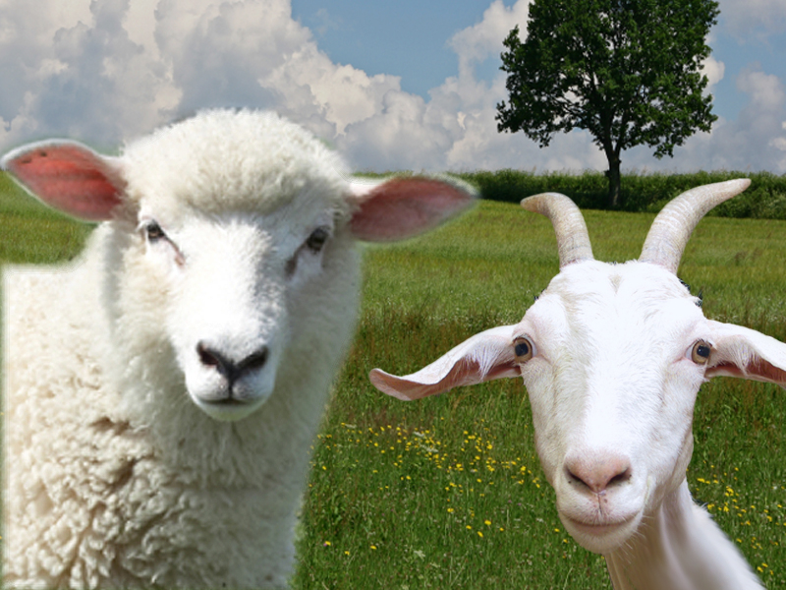
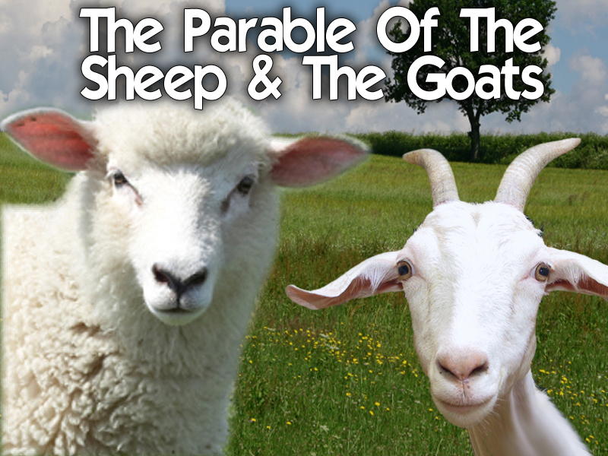
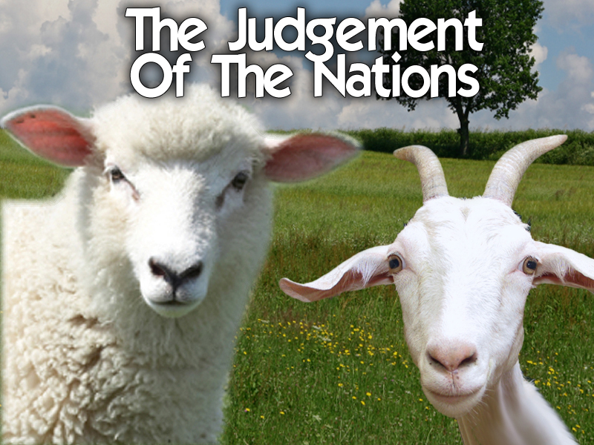

Slide 3
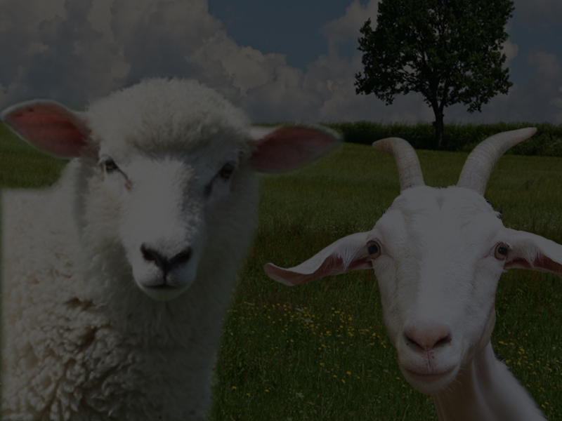
Some Don’t Consider These Scriptures A Parable Because It Doesn’t Seem To Relate To A Story Of Events To Other Characters
(However, I DO!)

Slide 4
It Is The Vital Portion Of A Section Centering On A Series Of Parables That All Deal With The Question The Disciples Asked At The Beginning Of Matthew 25

Slide 5
I’M TREATING IT AS A PARABLE!

Slide 6
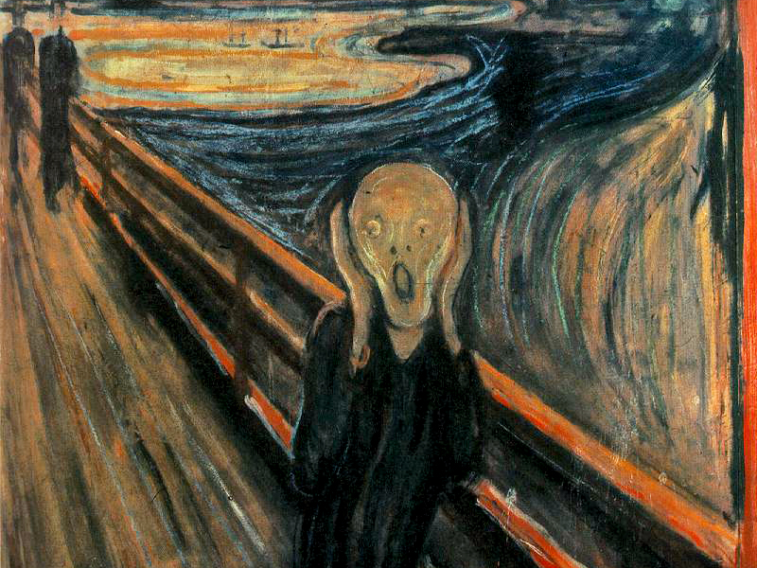

Slide 7
The Disciples asked Jesus: “When will these things happen concerning the destruction of the Temple?”

Slide 8
The Disciples asked Jesus: “What are the signs of your coming and the end of the world?”

Slide 9
Jesus gave the longest answer recorded in scriptures, and He took it one step further!

Slide 10
He described what will happen at the end of the Tribulation Period
(7 years of unprecedented anguish and holocaust of pain on planet earth)

Slide 11
This is a controversial passage that is often misunderstood, and even more rarely preached about!

Slide 12
Matthew 25:31
When the Son of man shall come in his glory, and all the holy angels with him, then shall he sit upon the throne of his glory:

Slide 13
JESUS IS THE JUDGE!
John 5:22 & 27
²²For the Father judgeth no man, but hath committed all judgment unto the Son:
²⁷And hath given him authority to execute judgment also, because he is the Son of man.

Slide 14
Jesus will preside over the ‘Judgment Of The Nations’

Slide 15
He will be accompanied by His Holy Angels in the ‘Pouring Out Of Judgment’

Slide 16
This judgment will take place when the Son comes in His Glory at the Second Coming!

Slide 17
This is not the Rapture (snatching away)

Slide 18
1 Thessalonians 4:16-17
¹⁶For the Lord himself shall descend from heaven with a shout, with the voice of the archangel, and with the trump of God: and the dead in Christ shall rise first:
¹⁷Then we which are alive and remain shall be caught up together with them in the clouds, to meet the Lord in the air: and so shall we ever be with the Lord.

Slide 19
This is when Jesus Christ comes to the earth at the end of the Tribulation Period

Slide 20
WHERE WILL THIS JUDGMENT TAKE PLACE?
Matthew 25:31
When the Son of man shall come in his glory, and all the holy angels with him, then shall he sit upon the throne of his glory:

Slide 21
WHERE WILL THIS JUDGMENT TAKE PLACE?
He will sit on His Glorious Throne
on Earth!

Slide 22
WHERE WILL THIS JUDGMENT TAKE PLACE?
Isaiah 9:7
Of the increase of his government and peace there shall be no end, upon the throne of David, and upon his kingdom, to order it, and to establish it with judgment and with justice from henceforth even for ever. The zeal of the LORD of hosts will perform this.

Slide 23
WHERE WILL THIS JUDGMENT TAKE PLACE?
He will reign a thousand years
on the Earth
(Millennial Reign of Christ)

Slide 24
WHERE WILL THIS JUDGMENT TAKE PLACE?
This Judgment Of The Nations will take place at the very beginning of His 1,000 year reign

Slide 25
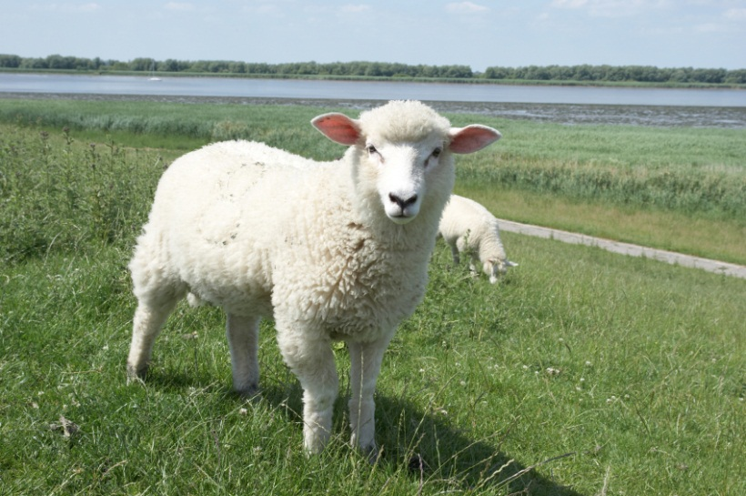
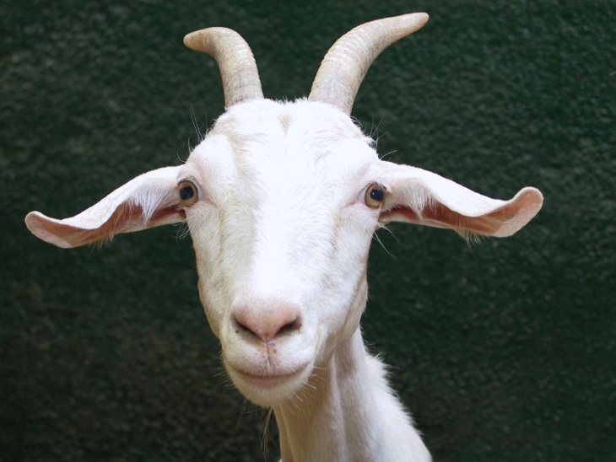
WHO WILL BE JUDGED?
Matthew 25:32
And before him shall be gathered all nations: and he shall separate them one from another, as a shepherd divideth his sheep from the goats:

Slide 26
WHO WILL BE JUDGED?
“All Nations”
means Peoples,
not Countries

Slide 27
WHO WILL BE JUDGED?
There will be believers in Jesus as well as non-believers on the earth after the Tribulation Period

Slide 28
WHO WILL BE JUDGED?
Those who have believed in Jesus Christ will reign with Jesus
for 1,000 years

Slide 29
WHO WILL BE JUDGED?
Those who
refused to believe, will immediately
go to Hell!

Slide 32
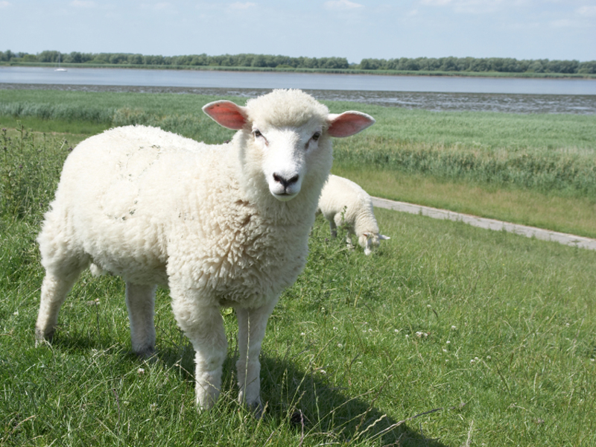

Slide 33
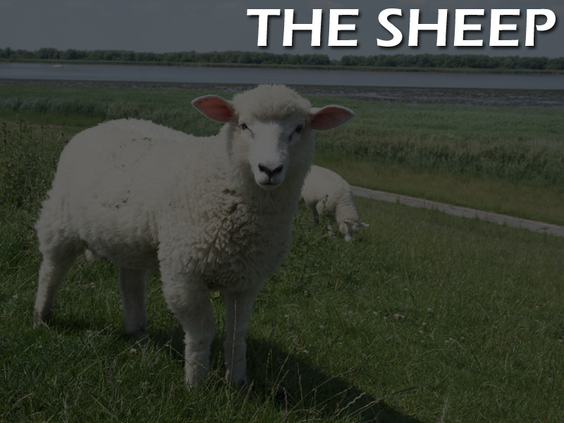
Matthew 25:33-40
³³And he shall set the sheep on his right hand, but the goats on the left.
³⁴Then shall the King say unto them on his right hand, Come, ye blessed of my Father, inherit the kingdom prepared for you from the foundation of the world:

Slide 34
Matthew 25:33-40
³⁵For I was an hungred, and ye gave me meat: I was thirsty, and ye gave me drink: I was a stranger, and ye took me in:
³⁶Naked, and ye clothed me: I was sick, and ye visited me: I was in prison, and ye came unto me.

Slide 35
Matthew 25:33-40
³⁷Then shall the righteous answer him, saying, Lord, when saw we thee an hungred, and fed thee? or thirsty, and gave thee drink?
³⁸When saw we thee a stranger, and took thee in? or naked, and clothed thee?

Slide 36
Matthew 25:33-40
³⁹Or when saw we thee sick, or in prison, and came unto thee?
⁴⁰And the King shall answer and say unto them, Verily I say unto you, Inasmuch as ye have done it unto one of the least of these my brethren, ye have done it unto me.

Slide 37
The sheep are
the believers in Jesus Christ

Slide 38
They are true believers
and the evidence of their relationship with Jesus Christ was truly manifest in what they did

Slide 39
6 Things They Did…
They gave food to the hungry
They gave drink to the thirsty
They gave hospitality to strangers
They gave clothes to the naked
They visited the sick
They befriended those in prison

Slide 40
These true believers in Jesus Christ had Faith In Action!

Slide 41
1 John 3:16-19
¹⁶Hereby perceive we the love of God, because he laid down his life for us: and we ought to lay down our lives for the brethren.

Slide 42
1 John 3:16-19
¹⁷But whoso hath this world's good, and seeth his brother have need, and shutteth up his bowels of compassion from him, how dwelleth the love of God in him?

Slide 43
1 John 3:16-19
¹⁸My little children, let us not love in word, neither in tongue; but in deed and in truth.

Slide 44
1 John 3:16-19
¹⁹And hereby we know that we are of the truth, and shall assure our hearts before him.

Slide 45
WHO DID THEY DO THIS FOR?
Matthew 25:40
And the King shall answer and say unto them, Verily I say unto you, Inasmuch as ye have done it unto one of the least of these my brethren, ye have done it unto me.

Slide 46
WHO DID THEY DO THIS FOR?
“MY BRETHREN”
They did it for the Jews!

Slide 47
WHO DID THEY DO THIS FOR?
Zechariah 13:8-9
⁸And it shall come to pass, that in all the land, saith the LORD, two parts therein shall be cut off and die; but the third shall be left therein.

Slide 48
WHO DID THEY DO THIS FOR?
Zechariah 13:8-9
⁹And I will bring the third part through the fire, and will refine them as silver is refined, and will try them as gold is tried: they shall call on my name, and I will hear them: I will say, It is my people: and they shall say, The LORD is my God.

Slide 49
WHO DID THEY DO THIS FOR?
Two-thirds of all
the Jews will die

Slide 50
WHO DID THEY DO THIS FOR?
Those who refuse the Anti-Christ will face annihilation

Slide 51
WHO DID THEY DO THIS FOR?
They will be hated, hunted down and exterminated

Slide 52
WHO DID THEY DO THIS FOR?
Certainly those assisting them will do so at their own peril!

Slide 53
Jesus Says To The True Believers, Those Who Do Right Regardless
Of The Consequences…
Matthew 25:34
Then shall the King say unto them on his right hand, Come, ye blessed of my Father, inherit the kingdom prepared for you from the foundation of the world:

Slide 54


Slide 55
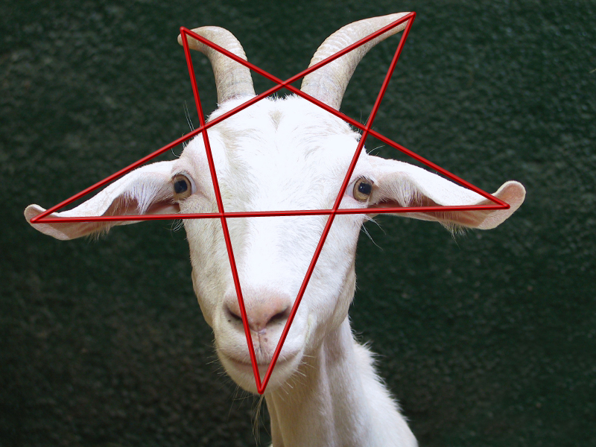

Slide 56
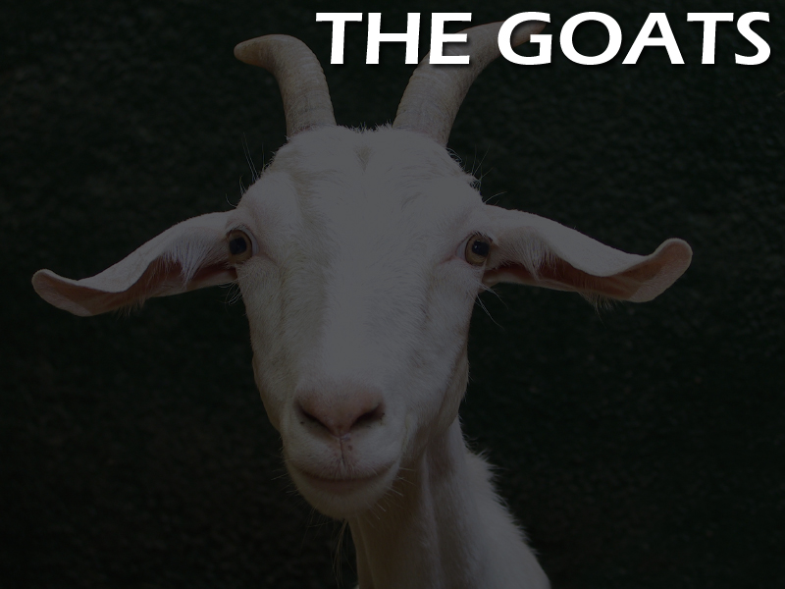
Matthew 25:41-46
⁴¹Then shall he say also unto them on the left hand, Depart from me, ye cursed, into everlasting fire, prepared for the devil and his angels:
⁴²For I was an hungred, and ye gave me no meat: I was thirsty, and ye gave me no drink:

Slide 57
Matthew 25:41-46
⁴³I was a stranger, and ye took me not in: naked, and ye clothed me not: sick, and in prison, and ye visited me not.
⁴⁴Then shall they also answer him, saying, Lord, when saw we thee an hungred, or athirst, or a stranger, or naked, or sick, or in prison, and did not minister unto thee?

Slide 58
Matthew 25:41-46
⁴⁵Then shall he answer them, saying, Verily I say unto you, Inasmuch as ye did it not to one of the least of these, ye did it not to me.
⁴⁶And these shall go away into everlasting punishment: but the righteous into life eternal.

Slide 59
The goats are unbelievers in
Jesus Christ

Slide 60
There is no evidence
of a true relationship
with Jesus Christ – because they don’t
know Him personally!

Slide 61
Matthew 7:21-23
²¹Not every one that saith unto me, Lord, Lord, shall enter into the kingdom of heaven; but he that doeth the will of my Father which is in heaven.

Slide 62
Matthew 7:21-23
²²Many will say to me in that day, Lord, Lord, have we not prophesied in thy name? and in thy name have cast out devils? and in thy name done many wonderful works?

Slide 63
Matthew 7:21-23
²³And then will I profess unto them, I never knew you: depart from me, ye that work iniquity.

Slide 64
7 Characteristics They Possess…
They claim to be Christians
They know the truth and don’t act on it
They hide, are ashamed and afraid
Their belief doesn’t affect their heart
They are damned by their lack of faith
They deny Jesus – He denies them!
They immediately go into everlasting
punishment!

Slide 66
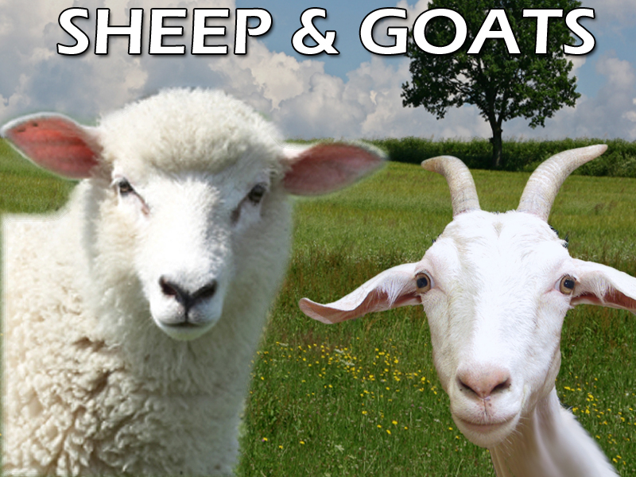

Slide 67
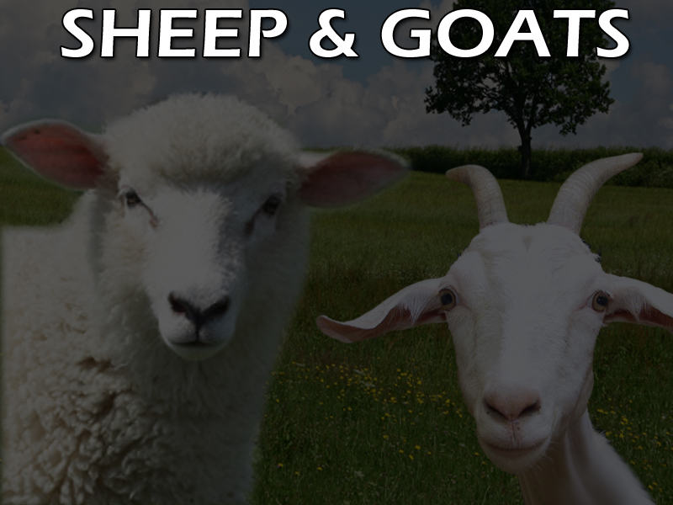
Their sounds are similar

Slide 68
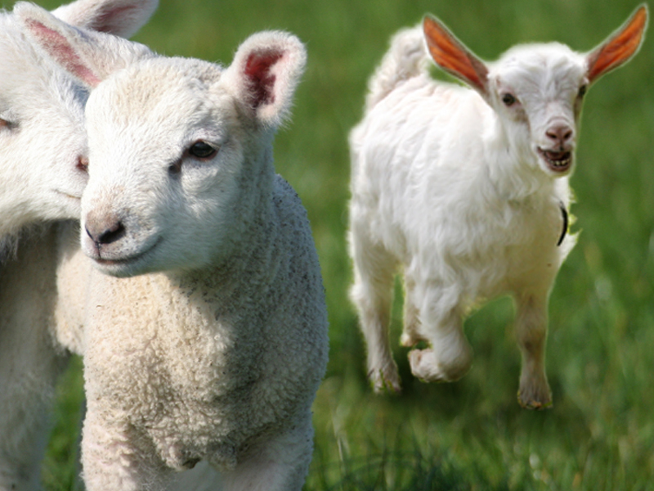
Even As Babies, They Look Alike

Slide 70
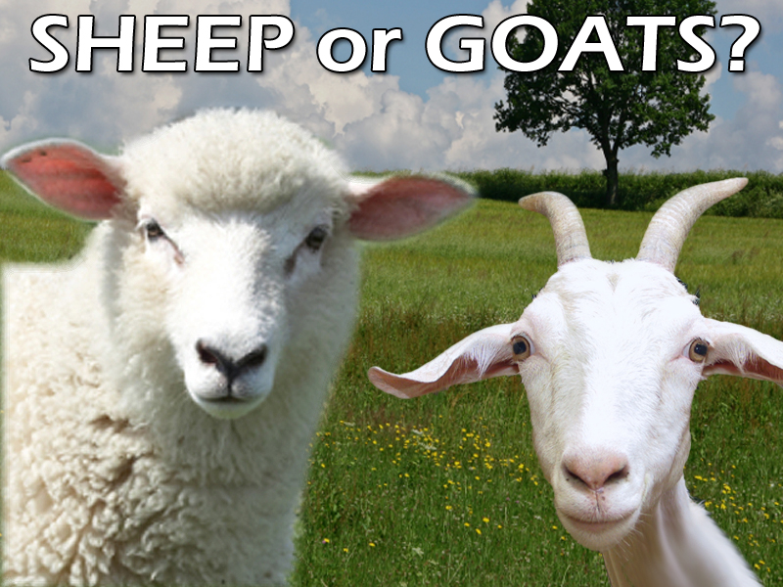

Slide 72
