Slide 1




Slide 2

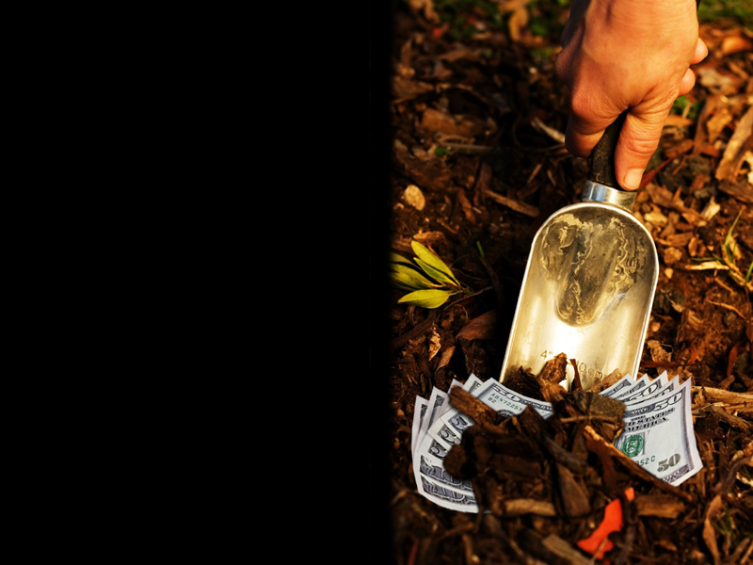


Slide 3
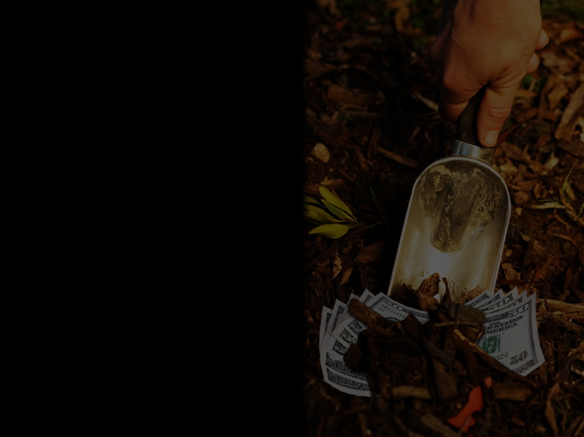
Look Again…
Matthew 25:13 Watch therefore, for ye know neither the day nor the hour wherein the Son of man cometh.

Slide 4
Watching And Waiting Doesn’t Mean Sitting!

Slide 5
We Are To Be Watching & Working!

Slide 6
Matthew 25:14-15 ¹⁴ For the kingdom of heaven is as a man travelling into a far country, who called his own servants, and delivered unto them his goods.
¹⁵ And unto one he gave five talents, to another two, and to another one; to every man according to his several ability; and straightway took his journey.

Slide 7
A Talent was a sum of money

Slide 8
In Jesus’ day, a talent would be equivalent to about 20 years worth of savings

Slide 9
A talent equaled about $500,000 in today’s money

Slide 10

Businessman #1 5 talents = $2,500,000
Businessman #2 2 talents = $1,000,000
Businessman #3 1 talent = $500,000

Slide 11
DO THE MATH
Matthew 25:16-17 ¹⁶ Then he that had received the five talents went and traded with the same, and made them other five talents.
¹⁷ And likewise he that had received two, he also gained other two.

Slide 12
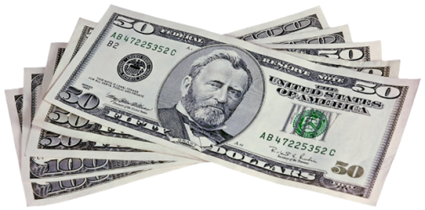
DO THE MATH
Businessman #1 Invested diligently & wisely
$2.5 million
+$2.5 million
= $5 million

Slide 13
DO THE MATH
Businessman #2 Invested diligently & wisely
$1 million
+$1 million
=$2 million

Slide 14
DO THE MATH
Matthew 25:18 But he that had received one went and digged in the earth, and hid his lord's money.

Slide 15
DO THE MATH
Matthew 25:18 But he that had received one went and digged in the earth, and hid his lord's money.

Slide 16
DO THE MATH
Businessman #3
He hid it where nobody could find it

Slide 17
DO THE MATH
Businessman #3
He took no risks and did no work

Slide 18
DO THE MATH
Businessman #3
He wasted his chances for investing

Slide 19
DO THE MATH
Businessman #3
He was irresponsible

Slide 20
DO THE MATH
Businessman #3
He was afraid and lacked faith

Slide 21
DO THE MATH
Businessman #3
He had very little regard for his master

Slide 22
DO THE MATH
Businessman #3
He was a failure!

Slide 23
A lot of Christians are afraid to serve the Lord “All Out!”

Slide 24
They are afraid to lead and take responsibility

Slide 25
They are afraid to give to God’s work
“It Scares Them To Death!”

Slide 26
Dow Jones don’t hold a candle to God when it comes to being tough on investment returns!

Slide 27
GOD EXPECTS A PROFIT
THAT’S THE BOTTOM LINE

Slide 28
A DAY OF RECKONING
THE LORD RETURNS!
Matthew 25:19-23 ¹⁹ After a long time the lord of those servants cometh, and reckoneth with them.
²⁰ And so he that had received five talents came and brought other five talents, saying, Lord, thou deliveredst unto me five talents: behold, I have gained beside them five talents more.

Slide 29
A DAY OF RECKONING
THE LORD RETURNS!
Matthew 25:19-23 ²¹ His lord said unto him, Well done, thou good and faithful servant: thou hast been faithful over a few things, I will make thee ruler over many things: enter thou into the joy of thy lord.

Slide 30
A DAY OF RECKONING
THE LORD RETURNS!
Matthew 25:19-23 ²² He also that had received two talents came and said, Lord, thou deliveredst unto me two talents: behold, I have gained two other talents beside them.

Slide 31
A DAY OF RECKONING
THE LORD RETURNS!
Matthew 25:19-23 ²³ His lord said unto him, Well done, good and faithful servant; thou hast been faithful over a few things, I will make thee ruler over many things: enter thou into the joy of thy lord.

Slide 32
A DAY OF RECKONING
THE LORD RETURNS!
These two were excited about what they had done!

Slide 33
A DAY OF RECKONING
THE LORD RETURNS!
They each received commendations, promotions and vacations!

Slide 34
A DAY OF RECKONING
THE LORD RETURNS!
Matthew 25:24-30 ²⁴ Then he which had received the one talent came and said, Lord, I knew thee that thou art an hard man, reaping where thou hast not sown, and gathering where thou hast not strawed:

Slide 35
A DAY OF RECKONING
THE LORD RETURNS!
Matthew 25:24-30 ²⁵ And I was afraid, and went and hid thy talent in the earth: lo, there thou hast that is thine.

Slide 36
A DAY OF RECKONING
THE LORD RETURNS!
Matthew 25:24-30 ²⁶ His lord answered and said unto him, Thou wicked and slothful servant, thou knewest that I reap where I sowed not, and gather where I have not strawed:

Slide 37
A DAY OF RECKONING
THE LORD RETURNS!
Matthew 25:24-30 ²⁷ Thou oughtest therefore to have put my money to the exchangers, and then at my coming I should have received mine own with usury.

Slide 38
A DAY OF RECKONING
THE LORD RETURNS!
Matthew 25:24-30 ²⁸ Take therefore the talent from him, and give it unto him which hath ten talents.
²⁹ For unto every one that hath shall be given, and he shall have abundance: but from him that hath not shall be taken away even that which he hath.

Slide 39
A DAY OF RECKONING
THE LORD RETURNS!
Matthew 25:24-30 ³⁰ And cast ye the unprofitable servant into outer darkness: there shall be weeping and gnashing of teeth.

Slide 40
Businessman #3
The Lord said he was lazy!

Slide 41
Businessman #3
The Lord rebuked him for his pitiful mismanagement

Slide 42
Businessman #3
He lost everything

Slide 43
Businessman #3
He got nothing!

Slide 44
Businessman #3
No Commendation
No Promotion
No Vacation!

Slide 46
WHAT DID I LEARN?

Slide 47
WHAT DID I LEARN?
Don’t claim you “have no gifts”
Know you will be judged by God according to what he has given you
If you don’t use it, you’ll lose it!
Lost opportunities
Lost influence for the Kingdom
Lost reward – forever!

Slide 48
1 Peter 3:15 But sanctify the Lord God in your hearts: and be ready always to give an answer to every man that asketh you a reason of the hope that is in you with meekness and fear:

