Slide 1




Slide 2

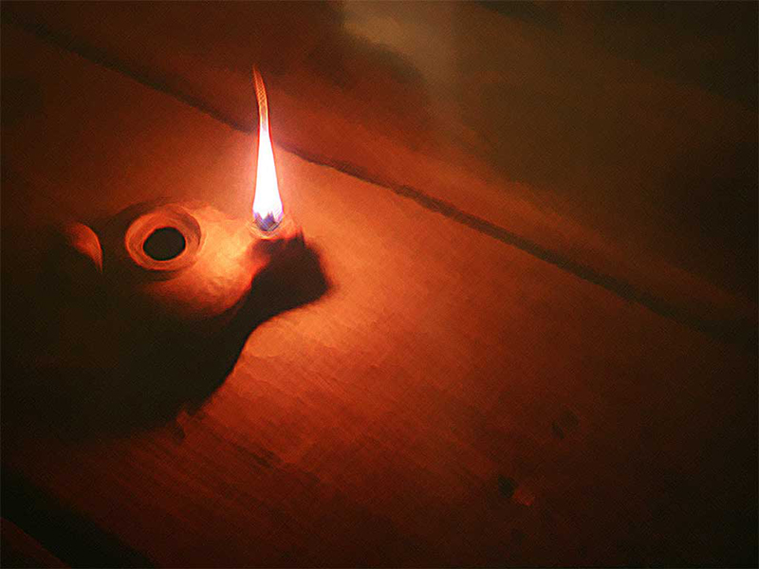


Slide 3

Matthew 25:1 Then shall the kingdom of heaven be likened unto ten virgins, which took their lamps, and went forth to meet the bridegroom.

Slide 4
FIRST THINGS FIRST
You Need To Understand A Jewish Wedding!

Slide 5
There are three BASIC parts to a Jewish wedding

Slide 6
PART ONE
The parents of the children agree on the marriage and establish a dowry

Slide 7
PART TWO
The bridegroom, along with his brothers and friends, go to the bride’s house to claim her as his very own

Slide 8
PART TWO
This was usually done in the evening and the bride would be prepared for his coming

Slide 9
PART TWO
She would then join the bridegroom and return with him to his home (his father’s house)

Slide 10
PART THREE
There would be a huge party that would often last for an entire week. After these events, they would return to their own home.

Slide 11
Matthew 25:2-4 2 And five of them were wise, and five were foolish.
3 They that were foolish took their lamps, and took no oil with them:
4 But the wise took oil in their vessels with their lamps.

Slide 12
5 Virgins were FOOLISH: They took lamps with no oil!

Slide 13
5 Virgins were WISE: They took lamps with oil!

Slide 14
Matthew 25:5 While the bridegroom tarried, they all slumbered and slept.
The bridegroom delayed in coming for the bride, and they all got sleepy and actually dozed off

Slide 15
Matthew 25:6 And at midnight there was a cry made, Behold, the bridegroom cometh; go ye out to meet him.
The Midnight Call: “The Bridegroom Comes!”

Slide 16
Matthew 25:7-9 7 Then all those virgins arose, and trimmed their lamps.
8 And the foolish said unto the wise, Give us of your oil; for our lamps are gone out.
9 But the wise answered, saying, Not so; lest there be not enough for us and you: but go ye rather to them that sell, and buy for yourselves.

Slide 17
They all got up and began working to light their lamps

Slide 18
The problem was – only five of the lamps actually worked!

Slide 19
The 5 foolish women said: “Give us some of your oil!”

Slide 20
The 5 wise women said: “No Way Hose-a”

Slide 21
The 5 wise women said: “There is not enough for both us and you too!”

Slide 22
The 5 wise women said: “Go Get Your Own!”

Slide 23
So what happened?

Slide 24
Matthew 25:10-12 10 And while they went to buy, the bridegroom came; and they that were ready went in with him to the marriage: and the door was shut.
11 Afterward came also the other virgins, saying, Lord, Lord, open to us.
12 But he answered and said, Verily I say unto you, I know you not.

Slide 25
When they got back to the procession, they were already in the father’s house, and the door was shut!
THE PARTY HAD STARTED!

Slide 26
The bridegroom said: “I DON’T KNOW YOU!”

Slide 27
THE POINT
Matthew 25:13 Watch therefore, for ye know neither the day nor the hour wherein the Son of man cometh.

Slide 28
THE POINT
We don’t know when Jesus is coming again
We can and must know that we are born again through Jesus Christ
We cannot make other people believe in Jesus Christ. It is their personal choice!
It is foolish to wait until the last minute to believe in Jesus Christ as your personal Lord and Savior!

Slide 29
THE POINT
2 Corinthians 6:2b (For he saith, I have heard thee in a time accepted, and in the day of salvation have I succoured thee: behold, now is the accepted time; behold, now is the day of salvation.)

