Slide 1




Slide 2

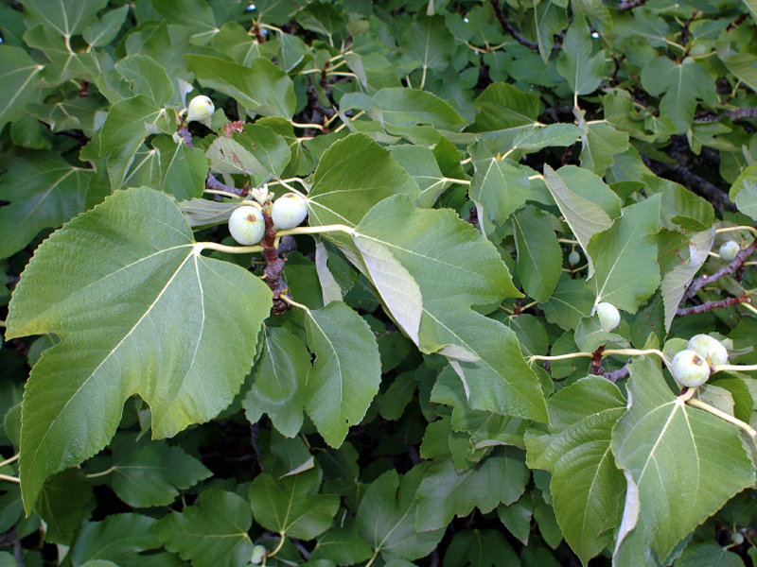
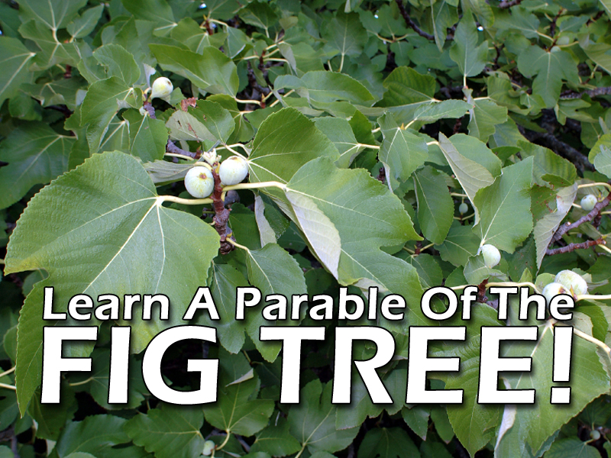

Slide 3
One out of every 30 Bible verses mentions the return of Jesus Christ or the end of the world

Slide 4
In the 216 chapters of the New Testament, there are more than 300 references to the Second Coming of Jesus Christ!

Slide 5
Those who knew Jesus while He was on Earth, REGULARLY talked about His return in their sermons and letters

Slide 6
This isn’t something ‘MADE UP’ by a bunch of wild-eyed, prophetical freaks!

Slide 7
When the disciples asked Jesus about His return and the end of the world, He gave them very specific details…

Slide 8
Matthew 24:3 And as he sat upon the mount of Olives, the disciples came unto him privately, saying, Tell us, when shall these things be? and what shall be the sign of thy coming, and of the end of the world?

Slide 9
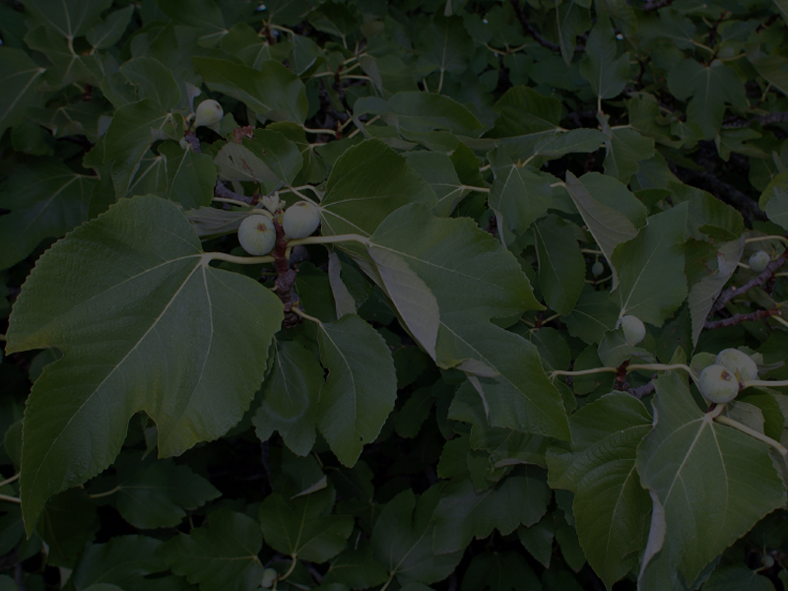
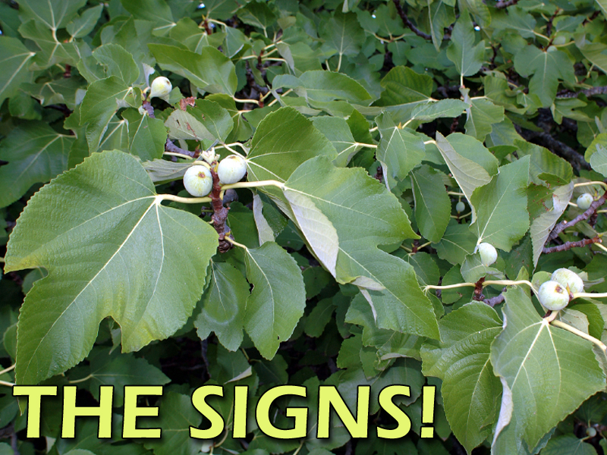

Slide 10
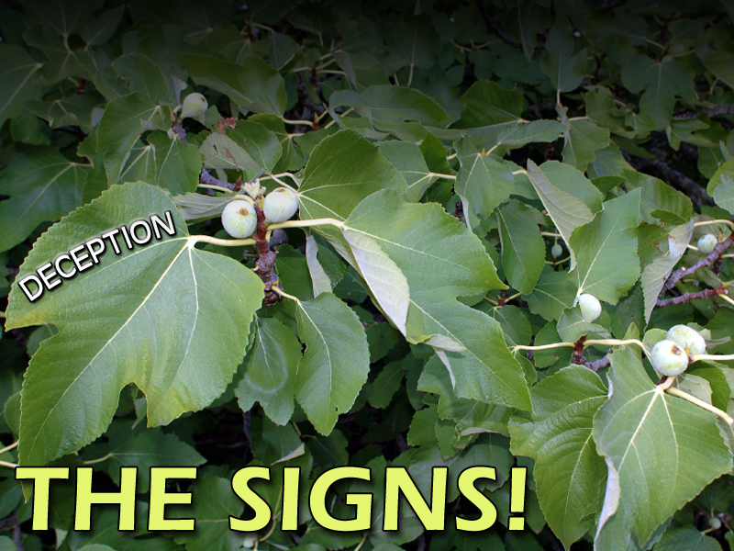
COUNTERFEIT
CHRISTS

Slide 11
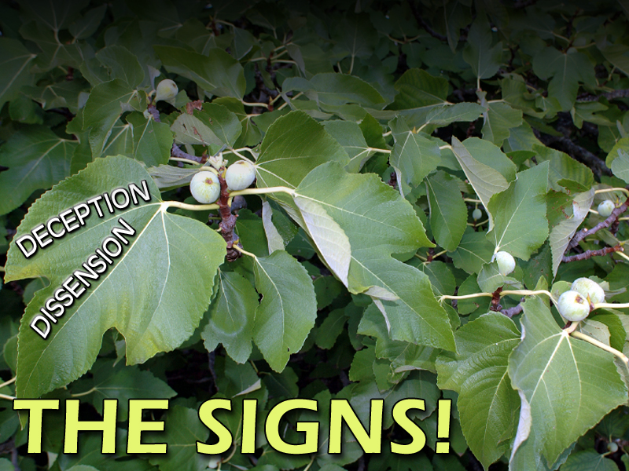
WARS & RUMORS OF WARS
COUNTERFEIT
CHRISTS

Slide 12
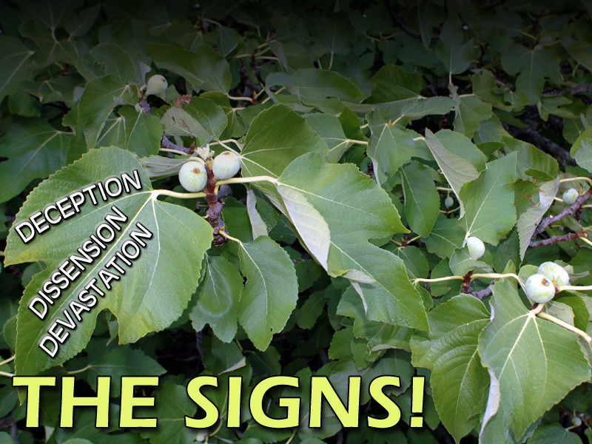
WARS & RUMORS OF WARS
FAMINES
COUNTERFEIT
CHRISTS

Slide 13
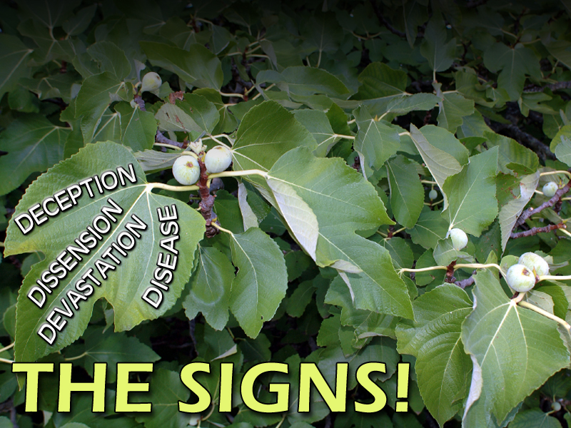
WARS & RUMORS OF WARS
FAMINES
PESTILENCES
COUNTERFEIT
CHRISTS

Slide 14
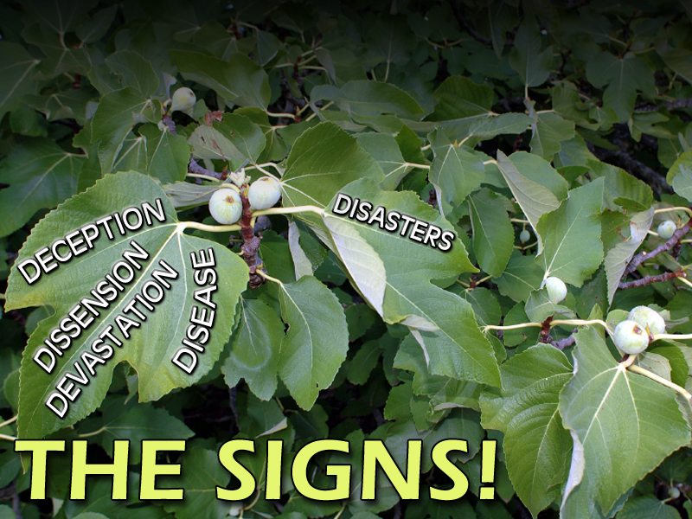
WARS & RUMORS OF WARS
FAMINES
PESTILENCES
COUNTERFEIT
CHRISTS
EARTHQUAKES

Slide 15
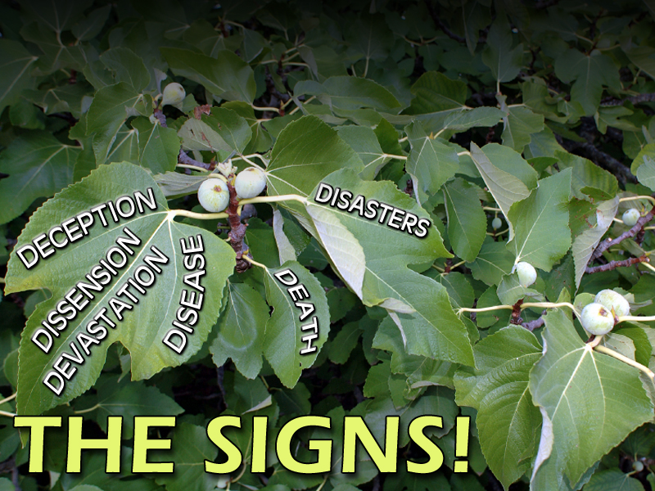
WARS & RUMORS OF WARS
FAMINES
PESTILENCES
COUNTERFEIT
CHRISTS
PERSECUTION
EARTHQUAKES

Slide 16
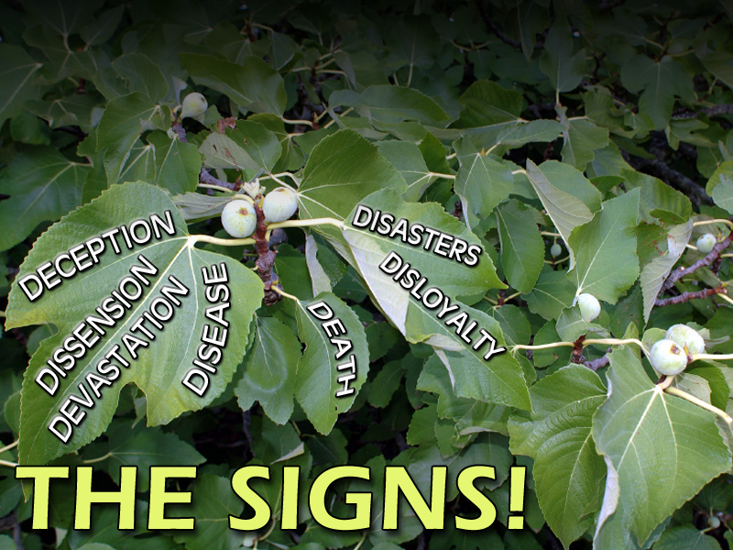
WARS & RUMORS OF WARS
FAMINES
PESTILENCES
COUNTERFEIT
CHRISTS
OFFENDING, BETRAYING & HATING
PERSECUTION
EARTHQUAKES

Slide 17
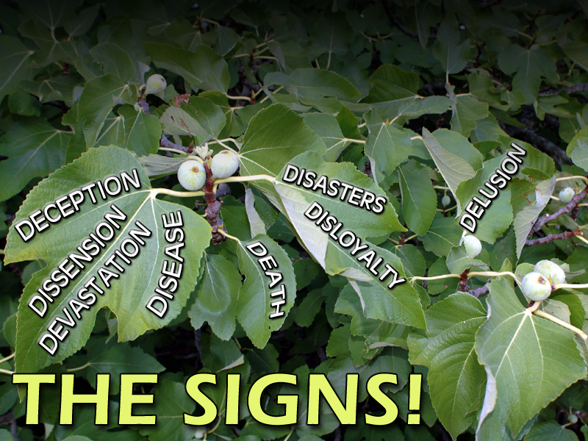
WARS & RUMORS OF WARS
FAMINES
PESTILENCES
COUNTERFEIT
CHRISTS
OFFENDING, BETRAYING & HATING
PERSECUTION
EARTHQUAKES
FALSE RELIGIONS

Slide 18
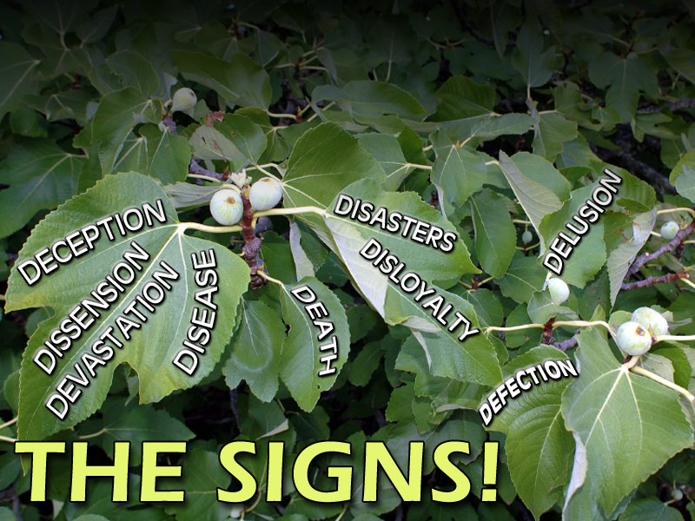
WARS & RUMORS OF WARS
FAMINES
PESTILENCES
COUNTERFEIT
CHRISTS
OFFENDING, BETRAYING & HATING
PERSECUTION
EARTHQUAKES
FALSE RELIGIONS
LAWLESS & COLD HEARTED

Slide 19
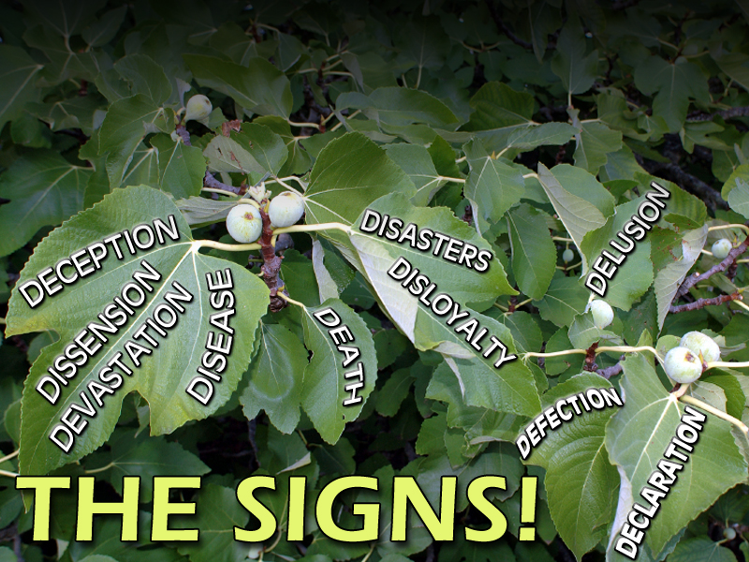
WARS & RUMORS OF WARS
FAMINES
PESTILENCES
COUNTERFEIT
CHRISTS
OFFENDING, BETRAYING & HATING
PERSECUTION
EARTHQUAKES
THE GOSPEL PREACHED IN ALL THE WORLD!
FALSE RELIGIONS
LAWLESS & COLD HEARTED

Slide 21
So, what does the Parable of the Fig Tree have to do with all the signs of Jesus coming and the end of the world?

Slide 22
EVERYTHING!

Slide 23
Matthew 24:32-36 32 Now learn a parable of the fig tree; When his branch is yet tender, and putteth forth leaves, ye know that summer is nigh:
33 So likewise ye, when ye shall see all these things, know that it is near, even at the doors.

Slide 24
Matthew 24:32-36 34 Verily I say unto you, This generation shall not pass, till all these things be fulfilled.
35 Heaven and earth shall pass away, but my words shall not pass away.
36 But of that day and hour knoweth no man, no, not the angels of heaven, but my Father only.

Slide 25
The Parable of the Fig Tree is a vivid and understandable illustration to HELP the Disciples, NOT confuse the Disciples!

Slide 26
Mark 4:11 And he said unto them, Unto you it is given to know the mystery of the kingdom of God: but unto them that are without, all these things are done in parables:

Slide 27
Jesus spoke in parables to help people who wanted to see the truth (to be able to see it) and to those who didn’t, it was concealed and not understood

Slide 28
Matthew 24:32-34 32 Now learn a parable of the fig tree; When his branch is yet tender, and putteth forth leaves, ye know that summer is nigh:
33 So likewise ye, when ye shall see all these things, know that it is near, even at the doors. 34 Verily I say unto you, This generation shall not pass, till all these things be fulfilled.

Slide 29
3 VIEWS OF THE PARABLE
Jesus was coming back very soon and ‘this generation’ means the disciples would not pass away before He returned

Slide 30
3 VIEWS OF THE PARABLE
‘Generation’ speaks of Israel and Jesus would return before Israel would ‘die out’

Slide 31
3 VIEWS OF THE PARABLE
The Fig Tree speaks of Israel and began being fulfilled in 1948 when Israel was re-established as a nation. The generation living at that time would not pass before Jesus Christ returned
Very popular view
A generation is between 30-40 years, so this view has lost some ooomph!
The date has been readjusted to the victory of the Six Day War in 1967 (that clock is ticking too!)

Slide 32
WHEN COMMON SENSE MAKES SENSE – THEN SEEK NO OTHER SENSE!

Slide 33
Fig Trees Were Everywhere In Israel.
They Were Common, Something That Was Easily Seen And That Most Knew At Least A Little Bit About…

Slide 35
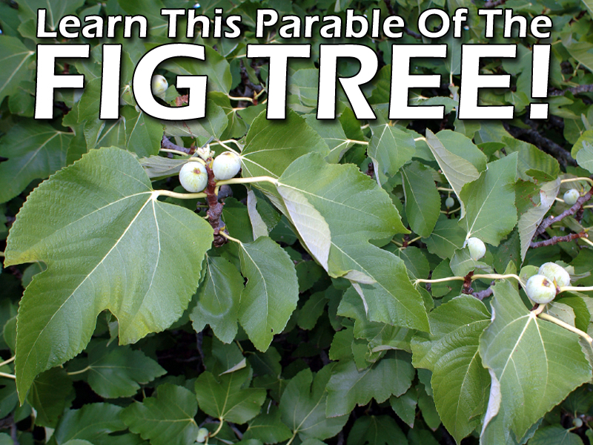
Matthew 24:32 Now learn a parable of the fig tree; When his branch is yet tender, and putteth forth leaves, ye know that summer is nigh:

Slide 36
“When the fig branches are tender, that is to say, when sap starts flowing and the leaves begin breaking forth, YOU KNOW that summer is just around the corner!”

Slide 37
WHAT WERE THE DISCIPLES QUESTIONS?
Matthew 24:3 And as he sat upon the mount of Olives, the disciples came unto him privately, saying, Tell us, when shall these things be? and what shall be the sign of thy coming, and of the end of the world?

Slide 38
So what had Jesus been talking to them about?

Slide 39
The signs of His coming and the end of the world!

Slide 40
So, what does the parable mean?
Jesus is saying, just as the budding of the fig tree means summer is near, likewise understand that the generation living when the signs of the last days occur, will not have to wait long for Christ’s appearing

Slide 41
It is hard knowing Jesus is coming again, and the world as we know it is going to being completely destroyed

Slide 42
But listen…
…It is consistently taught in the Bible!

Slide 43
2 Peter 3:10 But the day of the Lord will come as a thief in the night; in the which the heavens shall pass away with a great noise, and the elements shall melt with fervent heat, the earth also and the works that are therein shall be burned up.

Slide 44
Revelation 21:1 And I saw a new heaven and a new earth: for the first heaven and the first earth were passed away; and there was no more sea.

Slide 45
It Is Certainly Guaranteed By Jesus Christ’s Very Own Words!
Matthew 24:35 Heaven and earth shall pass away, but my words shall not pass away.

Slide 46
Impossible As It May Seem – This Is Going To Happen!

Slide 47
God’s Word Is True And More Permanent Than The Earth We Live On!

Slide 49
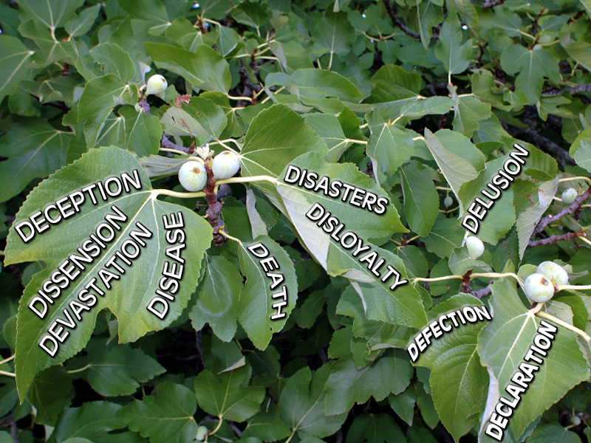

Slide 50
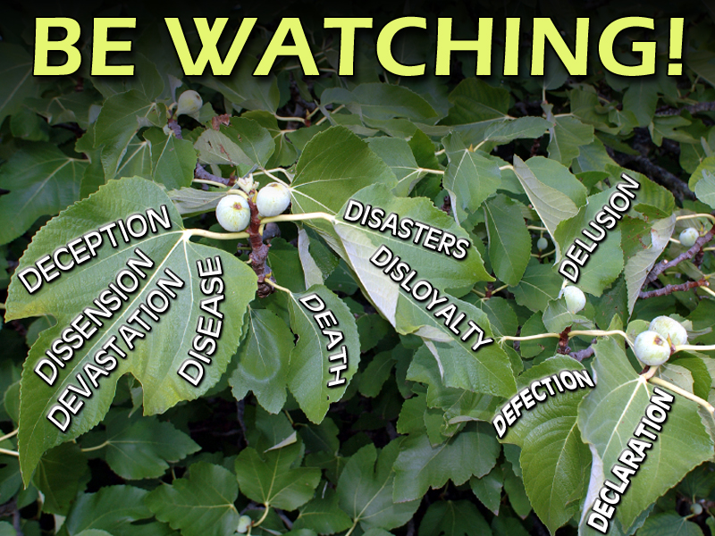

Slide 51
PAY ATTENTION
BELIEVE & BE WATCHING
KNOW YOU WILL BE ACCOUNTABLE TO HIM

