Slide 1
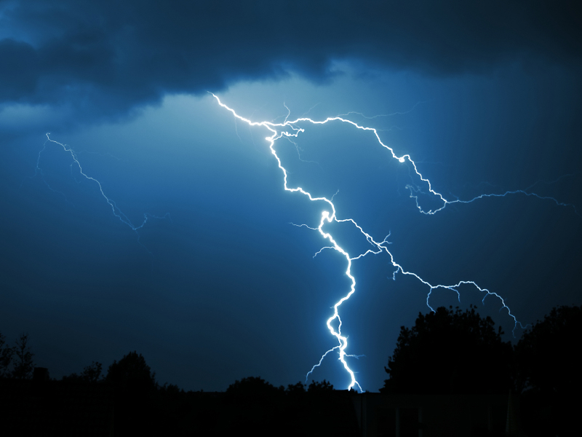
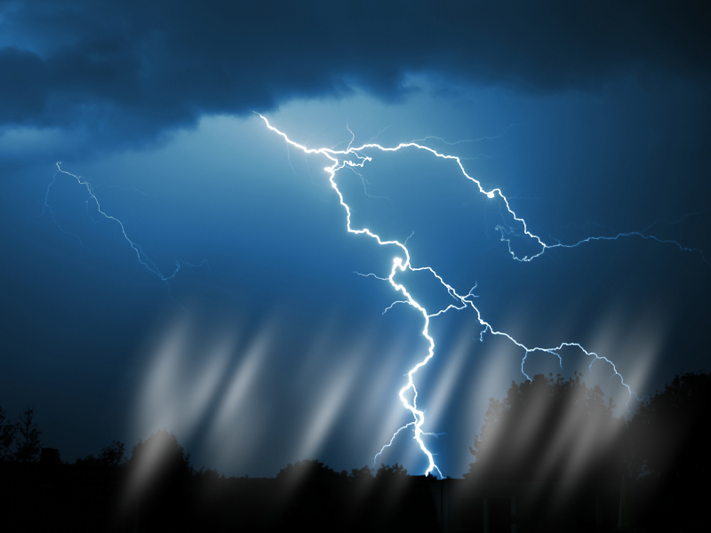



Slide 2


Because Of...

Slide 3
We Can Be Forgiven

Slide 4

Because Of...

Slide 5
We Can Live Forever

Slide 6
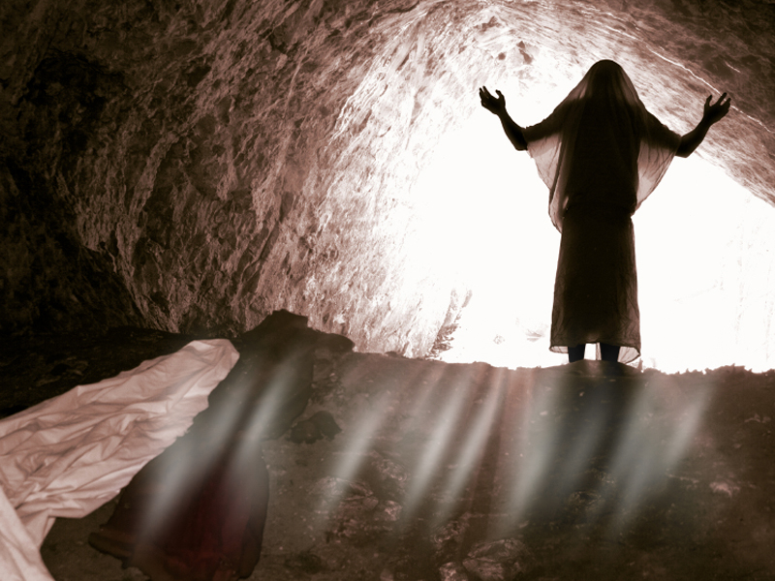

Because Of...

Slide 7
We Can Make A Difference

Slide 8


Slide 9

John 14:17-18 ¹⁷Even the Spirit of truth; whom the world cannot receive, because it seeth him not, neither knoweth him: but ye know him; for he dwelleth with you, and shall be in you.
¹⁸I will not leave you comfortless: I will come to you.

Slide 10
John 14:26-27 ²⁶But the Comforter, which is the Holy Ghost, whom the Father will send in my name, he shall teach you all things, and bring all things to your remembrance, whatsoever I have said unto you.
²⁷Peace I leave with you, my peace I give unto you: not as the world giveth, give I unto you. Let not your heart be troubled, neither let it be afraid.

Slide 11
John 16:5-7 ⁵But now I go my way to him that sent me; and none of you asketh me, Whither goest thou?
⁶But because I have said these things unto you, sorrow hath filled your heart.
⁷Nevertheless I tell you the truth; It is expedient for you that I go away: for if I go not away, the Comforter will not come unto you; but if I depart, I will send him unto you.

Slide 12
Acts 1:3-9 ³To whom also he shewed himself alive after his passion by many infallible proofs, being seen of them forty days, and speaking of the things pertaining to the kingdom of God:
⁴And, being assembled together with them, commanded them that they should not depart from Jerusalem, but wait for the promise of the Father, which, saith he, ye have heard of me.

Slide 13
Acts 1:3-9 ⁵For John truly baptized with water; but ye shall be baptized with the Holy Ghost not many days hence.
⁶When they therefore were come together, they asked of him, saying, Lord, wilt thou at this time restore again the kingdom to Israel?

Slide 14
Acts 1:3-9 ⁷And he said unto them, It is not for you to know the times or the seasons, which the Father hath put in his own power.

Slide 15
Acts 1:3-9 ⁸But ye shall receive power, after that the Holy Ghost is come upon you: and ye shall be witnesses unto me both in Jerusalem, and in all Judaea, and in Samaria, and unto the uttermost part of the earth.
⁹And when he had spoken these things, while they beheld, he was taken up; and a cloud received him out of their sight.

Slide 16
Acts 2:1-8 ¹And when the day of Pentecost was fully come, they were all with one accord in one place.
²And suddenly there came a sound from heaven as of a rushing mighty wind, and it filled all the house where they were sitting.

Slide 17
Acts 2:1-8 ³And there appeared unto them cloven tongues like as of fire, and it sat upon each of them.
⁴And they were all filled with the Holy Ghost, and began to speak with other tongues, as the Spirit gave them utterance.

Slide 18
Acts 2:1-8 ⁵And there were dwelling at Jerusalem Jews, devout men, out of every nation under heaven.
⁶Now when this was noised abroad, the multitude came together, and were confounded, because that every man heard them speak in his own language.

Slide 19
Acts 2:1-8 ⁷And they were all amazed and marvelled, saying one to another, Behold, are not all these which speak Galilaeans?
⁸And how hear we every man in our own tongue, wherein we were born?

Slide 20
Because Of...

Slide 21
You Can Make A Difference

Slide 22
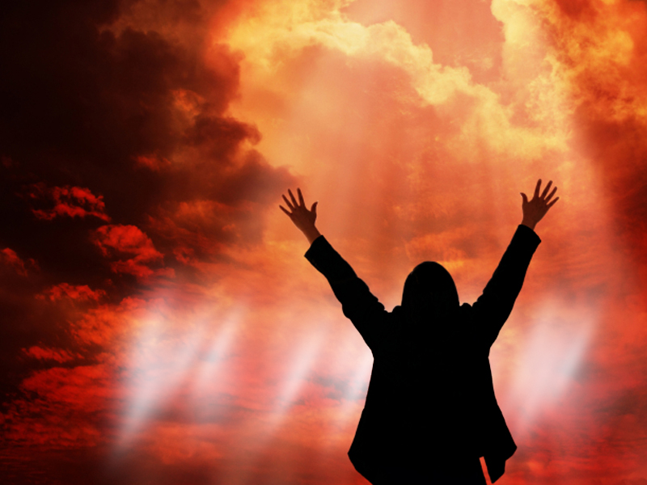
But How?

Slide 23
1. You Can Change
Acts 2:14-15 ¹⁴But Peter, standing up with the eleven, lifted up his voice, and said unto them, Ye men of Judaea, and all ye that dwell at Jerusalem, be this known unto you, and hearken to my words:

Slide 24
1. You Can Change
Acts 2:14-15 ¹⁵For these are not drunken, as ye suppose, seeing it is but the third hour of the day.

Slide 25
1. You Can Change
Listen To...
John The Baptist
John 3:30 He must increase, but I must decrease.

Slide 26
1. You Can Change
Listen To...
The Apostle Paul
1 Corinthians 15:31b I protest by your rejoicing which I have in Christ Jesus our Lord, I die daily.

Slide 27
1. You Can Change
Listen To...
The Lord Jesus Christ
Matthew 16:24 Then said Jesus unto his disciples, If any man will come after me, let him deny himself, and take up his cross, and follow me.

Slide 29
2. You Can Share
Him With Others
Acts 2:36-38 ³⁶Therefore let all the house of Israel know assuredly, that God hath made the same Jesus, whom ye have crucified, both Lord and Christ.

Slide 30
2. You Can Share
Him With Others
Acts 2:36-38 ³⁷Now when they heard this, they were pricked in their heart, and said unto Peter and to the rest of the apostles, Men and brethren, what shall we do?

Slide 31
2. You Can Share
Him With Others
Acts 2:36-38 ³⁸Then Peter said unto them, Repent, and be baptized every one of you in the name of Jesus Christ for the remission of sins, and ye shall receive the gift of the Holy Ghost.

Slide 32
2. You Can Share
Him With Others
Acts 2:41 Then they that gladly received his word were baptized: and the same day there were added unto them about three thousand souls.

Slide 34
3. You Can
Serve Others
Acts 3:1-8 ¹Now Peter and John went up together into the temple at the hour of prayer, being the ninth hour.

Slide 35
3. You Can
Serve Others
Acts 3:1-8 ²And a certain man lame from his mother's womb was carried, whom they laid daily at the gate of the temple which is called Beautiful, to ask alms of them that entered into the temple;

Slide 36
3. You Can
Serve Others
Acts 3:1-8 ³Who seeing Peter and John about to go into the temple asked an alms.
⁴And Peter, fastening his eyes upon him with John, said, Look on us.

Slide 37
3. You Can
Serve Others
Acts 3:1-8 ⁵And he gave heed unto them, expecting to receive something of them.
⁶Then Peter said, Silver and gold have I none; but such as I have give I thee: In the name of Jesus Christ of Nazareth rise up and walk.

Slide 38
3. You Can
Serve Others
Acts 3:1-8 ⁷And he took him by the right hand, and lifted him up: and immediately his feet and ankle bones received strength.

Slide 39
3. You Can
Serve Others
Acts 3:1-8 ⁸And he leaping up stood, and walked, and entered with them into the temple, walking, and leaping, and praising God.

Slide 41
4. You Can Suffer
Graciously
Acts 4:1-4 ¹And as they spake unto the people, the priests, and the captain of the temple, and the Sadducees, came upon them,
²Being grieved that they taught the people, and preached through Jesus the resurrection from the dead.

Slide 42
4. You Can Suffer
Graciously
Acts 4:1-4 ³And they laid hands on them, and put them in hold unto the next day: for it was now eventide.
⁴Howbeit many of them which heard the word believed; and the number of the men was about five thousand.

Slide 43
4. You Can Suffer
Graciously
Acts 4:7-13 ⁷And when they had set them in the midst, they asked, By what power, or by what name, have ye done this?
⁸Then Peter, filled with the Holy Ghost, said unto them, Ye rulers of the people, and elders of Israel,

Slide 44
4. You Can Suffer
Graciously
Acts 4:7-13 ⁹If we this day be examined of the good deed done to the impotent man, by what means he is made whole;

Slide 45
4. You Can Suffer
Graciously
Acts 4:7-13 ¹⁰Be it known unto you all, and to all the people of Israel, that by the name of Jesus Christ of Nazareth, whom ye crucified, whom God raised from the dead, even by him doth this man stand here before you whole.

Slide 46
4. You Can Suffer
Graciously
Acts 4:7-13 ¹¹This is the stone which was set at nought of you builders, which is become the head of the corner.
¹²Neither is there salvation in any other: for there is none other name under heaven given among men, whereby we must be saved.

Slide 47
4. You Can Suffer
Graciously
Acts 4:7-13 ¹³Now when they saw the boldness of Peter and John, and perceived that they were unlearned and ignorant men, they marvelled; and they took knowledge of them, that they had been with Jesus.

Slide 49
5. You Can Give
Generously
Acts 4:33-37 ³³And with great power gave the apostles witness of the resurrection of the Lord Jesus: and great grace was upon them all.

Slide 50
5. You Can Give
Generously
Acts 4:33-37 ³⁴Neither was there any among them that lacked: for as many as were possessors of lands or houses sold them, and brought the prices of the things that were sold,

Slide 51
5. You Can Give
Generously
Acts 4:33-37 ³⁵And laid them down at the apostles' feet: and distribution was made unto every man according as he had need.

Slide 52
5. You Can Give
Generously
Acts 4:33-37 ³⁶And Joses, who by the apostles was surnamed Barnabas, (which is, being interpreted, The son of consolation,) a Levite, and of the country of Cyprus,
³⁷Having land, sold it, and brought the money, and laid it at the apostles' feet.

Slide 53
Because Of...

Slide 54
You Can Make A Difference

Slide 55

You Can Make A Difference

Slide 56


