Slide 1
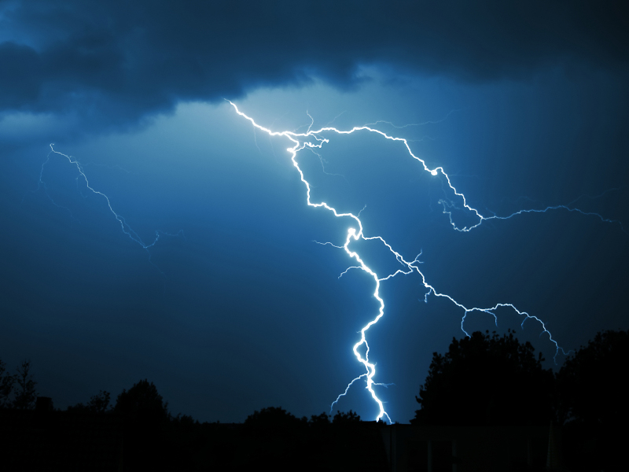
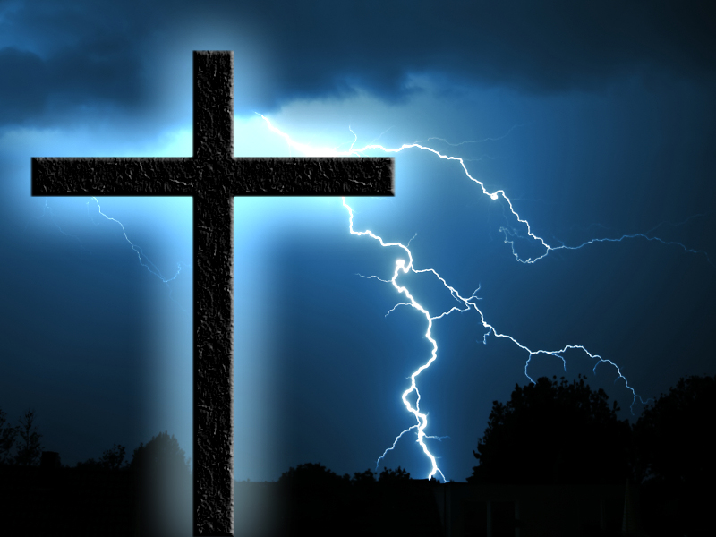
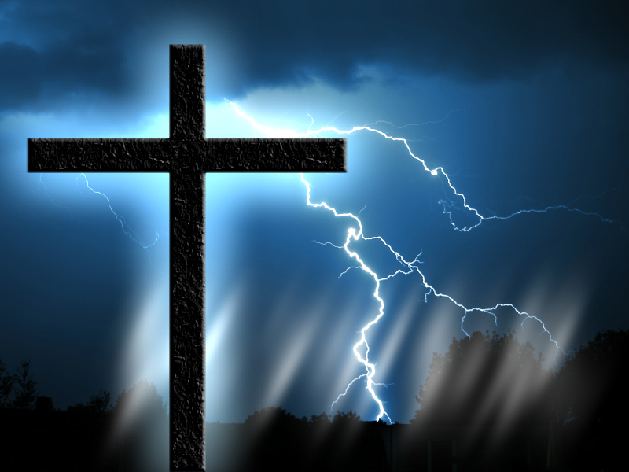
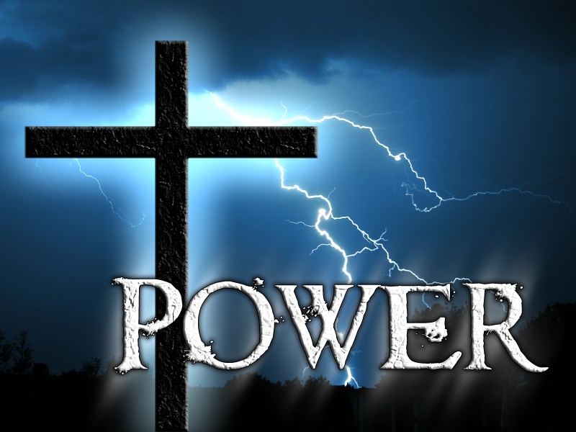
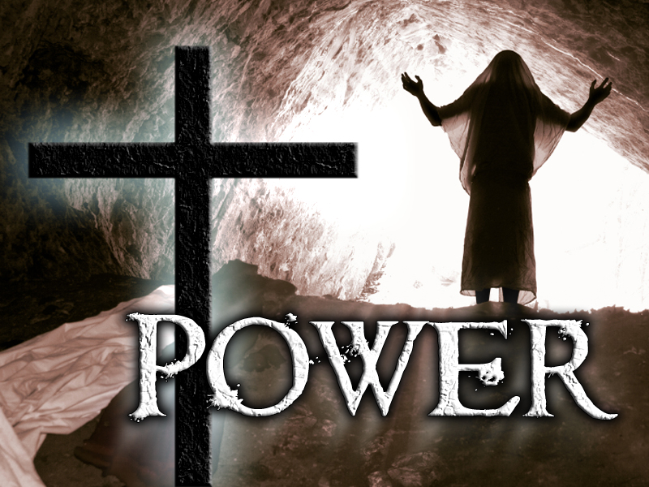
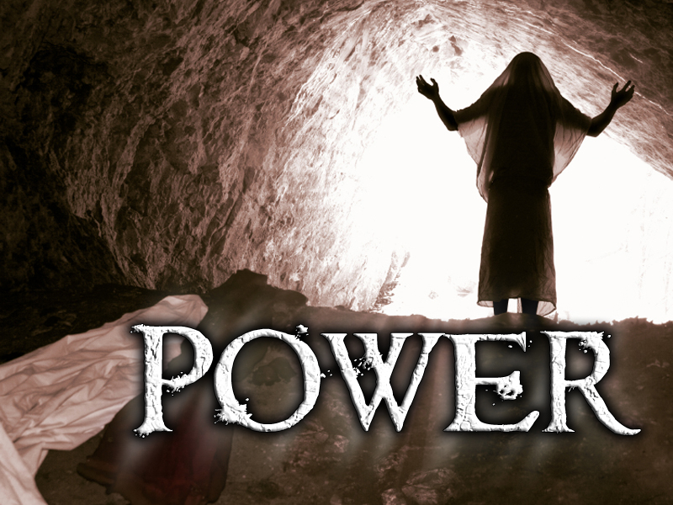
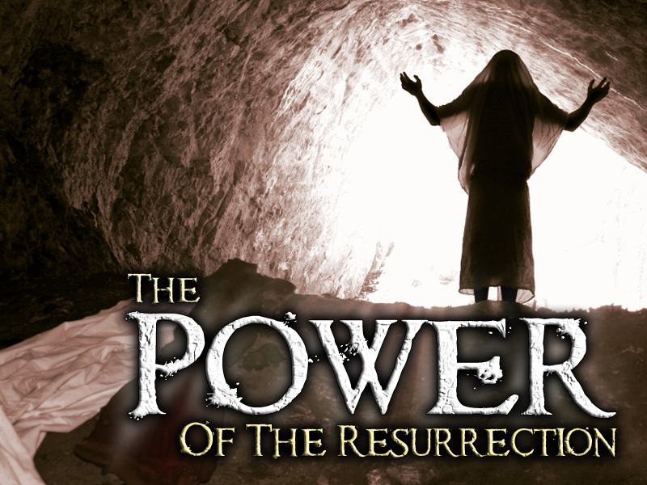
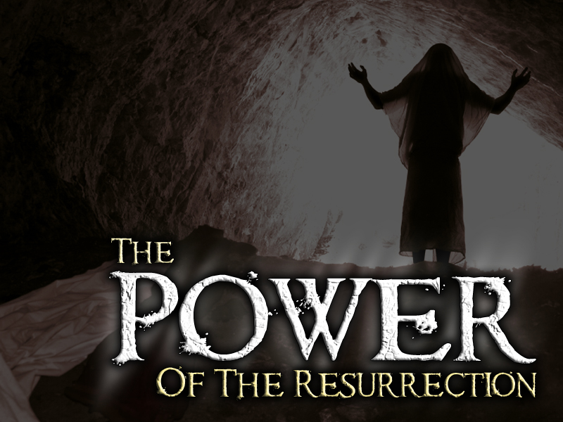

Slide 2
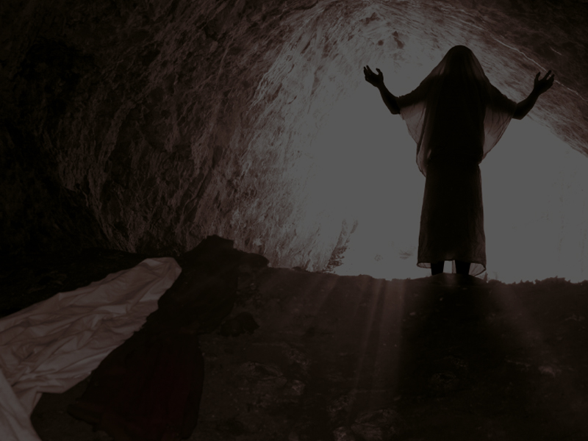
The Book Of Corinthians Was Written To The Church In Corinth
Corinth Was A City In Greece

Slide 3
The Book Of Corinthians Was Written To The Church In Corinth
The Greeks Did Not Believe In The Resurrection Of The Body

Slide 4
The Book Of Corinthians Was Written To The Church In Corinth
Greek Philosophy Considered The Human Body A Prison And They Welcomed Death As A Way To Escape From The Bondage Of The Body

Slide 5
The Book Of Corinthians Was Written To The Church In Corinth
Even Though The Church In Corinth Was A Christian Church, It Had Many Problems

Slide 6
The Book Of Corinthians Was Written To The Church In Corinth
One Of Their Main Problems Was Their SKEPTICAL ATTITUDES Concerning The Resurrection Of Jesus Christ

Slide 7
The Book Of Corinthians Was Written To The Church In Corinth
The Apostle Paul Had To Deal With This Situation Head On, And Does So In 1 Corinthians 15

Slide 8
WHY?
1. There is No Salvation for anyone and certainly No Power if one does not believe in the resurrection of Jesus Christ
2. It is Vitally Important that we get this truth Nailed in or mind and in our spirit

Slide 10
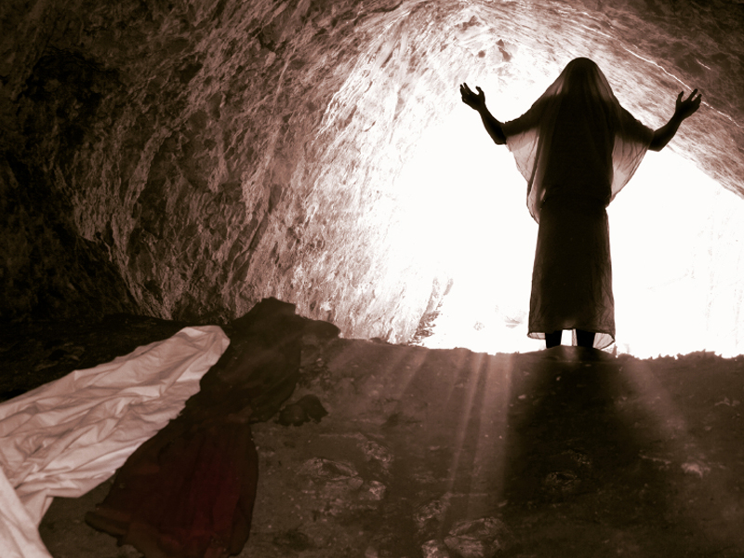
1 Corinthians 15:57-58 ⁵⁷But thanks be to God, which giveth us the victory through our Lord Jesus Christ.
⁵⁸Therefore, my beloved brethren, be ye stedfast, unmoveable, always abounding in the work of the Lord, forasmuch as ye know that your labour is not in vain in the Lord.

Slide 11
VICTORY
Through Our Lord Jesus Christ

Slide 12
THREE WORDS:
1. STEADFAST (In Salvation) loyal and determined
2. UNMOVABLE (In Suffering) not changing position
3. ABOUNDING (In Serving) abundant and running over

Slide 13
This Is What We Can Have Through The Power Of The Resurrection
Philippians 3:10 That I may know him, and the power of his resurrection, and the fellowship of his sufferings, being made conformable unto his death;
To Be Steadfast, Unmovable And Abounding...

Slide 14
You Must Have The Power!

Slide 15
A Skeptical Attitude About The Resurrection Of Jesus Will Not Cut It!

Slide 16
Did Jesus Christ Raise From The Dead?
The Apostle Paul Gives Three Proofs

Slide 17

#
Proof #1
Your Own Salvation
1 Corinthians 15:1-2 ¹Moreover, brethren, I declare unto you the gospel which I preached unto you, which also ye have received, and wherein ye stand;
²By which also ye are saved, if ye keep in memory what I preached unto you, unless ye have believed in vain.

Slide 18
#
Proof #1
Your Own Salvation
These Corinthian Believers Had Received The Message Of The Gospel (Good News)

Slide 19
#
Proof #1
Your Own Salvation
What Is The Message Of The Gospel?

Slide 20
#
Proof #1
Your Own Salvation
1 Corinthians 15:3-4 ³For I delivered unto you first of all that which I also received, how that Christ died for our sins according to the scriptures;
⁴And that he was buried, and that he rose again the third day according to the scriptures:

Slide 21
#
Proof #1
Your Own Salvation
Their Faith In The Good News Of Jesus Had Transformed Their Lives!

Slide 22
#
Proof #1
Your Own Salvation
They Were Standing In The Good News Of Jesus, And This Was Proof In Itself Of The Resurrection Of Jesus Christ

Slide 24
#
Proof #2
Old Testament Scriptures
1 Corinthians 15:3-4 ³For I delivered unto you first of all that which I also received, how that Christ died for our sins according to the scriptures;
⁴And that he was buried, and that he rose again the third day according to the scriptures:

Slide 25
#
Proof #2
Old Testament Scriptures
“According To The Scriptures”

Slide 26
#
Proof #2
Old Testament Scriptures
Much Of The Old Testament Pointed To The Sacrifice Of Jesus Christ As Our Substitute And Savior

Slide 27
#
Proof #2
Old Testament Scriptures
WHERE?
Jesus Himself Pointed To Jonah!
Matthew 12:39-40 ³⁹But he answered and said unto them, An evil and adulterous generation seeketh after a sign; and there shall no sign be given to it, but the sign of the prophet Jonas:

Slide 28
#
Proof #2
Old Testament Scriptures
WHERE?
Jesus Himself Pointed To Jonah!
Matthew 12:39-40 ⁴⁰For as Jonas was three days and three nights in the whale's belly; so shall the Son of man be three days and three nights in the heart of the earth.

Slide 29
#
Proof #2
Old Testament Scriptures
WHERE?
The Apostle Paul Compared Jesus’ Resurrection To “First Fruit”
1 Corinthians 15:23 But every man in his own order: Christ the firstfruits; afterward they that are Christ's at his coming.

Slide 30
#
Proof #2
Old Testament Scriptures
WHERE?
First Fruits Were Presented To God On The Day Following The Sabbath After Passover
Leviticus 23:9-12 ⁹And the LORD spake unto Moses, saying,

Slide 31
#
Proof #2
Old Testament Scriptures
WHERE?
First Fruits Were Presented To God On The Day Following The Sabbath After Passover
Leviticus 23:9-12 ¹⁰Speak unto the children of Israel, and say unto them, When ye be come into the land which I give unto you, and shall reap the harvest thereof, then ye shall bring a sheaf of the firstfruits of your harvest unto the priest:

Slide 32
#
Proof #2
Old Testament Scriptures
WHERE?
First Fruits Were Presented To God On The Day Following The Sabbath After Passover
Leviticus 23:9-12 ¹¹And he shall wave the sheaf before the LORD, to be accepted for you: on the morrow after the sabbath the priest shall wave it.

Slide 33
#
Proof #2
Old Testament Scriptures
WHERE?
First Fruits Were Presented To God On The Day Following The Sabbath After Passover
Leviticus 23:9-12 ¹²And ye shall offer that day when ye wave the sheaf an he lamb without blemish of the first year for a burnt offering unto the LORD.

Slide 34
#
Proof #2
Old Testament Scriptures
WHERE?
David Predicted Christ’s Resurrection
Psalms 16:10 For thou wilt not leave my soul in hell; neither wilt thou suffer thine Holy One to see corruption.

Slide 35
#
Proof #2
Old Testament Scriptures
WHERE?
Isaiah Predicted Christ’s Resurrection
Isaiah 53:9-11 ⁹And he made his grave with the wicked, and with the rich in his death; because he had done no violence, neither was any deceit in his mouth.

Slide 36
#
Proof #2
Old Testament Scriptures
WHERE?
Isaiah Predicted Christ’s Resurrection
Isaiah 53:9-11 ¹⁰Yet it pleased the LORD to bruise him; he hath put him to grief: when thou shalt make his soul an offering for sin, he shall see his seed, he shall prolong his days, and the pleasure of the LORD shall prosper in his hand.

Slide 37
#
Proof #2
Old Testament Scriptures
WHERE?
Isaiah Predicted Christ’s Resurrection
Isaiah 53:9-11 ¹¹He shall see of the travail of his soul, and shall be satisfied: by his knowledge shall my righteous servant justify many; for he shall bear their iniquities.

Slide 38
#
Proof #2
Old Testament Scriptures
WHERE?
And There Are Many Other Examples
The Coats Of Skin
Genesis 3:21

Slide 39
#
Proof #2
Old Testament Scriptures
WHERE?
And There Are Many Other Examples
The Ark
Genesis 7 & 8

Slide 40
#
Proof #2
Old Testament Scriptures
WHERE?
And There Are Many Other Examples
The Lamb For Abraham And Isaac
Genesis 22

Slide 41
#
Proof #2
Old Testament Scriptures
WHERE?
And There Are Many Other Examples
The Passover Lamb
Exodus 12

Slide 42
#
Proof #2
Old Testament Scriptures
WHERE?
And There Are Many Other Examples
The Passage Through The Red Sea
Exodus 14 & 15

Slide 43
#
Proof #2
Old Testament Scriptures
WHERE?
And There Are Many Other Examples
The Levitical Offerings
Leviticus 1-5

Slide 44
#
Proof #2
Old Testament Scriptures
WHERE?
And There Are Many Other Examples
The Day Of Atonement
Leviticus 16

Slide 45
#
Proof #2
Old Testament Scriptures
WHERE?
And There Are Many Other Examples
The Red Heifer
Numbers 19

Slide 46
#
Proof #2
Old Testament Scriptures
WHERE?
And There Are Many Other Examples
The Brazen Serpent
Numbers 21

Slide 48
#
Proof #3
Witnesses who actually saw the resurrected Jesus
1 Corinthians 15:5-8 ⁵And that he was seen of Cephas, then of the twelve:

Slide 49
#
Proof #3
Witnesses who actually saw the resurrected Jesus
1 Corinthians 15:5-8 ⁶After that, he was seen of above five hundred brethren at once; of whom the greater part remain unto this present, but some are fallen asleep.

Slide 50
#
Proof #3
Witnesses who actually saw the resurrected Jesus
1 Corinthians 15:5-8 ⁷After that, he was seen of James; then of all the apostles.
⁸And last of all he was seen of me also, as of one born out of due time.

Slide 51
#
Proof #3
Witnesses who actually saw the resurrected Jesus
SO, WHAT’S THE POINT?
We Are Powerless And We Are Lost If There Is No Resurrection Of Jesus

Slide 52
#
Proof #3
Witnesses who actually saw the resurrected Jesus
1 Corinthians 15:12-19 ¹²Now if Christ be preached that he rose from the dead, how say some among you that there is no resurrection of the dead?

Slide 53
#
Proof #3
Witnesses who actually saw the resurrected Jesus
1 Corinthians 15:12-19 ¹³But if there be no resurrection of the dead, then is Christ not risen:
¹⁴And if Christ be not risen, then is our preaching vain, and your faith is also vain.

Slide 54
#
Proof #3
Witnesses who actually saw the resurrected Jesus
1 Corinthians 15:12-19 ¹⁵Yea, and we are found false witnesses of God; because we have testified of God that he raised up Christ: whom he raised not up, if so be that the dead rise not.

Slide 55
#
Proof #3
Witnesses who actually saw the resurrected Jesus
1 Corinthians 15:12-19 ¹⁶For if the dead rise not, then is not Christ raised:
¹⁷And if Christ be not raised, your faith is vain; ye are yet in your sins.

Slide 56
#
Proof #3
Witnesses who actually saw the resurrected Jesus
1 Corinthians 15:12-19 ¹⁸Then they also which are fallen asleep in Christ are perished.
¹⁹If in this life only we have hope in Christ, we are of all men most miserable.

Slide 57
BUT, HALLELUJAH!
JESUS DID RESURRECT AND SO SHALL WE!

Slide 58
1 Corinthians 15:20-22 ²⁰But now is Christ risen from the dead, and become the firstfruits of them that slept.
²¹For since by man came death, by man came also the resurrection of the dead.
²²For as in Adam all die, even so in Christ shall all be made alive.

Slide 59
1 Corinthians 15:50-55 ⁵⁰Now this I say, brethren, that flesh and blood cannot inherit the kingdom of God; neither doth corruption inherit incorruption.
⁵¹Behold, I shew you a mystery; We shall not all sleep, but we shall all be changed,

Slide 60
1 Corinthians 15:50-55 ⁵²In a moment, in the twinkling of an eye, at the last trump: for the trumpet shall sound, and the dead shall be raised incorruptible, and we shall be changed.
⁵³For this corruptible must put on incorruption, and this mortal must put on immortality.

Slide 61
1 Corinthians 15:50-55 ⁵⁴So when this corruptible shall have put on incorruption, and this mortal shall have put on immortality, then shall be brought to pass the saying that is written, Death is swallowed up in victory.
⁵⁵O death, where is thy sting? O grave, where is thy victory?

Slide 63
1 Corinthians 15:57-58 ⁵⁷But thanks be to God, which giveth us the victory through our Lord Jesus Christ.
⁵⁸Therefore, my beloved brethren, be ye stedfast, unmoveable, always abounding in the work of the Lord, forasmuch as ye know that your labour is not in vain in the Lord.

Slide 64
VICTORY
Through Our Lord Jesus Christ

Slide 65
THREE WORDS:
1. STEADFAST I am loyal and determined
2. UNMOVABLE I am positioned in Christ
3. ABOUNDING I am over flowing

Slide 66
Have You Made The Decision To Believe In The Good News Of Jesus?

Slide 67
Are You Confident That You Have Been Positioned In Christ?

Slide 68
Are You Overflowing With Hope Because Of Your Faith In Jesus Christ?

Slide 69
Listen To Jesus...
John 11:25-26 ²⁵Jesus said unto her, I am the resurrection, and the life: he that believeth in me, though he were dead, yet shall he live:

Slide 70
Listen To Jesus...
John 11:25-26 ²⁶And whosoever liveth and believeth in me shall never die. Believest thou this?

Slide 71
Do You Believe This?

Slide 73
