Slide 1
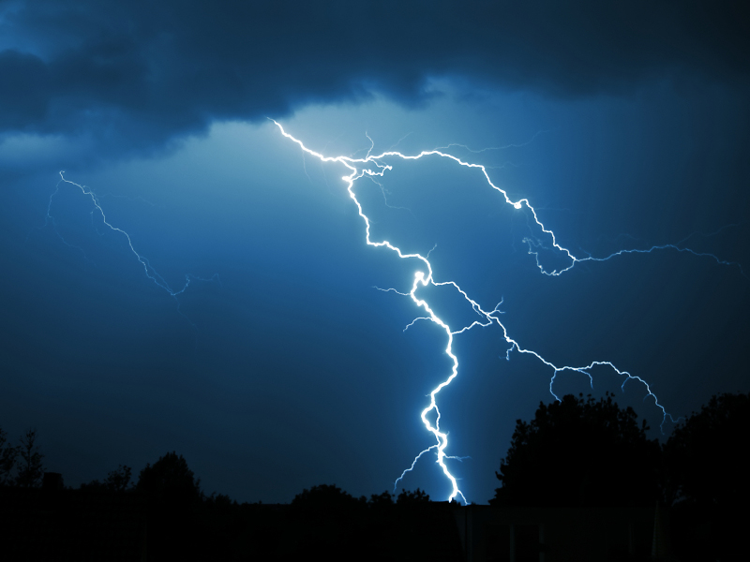
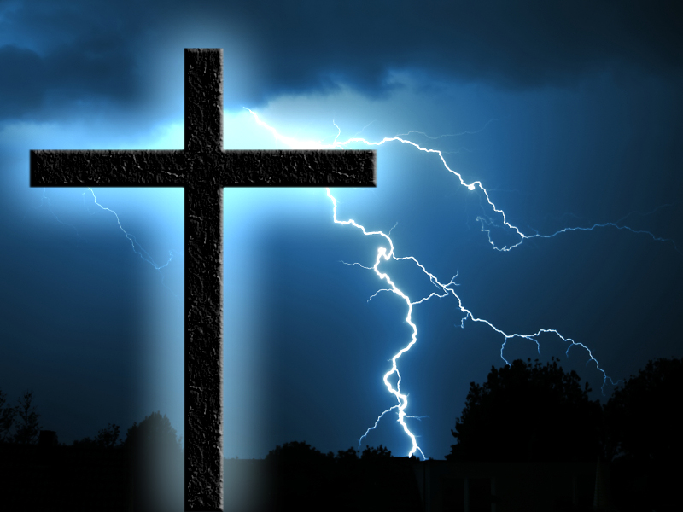
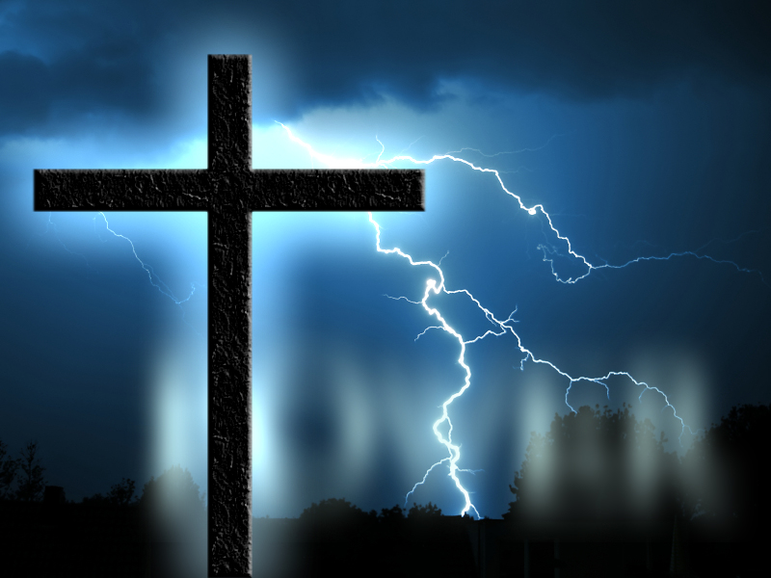




Slide 2
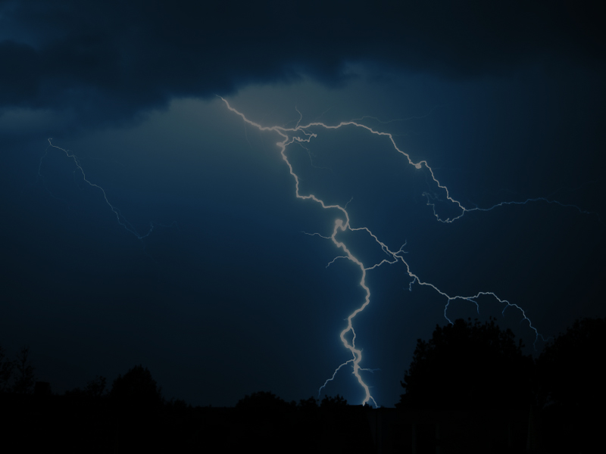
One Out Of Five Verses In The Four Gospels Speaks Of The Last Three Days Of Jesus’ Earthly Life

Slide 3
In The New Testament, The Death Of Jesus Christ Is Mentioned 175 Times – That’s About One Out Of Every 50 Verses

Slide 4
Other Religions Base Their Significance On The Teachings Of Their Founders

Slide 5
Christianity’s Significance Is Based On The DEATH Of It’s Founder

Slide 6
Christianity Is Founded On The Love That God Has For Mankind And Is Expressed To Us In The Substitutionary Death Of His One And Only Son, Jesus Christ, Our Savior And Lord

Slide 7
While On This Earth Jesus Spoke Often
Of His Death

Slide 8
John 2:19
Jesus answered and said unto them, Destroy this temple, and in three days I will raise it up.

Slide 9
John 3:14
And as Moses lifted up the serpent in the wilderness, even so must the Son of man be lifted up:

Slide 10
Luke 9:22
Saying, The Son of man must suffer many things, and be rejected of the elders and chief priests and scribes, and be slain, and be raised the third day.

Slide 11
Matthew 17:22-23
²²And while they abode in Galilee, Jesus said unto them, The Son of man shall be betrayed into the hands of men:
²³And they shall kill him, and the third day he shall be raised again. And they were exceeding sorry.

Slide 12
John 10:17
Therefore doth my Father love me, because I lay down my life, that I might take it again.

Slide 13
Mark 10:33-34
³³Saying, Behold, we go up to Jerusalem; and the Son of man shall be delivered unto the chief priests, and unto the scribes; and they shall condemn him to death, and shall deliver him to the Gentiles:
³⁴And they shall mock him, and shall scourge him, and shall spit upon him, and shall kill him: and the third day he shall rise again.

Slide 14
Mark 14:8
She hath done what she could: she is come aforehand to anoint my body to the burying.

Slide 15
John 12:32
And I, if I be lifted up from the earth, will draw all men unto me.

Slide 16
Matthew 26:31
Then saith Jesus unto them, All ye shall be offended because of me this night: for it is written, I will smite the shepherd, and the sheep of the flock shall be scattered abroad.

Slide 17
John 16:7
Nevertheless I tell you the truth; It is expedient for you that I go away: for if I go not away, the Comforter will not come unto you; but if I depart, I will send him unto you.

Slide 19
Listen To The Enemies Of Jesus Christ

Slide 20
Matthew 27:40-42
³³Saying, Behold, we go up to Jerusalem; and the Son of man shall be delivered unto the chief priests, and unto the scribes; and they shall condemn him to death, and shall deliver him to the Gentiles:
³⁴And they shall mock him, and shall scourge him, and shall spit upon him, and shall kill him: and the third day he shall rise again.

Slide 21
Thank God Jesus Didn’t Come Down From The Cross!

Slide 22
The Death
Of Jesus On The Cross Is POWERFUL

Slide 23
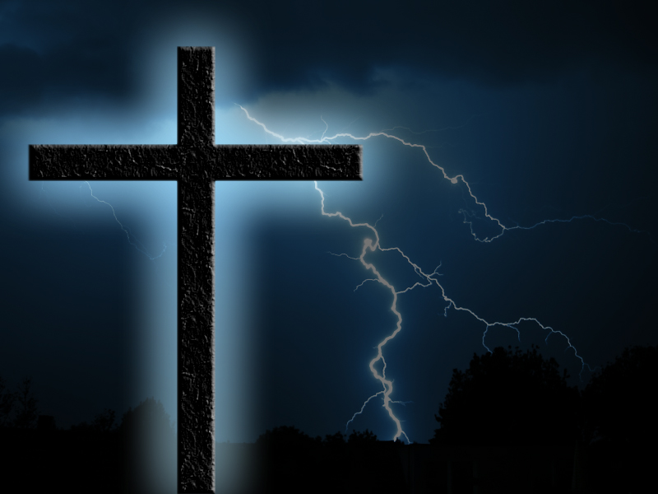
1. HE REDEEMED MANKIND
Ephesians 1:7
In whom we have redemption through his blood, the forgiveness of sins, according to the riches of his grace;

Slide 24
1. HE REDEEMED MANKIND
Galatians 3:13
Christ hath redeemed us from the curse of the law, being made a curse for us: for it is written, Cursed is every one that hangeth on a tree:

Slide 25
1. HE REDEEMED MANKIND
Revelation 5:9-13
⁹And they sung a new song, saying, Thou art worthy to take the book, and to open the seals thereof: for thou wast slain, and hast redeemed us to God by thy blood out of every kindred, and tongue, and people, and nation;

Slide 26
1. HE REDEEMED MANKIND
Revelation 5:9-13
¹⁰And hast made us unto our God kings and priests: and we shall reign on the earth.

Slide 27
1. HE REDEEMED MANKIND
Revelation 5:9-13
¹¹And I beheld, and I heard the voice of many angels round about the throne and the beasts and the elders: and the number of them was ten thousand times ten thousand, and thousands of thousands;

Slide 28
1. HE REDEEMED MANKIND
Revelation 5:9-13
¹²Saying with a loud voice, Worthy is the Lamb that was slain to receive power, and riches, and wisdom, and strength, and honour, and glory, and blessing.

Slide 29
1. HE REDEEMED MANKIND
Revelation 5:9-13
¹³And every creature which is in heaven, and on the earth, and under the earth, and such as are in the sea, and all that are in them, heard I saying, Blessing, and honour, and glory, and power, be unto him that sitteth upon the throne, and unto the Lamb for ever and ever.

Slide 30
1. HE REDEEMED MANKIND
The Word “REDEMPTION”
Speaks Of A Special Intervention By God For The Salvation
Of Mankind

Slide 31
1. HE REDEEMED MANKIND
This Intervention Is Centered In The Atoning Work Of Jesus On The Cross

Slide 32
1. HE REDEEMED MANKIND
REDEEMED MEANS...
...I Have Been Delivered
...I Have Been Loosed
...I Am Free!

Slide 34
The Death
Of Jesus On The Cross Is POWERFUL

Slide 35
2. HE SANCTIFIED BELIEVERS
Galatians 1:4-5
⁴Who gave himself for our sins, that he might deliver us from this present evil world, according to the will of God and our Father:
⁵To whom be glory for ever and ever. Amen.

Slide 36
2. HE SANCTIFIED BELIEVERS
Hebrews 10:10
By the which will we are sanctified through the offering of the body of Jesus Christ once for all.

Slide 37
2. HE SANCTIFIED BELIEVERS
Hebrews 10:19-23
¹⁹Having therefore, brethren, boldness to enter into the holiest by the blood of Jesus,

Slide 38
2. HE SANCTIFIED BELIEVERS
Hebrews 10:19-23
²⁰By a new and living way, which he hath consecrated for us, through the veil, that is to say, his flesh;
²¹And having an high priest over the house of God;

Slide 39
2. HE SANCTIFIED BELIEVERS
Hebrews 10:19-23
²²Let us draw near with a true heart in full assurance of faith, having our hearts sprinkled from an evil conscience, and our bodies washed with pure water.

Slide 40
2. HE SANCTIFIED BELIEVERS
Hebrews 10:19-23
²³Let us hold fast the profession of our faith without wavering; (for he is faithful that promised;)

Slide 41
2. HE SANCTIFIED BELIEVERS
Acts 26:18
To open their eyes, and to turn them from darkness to light, and from the power of Satan unto God, that they may receive forgiveness of sins, and inheritance among them which are sanctified by faith that is in me.

Slide 42
2. HE SANCTIFIED BELIEVERS
SANCTIFIED MEANS...
...I Have Been Set Apart For A
Sacred Purpose
...I Have Been Positioned In Christ
...I Am A Saint - Now That Is Power!

Slide 44
The Death
Of Jesus On The Cross Is POWERFUL

Slide 45
3. HE DESTROYED DEATH AND THE devil
Hebrews 2:14-15
¹⁴Forasmuch then as the children are partakers of flesh and blood, he also himself likewise took part of the same; that through death he might destroy him that had the power of death, that is, the devil;

Slide 46
3. HE DESTROYED DEATH AND THE devil
Hebrews 2:14-15
¹⁵And deliver them who through fear of death were all their lifetime subject to bondage.

Slide 47
3. HE DESTROYED DEATH AND THE devil
Colossians 2:14-15
¹⁴Blotting out the handwriting of ordinances that was against us, which was contrary to us, and took it out of the way, nailing it to his cross;
¹⁵And having spoiled principalities and powers, he made a shew of them openly, triumphing over them in it.

Slide 48
3. HE DESTROYED DEATH AND THE devil
1 Corinthians 15:22
For as in Adam all die, even so in Christ shall all be made alive.

Slide 49
3. HE DESTROYED DEATH AND THE devil
Revelation 12:9-11
⁹And the great dragon was cast out, that old serpent, called the Devil, and Satan, which deceiveth the whole world: he was cast out into the earth, and his angels were cast out with him.

Slide 50
3. HE DESTROYED DEATH AND THE devil
Revelation 12:9-11
¹⁰And I heard a loud voice saying in heaven, Now is come salvation, and strength, and the kingdom of our God, and the power of his Christ: for the accuser of our brethren is cast down, which accused them before our God day and night.

Slide 51
3. HE DESTROYED DEATH AND THE devil
Revelation 12:9-11
¹¹And they overcame him by the blood of the Lamb, and by the word of their testimony; and they loved not their lives unto the death.

Slide 52
3. HE DESTROYED DEATH AND THE devil
THE FEAR OF DEATH IS GONE!

Slide 53
3. HE DESTROYED DEATH AND THE devil
The devil
Ain’t My Daddy Any More!

Slide 54
3. HE DESTROYED DEATH AND THE devil
The Death
Of Jesus Destroyed That

Slide 55
3. HE DESTROYED DEATH AND THE devil
NOW THAT IS POWERFUL

Slide 57
I HAVE BEEN EXEMPTED FROM THE SECOND DEATH
Revelation 2:11
He that hath an ear, let him hear what the Spirit saith unto the churches; He that overcometh shall not be hurt of the second death.

Slide 58
I HAVE BEEN GRANTED IMMORTALITY
2 Timothy 1:10
But is now made manifest by the appearing of our Saviour Jesus Christ, who hath abolished death, and hath brought life and immortality to light through the gospel:

Slide 59
I HAVE BEEN GRANTED IMMORTALITY
John 11:25-26
²⁵Jesus said unto her, I am the resurrection, and the life: he that believeth in me, though he were dead, yet shall he live:

Slide 60
I HAVE BEEN GRANTED IMMORTALITY
John 11:25-26
²⁶And whosoever liveth and believeth in me shall never die. Believest thou this?

Slide 61
IMMORTALITY IS...
...Deathlessness To The Whole
Person
...A State Of Deliverance And
Bliss Due To The Redemption
Of Jesus On The Cross
...The Possession Of A Glorified
Body One Day (Deathless,
Painless, Sinless)

Slide 62
Spiritual Death Is A Separation From God

Slide 63
The Lost Die Forever, But Never Die – They Are Never Totally Annihilated

Slide 64
Mark 9:43-48
⁴³And if thy hand offend thee, cut it off: it is better for thee to enter into life maimed, than having two hands to go into hell, into the fire that never shall be quenched:
⁴⁴Where their worm dieth not, and the fire is not quenched.

Slide 65
Mark 9:43-48
⁴⁵And if thy foot offend thee, cut it off: it is better for thee to enter halt into life, than having two feet to be cast into hell, into the fire that never shall be quenched:
⁴⁶Where their worm dieth not, and the fire is not quenched.

Slide 66
Mark 9:43-48
⁴⁷And if thine eye offend thee, pluck it out: it is better for thee to enter into the kingdom of God with one eye, than having two eyes to be cast into hell fire:
⁴⁸Where their worm dieth not, and the fire is not quenched.

Slide 67
Revelation 20:11-15
¹¹And I saw a great white throne, and him that sat on it, from whose face the earth and the heaven fled away; and there was found no place for them.
¹²And I saw the dead, small and great, stand before God; and the books were opened: and another book was opened, which is the book of life: and the dead were judged out of those things which were written in the books, according to their works.

Slide 68
Revelation 20:11-15
¹³And the sea gave up the dead which were in it; and death and hell delivered up the dead which were in them: and they were judged every man according to their works.
¹⁴And death and hell were cast into the lake of fire. This is the second death.
¹⁵And whosoever was not found written in the book of life was cast into the lake of fire.

Slide 69
“
Come Down From The Cross And We Will Believe
”

Slide 70
WELL, HE DIDN’T
’
!

Slide 71
Do You Believe In Him Anyhow
?

Slide 72
Thank God, Jesus Didn’t Come Down From The Cross!

Slide 73
1 Corinthians 1:18
For the preaching of the cross is to them that perish foolishness; but unto us which are saved it is the power of God.

