Slide 1
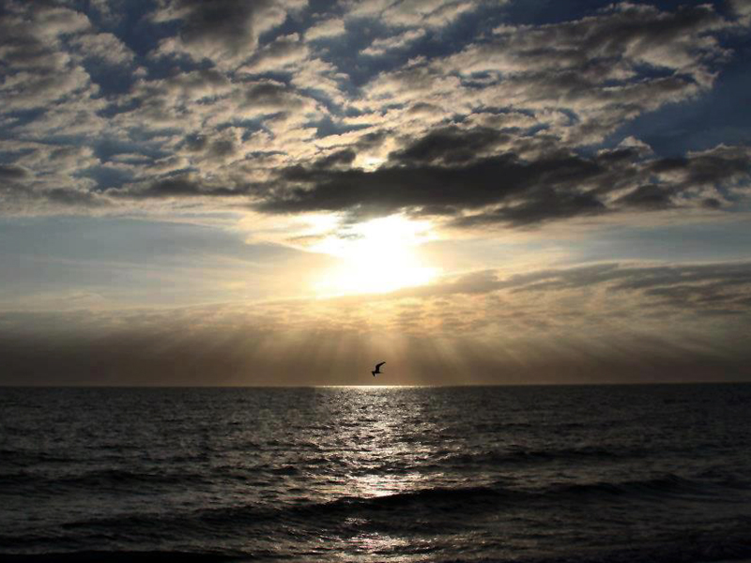


Slide 2
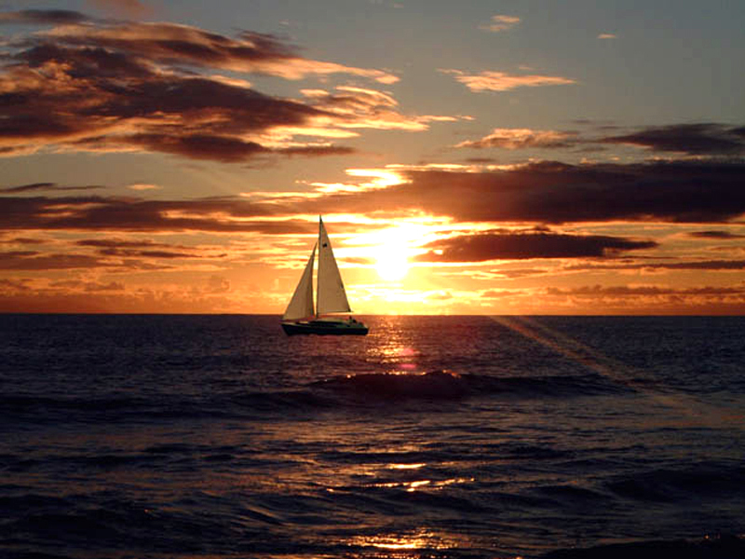



Slide 3
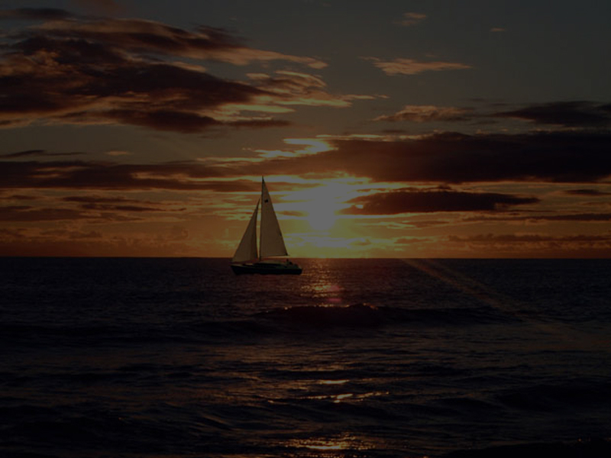
John 21:1-3
1 After these things Jesus shewed himself again to the disciples at the sea of Tiberias; and on this wise shewed he himself.
2 There were together Simon Peter, and Thomas called Didymus, and Nathanael of Cana in Galilee, and the sons of Zebedee, and two other of his disciples.

Slide 4
John 21:1-3
3 Simon Peter saith unto them, I go a fishing. They say unto him, We also go with thee. They went forth, and entered into a ship immediately; and that night they caught nothing.

Slide 5
“I Go A Fishing...”
I’m just gonna get
in MY boat, and...
...Do what I can do!
(in the flesh)

Slide 6
This FISHING FOR MEN stuff requires me being empowered by GOD!
And I Ain’t Feelin’ It!

Slide 7
I FEEL
Guilty
Unworthy
Not very useful!

Slide 8
I FEEL
Soiled
Stained
Even Scared!
especially of failing again

Slide 9
John 21:4-13
4 But when the morning was now come, Jesus stood on the shore: but the disciples knew not that it was Jesus.
5 Then Jesus saith unto them, Children, have ye any meat? They answered him, No.
6 And he said unto them, Cast the net on the right side of the ship, and ye shall find. They cast therefore, and now they were not able to draw it for the multitude of fishes.

Slide 10
John 21:4-13
7 Therefore that disciple whom Jesus loved saith unto Peter, It is the Lord. Now when Simon Peter heard that it was the Lord, he girt his fisher's coat unto him, (for he was naked,) and did cast himself into the sea.
8 And the other disciples came in a little ship; (for they were not far from land, but as it were two hundred cubits,) dragging
the net with fishes.

Slide 11
John 21:4-13
9 As soon then as they were come to land, they saw a fire of coals there, and fish laid thereon, and bread.
10 Jesus saith unto them, Bring of the fish which ye have now caught.
11 Simon Peter went up, and drew the net to land full of great fishes, an hundred and fifty and three: and for all there were so many, yet was not the net broken.

Slide 12
John 21:4-13
12 Jesus saith unto them, Come and dine. And none of the disciples durst ask him, Who art thou? knowing that it was the Lord.
13 Jesus then cometh, and taketh bread, and giveth them, and fish likewise.

Slide 13
This Was The THIRD Time That Jesus Had Appeared
To The Disciples
John 21:14
This is now the third time that Jesus shewed himself to his disciples, after that he was risen from the dead.

Slide 14
There is no doubt that Peter had received forgiveness from the Lord
That is not even in
question here!

Slide 15
But Peter hadn’t
FORGIVEN HIMSELF!
And I believed it “dogged” him still...

Slide 16
Jesus Christ had tremendous purpose for Peter to accomplish
But, Peter needed help – because he was hurting

Slide 17
Look At How Jesus
Dealt With Peter
1st, He Gave Him A Chance...
To dry off
To get warm
To get fed
To get some fellowship

Slide 18
Maybe you are feeling...
All Wet
Extremely Cold
Malnourished Spiritually
Lonely & Isolated

Slide 19
Jesus Christ Wants
To Help You
If you are feeling guilty, ashamed, unworthy, soiled, stained, scarred and scared

Slide 20
JESUS CHRIST
IS PATIENT
AND TENDER!

Slide 21
He Stands At Your
Door And Knocks
Revelation 3:20
Behold, I stand at the door, and knock: if any man hear my voice, and open the door, I will come in to him, and will sup with him, and he with me.

Slide 22
He Says
“Come Unto Me!”
Matthew 11:28-30
28 Come unto me, all ye that labour and are heavy laden, and I will give you rest.
29 Take my yoke upon you, and learn of me; for I am meek and lowly in heart: and ye shall find rest unto your souls.
30 For my yoke is easy, and my burden is light.

Slide 23
So, When They Dined...
John 21:15
So when they had dined, Jesus saith to Simon Peter, Simon, son of Jonas, lovest thou me more than these? He saith unto him, Yea, Lord; thou knowest that I love thee. He saith unto him, Feed my lambs.

Slide 25
Peter was DRY, he was WARM, he was FILLED, and he had been BEFRIENDED

Slide 26
Jesus Got ONE-ON-ONE With Peter
John 21:15
So when they had dined, Jesus saith to Simon Peter, Simon, son of Jonas, lovest thou me more than these? He saith unto him, Yea, Lord; thou knowest that I love thee. He saith unto him, Feed my lambs.

Slide 27
DO YOU LOVE ME
MORE THAN THESE?
These Fish?
These Nets?
That’s Not What
He Meant!

Slide 28
DO YOU LOVE ME
^{(as you claimed)}
MORE THAN THESE OTHER GUYS LOVE ME?

Slide 29
Peter Boasted In...
John 13:37
Peter said unto him, Lord, why cannot I follow thee now? I will lay down my life for thy sake.

Slide 30
Peter Boasted In...
Matthew 26:33
Peter answered and said unto him, Though all men shall be offended because of thee, yet will I never be offended.

Slide 31
Peter Believed That He Loved The Lord More Than The Other Disciples Did!
This is dangerous to ANY of us when we think this way!

Slide 32
Proverbs 16:18
Pride goeth before destruction, and an haughty spirit before a fall.

Slide 33
1 Corinthians 10:12
Wherefore let him that thinketh he standeth take heed lest he fall.

Slide 34
2 Corinthians 10:12
For we dare not make ourselves of the number, or compare ourselves with some that commend themselves: but they measuring themselves by themselves, and comparing themselves among themselves, are not wise.

Slide 35
1 Peter 5:6
Humble yourselves therefore under the mighty hand of God, that he may exalt you in due time:

Slide 36
This is why Peter
felt so unworthy,
so guilty, so ashamed, so dirty...

Slide 38
Jesus Dealt With It
“PUBLICALLY”
Not to EMBARRASS him,
but to EMPOWER him!

Slide 39
Jesus never doubted that Peter loved Him!
But Peter doubted how much he loved Jesus!

Slide 40
He had been forgiven, but he had not forgiven himself
And satan attacked him in this area!

Slide 41
Jesus Was Restoring Peter To Leadership & Service
John 21:15
So when they had dined, Jesus saith to Simon Peter, Simon, son of Jonas, lovest thou me more than these? He saith unto him, Yea, Lord; thou knowest that I love thee. He saith unto him, Feed my lambs.

Slide 42
Jesus Was Restoring Peter To Leadership & Service
John 21:15
So when they had dined, Jesus saith to Simon Peter, Simon, son of Jonas, lovest thou me more than these? He saith unto him, Yea, Lord; thou knowest that I love thee. He saith unto him, Feed my lambs.

Slide 43
Do You Love ME Peter?
YES!

Slide 44
Then Do Something!
FEED MY LAMBS!

Slide 45
You Are Doing
This For Me!
I accept you working for Me!

Slide 46
John 21:16
He saith to him again the second time, Simon, son of Jonas, lovest thou me? He saith unto him, Yea, Lord; thou knowest that I love thee. He saith unto him, Feed my sheep.

Slide 47
Do You Love ME Peter?
YES!

Slide 48
Then Do Something!
FEED MY SHEEP!

Slide 49
You Are Doing
This For Me!
I accept you working for Me!

Slide 50
John 21:17
He saith unto him the third time, Simon, son of Jonas, lovest thou me? Peter was grieved because he said unto him the third time, Lovest thou me? And he said unto him, Lord, thou knowest all things; thou knowest that I love thee. Jesus saith unto him, Feed my sheep.

Slide 51
Do You Love ME Peter?
YOU KNOW
I LOVE YOU!

Slide 52
YOU KNOW EVERYTHING!
YOU KNOW
I LOVE YOU!

Slide 53
NOW I KNOW
THAT YOU KNOW
THAT I LOVE YOU!

Slide 54
No Matter What
Has Happened...
1 John 1:9
If we confess our sins, he is faithful and just to forgive us our sins, and to cleanse us from all unrighteousness.

Slide 55
No Matter What
Has Happened...
IF WE HAVE SINCERELY
ASKED FOR FORGIVENESS, THEN WE ARE FORGIVEN!

Slide 56
Psalms 103:12
As far as the east is from the west, so far hath he removed our transgressions from us.

Slide 57
Isaiah 1:18
Come now, and let us reason together, saith the LORD: though your sins be as scarlet, they shall be as white as snow; though they be red like crimson, they shall be as wool.

Slide 58
BEING FORGIVEN
& REALLY KNOWING
YOU ARE FORGIVEN
ARE TWO TOTALLY DIFFERENT THINGS!

Slide 59
Philippians 1:20-21
20 According to my earnest expectation and my hope, that in nothing I shall be ashamed, but that with all boldness, as always, so now also Christ shall be magnified in my body, whether it be by life, or by death.
21 For to me to live is Christ, and to die is gain.

Slide 60
Let Go Of Past Failures
Live For Jesus Christ
Die For Jesus Christ

Slide 61
Get Back On Board
Stay On Board
Die On Board

Slide 62
JESUS
FORGIVES YOU!
He accepts you working for Him!

