Slide 1
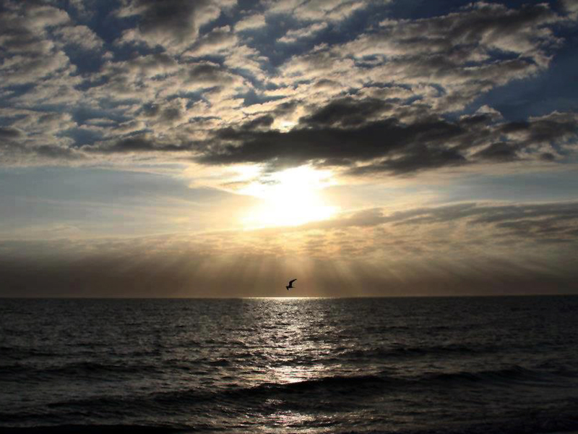


Slide 2
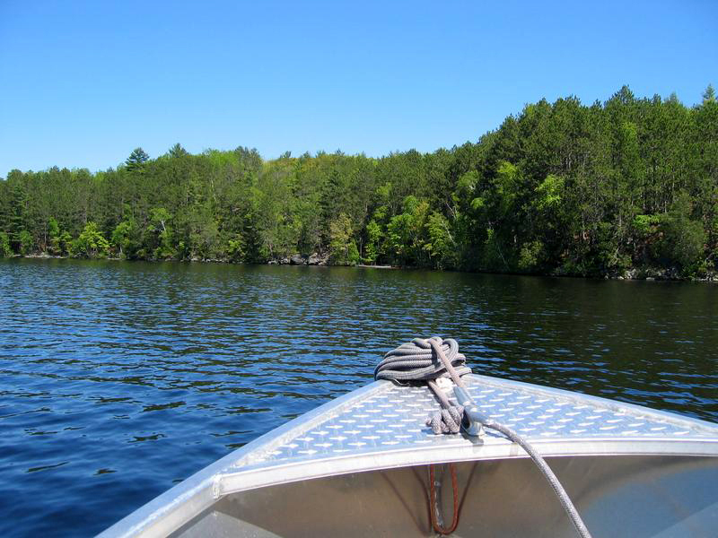




Slide 3

Luke 8:22 Now it came to pass on a certain day, that he went into a ship with his disciples: and he said unto them, Let us go over unto the other side of the lake. And they launched forth.

Slide 4
JESUS SAID:
“Let us go over to the other side of the lake”

Slide 5
If you’re Boat Trippin’ with Jesus, you must believe that HE’S GONNA GET YOU THERE!

Slide 6
Luke 8:23-24 23 But as they sailed he fell asleep: and there came down a storm of wind on the lake; and they were filled with water, and were in jeopardy.
24 And they came to him, and awoke him, saying, Master, master, we perish. Then he arose, and rebuked the wind and the raging of the water: and they ceased, and there was a calm.

Slide 7
BOTH the wind and the waves were calm IMMEDIATELY!

Slide 8
Luke 8:25 And he said unto them, Where is your faith? And they being afraid wondered, saying one to another, What manner of man is this! for he commandeth even the winds and water, and they obey him.

Slide 10
WHAT HAPPENED WHEN THEY GOT TO THE OTHER SIDE?
Luke 8:26-33 26 And they arrived at the country of the Gadarenes, which is over against Galilee.
27 And when he went forth to land, there met him out of the city a certain man, which had devils long time, and ware no clothes, neither abode in any house, but in the tombs.

Slide 11
WHAT HAPPENED WHEN THEY GOT TO THE OTHER SIDE?
Luke 8:26-33 28 When he saw Jesus, he cried out, and fell down before him, and with a loud voice said, What have I to do with thee, Jesus, thou Son of God most high? I beseech thee, torment me not.

Slide 12
WHAT HAPPENED WHEN THEY GOT TO THE OTHER SIDE?
Luke 8:26-33 29 (For he had commanded the unclean spirit to come out of the man. For oftentimes it had caught him: and he was kept bound with chains and in fetters; and he brake the bands, and was driven of the devil into the wilderness.)

Slide 13
WHAT HAPPENED WHEN THEY GOT TO THE OTHER SIDE?
Luke 8:26-33 30 And Jesus asked him, saying, What is thy name? And he said, Legion: because many devils were entered into him.
31 And they besought him that he would not command them to go out into the deep.

Slide 14
WHAT HAPPENED WHEN THEY GOT TO THE OTHER SIDE?
Luke 8:26-33 32 And there was there an herd of many swine feeding on the mountain: and they besought him that he would suffer them to enter into them. And he suffered them.

Slide 15
WHAT HAPPENED WHEN THEY GOT TO THE OTHER SIDE?
Luke 8:26-33 33 Then went the devils out of the man, and entered into the swine: and the herd ran violently down a steep place into the lake, and were choked.

Slide 16
WHAT HAPPENED WHEN THEY GOT TO THE OTHER SIDE?
Two Met Him With devils!
Matthew 8:28
And when he was come to the other side into the country of the Gergesenes, there met him two possessed with devils, coming out of the tombs, exceeding fierce, so that no man might pass by that way.

Slide 17
THEY WERE PITIFUL!
Naked
Living Among The Tombs
Violent & Dangerous
Terrorizing The Neighborhood
Controlled By Legion Of demons
* A Roman Legion Could Have As Many As 6000 Soldiers!

Slide 18
SATAN...
...Is A Thief
...Will Rob You Of Everything Good
...Will Try To Destroy Your Life
John 10:10
The thief cometh not, but for to steal, and to kill, and to destroy: I am come that they might have life, and that they might have it more abundantly.

Slide 19
SATAN...
ONLY JESUS CHRIST!
...Is A Thief
...Will Rob You Of Everything Good
...Will Try To Destroy Your Life
Nothing Can Restrain, Control Or Change The devil’s Servant

Slide 21
THE DEMONS BELIEVE
They believe that Jesus is the Son of God with authority to command them
James 2:19
Thou believest that there is one God; thou doest well: the devils also believe, and tremble.

Slide 22
THE DEMONS BELIEVE
They believe that Jesus is the Son of God with authority to command them
Luke 8:28 When he saw Jesus, he cried out, and fell down before him, and with a loud voice said, What have I to do with thee, Jesus, thou Son of God most high? I beseech thee, torment me not.

Slide 23
THE DEMONS BELIEVE
They believe that Jesus is the Son of God with authority to command them
They believe in the future judgment
Matthew 8:29
And, behold, they cried out, saying, What have we to do with thee, Jesus, thou Son of God? art thou come hither to torment us before the time?

Slide 24
THE DEMONS BELIEVE
They believe that Jesus is the Son of God with authority to command them
They believe in the future judgment
They believe in Hell (Abyss)
Luke 8:31
And they besought him that he would not command them to go out into the deep.

Slide 25
THE DEMONS BELIEVE
They believe that Jesus is the Son of God with authority to command them
They believe in the future judgment
They believe in Hell (Abyss)
Revelations 20:3
And cast him into the bottomless pit, and shut him up, and set a seal upon him, that he should deceive the nations no more, till the thousand years should be fulfilled: and after that he must be loosed a little season.

Slide 26
THE DEMONS BELIEVE
They believe that Jesus is the Son of God with authority to command them
They believe in the future judgment
They believe in Hell (Abyss)
I guess they believe in prayer too, since they asked Jesus to “send them into the pigs”

Slide 28
MEN ARE MORE IMPORTANT THAN PIGS!
Luke 8:34-37 34 When they that fed them saw what was done, they fled, and went and told it in the city and in the country.
35 Then they went out to see what was done; and came to Jesus, and found the man, out of whom the devils were departed, sitting at the feet of Jesus, clothed, and in his right mind: and they were afraid.

Slide 29
MEN ARE MORE IMPORTANT THAN PIGS!
Luke 8:34-37 36 They also which saw it told them by what means he that was possessed of the devils was healed.
37 Then the whole multitude of the country of the Gadarenes round about besought him to depart from them; for they were taken with great fear: and he went up into the ship, and returned back again.

Slide 30
MEN ARE BETTER THAN SHEEP!
Matthew 12:12 How much then is a man better than a sheep? Wherefore it is lawful to do well on the sabbath days.

Slide 31
The Lives Of These Two Men Were Transformed!

Slide 32
YOU’D THINK THE COMMUNITY WOULD HAVE BEEN GRATEFUL
They begged Jesus to leave
Obviously, “Pig Money” was more important than God’s Mercy!

Slide 33
Luke 8:38-39a 38 Now the man out of whom the devils were departed besought him that he might be with him: but Jesus sent him away, saying,
39 Return to thine own house, and shew how great things God hath done unto thee. And he went his way, and published throughout the whole city how great things Jesus had done unto him.

Slide 34
ONE OF THE MEN WHO WERE TRANSFORMED, ASKED JESUS IF HE COULD GO WITH HIM
Jesus said “No... But Go!”
GO to your house (leave the tombs), you don’t live here any more
GO show what great things God has done for you

Slide 35
GO & SHOW!
And He Did It!
Luke 8:39b Return to thine own house, and shew how great things God hath done unto thee. And he went his way, and published throughout the whole city how great things Jesus had done unto him.

Slide 36
GO & SHOW!
Talk Is Cheap
Religion Doesn’t Cut It

Slide 37
GO & SHOW!
But Look At The Power Of A Changed Life
Luke 8:40 And it came to pass, that, when Jesus was returned, the people gladly received him: for they were all waiting for him.

Slide 38
GO & SHOW!
When Jesus Came Back To Gadera:
The people received Him gladly
They were all waiting for Him

Slide 39
MERCY TRUMPS MONEY
EVERY TIME!

Slide 41
WHAT CAN WE LEARN ABOUT TODAY’S SHIP TO SHORE TRIP WITH JESUS?
Believe That He Is Going To Get You There
Matthew 28:19-20 19 Go ye therefore, and teach all nations, baptizing them in the name of the Father, and of the Son, and of the Holy Ghost:

Slide 42
WHAT CAN WE LEARN ABOUT TODAY’S SHIP TO SHORE TRIP WITH JESUS?
Believe That He Is Going To Get You There
Matthew 28:19-20 20 Teaching them to observe all things whatsoever I have commanded you: and, lo, I am with you always, even unto the end of the world. Amen.

Slide 43
WHAT CAN WE LEARN ABOUT TODAY’S SHIP TO SHORE TRIP WITH JESUS?
Deal With Fear First, By Faith
Romans 10:17 So then faith cometh by hearing, and hearing by the word of God.

Slide 44
WHAT CAN WE LEARN ABOUT TODAY’S SHIP TO SHORE TRIP WITH JESUS?
Know That satan Is A Thief
John 10:10 The thief cometh not, but for to steal, and to kill, and to destroy: I am come that they might have life, and that they might have it more abundantly.

Slide 45
WHAT CAN WE LEARN ABOUT TODAY’S SHIP TO SHORE TRIP WITH JESUS?
Know That Man’s Soul Is More Important Than Anything
Matthew 16:26 For what is a man profited, if he shall gain the whole world, and lose his own soul? or what shall a man give in exchange for his soul?

Slide 46
WHAT CAN WE LEARN ABOUT TODAY’S SHIP TO SHORE TRIP WITH JESUS?
Believe You Can Make A Difference
Matthew 5:16 Let your light so shine before men, that they may see your good works, and glorify your Father which is in heaven.

Slide 47
WHAT CAN WE LEARN ABOUT TODAY’S SHIP TO SHORE TRIP WITH JESUS?
Know That Mercy Trumps Money Every Time!
2 Corinthians 8:9 For ye know the grace of our Lord Jesus Christ, that, though he was rich, yet for your sakes he became poor, that ye through his poverty might be rich.

