Slide 1
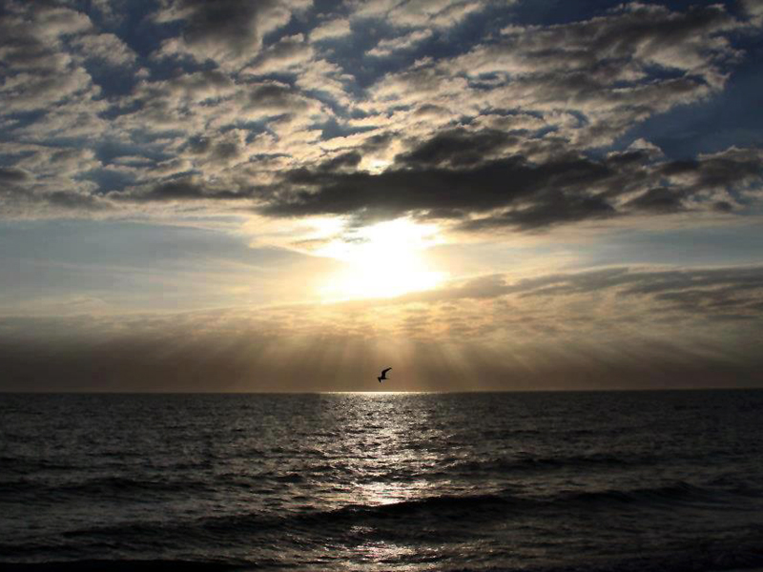


Slide 2
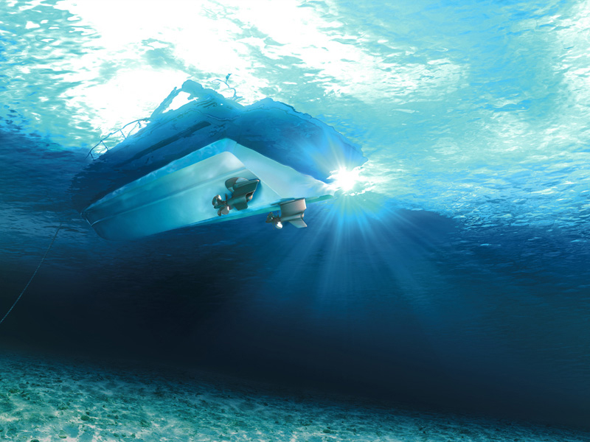


Slide 3
Letting Jesus Take You From Where You Are To Where You Can Be

Slide 4
Matthew 4:17-22
17 From that time Jesus began to preach, and to say, Repent: for the kingdom of heaven is at hand.
18 And Jesus, walking by the sea (SHORE) of Galilee, saw two brethren, Simon called Peter, and Andrew his brother, casting a net into the sea: for they were fishers.
19 And he saith unto them, Follow me, and I will make you fishers of men.

Slide 5
Matthew 4:17-22
20 And they straightway left their nets, and followed him.
21 And going on from thence, he saw other two brethren, James the son of Zebedee, and John his brother, in a ship with Zebedee their father, mending their nets; and he called them.
22 And they immediately left the ship and their father, and followed him.

Slide 6
REPENT
That Was His MESSAGE
Matthew 4:17
From that time Jesus began to preach, and to say, Repent: for the kingdom of heaven is at hand

Slide 7
REPENT
That Was His MESSAGE
“Turn Around
I Am Here!”

Slide 8
REPENT
That Was His MESSAGE
Jesus Is The King Of Heaven
Revelation 19:16
And he hath on his vesture and on his thigh a name written, KING OF KINGS, AND LORD OF LORDS.

Slide 9
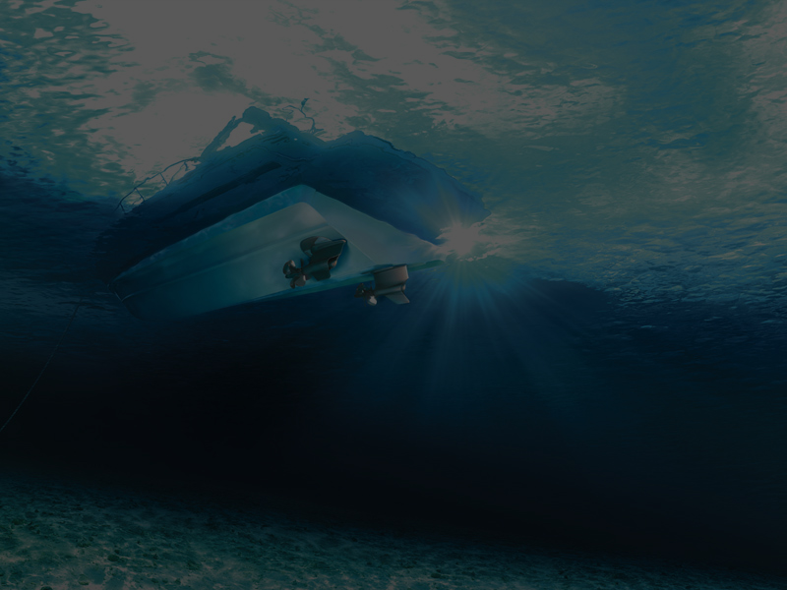

Slide 10
REALITY
That Is Where He MET Them
Matthew 4:18
And Jesus, walking by the sea (SHORE) of Galilee, saw two brethren, Simon called Peter, and Andrew his brother, casting a net into the sea: for they were fishers.

Slide 11
REALITY
That Is Where He MET Them
Matthew 4:21
And going on from thence, he saw other two brethren, James the son of Zebedee, and John his brother, in a ship with Zebedee their father, mending their nets; and he called them.

Slide 12
REALITY
That Is Where He MET Them
In The Real World
Where They Really Lived

Slide 13
REALITY
That Is Where He MET Them
They Were Fishermen
*That’s Who They Were
They Were Casting Nets
*That’s What They Did
They Were At The Sea Of Galilee
*That’s Where They Lived

Slide 14
REALITY
That Is Where He MET Them
Jesus Met Them At The Boat They Were In

Slide 16
RABBI
That Is What He MEANT
“I’ll Be Your Rabbi”

Slide 17
RABBI
That Is What He MEANT
Matthew 4:19
And he saith unto them, Follow me, and I will make you fishers of men.
“Follow Me”

Slide 18
RABBI
That Is What He MEANT
Matthew 4:21
And going on from thence, he saw other two brethren, James the son of Zebedee, and John his brother, in a ship with Zebedee their father, mending their nets; and he called them.
“He Called Them”

Slide 19
RABBI
That Is What He MEANT
I Call You
I Can Teach You
You Can Do What I Do

Slide 20
RABBI
That Is What He MEANT
THE TORAH
All
THE COMPLETE OLD TESTAMENT
THE BEST
THE CHOSEN ONES
THE BEST OF THE BEST

Slide 21
RABBI
That Is What He MEANT
1 Corinthians 1:26-29
26 For ye see your calling, brethren, how that not many wise men after the flesh, not many mighty, not many noble, are called:

Slide 22
RABBI
That Is What He MEANT
1 Corinthians 1:26-29
27 But God hath chosen the foolish things of the world to confound the wise; and God hath chosen the weak things of the world to confound the things which are mighty;

Slide 23
RABBI
That Is What He MEANT
1 Corinthians 1:26-29
28 And base things of the world, and things which are despised, hath God chosen, yea, and things which are not, to bring to nought things that are:

Slide 24
RABBI
That Is What He MEANT
1 Corinthians 1:26-29
29 That no flesh should glory in his presence.

Slide 25
RABBI
That Is What He MEANT
Jesus Came To The Boat They Were In

Slide 27
SO, WHAT DID THEY DO?
They Forsook Immediately
Mark 1:18
And straightway they forsook their nets, and followed him.

Slide 28
SO, WHAT DID THEY DO?
They Forsook Immediately
They Left Their Nets
Matthew 4:20
And they straightway left their nets, and followed him.

Slide 29
SO, WHAT DID THEY DO?
They Forsook Immediately
They Left Their Nets
They Left Their Boat
Matthew 4:22a
And they immediately left the ship and their father, and followed him.

Slide 30
SO, WHAT DID THEY DO?
They Forsook Immediately
They Left Their Nets
They Left Their Boat
They Left Their Father (families)
Matthew 4:22b
And they immediately left the ship and their father, and followed him.

Slide 31
SO, WHAT DID THEY DO?
They Followed Jesus
Matthew 4:23-24
23 And Jesus went about all Galilee, teaching in their synagogues, and preaching the gospel of the kingdom, and healing all manner of sickness and all manner of disease among the people.

Slide 32
SO, WHAT DID THEY DO?
They Followed Jesus
Matthew 4:23-24
24 And his fame went throughout all Syria: and they brought unto him all sick people that were taken with divers diseases and torments, and those which were possessed with devils, and those which were lunatick, and those that had the palsy; and he healed them.

Slide 33
SO, WHAT DID THEY DO?
They Followed Jesus
ALL OVER GALILEE
Teaching In Synagogues
Preaching The Gospel
Healing Sickness And Disease
Casting Out Demons

Slide 35
THE IMPORTANCE OF THE
MEN JESUS CALLED
These guys made a difference and were important to the
overall plan of God

Slide 36
THE IMPORTANCE OF THE
MEN JESUS CALLED
These fishermen were now not only followers, but leaders, helping Jesus with His ministry

Slide 37
THE IMPORTANCE OF THE
MEN JESUS CALLED
This had a profound
effect on the people...
Especially the
“COMMON FOLK!”

Slide 38
THE IMPORTANCE OF THE
MEN JESUS CALLED
Their religious leaders had always dressed a certain
way, taught a certain way,
and for the most part, were from a certain family...

Slide 39
THE IMPORTANCE OF THE
MEN JESUS CALLED
THE TRIBE OF LEVI!

Slide 40
THE IMPORTANCE OF THE
MEN JESUS CALLED
This Was Wild!
Galilean Fishermen Chosen To Help The Rabbi!
GO FIGURE!

Slide 42
JESUS WANTS YOU TO
COME AND FOLLOW HIM!
Why?
Because He’s The King!
“Turn Around I Am Here!”

Slide 43
JESUS WANTS YOU TO
COME AND FOLLOW HIM!
REPENT: Turn Around And Follow The King
Jesus is the Son of God
John 14:1
Let not your heart be troubled: ye believe in God, believe also in me.

Slide 44
JESUS WANTS YOU TO
COME AND FOLLOW HIM!
REPENT: Turn Around And Follow The King
Jesus is the Son of God
John 3:16
For God so loved the world, that he gave his only begotten Son, that whosoever believeth in him should not perish, but have everlasting life.

Slide 45
JESUS WANTS YOU TO
COME AND FOLLOW HIM!
REPENT: Turn Around And Follow The King
Jesus is the Son of God
Jesus died and rose from the dead
1 Corinthians 15:3-4
3 For I delivered unto you first of all that which I also received, how that Christ died for our sins according to the scriptures;

Slide 46
JESUS WANTS YOU TO
COME AND FOLLOW HIM!
REPENT: Turn Around And Follow The King
Jesus is the Son of God
Jesus died and rose from the dead
1 Corinthians 15:3-4
4 And that he was buried, and that he rose again the third day according to the scriptures:

Slide 47
JESUS WANTS YOU TO
COME AND FOLLOW HIM!
REPENT: Turn Around And Follow The King
Jesus is the Son of God
Jesus died and rose from the dead
Jesus is the only way to Heaven
John 14:6
Jesus saith unto him, I am the way, the truth, and the life: no man cometh unto the Father, but by me.

Slide 48
JESUS WANTS YOU TO
COME AND FOLLOW HIM!
REPENT: Turn Around And Follow The King
Jesus is the Son of God
Jesus died and rose from the dead
Jesus is the only way to Heaven
Jesus forgives sin
Matthew 9:6
But that ye may know that the Son of man hath power on earth to forgive sins, (then saith he to the sick of the palsy,) Arise, take up thy bed, and go unto thine house.

Slide 49
JESUS WANTS YOU TO
COME AND FOLLOW HIM!
REPENT: Turn Around And Follow The King
Jesus is the Son of God
Jesus died and rose from the dead
Jesus is the only way to Heaven
Jesus forgives sin
1 John 1:9
If we confess our sins, he is faithful and just to forgive us our sins, and to cleanse us from all unrighteousness.

Slide 50
JESUS WANTS YOU TO
COME AND FOLLOW HIM!
REPENT: Turn Around And Follow The King
Jesus is the Son of God
Jesus died and rose from the dead
Jesus is the only way to Heaven
Jesus forgives sin
Jesus is the Judge
John 5:22
For the Father judgeth no man, but hath committed all judgment unto the Son:

Slide 51
JESUS WANTS YOU TO
COME AND FOLLOW HIM!
REPENT: Turn Around And Follow The King
Jesus is the Son of God
Jesus died and rose from the dead
Jesus is the only way to Heaven
Jesus forgives sin
Jesus is the Judge
John 5:27
And hath given him authority to execute judgment also, because he is the Son of man.

Slide 52
HE’S
CALLING
YOU!

Slide 53
He has come to the boat you’re in!

Slide 54
To Your
Real World!

Slide 55
IT’S YOUR DECISION!

Slide 56
Forsake
or Follow!

Slide 57
WHY?
Because You Can!

Slide 58
Jesus Christ Can Save You, Because He Saved Me!

