Slide 1
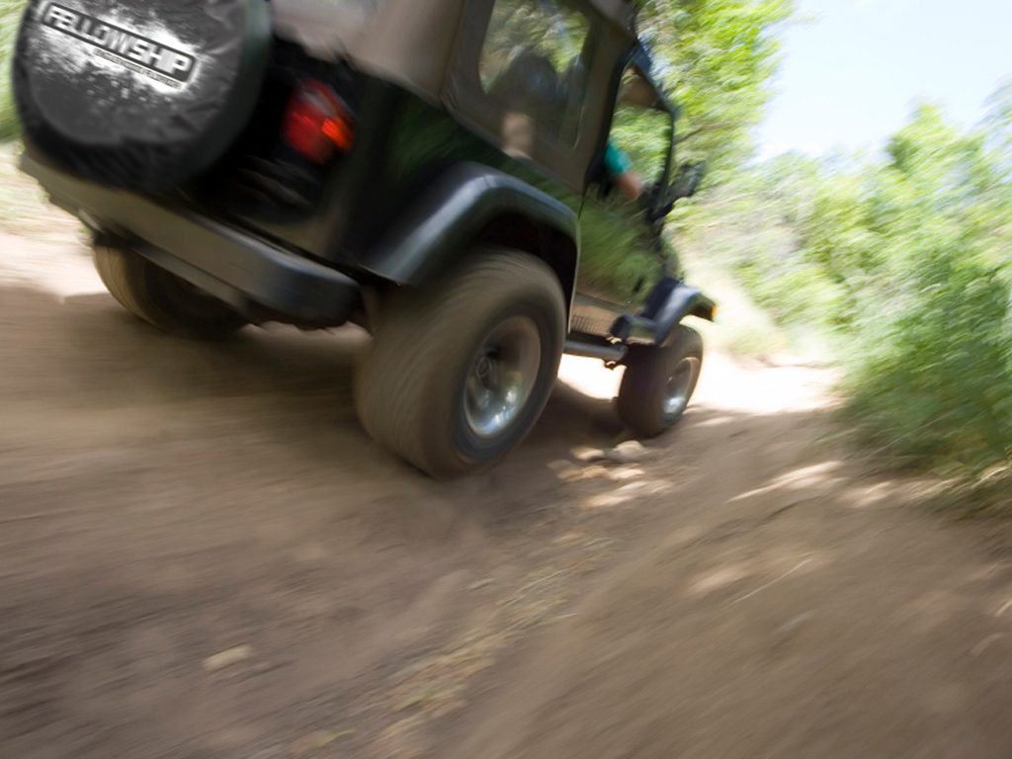



Slide 2





Slide 3

Several Nations Are Prophesied About In This Little Book Of Amos

Slide 4
I Want Us To Focus On ISRAEL
The Time Frame Was About
775 BC

Slide 5
Israel Was Under The Reign Of King Jeroboam II
He was a very able, but
idolatrous king
Israel prospered under him
Israel became very
powerful under his
leadership

Slide 6
JEROBOAM II
The son of Jehoash (Joash)
and the thirteenth king of
Israel (783-748 BC)
Jeroboam’s father opened the way to prosperous reign by his recovery of the territory which had been lost to Syria under Jehoahaz

Slide 7
JEROBOAM II
Jeroboam II resolved to carry this program even farther and extended the Northern kingdom to Hamath, the boundary of Solomon’s empire.

Slide 8
JEROBOAM II
The revenue which poured into Samaria from these tributaries brought Israel to a period of prosperity unknown since Solomon.

Slide 9
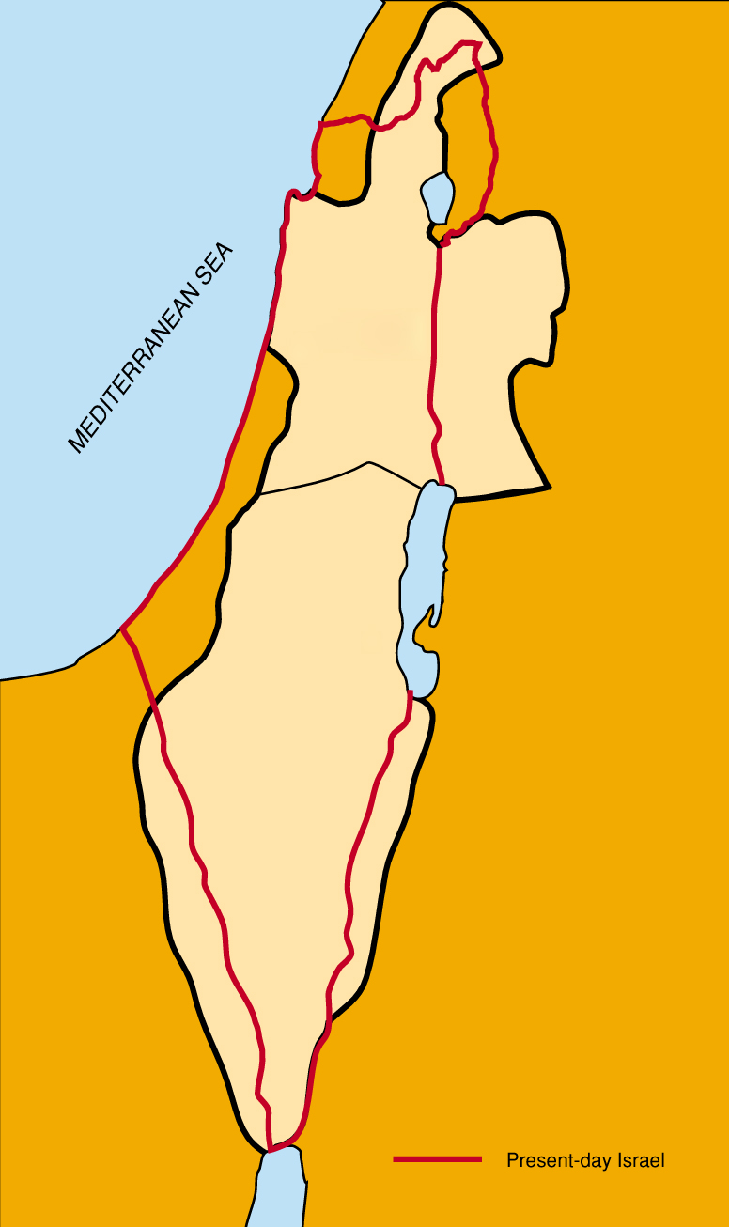
Samaria was the capital of the northern kingdom of Israel

Slide 10
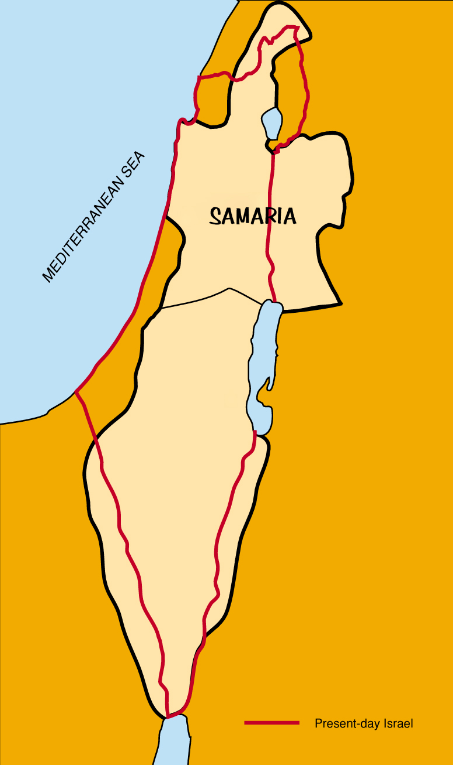
Samaria was the capital of the northern kingdom of Israel

Slide 11
Jerusalem was the capital of the southern kingdom of Israel
(called Judah)

Slide 12
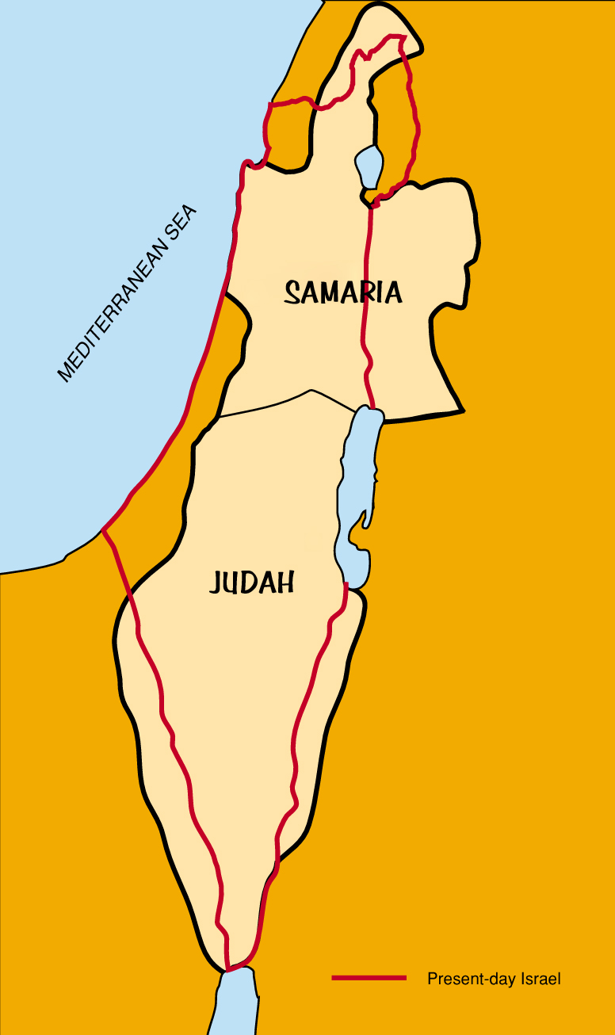
Jerusalem was the capital of the southern kingdom of Israel
(called Judah)

Slide 13
SOME BACKGROUND
ON AMOS
Amaziah the Priest points the finger at Amos the prophet!

Slide 14
SOME BACKGROUND
ON AMOS
When you have a “big shot” Priest going at it with the country “Fig Pickin’” Prophet…

Slide 15
SOME BACKGROUND
ON AMOS
YOU GOT A
FIGHT!

Slide 16
Amos 7:10-13
10 Then Amaziah the priest of Bethel sent to Jeroboam king of Israel, saying, Amos hath conspired against thee in the midst of the house of Israel: the land is not able to bear all his words.
11 For thus Amos saith, Jeroboam shall die by the sword, and Israel shall surely be led away captive out of their own land.

Slide 17
Amos 7:10-13
12 Also Amaziah said unto Amos, O thou seer, go, flee thee away into the land of Judah, and there eat bread, and prophesy there:
13 But prophesy not again any more at Bethel: for it is the king's chapel, and it is the king's court.

Slide 18
AMAZIAH THE PRIEST
Telling ON Amos
Telling OFF Amos
This is the King’s Chapel – The King’s Court!

Slide 19
AMOS FIRED BACK!
Amos 7:14-17
14 Then answered Amos, and said to Amaziah, I was no prophet, neither was I a prophet's son; but I was an herdman, and a gatherer of sycomore fruit:
15 And the LORD took me as I followed the flock, and the LORD said unto me, Go, prophesy unto my people Israel.

Slide 20
AMOS FIRED BACK!
Amos 7:14-17
16 Now therefore hear thou the word of the LORD: Thou sayest, Prophesy not against Israel, and drop not thy word against the house of Isaac.

Slide 21
AMOS FIRED BACK!
Amos 7:14-17
17 Therefore thus saith the LORD; Thy wife shall be an harlot in the city, and thy sons and thy daughters shall fall by the sword, and thy land shall be divided by line; and thou shalt die in a polluted land: and Israel shall surely go into captivity forth of his land.

Slide 22
AMOS FIRED BACK!
I didn’t ask for the job! (v14-15)
You say “shut my mouth”
about Israel!
“Fig Pickin’ Preacher”
FINE!!!
Let’s Talk About You!

Slide 23
Amos 7:17
Therefore thus saith the LORD; Thy wife shall be an harlot in the city, and thy sons and thy daughters shall fall by the sword, and thy land shall be divided by line; and thou shalt die in a polluted land: and Israel shall surely go into captivity forth of his land.

Slide 24
THUS SAYS THE LORD!
Your wife will become a harlot
Your sons and daughters
will be killed
You will die in a polluted land
Israel will go into captivity

Slide 25
LETS LOOK AT WHY ISRAEL WOULD BE JUDGED
What were the MAJOR problems?

Slide 26
LETS LOOK AT WHY ISRAEL WOULD BE JUDGED
^{1.} PRIDE
Amos 6:1-2
1 Woe to them that are at ease in Zion, and trust in the mountain of Samaria, which are named chief of the nations, to whom the house of Israel came!

Slide 27
LETS LOOK AT WHY ISRAEL WOULD BE JUDGED
^{1.} PRIDE
Amos 6:1-2
2 Pass ye unto Calneh, and see; and from thence go ye to Hamath the great: then go down to Gath of the Philistines: be they better than these kingdoms? or their border greater than your border?

Slide 28
LETS LOOK AT WHY ISRAEL WOULD BE JUDGED
^{1.} PRIDE
They were UNTOUCHABLE
They were the CHIEF of Nations
They were CHOSEN of God
They needed their memory JOGGED

Slide 29
LETS LOOK AT WHY ISRAEL WOULD BE JUDGED
^{1.} PRIDE
Calneh, Hamath & Gath
ALL DESTROYED!
These were bigger and badder than you!

Slide 30


Slide 31
LETS LOOK AT WHY ISRAEL WOULD BE JUDGED
^{2.} PRESUMPTION
Amos 6:3
Ye that put far away the evil day, and cause the seat of violence to come near;

Slide 32
LETS LOOK AT WHY ISRAEL WOULD BE JUDGED
^{2.} PRESUMPTION
EVIL DAY
The Day Of Reckoning
(Judgment Day)

Slide 33
LETS LOOK AT WHY ISRAEL WOULD BE JUDGED
^{2.} PRESUMPTION
OUT OF SIGHT
OUT OF MIND

Slide 34
LETS LOOK AT WHY ISRAEL WOULD BE JUDGED
^{2.} PRESUMPTION
You cause the violence to
come near…

Slide 35
LETS LOOK AT WHY ISRAEL WOULD BE JUDGED
^{2.} PRESUMPTION
Amos 8:4-7
4 Hear this, O ye that swallow up the needy, even to make the poor of the land to fail,

Slide 36
LETS LOOK AT WHY ISRAEL WOULD BE JUDGED
^{2.} PRESUMPTION
Amos 8:4-7
5 Saying, When will the new moon be gone, that we may sell corn? and the sabbath, that we may set forth wheat, making the ephah small, and the shekel great, and falsifying the balances by deceit?

Slide 37
LETS LOOK AT WHY ISRAEL WOULD BE JUDGED
^{2.} PRESUMPTION
Amos 8:4-7
6 That we may buy the poor for silver, and the needy for a pair of shoes; yea, and sell the refuse of the wheat?
7 The LORD hath sworn by the excellency of Jacob, Surely I will never forget any of their works.

Slide 38
LETS LOOK AT WHY ISRAEL WOULD BE JUDGED
^{2.} PRESUMPTION
I will NEVER forget ANY of their works…

Slide 39
LETS LOOK AT WHY ISRAEL WOULD BE JUDGED
^{2.} PRESUMPTION
Amos 3:1-8
1 Hear this word that the LORD hath spoken against you, O children of Israel, against the whole family which I brought up from the land of Egypt, saying,

Slide 40
LETS LOOK AT WHY ISRAEL WOULD BE JUDGED
^{2.} PRESUMPTION
Amos 3:1-8
2 You only have I known of all the families of the earth: therefore I will punish you for all your iniquities.
3 Can two walk together, except they be agreed?

Slide 41
LETS LOOK AT WHY ISRAEL WOULD BE JUDGED
^{2.} PRESUMPTION
Amos 3:1-8
4 Will a lion roar in the forest, when he hath no prey? will a young lion cry out of his den, if he have taken nothing?

Slide 42
LETS LOOK AT WHY ISRAEL WOULD BE JUDGED
^{2.} PRESUMPTION
Amos 3:1-8
5 Can a bird fall in a snare upon the earth, where no gin is for him? shall one take up a snare from the earth, and have taken nothing at all?

Slide 43
LETS LOOK AT WHY ISRAEL WOULD BE JUDGED
^{2.} PRESUMPTION
Amos 3:1-8
6 Shall a trumpet be blown in the city, and the people not be afraid? shall there be evil in a city, and the LORD hath not done it?

Slide 44
LETS LOOK AT WHY ISRAEL WOULD BE JUDGED
^{2.} PRESUMPTION
Amos 3:1-8
7 Surely the Lord GOD will do nothing, but he revealeth his secret unto his servants the prophets.
8 The lion hath roared, who will not fear? the Lord GOD hath spoken, who can but prophesy?

Slide 46
LETS LOOK AT WHY ISRAEL WOULD BE JUDGED
^{3.} PLEASURE
Amos 6:4-6
4 That lie upon beds of ivory, and stretch themselves upon their couches, and eat the lambs out of the flock, and the calves out of the midst of the stall;

Slide 47
LETS LOOK AT WHY ISRAEL WOULD BE JUDGED
^{3.} PLEASURE
Amos 6:4-6
5 That chant to the sound of the viol, and invent to themselves instruments of musick, like David;

Slide 48
LETS LOOK AT WHY ISRAEL WOULD BE JUDGED
^{3.} PLEASURE
Amos 6:4-6
6 That drink wine in bowls, and anoint themselves with the chief ointments: but they are not grieved for the affliction of Joseph.

Slide 49
LETS LOOK AT WHY ISRAEL WOULD BE JUDGED
^{3.} PLEASURE
Extravagant in their stuff
They were lazy
Extravagant in their meals
Loved to party and get wasted
No concern for others

Slide 51
LETS LOOK AT WHY ISRAEL WOULD BE JUDGED
^{4.} PRISON
Amos 6:7
Therefore now shall they go captive with the first that go captive, and the banquet of them that stretched themselves shall be removed.

Slide 52
LETS LOOK AT WHY ISRAEL WOULD BE JUDGED
^{4.} PRISON
Those who lived in luxury will lose their liberty
Those who trusted in the land and not the Lord
will be carried away
Those who thrived on pleasure will be deprived
of even the smallest pleasure (THE PARTY’S OVER!)
Those who are lazy are going to work
Those who put the evil day far away, will find
it very close

Slide 53
LETS LOOK AT WHY ISRAEL WOULD BE JUDGED
^{4.} PRISON
They will go into captivity first!

Slide 54
LETS LOOK AT WHY ISRAEL WOULD BE JUDGED
^{4.} PRISON
2 Kings 17:20-23
20 And the LORD rejected all the seed of Israel, and afflicted them, and delivered them into the hand of spoilers, until he had cast them out of his sight.

Slide 55
LETS LOOK AT WHY ISRAEL WOULD BE JUDGED
^{4.} PRISON
2 Kings 17:20-23
21 For he rent Israel from the house of David; and they made Jeroboam the son of Nebat king: and Jeroboam drave Israel from following the LORD, and made them sin a great sin.

Slide 56
LETS LOOK AT WHY ISRAEL WOULD BE JUDGED
^{4.} PRISON
2 Kings 17:20-23
22 For the children of Israel walked in all the sins of Jeroboam which he did; they departed not from them;

Slide 57
LETS LOOK AT WHY ISRAEL WOULD BE JUDGED
^{4.} PRISON
2 Kings 17:20-23
23 Until the LORD removed Israel out of his sight, as he had said by all his servants the prophets. So was Israel carried away out of their own land to Assyria unto this day.

Slide 59
What did we learn besides…
“Don’t Mess With A Fig Pickin’ Preacher?”

Slide 60
Minimize Pride
Don’t Presume
On The Future
Life’s More
Than A Party

Slide 61
AVOID PRISON
Know The Lord NEVER Forgets Our Sins Unless We Are WASHED IN THE BLOOD OF JESUS CHRIST!

