Slide 1
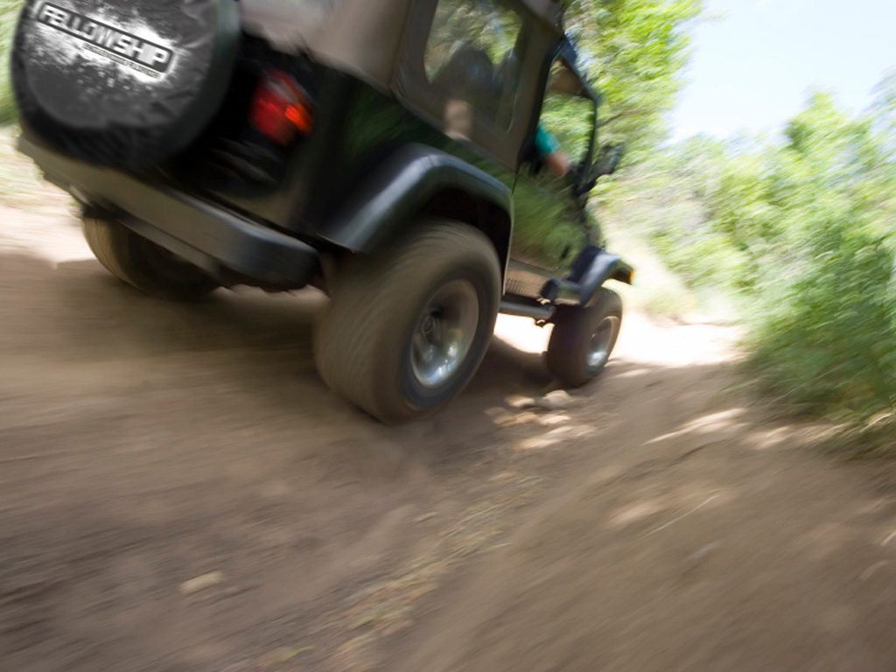




Slide 2

We’ve Been Off Road In The Past

Slide 3
Let’s Go Off Roading Again…

Slide 4
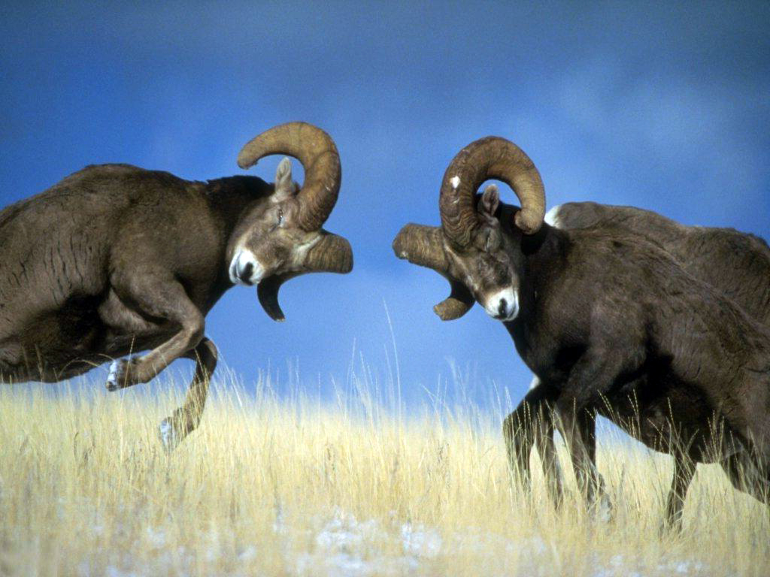
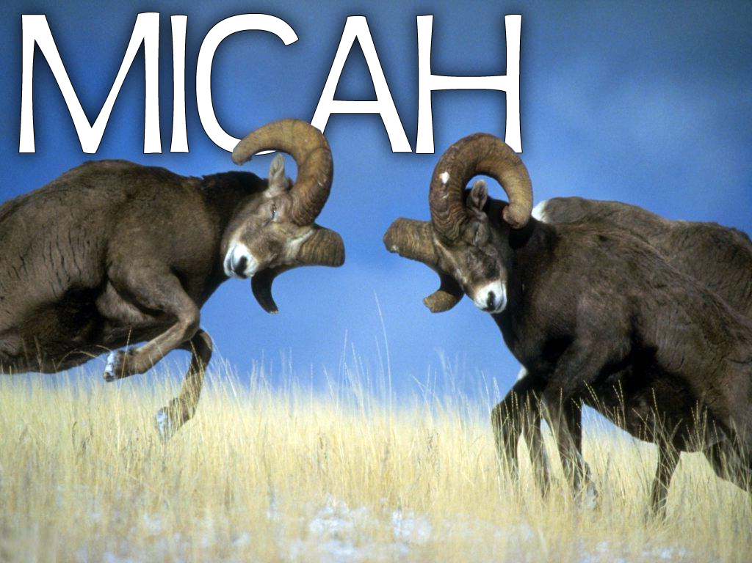
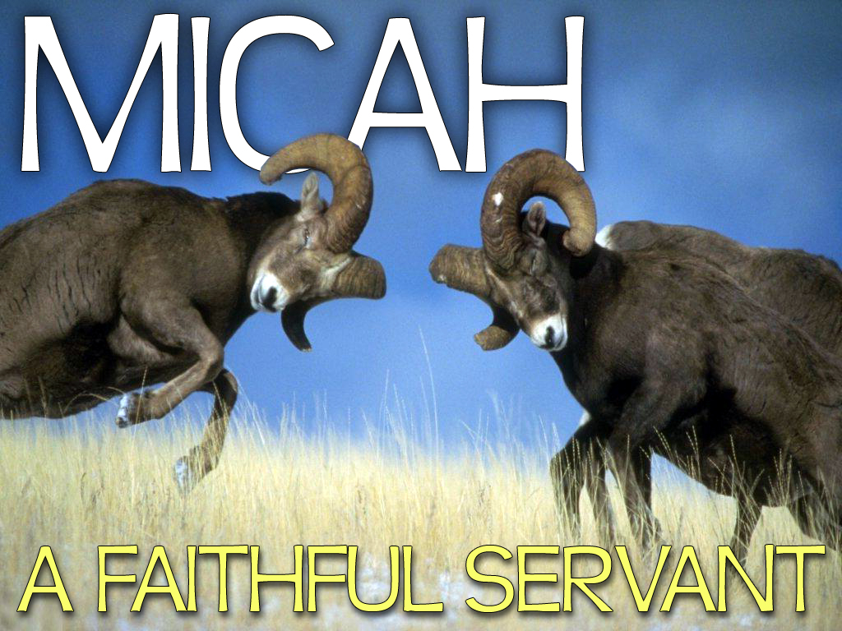


Slide 5
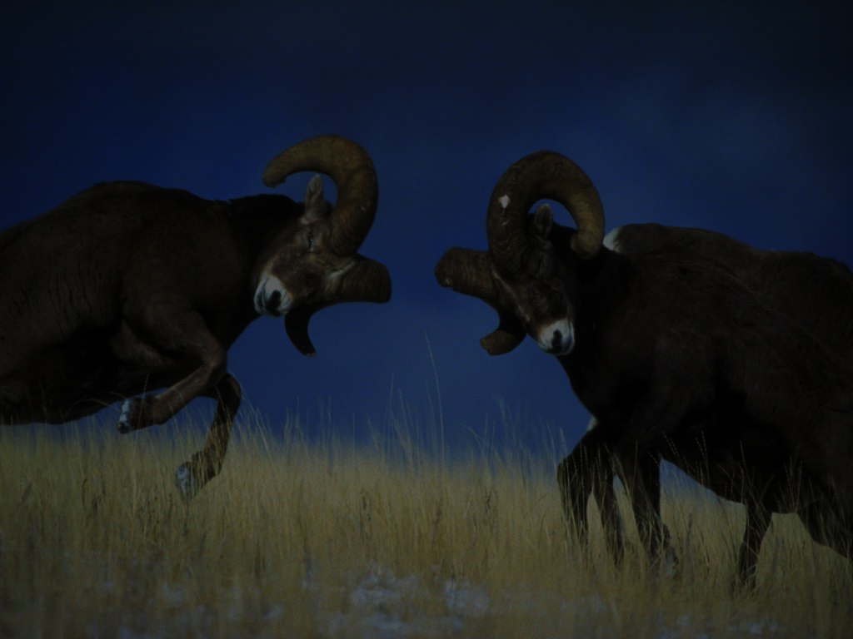
Micah was a Prophet who prophesied from around 740-690 BC
(50 Years)

Slide 6
Micah 1:1 The word of the LORD that came to Micah the Morasthite in the days of Jotham, Ahaz, and Hezekiah, kings of Judah, which he saw concerning Samaria and Jerusalem.

Slide 7
Micah lived on the border of the Philistines, in a town called Moresheth…

Slide 8
He prophesied during the reigns of Jothan, Ahaz and Hezekiah

Slide 9
He was the ONLY prophet to prophesy to both the Northern Kingdom (Samaria) and to the Southern Kingdom (Jerusalem)

Slide 10
He was quoted by the Magi (wise men) who came to worship Jesus
Matthew 2:5-6 ⁵ And they said unto him, In Bethlehem of Judaea: for thus it is written by the prophet,
⁶ And thou Bethlehem, in the land of Juda, art not the least among the princes of Juda: for out of thee shall come a Governor, that shall rule my people Israel.

Slide 11
He was quoted by Jesus when He sent out the disciples
Matthew 10:35-36 ³⁵ For I am come to set a man at variance against his father, and the daughter against her mother, and the daughter in law against her mother in law.
³⁶ And a man's foes shall be they of his own household.

Slide 12
He Has Three Major Themes:
ISRAEL’S SIN
DESTRUCTION
RESTORATION

Slide 13
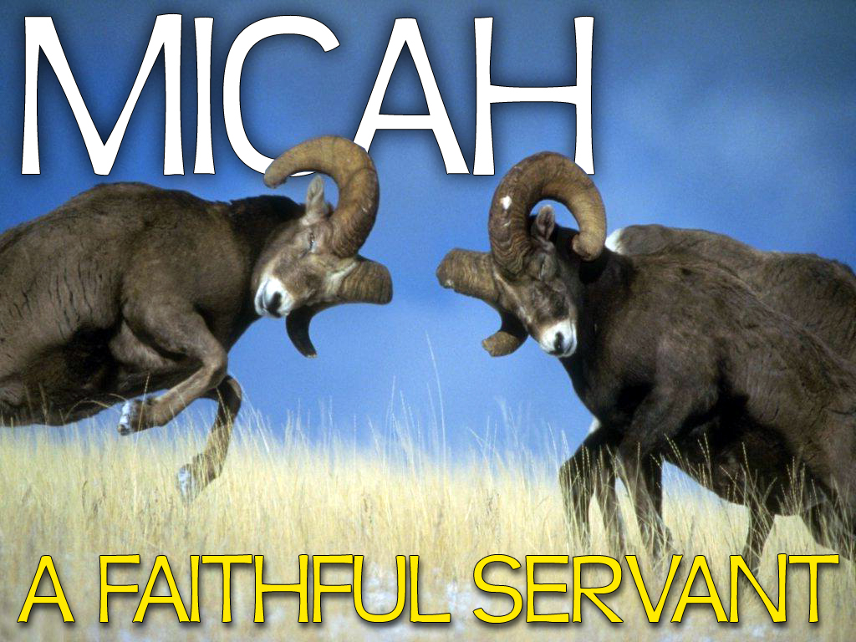

Slide 14
PROPHESIES OF MICAH CHAPTERS 4 & 5
1. Judah will suffer a 70 year Babylonian captivity
Micah 4:10 Be in pain, and labour to bring forth, O daughter of Zion, like a woman in travail: for now shalt thou go forth out of the city, and thou shalt dwell in the field, and thou shalt go even to Babylon; there shalt thou be delivered; there the LORD shall redeem thee from the hand of thine enemies.

Slide 15
PROPHESIES OF MICAH CHAPTERS 4 & 5
1. Judah will suffer a 70 year Babylonian captivity
Remarkable prediction!
Assyria was the strong power sweeping away everything in it’s path. (although Jerusalem survived them)
It would be about 100 years before Babylon became a world power. They fell to Babylon around 606 BC.

Slide 16
PROPHESIES OF MICAH CHAPTERS 4 & 5
2. The Messiah, the Christ, will be born in Bethlehem
Micah 5:2 But thou, Bethlehem Ephratah, though thou be little among the thousands of Judah, yet out of thee shall he come forth unto me that is to be ruler in Israel; whose goings forth have been from of old, from everlasting.

Slide 17
PROPHESIES OF MICAH CHAPTERS 4 & 5
2. The Messiah, the Christ, will be born in Bethlehem
The ONLY place in the Old Testament where it states “where” Jesus would be born
A very small town, located five miles south of Jerusalem

Slide 18
Matthew 2:1-2 ¹ Now when Jesus was born in Bethlehem of Judaea in the days of Herod the king, behold, there came wise men from the east to Jerusalem,
² Saying, Where is he that is born King of the Jews? for we have seen his star in the east, and are come to worship him.

Slide 19
Luke 2:4 And Joseph also went up from Galilee, out of the city of Nazareth, into Judaea, unto the city of David, which is called Bethlehem; (because he was of the house and lineage of David:)

Slide 20
John 7:42 Hath not the scripture said, That Christ cometh of the seed of David, and out of the town of Bethlehem, where David was?

Slide 21
PROPHESIES OF MICAH CHAPTERS 4 & 5
3. Israel will be set aside until their “Spiritual Re-Birth” during the tribulation period
Micah 5:3 Therefore will he give them up, until the time that she which travaileth hath brought forth: then the remnant of his brethren shall return unto the children of Israel.

Slide 22
PROPHESIES OF MICAH CHAPTERS 4 & 5
4. The nations will come against Israel at Armageddon
Micah 4:11-13 ¹¹ Now also many nations are gathered against thee, that say, Let her be defiled, and let our eye look upon Zion.
¹² But they know not the thoughts of the LORD, neither understand they his counsel: for he shall gather them as the sheaves into the floor.

Slide 23
PROPHESIES OF MICAH CHAPTERS 4 & 5
4. The nations will come against Israel at Armageddon
Micah 4:11-13 ¹³ Arise and thresh, O daughter of Zion: for I will make thine horn iron, and I will make thy hoofs brass: and thou shalt beat in pieces many people: and I will consecrate their gain unto the LORD, and their substance unto the Lord of the whole earth.

Slide 24
PROPHESIES OF MICAH CHAPTERS 4 & 5
4. The nations will come against Israel at Armageddon
John’s Vision In Revelation…

Slide 25
PROPHESIES OF MICAH CHAPTERS 4 & 5
4. The nations will come against Israel at Armageddon
John 16:13-16 ¹³ And I saw three unclean spirits like frogs come out of the mouth of the dragon, and out of the mouth of the beast, and out of the mouth of the false prophet.

Slide 26
PROPHESIES OF MICAH CHAPTERS 4 & 5
4. The nations will come against Israel at Armageddon
John 16:13-16 ¹⁴ For they are the spirits of devils, working miracles, which go forth unto the kings of the earth and of the whole world, to gather them to the battle of that great day of God Almighty.

Slide 27
PROPHESIES OF MICAH CHAPTERS 4 & 5
4. The nations will come against Israel at Armageddon
John 16:13-16 ¹⁵ Behold, I come as a thief. Blessed is he that watcheth, and keepeth his garments, lest he walk naked, and they see his shame.
¹⁶ And he gathered them together into a place called in the Hebrew tongue Armageddon.

Slide 28
PROPHESIES OF MICAH CHAPTERS 4 & 5
5. The nations will be utterly destroyed
Micah 5:15 And I will execute vengeance in anger and fury upon the heathen, such as they have not heard.

Slide 29
PROPHESIES OF MICAH CHAPTERS 4 & 5
5. The nations will be utterly destroyed
John’s Vision In Revelation…

Slide 30
PROPHESIES OF MICAH CHAPTERS 4 & 5
5. The nations will be utterly destroyed
John 19:11-12 ¹¹ And I saw heaven opened, and behold a white horse; and he that sat upon him was called Faithful and True, and in righteousness he doth judge and make war.

Slide 31
PROPHESIES OF MICAH CHAPTERS 4 & 5
5. The nations will be utterly destroyed
John 19:11-12 ¹² His eyes were as a flame of fire, and on his head were many crowns; and he had a name written, that no man knew, but he himself.

Slide 32
PROPHESIES OF MICAH CHAPTERS 4 & 5
6. Jesus Christ will Rule & Reign
Micah 4:1-8 ¹ But in the last days it shall come to pass, that the mountain of the house of the LORD shall be established in the top of the mountains, and it shall be exalted above the hills; and people shall flow unto it.

Slide 33
PROPHESIES OF MICAH CHAPTERS 4 & 5
6. Jesus Christ will Rule & Reign
Micah 4:1-8 ² And many nations shall come, and say, Come, and let us go up to the mountain of the LORD, and to the house of the God of Jacob; and he will teach us of his ways, and we will walk in his paths: for the law shall go forth of Zion, and the word of the LORD from Jerusalem.

Slide 34
PROPHESIES OF MICAH CHAPTERS 4 & 5
6. Jesus Christ will Rule & Reign
Micah 4:1-8 ³ And he shall judge among many people, and rebuke strong nations afar off; and they shall beat their swords into plowshares, and their spears into pruninghooks: nation shall not lift up a sword against nation, neither shall they learn war any more.

Slide 35
PROPHESIES OF MICAH CHAPTERS 4 & 5
6. Jesus Christ will Rule & Reign
Micah 4:1-8 ⁴ But they shall sit every man under his vine and under his fig tree; and none shall make them afraid: for the mouth of the LORD of hosts hath spoken it.
⁵ For all people will walk every one in the name of his god, and we will walk in the name of the LORD our God for ever and ever.

Slide 36
PROPHESIES OF MICAH CHAPTERS 4 & 5
6. Jesus Christ will Rule & Reign
Micah 4:1-8 ⁶ In that day, saith the LORD, will I assemble her that halteth, and I will gather her that is driven out, and her that I have afflicted;
⁷ And I will make her that halted a remnant, and her that was cast far off a strong nation: and the LORD shall reign over them in mount Zion from henceforth, even for ever.

Slide 37
PROPHESIES OF MICAH CHAPTERS 4 & 5
6. Jesus Christ will Rule & Reign
Micah 4:1-8 ⁸ And thou, O tower of the flock, the strong hold of the daughter of Zion, unto thee shall it come, even the first dominion; the kingdom shall come to the daughter of Jerusalem.

Slide 38
God Had A Problem With His People

Slide 39
What Have I Done To Make You So Tired Of Serving Me?
Micah 6:1-3 ¹ Hear ye now what the LORD saith; Arise, contend thou before the mountains, and let the hills hear thy voice.
² Hear ye, O mountains, the LORD's controversy, and ye strong foundations of the earth: for the LORD hath a controversy with his people, and he will plead with Israel.
³ O my people, what have I done unto thee? and wherein have I wearied thee? testify against me.

Slide 40
How Do I Get Tired Of Serving God?
Ungrateful Spirit
Micah 6:4 For I brought thee up out of the land of Egypt, and redeemed thee out of the house of servants; and I sent before thee Moses, Aaron, and Miriam.

Slide 41
How Do I Get Tired Of Serving God?
Ungrateful Spirit
Religious Phoniness
Micah 6:5 O my people, remember now what Balak king of Moab consulted, and what Balaam the son of Beor answered him from Shittim unto Gilgal; that ye may know the righteousness of the LORD.

Slide 42
How Do I Get Tired Of Serving God?
Ungrateful Spirit
Religious Phoniness
Dishonesty
Micah 6:6 Wherewith shall I come before the LORD, and bow myself before the high God? shall I come before him with burnt offerings, with calves of a year old?

Slide 43
WHAT DOES THE LORD REQUIRE OF US?

Slide 44
IS HE UNREASONABLE AND OVERBEARING?
Micah 6:7 Will the LORD be pleased with thousands of rams, or with ten thousands of rivers of oil? shall I give my firstborn for my transgression, the fruit of my body for the sin of my soul?

Slide 45
What Do You Want From Me God?
Micah 6:8 He hath shewed thee, O man, what is good; and what doth the LORD require of thee, but to do justly, and to love mercy, and to walk humbly with thy God?

Slide 46
What Do You Want From Me God?
1. To Do Justly
Do Right
Be Honest
STOP Making Excuses About Your Behavior

Slide 47
What Do You Want From Me God?
2. To Love Mercy
Appreciate The Forgiveness Of God Through The Sacrifice Of His Son Jesus
Luke 7:44-47 ⁴⁴ And he turned to the woman, and said unto Simon, Seest thou this woman? I entered into thine house, thou gavest me no water for my feet: but she hath washed my feet with tears, and wiped them with the hairs of her head.

Slide 48
What Do You Want From Me God?
2. To Love Mercy
Appreciate The Forgiveness Of God Through The Sacrifice Of His Son Jesus
Luke 7:44-47 ⁴⁵ Thou gavest me no kiss: but this woman since the time I came in hath not ceased to kiss my feet.

Slide 49
What Do You Want From Me God?
2. To Love Mercy
Appreciate The Forgiveness Of God Through The Sacrifice Of His Son Jesus
Luke 7:44-47 ⁴⁶ My head with oil thou didst not anoint: but this woman hath anointed my feet with ointment.

Slide 50
What Do You Want From Me God?
2. To Love Mercy
Appreciate The Forgiveness Of God Through The Sacrifice Of His Son Jesus
Luke 7:44-47 ⁴⁷ Wherefore I say unto thee, Her sins, which are many, are forgiven; for she loved much: but to whom little is forgiven, the same loveth little.

Slide 51
What Do You Want From Me God?
2. To Love Mercy
Appreciate The Forgiveness Of God Through The Sacrifice Of His Son Jesus
DON’T Get Tired Of Being Forgiven

Slide 52
What Do You Want From Me God?
3. Walk Humbly With God
Hate Being A Phony – Stop playing games with God
Don’t OverRate Yourself – Realize your imperfections
Know Your Lord Is Great And Greatly To Be Praised – Not you or me!

Slide 53
Psalm 48:1 Great is the LORD, and greatly to be praised in the city of our God, in the mountain of his holiness.

Slide 55
LORD, HELP ME TO STOP MAKING EXCUSES ABOUT MY BEHAVIOR…

Slide 56
LORD, HELP ME TO NEVER GET TIRED OF BEING FORGIVEN

Slide 57
LORD, HELP ME TO NOT OVERRATE MYSELF, BUT PRAISE & GLORIFY YOU, FOR YOU ARE GREAT!

