Slide 1




Slide 2
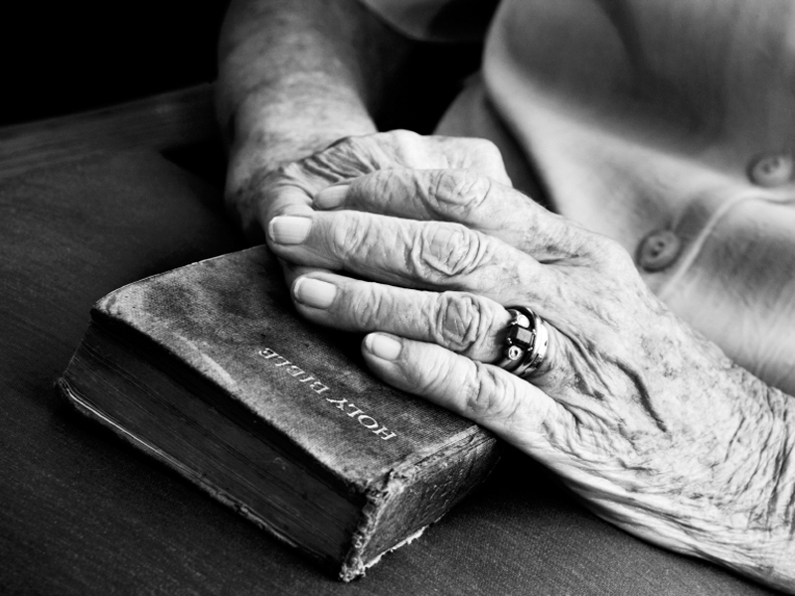





Slide 3

…What We’ve Seen So Far…

Slide 4

An Integrated World Government

Slide 5

Daniel 2:42-43 42 And as the toes of the feet were part of iron, and part of clay, so the kingdom shall be partly strong, and partly broken.
43 And whereas thou sawest iron mixed with miry clay, they shall mingle themselves with the seed of men: but they shall not cleave one to another, even as iron is not mixed with clay.

Slide 6

Economic Devastation

Slide 7

Revelation 6:5-6 5 And when he had opened the third seal, I heard the third beast say, Come and see. And I beheld, and lo a black horse; and he that sat on him had a pair of balances in his hand.
6 And I heard a voice in the midst of the four beasts say, A measure of wheat for a penny, and three measures of barley for a penny; and see thou hurt not the oil and the wine.

Slide 8

The Love Of Brothers Or The Judging Of Others

Slide 9

Revelation 3:8-10 8 I know thy works: behold, I have set before thee an open door, and no man can shut it: for thou hast a little strength, and hast kept my word, and hast not denied my name.
9 Behold, I will make them of the synagogue of Satan, which say they are Jews, and are not, but do lie; behold, I will make them to come and worship before thy feet, and to know that I have loved thee.

Slide 10
Revelation 3:8-10 10 Because thou hast kept the word of my patience, I also will keep thee from the hour of temptation, which shall come upon all the world, to try them that dwell upon the earth.

Slide 11
Revelation 3:14-16 14 And unto the angel of the church of the Laodiceans write; These things saith the Amen, the faithful and true witness, the beginning of the creation of God;
15 I know thy works, that thou art neither cold nor hot: I would thou wert cold or hot.
16 So then because thou art lukewarm, and neither cold nor hot, I will spue thee out of my mouth.

Slide 12

A Civilization In Decline

Slide 13

2 Timothy 3:1-4 1 This know also, that in the last days perilous times shall come.
2 For men shall be lovers of their own selves, covetous, boasters, proud, blasphemers, disobedient to parents, unthankful, unholy,
3 Without natural affection, trucebreakers, false accusers, incontinent, fierce, despisers of those that are good,
4 Traitors, heady, highminded, lovers of pleasures more than lovers of God;

Slide 14
All Of These Things Seem To Point To The “END GAME”

Slide 15
How Does The END GAME (I.E. The Return Of Jesus Christ And The Unfolding Of Future Events) Relate To You?

Slide 16
What Is The State Of Your Union With Jesus Christ?

Slide 17
Check Yourself Out With The Following Questions That Directly Relate To You And The Return Of Jesus Christ

Slide 18

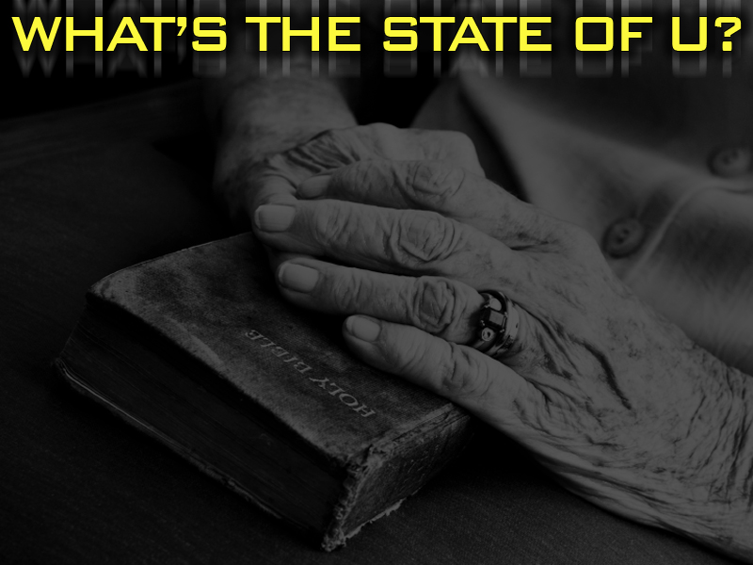
1. Are You Loving People?
1 Thessalonians 3:12-13 12 And the Lord make you to increase and abound in love one toward another, and toward all men, even as we do toward you:
13 To the end he may stablish your hearts unblameable in holiness before God, even our Father, at the coming of our Lord Jesus Christ with all his saints.

Slide 19
2. Are You Judging Others?
1 Corinthians 4:5 Therefore judge nothing before the time, until the Lord come, who both will bring to light the hidden things of darkness, and will make manifest the counsels of the hearts: and then shall every man have praise of God.

Slide 20
3. Are You Active In Your
Church Fellowship?
Hebrews 10:24-25 24 And let us consider one another to provoke unto love and to good works:
25 Not forsaking the assembling of ourselves together, as the manner of some is; but exhorting one another: and so much the more, as ye see the day approaching.

Slide 21
4. Are You Remembering The
Lord’s Communion?
1 Corinthians 11:26 For as often as ye eat this bread, and drink this cup, ye do shew the Lord's death till he come.

Slide 22
5. Are You Committed To
Living For Jesus Christ?
2 Timothy 4:1-2 1 I charge thee therefore before God, and the Lord Jesus Christ, who shall judge the quick and the dead at his appearing and his kingdom;
2 Preach the word; be instant in season, out of season; reprove, rebuke, exhort with all long suffering and doctrine.

Slide 23
6. Are You Responding To
Life Spiritually?
Colossians 3:1-4 1 If ye then be risen with Christ, seek those things which are above, where Christ sitteth on the right hand of God.
2 Set your affection on things above, not on things on the earth.

Slide 24
6. Are You Responding To
Life Spiritually?
Colossians 3:1-4 3 For ye are dead, and your life is hid with Christ in God.
4 When Christ, who is our life, shall appear, then shall ye also appear with him in glory.

Slide 25
7. Are You Keeping Short
Sin Accounts?
1 John 2:28-29 28 And now, little children, abide in him; that, when he shall appear, we may have confidence, and not be ashamed before him at his coming.
29 If ye know that he is righteous, ye know that every one that doeth righteousness is born of him.

Slide 26
8. Are You Sharing Jesus Christ
With Family And Friends?
Jude 21-23 21 Keep yourselves in the love of God, looking for the mercy of our Lord Jesus Christ unto eternal life.
22 And of some have compassion, making a difference:
23 And others save with fear, pulling them out of the fire; hating even the garment spotted by the flesh.

Slide 27
9. Are You Comforting Others?
1 Thessalonians 4:13-18 13 But I would not have you to be ignorant, brethren, concerning them which are asleep, that ye sorrow not, even as others which have no hope.
14 For if we believe that Jesus died and rose again, even so them also which sleep in Jesus will God bring with him.

Slide 28
9. Are You Comforting Others?
1 Thessalonians 4:13-18 15 For this we say unto you by the word of the Lord, that we which are alive and remain unto the coming of the Lord shall not prevent them which are asleep.

Slide 29
9. Are You Comforting Others?
1 Thessalonians 4:13-18 16 For the Lord himself shall descend from heaven with a shout, with the voice of the archangel, and with the trump of God: and the dead in Christ shall rise first:

Slide 30
9. Are You Comforting Others?
1 Thessalonians 4:13-18 17 Then we which are alive and remain shall be caught up together with them in the clouds, to meet the Lord in the air: and so shall we ever be with the Lord.
18 Wherefore comfort one another with these words.

Slide 31
10. Are You Patiently
Anticipating Christ’s Return?
James 5:7-8 7 Be patient therefore, brethren, unto the coming of the Lord. Behold, the husbandman waiteth for the precious fruit of the earth, and hath long patience for it, until he receive the early and latter rain.
8 Be ye also patient; stablish your hearts: for the coming of the Lord draweth nigh.

Slide 33
…So, How Did You Do?

Slide 34
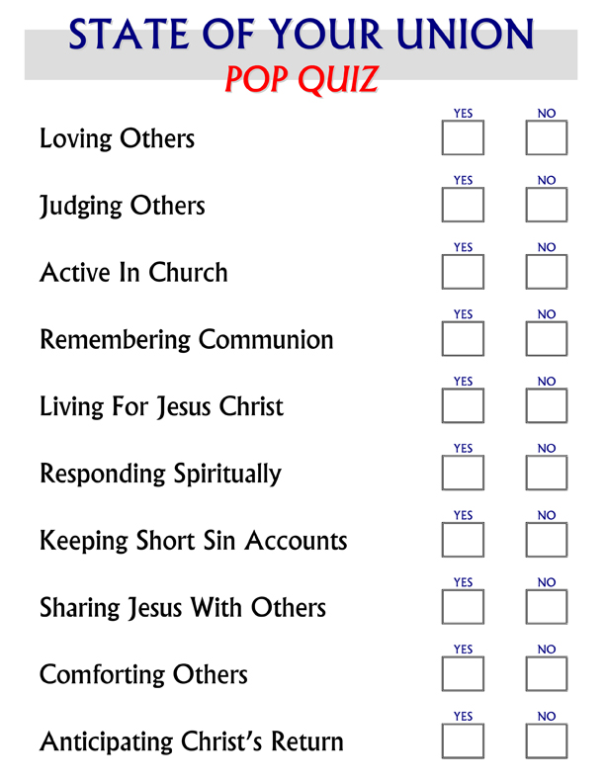


Slide 35




