Slide 1
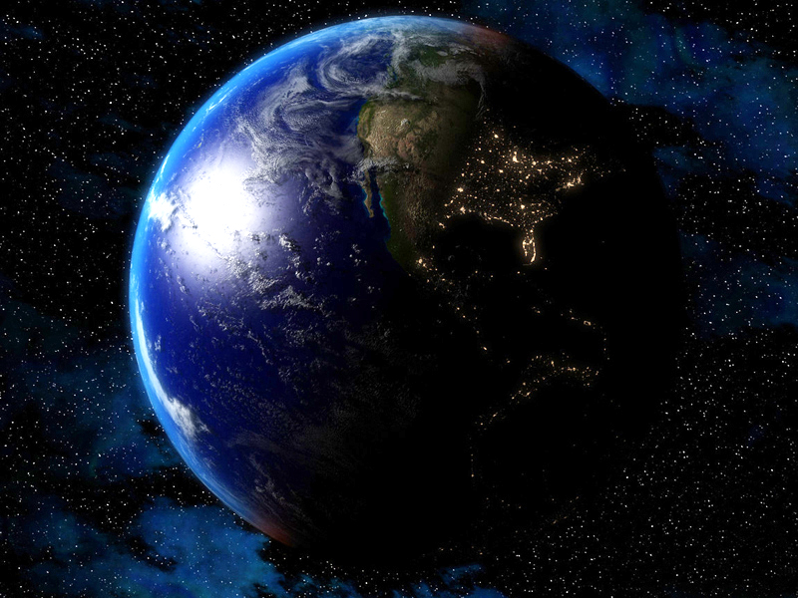



Slide 2
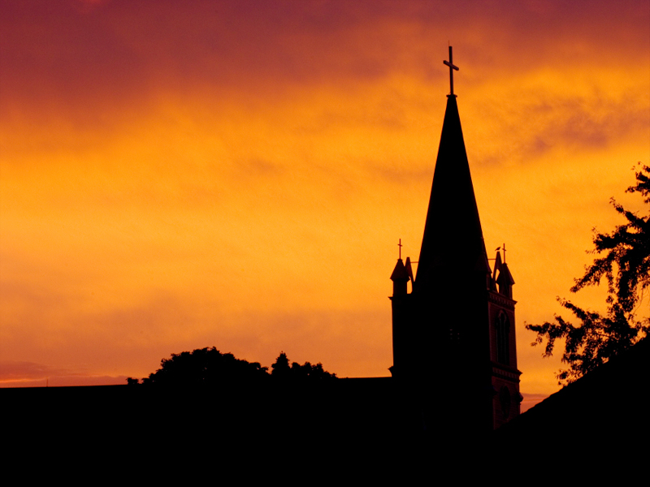
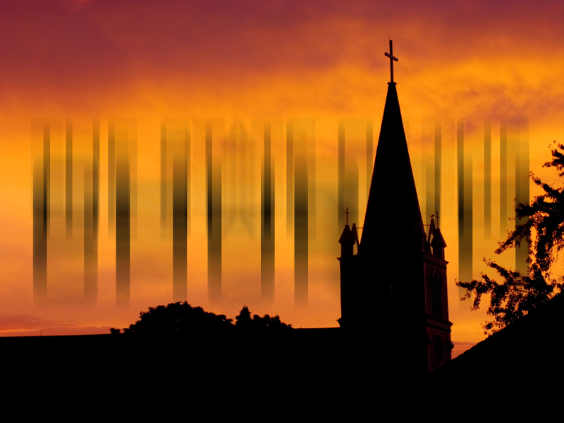



Slide 3
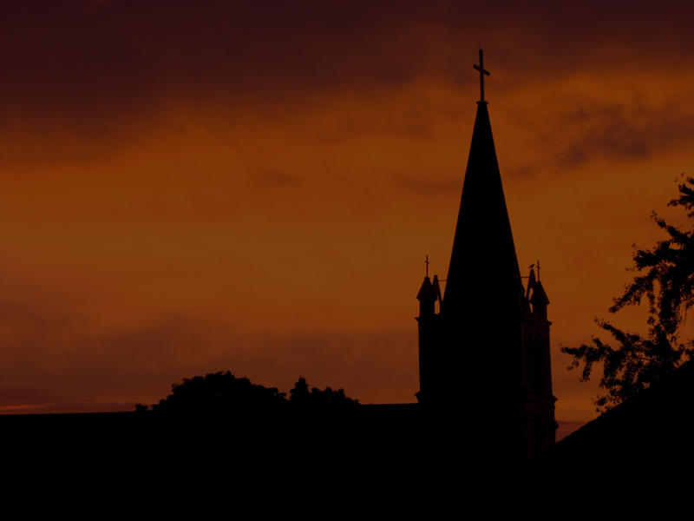
What Will The Church Look Like And Be Like In The Latter Days?

Slide 4
2 Timothy 3:1-5 1 This know also, that in the last days perilous times shall come.
2 For men shall be lovers of their own selves, covetous, boasters, proud, blasphemers, disobedient to parents, unthankful, unholy,
3 Without natural affection, trucebreakers, false accusers, incontinent, fierce, despisers of those that are good,

Slide 5
2 Timothy 3:1-5 4 Traitors, heady, highminded, lovers of pleasures more than lovers of God;
5 Having a form of godliness, but denying the power thereof: from such turn away.

Slide 6
2 Timothy 4:1-5 1 I charge thee therefore before God, and the Lord Jesus Christ, who shall judge the quick and the dead at his appearing and his kingdom;
2 Preach the word; be instant in season, out of season; reprove, rebuke, exhort with all long suffering and doctrine.

Slide 7
2 Timothy 4:1-5 3 For the time will come when they will not endure sound doctrine; but after their own lusts shall they heap to themselves teachers, having itching ears;

Slide 8
2 Timothy 4:1-5 4 And they shall turn away their ears from the truth, and shall be turned unto fables.
5 But watch thou in all things, endure afflictions, do the work of an evangelist, make full proof of thy ministry.

Slide 9
IN THE BOOK OF REVELATION, JESUS MIRACULOUSLY APPEARS TO THE APOSTLE JOHN ON THE ISLE OF PATMOS
Jesus Says In Revelation 1:11 “Write What You See And Send It To The Seven Churches Which Are In Asia”

Slide 10
IN THE BOOK OF REVELATION, JESUS MIRACULOUSLY APPEARS TO THE APOSTLE JOHN ON THE ISLE OF PATMOS
In Chapters Two And Three, Jesus Gives Specific Messages To Each Of The Seven Churches

Slide 11
IN THE BOOK OF REVELATION, JESUS MIRACULOUSLY APPEARS TO THE APOSTLE JOHN ON THE ISLE OF PATMOS
These Are Literal Letters To Literal Churches, But Also They Are A Revealing Or Unveiling Of Things To Come

Slide 12
Let’s Look At The Last Two Letters Which I Believe Give Us Light To The STATE OF THE CHURCH In The Last Days

Slide 13
THE CHURCH OF
PHILADELPHIA
Revelation 3:7 And to the angel of the church in Philadelphia write; These things saith he that is holy, he that is true, he that hath the key of David, he that openeth, and no man shutteth; and shutteth, and no man openeth;

Slide 14
THE CHURCH OF
PHILADELPHIA
Philadelphia Means “Brotherly Love” Or “The Love Of Brothers”

Slide 15
THE CHURCH OF
PHILADELPHIA
Jesus Says “This Is From Me”
I AM THE HOLY ONE!
I AM THE TRUE ONE!
I HAVE THE KEYS!

Slide 16
THE CHURCH OF
PHILADELPHIA
Jesus Says “This Is From Me”
I Am The One That Opens And No Man Shuts, And I Am The One That Shuts And No Man Opens!

Slide 17
THE CHURCH OF
PHILADELPHIA
Jesus Says “This Is From Me”
I AM THE ULTIMATE AUTHORITY!

Slide 18
THE CHURCH OF
PHILADELPHIA
What Does Jesus Say To This Church?
Revelation 3:8a I know thy works: behold, I have set before thee an open door, and no man can shut it: for thou hast a little strength, and hast kept my word, and hast not denied my name.

Slide 19
THE CHURCH OF
PHILADELPHIA
What Does Jesus Say To This Church?
I Know Your Works
I Have Set Before You
An Open Door

Slide 20
THE CHURCH OF
PHILADELPHIA
He Has Nothing Bad To Say About Them…
Romans 8:1 There is therefore now no condemnation to them which are in Christ Jesus, who walk not after the flesh, but after the Spirit.

Slide 21
THE CHURCH OF
PHILADELPHIA
Jesus Commends This Church…
Revelation 3:8b I know thy works: behold, I have set before thee an open door, and no man can shut it: for thou hast a little strength, and hast kept my word, and hast not denied my name.

Slide 22
THE CHURCH OF
PHILADELPHIA
Jesus Commends This Church…
“You Have Little Strength”

Slide 23
THE CHURCH OF
PHILADELPHIA
Jesus Commends This Church…
2 Corinthians 12:9-10 9 And he said unto me, My grace is sufficient for thee: for my strength is made perfect in weakness. Most gladly therefore will I rather glory in my infirmities, that the power of Christ may rest upon me.

Slide 24
THE CHURCH OF
PHILADELPHIA
Jesus Commends This Church…
2 Corinthians 12:9-10 10 Therefore I take pleasure in infirmities, in reproaches, in necessities, in persecutions, in distresses for Christ's sake: for when I am weak, then am I strong.

Slide 25
THE CHURCH OF
PHILADELPHIA
Jesus Commends This Church…
1 Corinthians 1:25-29 25 Because the foolishness of God is wiser than men; and the weakness of God is stronger than men.

Slide 26
THE CHURCH OF
PHILADELPHIA
Jesus Commends This Church…
1 Corinthians 1:25-29 26 For ye see your calling, brethren, how that not many wise men after the flesh, not many mighty, not many noble, are called:

Slide 27
THE CHURCH OF
PHILADELPHIA
Jesus Commends This Church…
1 Corinthians 1:25-29 27 But God hath chosen the foolish things of the world to confound the wise; and God hath chosen the weak things of the world to confound the things which are mighty;

Slide 28
THE CHURCH OF
PHILADELPHIA
Jesus Commends This Church…
1 Corinthians 1:25-29 28 And base things of the world, and things which are despised, hath God chosen, yea, and things which are not, to bring to nought things that are:

Slide 29
THE CHURCH OF
PHILADELPHIA
Jesus Commends This Church…
1 Corinthians 1:25-29 29 That no flesh should glory in his presence.

Slide 30
THE CHURCH OF
PHILADELPHIA
Jesus Commends This Church…
“You Have Kept My Word”

Slide 31
THE CHURCH OF
PHILADELPHIA
Jesus Commends This Church…
Psalm 119:89 For ever, O LORD, thy word is settled in heaven.

Slide 32
THE CHURCH OF
PHILADELPHIA
Jesus Commends This Church…
Psalm 119:105 Thy word is a lamp unto my feet, and a light unto my path.

Slide 33
THE CHURCH OF
PHILADELPHIA
Jesus Commends This Church…
Psalm 119:130 The entrance of thy words giveth light; it giveth understanding unto the simple.

Slide 34
THE CHURCH OF
PHILADELPHIA
Jesus Commends This Church…
Psalm 119:140 Thy word is very pure: therefore thy servant loveth it.

Slide 35
THE CHURCH OF
PHILADELPHIA
Jesus Commends This Church…
“You Have Confessed My Name Openly”

Slide 36
THE CHURCH OF
PHILADELPHIA
Jesus Commends This Church…
Romans 10:9-11 9 That if thou shalt confess with thy mouth the Lord Jesus, and shalt believe in thine heart that God hath raised him from the dead, thou shalt be saved.

Slide 37
THE CHURCH OF
PHILADELPHIA
Jesus Commends This Church…
Romans 10:9-11 10 For with the heart man believeth unto righteousness; and with the mouth confession is made unto salvation.

Slide 38
THE CHURCH OF
PHILADELPHIA
Jesus Commends This Church…
Romans 10:9-11 11 For the scripture saith, Whosoever believeth on him shall not be ashamed.

Slide 39
THE CHURCH OF
PHILADELPHIA
Jesus Promises This Church…
“I Will Exalt You Above The Phonies And They Will Know I Love You”

Slide 40
THE CHURCH OF
PHILADELPHIA
Jesus Promises This Church…
Revelation 3:9 Behold, I will make them of the synagogue of Satan, which say they are Jews, and are not, but do lie; behold, I will make them to come and worship before thy feet, and to know that I have loved thee.

Slide 41
THE CHURCH OF
PHILADELPHIA
Jesus Promises This Church…
“I Will Keep You From The Hour Of Temptation”

Slide 42
THE CHURCH OF
PHILADELPHIA
Jesus Promises This Church…
Revelation 3:10-11 10 Because thou hast kept the word of my patience, I also will keep thee from the hour of temptation, which shall come upon all the world, to try them that dwell upon the earth.

Slide 43
THE CHURCH OF
PHILADELPHIA
Jesus Promises This Church…
Revelation 3:10-11 11 Behold, I come quickly: hold that fast which thou hast, that no man take thy crown.

Slide 44
THE CHURCH OF
PHILADELPHIA
Jesus Promises This Church…
“I Will Make You A Pillar In The Temple Of God”

Slide 45
THE CHURCH OF
PHILADELPHIA
Jesus Promises This Church…
Revelation 3:12a Him that overcometh will I make a pillar in the temple of my God, and he shall go no more out…

Slide 46
THE CHURCH OF
PHILADELPHIA
Jesus Promises This Church…
“I Will Write Up You ‘My New Name’”

Slide 47
THE CHURCH OF
PHILADELPHIA
Jesus Promises This Church…
Revelation 3:12b …and I will write upon him the name of my God, and the name of the city of my God, which is new Jerusalem, which cometh down out of heaven from my God: and I will write upon him my new name.

Slide 49
In The Last Days, There Will Be A TRUE CHURCH

Slide 50
BUT...

Slide 51
In The Last Days There Will Be A FALSE CHURCH Also

Slide 52
THE CHURCH OF
LAODICEA
Revelation 3:14 And unto the angel of the church of the Laodiceans write; These things saith the Amen, the faithful and true witness, the beginning of the creation of God;

Slide 53
THE CHURCH OF
LAODICEA
Laodicea Means “People Judge” Or “The Judgment Of People”

Slide 54
THE CHURCH OF
LAODICEA
Jesus Says…
I AM THE AMEN
I AM THE FAITHFUL AND
TRUE WITNESS
I AM THE BEGINNING OF
THE CREATION OF GOD

Slide 55
THE CHURCH OF
LAODICEA
Jesus Gives This Church No Commendation…

Slide 56
THE CHURCH OF
LAODICEA
Only Condemnation!

Slide 57
THE CHURCH OF
LAODICEA
Jesus Has Nothing Good To Say About Them…
Revelation 3:15-16 15 I know thy works, that thou art neither cold nor hot: I would thou wert cold or hot.

Slide 58
THE CHURCH OF
LAODICEA
Jesus Has Nothing Good To Say About Them…
Revelation 3:15-16 16 So then because thou art lukewarm, and neither cold nor hot, I will spue thee out of my mouth.

Slide 59
THE CHURCH OF
LAODICEA
Jesus Has Nothing Good To Say About Them…
Literally… “I will vomit you out of my mouth!”

Slide 60
THE CHURCH OF
LAODICEA
Jesus Condemns Them…
Revelation 3:17 Because thou sayest, I am rich, and increased with goods, and have need of nothing; and knowest not that thou art wretched, and miserable, and poor, and blind, and naked:

Slide 61
THE CHURCH OF
LAODICEA
You Say…
I AM RICH – No Humility!
I AM INCREASED WITH
GOODS – No Bible!
I DON’T NEED ANYTHING –
No Jesus!

Slide 62
THE CHURCH OF
LAODICEA
Full Of Self!
Full Of Stuff!
Full Of Bull!

Slide 63
THE CHURCH OF
LAODICEA
Jesus Says…
YOU ARE WRETCHED
YOU ARE MISERABLE
YOU ARE POOR
YOU ARE NAKED
YOU ARE BLIND

Slide 64
THE CHURCH OF
LAODICEA
Jesus Gives Some Counsel…
Revelation 3:18 I counsel thee to buy of me gold tried in the fire, that thou mayest be rich; and white raiment, that thou mayest be clothed, and that the shame of thy nakedness do not appear; and anoint thine eyes with eyesalve, that thou mayest see.

Slide 65
THE CHURCH OF
LAODICEA
Buy Of Me Or Get From Me…
GOLD
WHITE RAIMENT
EYE SALVE

Slide 66
THE CHURCH OF
LAODICEA
What’s Gold With God?
Faith In God...
Hebrews 11:1 Now faith is the substance of things hoped for, the evidence of things not seen.

Slide 67
THE CHURCH OF
LAODICEA
What’s Gold With God?
Faith In God...
Hebrews 11:6 But without faith it is impossible to please him: for he that cometh to God must believe that he is, and that he is a rewarder of them that diligently seek him.

Slide 68
THE CHURCH OF
LAODICEA
What’s Gold With God?
Faith In God...
Romans 1:17 For therein is the righteousness of God revealed from faith to faith: as it is written, The just shall live by faith.

Slide 69
THE CHURCH OF
LAODICEA
What’s White Raiment With God?
The Righteousness Of God...
Isaiah 64:6 But we are all as an unclean thing, and all our righteousnesses are as filthy rags; and we all do fade as a leaf; and our iniquities, like the wind, have taken us away.

Slide 70
THE CHURCH OF
LAODICEA
What’s White Raiment With God?
The Righteousness Of God...
2 Corinthians 5:17 Therefore if any man be in Christ, he is a new creature: old things are passed away; behold, all things are become new.

Slide 71
THE CHURCH OF
LAODICEA
What’s White Raiment With God?
The Righteousness Of God...
2 Corinthians 5:21 For he hath made him to be sin for us, who knew no sin; that we might be made the righteousness of God in him.

Slide 72
THE CHURCH OF
LAODICEA
What’s Eye Salve With God?
The Forgiveness Of God...
Colossians 1:14 In whom we have redemption through his blood, even the forgiveness of sins:

Slide 73
THE CHURCH OF
LAODICEA
What’s Eye Salve With God?
The Forgiveness Of God...
Ephesians 2:1 And you hath he quickened, who were dead in trespasses and sins;

Slide 74
THE CHURCH OF
LAODICEA
What’s Eye Salve With God?
The Forgiveness Of God...
Ephesians 2:8-9 8 For by grace are ye saved through faith; and that not of yourselves: it is the gift of God:
9 Not of works, lest any man should boast.

Slide 75
THE CHURCH OF
LAODICEA
Faith In God Makes
You Rich
The Righteousness Of
God Clothes You And
Makes You Unashamed
The Forgiveness Of
God Opens Your Eyes

Slide 77
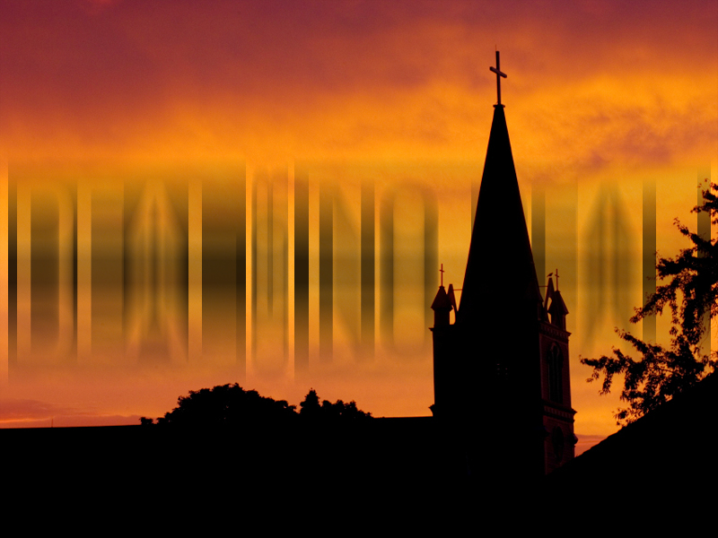



Slide 78
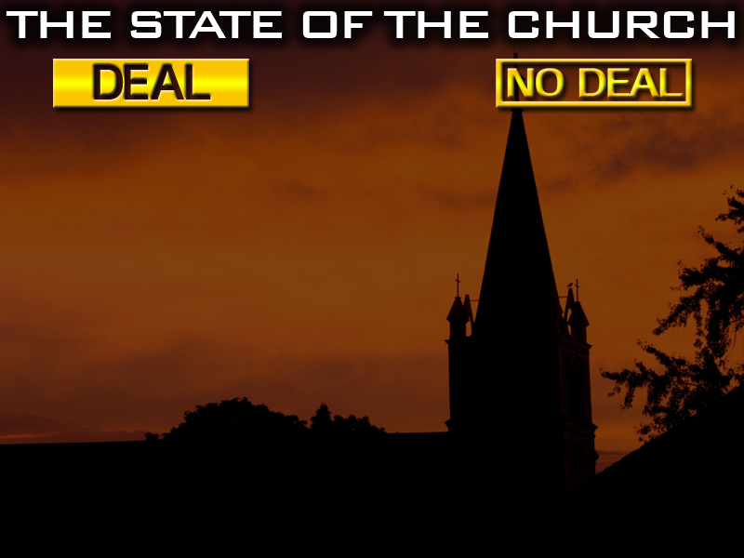
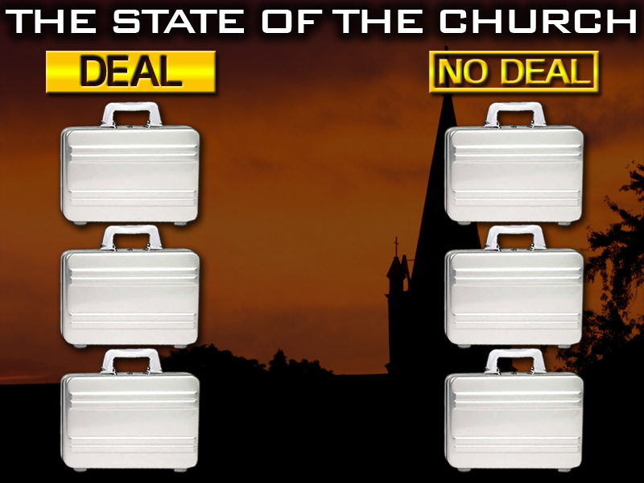

Slide 79
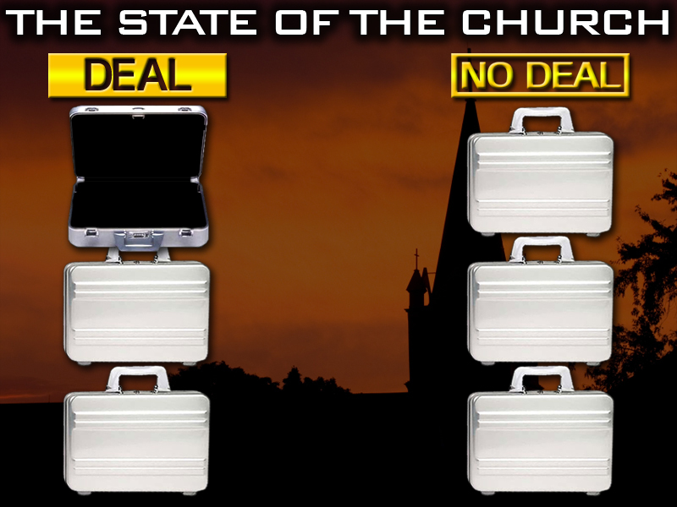
THE LOVE OF BROTHERS

Slide 80
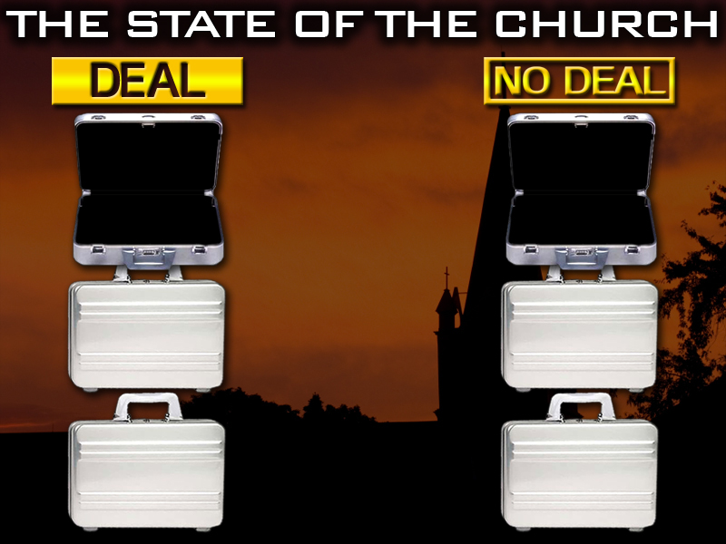
THE LOVE OF BROTHERS
THE JUDGMENT OF PEOPLE

Slide 81
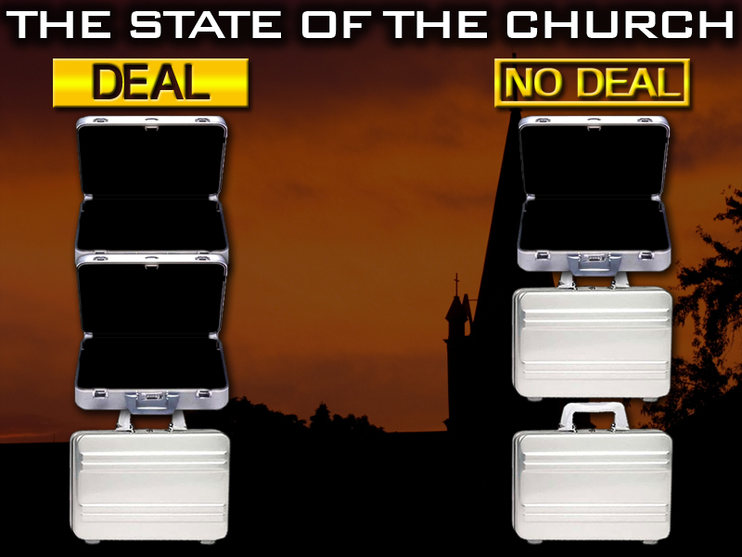
THE LOVE OF BROTHERS
THE JUDGMENT OF PEOPLE
HUMBLE

Slide 82
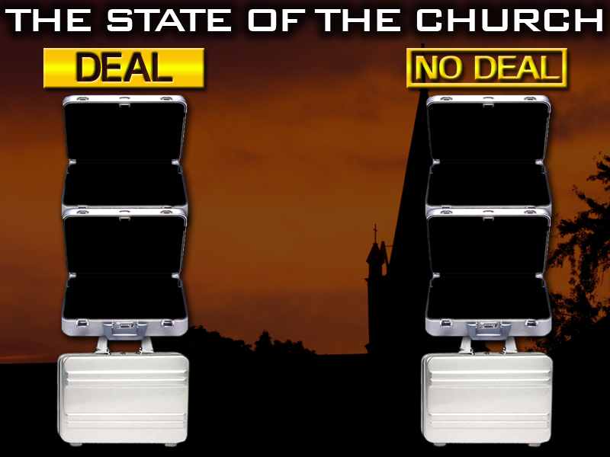
THE LOVE OF BROTHERS
THE JUDGMENT OF PEOPLE
HUMBLE
PROUD

Slide 83
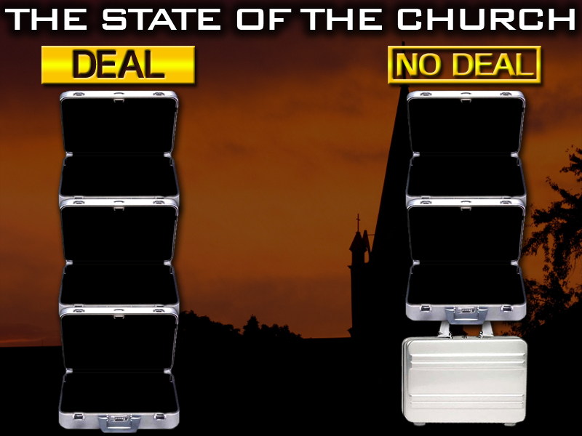
THE LOVE OF BROTHERS
THE JUDGMENT OF PEOPLE
HUMBLE
PROUD
BELIEVES THE WORD OF GOD

Slide 84
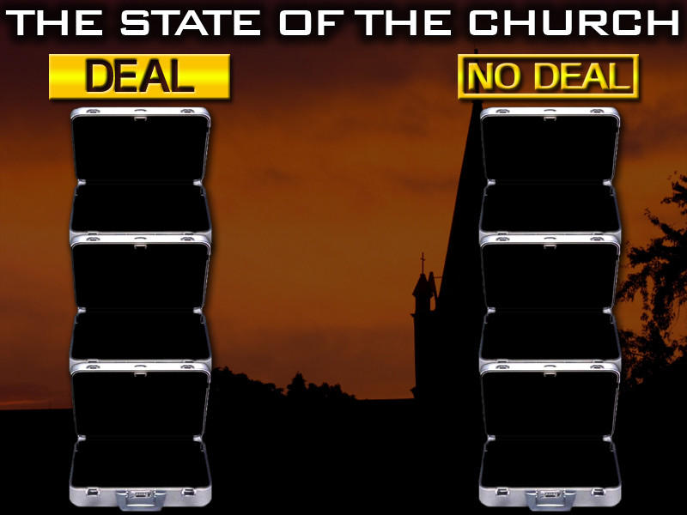
THE LOVE OF BROTHERS
THE JUDGMENT OF PEOPLE
HUMBLE
PROUD
BELIEVES THE WORD OF GOD
DOUBTS THE WORD OF GOD

Slide 86
CONFESSES JESUS CHRIST OPENLY

Slide 87
CONFESSES JESUS CHRIST OPENLY
DIMINISHES OR DENIES CHRIST

Slide 88
CONFESSES JESUS CHRIST OPENLY
DIMINISHES OR DENIES CHRIST
FAITH

Slide 89
CONFESSES JESUS CHRIST OPENLY
DIMINISHES OR DENIES CHRIST
FAITH
MONEY

Slide 90
CONFESSES JESUS CHRIST OPENLY
DIMINISHES OR DENIES CHRIST
FAITH
MONEY
RIGHTEOUSNESS

Slide 91
CONFESSES JESUS CHRIST OPENLY
DIMINISHES OR DENIES CHRIST
FAITH
MONEY
RIGHTEOUSNESS
SINFULNESS

Slide 93
FORGIVENESS

Slide 94
FORGIVENESS
BLINDNESS

Slide 95
FORGIVENESS
BLINDNESS
RAPTURED

Slide 96
FORGIVENESS
BLINDNESS
RAPTURED
LEFT BEHIND

Slide 97
FORGIVENESS
BLINDNESS
RAPTURED
LEFT BEHIND
HEAVEN

Slide 98
FORGIVENESS
BLINDNESS
RAPTURED
LEFT BEHIND
HEAVEN
HELL

Slide 99
Revelation 3:20 Behold, I stand at the door, and knock: if any man hear my voice, and open the door, I will come in to him, and will sup with him, and he with me.

Slide 100




