Slide 1
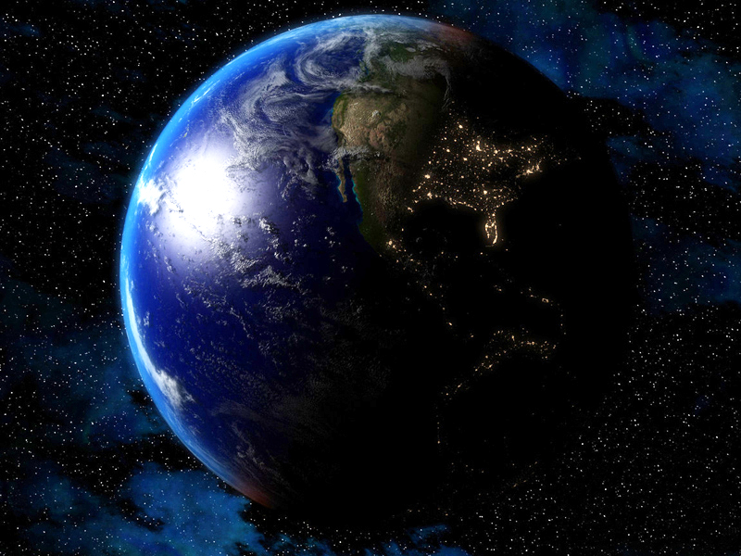



Slide 2
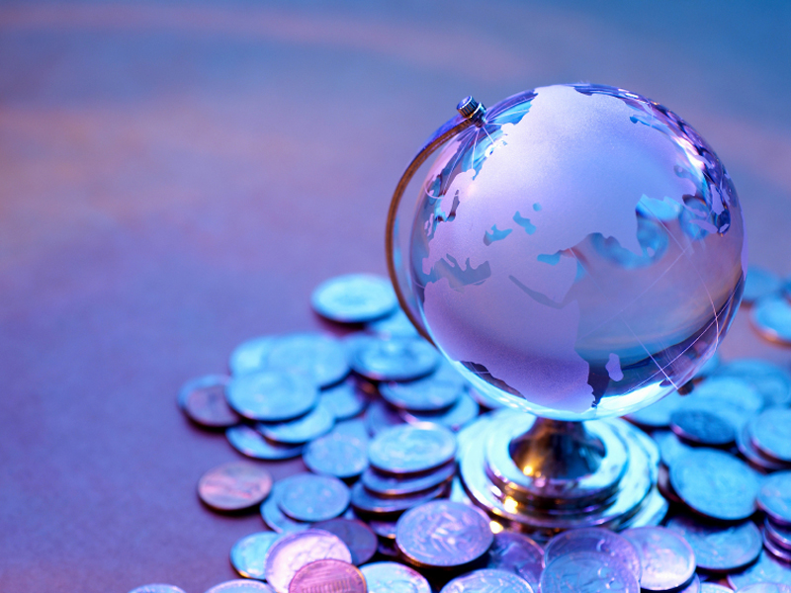


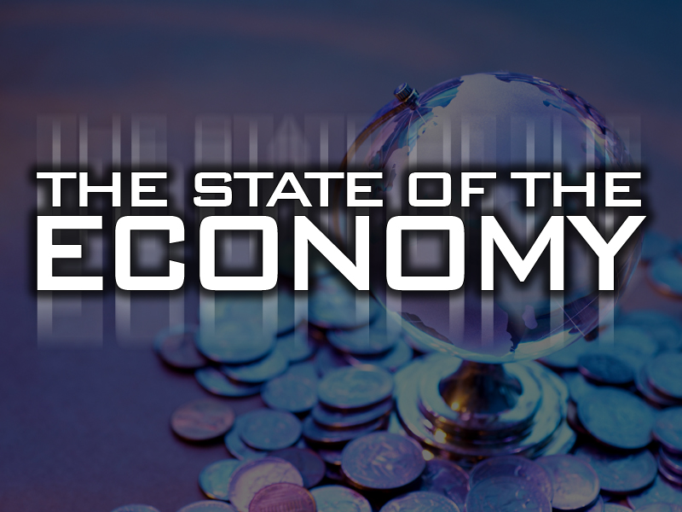

Slide 3

The World Stage Is Being Set For What Could Be “THE END GAME”

Slide 4
Gradually, Yet Steadily, The Nations Of Europe (EU) Have Come Together To Create A Modern Replica Of The Ancient Roman Empire As Prophesied By The Prophet Daniel Over 2600 Years Ago

Slide 5
In The Book Revelation (Which Means An Unveiling Or Revealing Of Things To Come) We See Some “Snap Shots” Of Things That Will Come To Pass

Slide 6
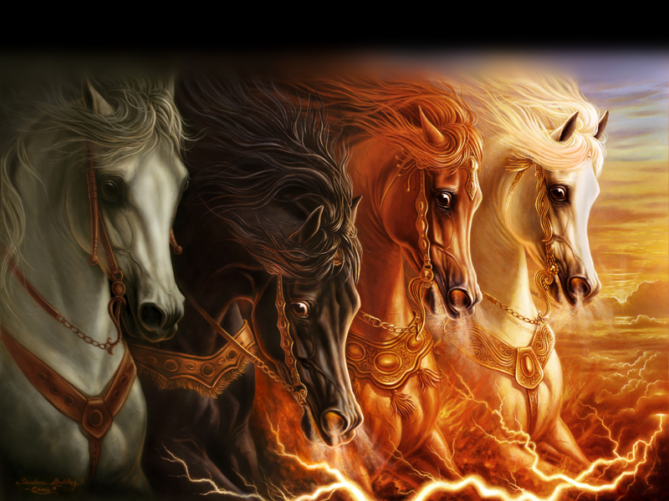
THE FOUR HORSEMEN OF
THE APOCALYPSE

Slide 7
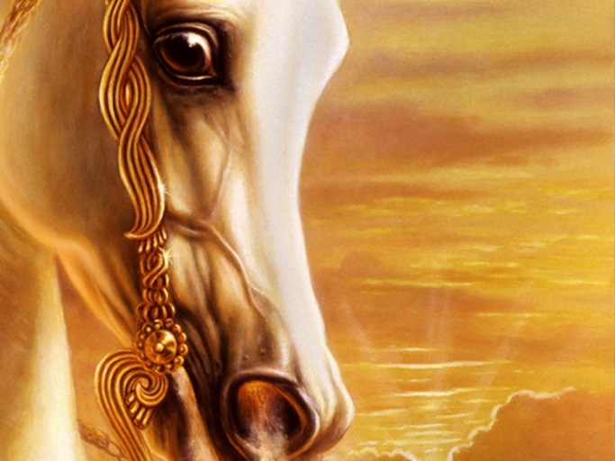
THE WHITE
HORSE
Deception – The Anti-Christ
Revelation 6:2
And I saw, and behold a white horse: and he that sat on him had a bow; and a crown was given unto him: and he went forth conquering, and to conquer.

Slide 8
THE WHITE
HORSE
Deception – The Anti-Christ
Chaotic Conditions Will Call For
A Great leader
His Charisma And Ability Will Gain
Him World Recognition
He Will Be Able To Bring What
Seems To Be REAL PEACE To The
Middle East Mess

Slide 9
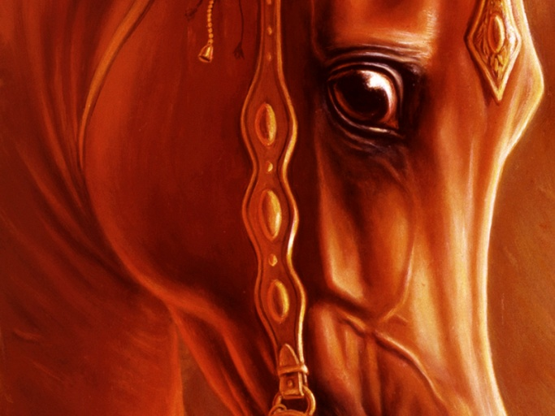
THE RED
HORSE
Dissension – War
Revelation 6:4
And there went out another horse that was red: and power was given to him that sat thereon to take peace from the earth, and that they should kill one another: and there was given unto him a great sword.

Slide 10
THE RED
HORSE
Dissension – War
The Peace Treaty In The Middle East
Will Be Broken And Unbelievable
Hostility, Like Never Seen Before,
Will Break Out
There Should Be No Doubt Among
“Thinking People” For The Possibility
Of Catastrophic, All Out War, As
Prophesied In The Bible

Slide 11
THE RED
HORSE
Dissension – War
Listen To Jesus…

Slide 12
THE RED
HORSE
Dissension – War
Matthew 24:3-8
3 And as he sat upon the mount of Olives, the disciples came unto him privately, saying, Tell us, when shall these things be? and what shall be the sign of thy coming, and of the end of the world?

Slide 13
THE RED
HORSE
Dissension – War
Matthew 24:3-8
4 And Jesus answered and said unto them, Take heed that no man deceive you.
5 For many shall come in my name, saying, I am Christ; and shall deceive many.

Slide 14
THE RED
HORSE
Dissension – War
Matthew 24:3-8
6 And ye shall hear of wars and rumours of wars: see that ye be not troubled: for all these things must come to pass, but the end is not yet.

Slide 15
THE RED
HORSE
Dissension – War
Matthew 24:3-8
7 For nation shall rise against nation, and kingdom against kingdom: and there shall be famines, and pestilences, and earthquakes, in divers places.
8 All these are the beginning of sorrows.

Slide 16
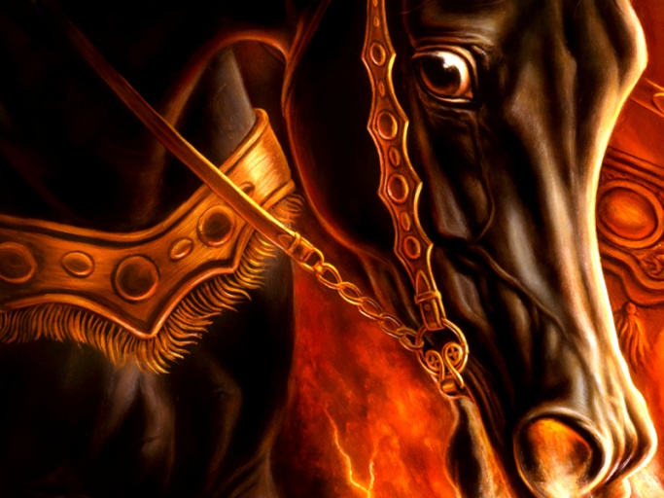
THE BLACK
HORSE
Devastation –
Economic Collapse
Revelation 6:5-6
5 And when he had opened the third seal, I heard the third beast say, Come and see. And I beheld, and lo a black horse; and he that sat on him had a pair of balances in his hand.

Slide 17
THE BLACK
HORSE
Devastation –
Economic Collapse
Revelation 6:5-6
6 And I heard a voice in the midst of the four beasts say, A measure of wheat for a penny, and three measures of barley for a penny; and see thou hurt not the oil and the wine.

Slide 18
THE BLACK
HORSE
Black Or Blackness Is Found 23
Times In The Bible
Blackness Seems To Speak Most
Often Of “Darkness”
The Israelites Used “Blackess” To
Signify The MOURNING OF MEN
Due To Scarcity, Want And Famine

Slide 19
THE BLACK
HORSE
Lamentations 5:10
Our skin was black like an oven because of the terrible famine.

Slide 20
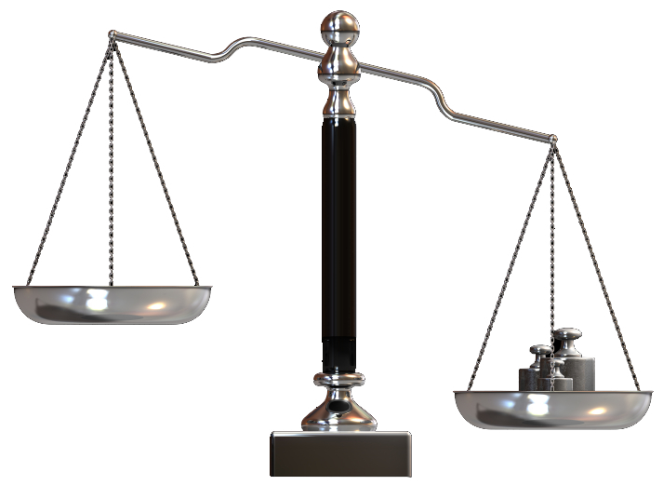
THE BLACK
HORSE
A Pair Of Balances
In His Hand…
When Scales Are Mentioned In Measuring Bread, It Is A Symbol Of Scarcity, Because Bread Would Have Sold By The Loaf, Not Exact Weight

Slide 21
THE BLACK
HORSE
A Pair Of Balances
In His Hand…
During A Famine, However,
Each Ounce Of Flour
Would Be Extremely
Valuable And Rationed By Weight Or Measure

Slide 22
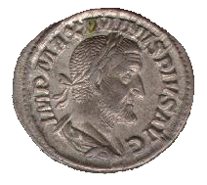
THE BLACK
HORSE
A Measure Of Wheat For A Penny And Three Measures
Of Barley For A Penny
A Measure Is Equal To Our Quart, And A Penny Was The Roman Denarius, Which Was An Entire Day’s Wage

Slide 23
THE BLACK
HORSE
A Measure Of Wheat For A Penny And Three Measures
Of Barley For A Penny
One Quart Of Wheat Will Sell For A Day’s Wage
(a quart is the amount a
normal man needs to survive)

Slide 24
THE BLACK
HORSE
A Measure Of Wheat For A Penny And Three Measures
Of Barley For A Penny
In Roman Times, A Day’s Wage Would Buy 8 Quarts Of Wheat, Or 24 Quarts
Of Barley – But Not
During This Time!

Slide 25
THE BLACK
HORSE
Imagine A Loaf Of Bread Costing
$16-20 A Loaf!

Slide 27
MOST PEOPLE IN THE WORLD ARE ALREADY FACING ECONOMIC DEVASTATION

Slide 28
Some Facts…
There Are Approximately 6.5 Billion People In The World

Slide 29
Some Facts…
About 1 Billion Alive Today Are Malnourished

Slide 30
Some Facts…
About 16,500 Children Under The Age Of Five Die Every Day Because Of Malnutrition
(that’s about 700 per hour)

Slide 31
Some Facts…
More Than 1 Billion People Live On Less Than One Dollar A Day

Slide 32
Some Facts…
Four Billion Of The
6.5 Billion People In
The World Live On 5% Of The World’s Income

Slide 33
There Is Already Economic Devastation
(and these figures were calculated prior to the current world economic crisis!)

Slide 34


THERE WILL BE
ECONOMIC DEVASTATION

Slide 35
Hurt Not
The Oil Nor The Wine…

Slide 36
LET’S SWITCH GEARS!

Slide 37
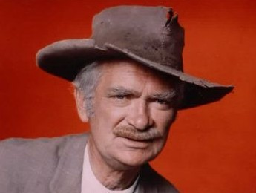
Now Listen To
A Story…

Slide 38
Do You Think
Oil Is A Big
Deal Today?

Slide 39
Interestingly… It Never Was Prior To The Last 100 Years

Slide 40
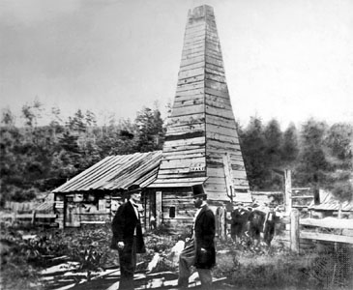
Guess Where The First Oil Well Was Drilled?
In Titusville, PA., On August 27, 1859 By Edward Drake

Slide 41
Today, Oil Is The Most Valuable, Most Widely Used Commodity In The World…

Slide 42
Who Woulda Thunk It?

Slide 43
American Oil Companies Were The Ones Who Went To The Middle
East To Help These Nations Develop Their
Oil Industries, And Now All Of The Middle Eastern
Oil Is Nationalized

Slide 44
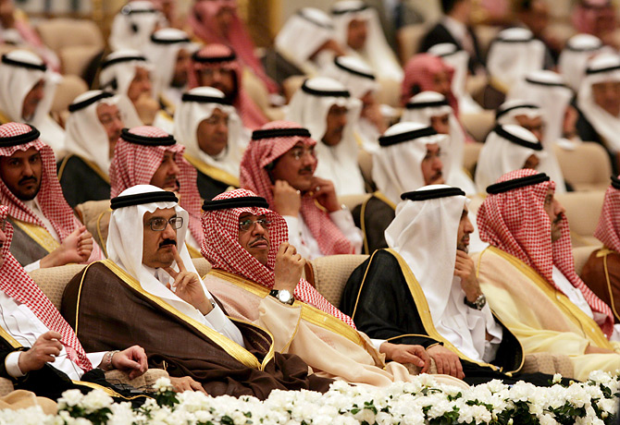
Over 60% Of The World’s Oil Supply Is Controlled By A Small Number Of Powerful Arab Rulers

Slide 45
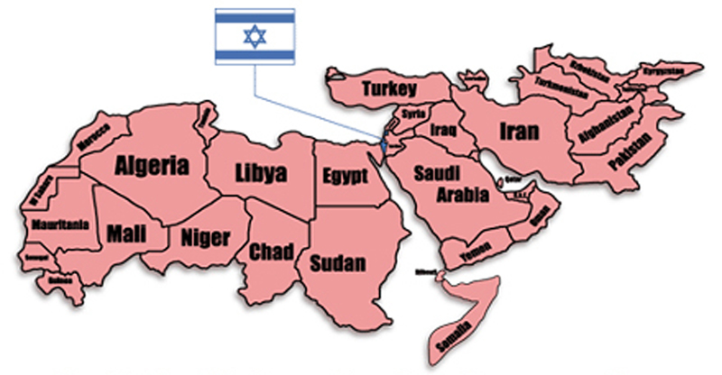
For Centuries, Students
Of Prophesy Could Not Understand How The Middle Eastern Nations Could Play Such A Powerful Role In
End Time Events…

Slide 46
Now
We Can!

Slide 47
Who Controls
The World’s Oil?
1. Saudi Arabia
264 Billion Barrels
2. Iran
138 Billion Barrels
3. Iraq
115 Billion Barrels
4. Kuwait
102 Billion Barrels
5. UAE
98 Billion Barrels
6. Russia
80 Billion Barrels
7. Venezuela
80 Billion Barrels
8. Libya
42 Billion Barrels

Slide 48
Who Controls
The World’s Oil?
The United States Is Ranked 11th With 30 Billion Barrels Of Oil

Slide 49
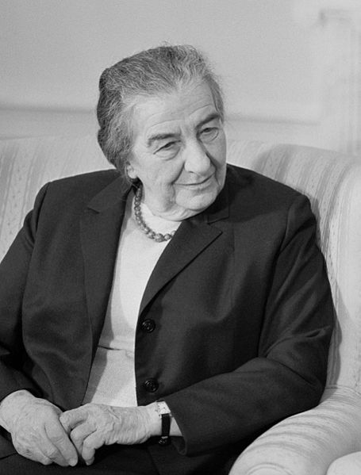
Who Controls
The World’s Oil?
Former Prime Minister Of Israel Golda Meir Said “Moses Dragged Us 40 Years Through The Desert To Bring Us To The One Place In The Middle East Where There Is No Oil!”

Slide 50
Who Uses Most Of
The World’s Oil?
The United States Uses 25% Of All The Oil Produced In The World – Followed By Europe, China And Japan

Slide 51
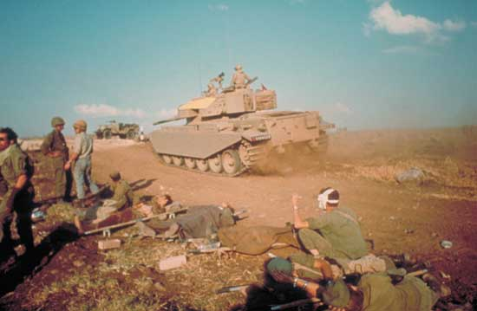
Oil Diplomacy:
Using Oil As A Weapon
Arab Nations United Against Israel In 1973 (Yom Kippur War),
And On October 17th, 1973 They Agreed To Reduce The Oil Supply
To Nations Who Favored Israel

Slide 52
Oil Diplomacy:
Using Oil As A Weapon
Oil Quadrupled
In Price, From $3 To $12 A Barrel!
This Is The First Time Unified
Arab Nations Impacted The
World Economy

Slide 53
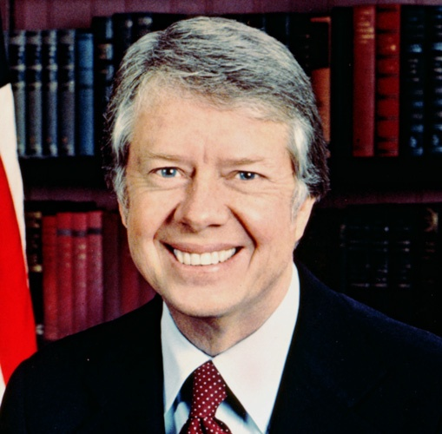
Oil Diplomacy:
Using Oil As A Weapon
On January 23rd, 1980, President Jimmy Carter
Set Forth The “Carter Doctrine”

Slide 54
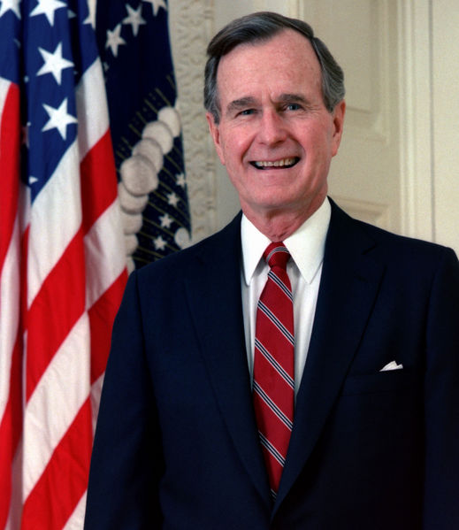
Oil Diplomacy:
Using Oil As A Weapon
In 1990, President George H.W. Bush Used
Armed Forces To Drive Iraq
Out Of Kuwait

Slide 55
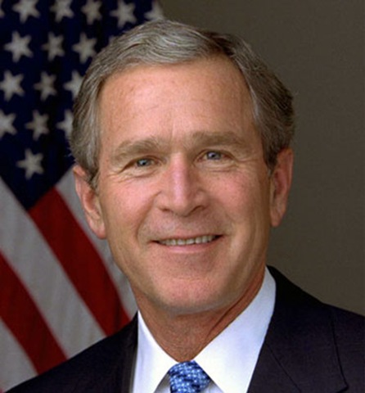
Oil Diplomacy:
Using Oil As A Weapon
In 2003, President George W. Bush Used Armed
Forces To Invade Iraq And Overthrow Saddam Hussein

Slide 56
Oil Diplomacy:
Using Oil As A Weapon
Just Last
Week, OPEC
Cut Production
By 1.5 Million Barrels A Day To Drive The Price Of Oil Back Up!

Slide 57



Slide 58
WHAT SHOULD I DO?

Slide 59
1. Wait On The Lord
Matthew 24:33-36
33 So likewise ye, when ye shall see all these things, know that it is near, even at the doors.
34 Verily I say unto you, This generation shall not pass, till all these things be fulfilled.

Slide 60
1. Wait On The Lord
Matthew 24:33-36
35 Heaven and earth shall pass away, but my words shall not pass away.
36 But of that day and hour knoweth no man, no, not the angels of heaven, but my Father only.

Slide 61
1. Wait On The Lord
Wait With Confidence, Knowing That
“What God’s Word Says Will Happen!”

Slide 62
2. Work For The Lord
Matthew 24:46
Blessed is that servant, whom his lord when he cometh shall find so doing.

Slide 63
2. Work For The Lord
John 9:4
I must work the works of him that sent me, while it is day: the night cometh, when no man can work.

Slide 64
2. Work For The Lord
Don’t Retreat Because Of Fear, But Rather Advance The Message Of Jesus Christ While You Still Have The Opportunity

Slide 65
3. Watch For The Lord
Luke 21:28
And when these things begin to come to pass, then look up, and lift up your heads; for your redemption draweth nigh.

Slide 66
3. Watch For The Lord
Don’t Be Discouraged Or Hang Your Head In Despair, But Rather Be Encouraged And Lift Your Head With Delight Knowing That This Could Be The Day Jesus Christ Comes Again

Slide 67
3. Watch For The Lord
Luke 12:35-40
35 Let your loins be girded about, and your lights burning;
36 And ye yourselves like unto men that wait for their lord, when he will return from the wedding; that when he cometh and knocketh, they may open unto him immediately.

Slide 68
3. Watch For The Lord
Luke 12:35-40
37 Blessed are those servants, whom the lord when he cometh shall find watching: verily I say unto you, that he shall gird himself, and make them to sit down to meat, and will come forth and serve them.

Slide 69
3. Watch For The Lord
Luke 12:35-40
38 And if he shall come in the second watch, or come in the third watch, and find them so, blessed are those servants.

Slide 70
3. Watch For The Lord
Luke 12:35-40
39 And this know, that if the goodman of the house had known what hour the thief would come, he would have watched, and not have suffered his house to be broken through.
40 Be ye therefore ready also: for the Son of man cometh at an hour when ye think not.

