Slide 1
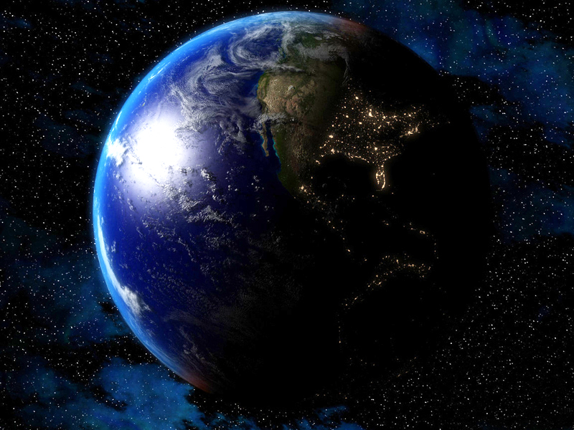



Slide 2




Slide 3
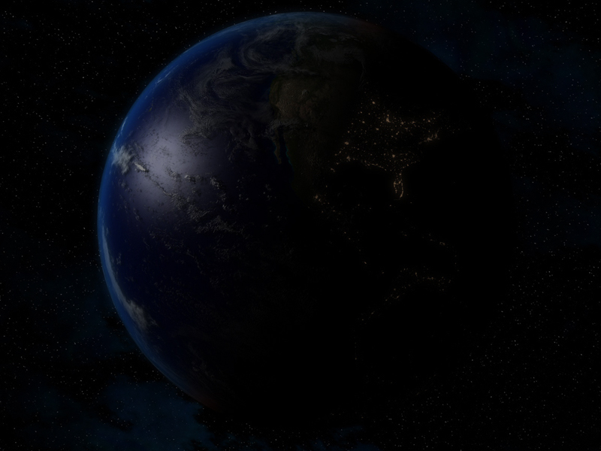
The Last Great “World Ruling” Empire On Earth Was The Roman Empire

Slide 4
Since It’s Ultimate Collapse In About 400AD, Many Leaders Have Come On The Scene Trying To Rule The World, But All Have Failed

Slide 5
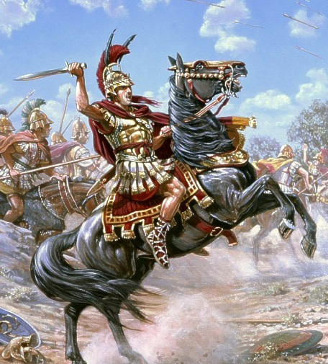
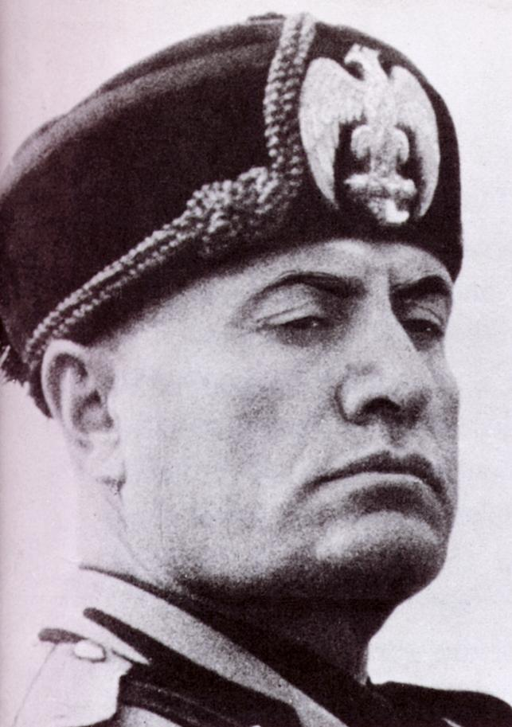
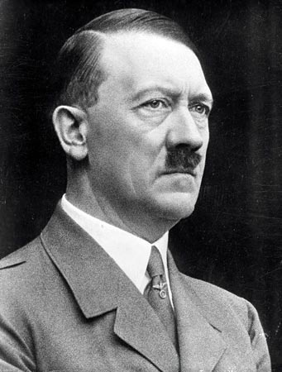
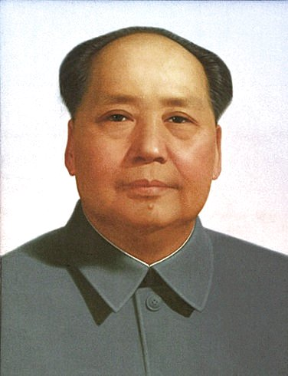
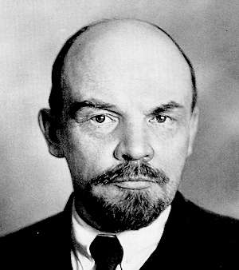

Slide 6
But The Day Will Come When A Revived One-World Empire Will Exist And Set The Stage For The One Whom The Bible Calls The Anti-Christ

Slide 7
SOUND SPOOKY AND FAR OUT?

Slide 8
Lets Go Back In Time About 600 Years Before Jesus Christ Was Born In Bethlehem

Slide 9
Lets See Just How Accurately God Has Predicted The Rise And Fall Of The Kingdoms Of This World

Slide 11
IT ALL STARTS
WITH A DREAM
Daniel 2:1-12 1 And in the second year of the reign of Nebuchadnezzar Nebuchadnezzar dreamed dreams, wherewith his spirit was troubled, and his sleep brake from him.

Slide 12
IT ALL STARTS
WITH A DREAM
Daniel 2:1-12 2 Then the king commanded to call the magicians, and the astrologers, and the sorcerers, and the Chaldeans, for to shew the king his dreams. So they came and stood before the king.

Slide 13
IT ALL STARTS
WITH A DREAM
Daniel 2:1-12 3 And the king said unto them, I have dreamed a dream, and my spirit was troubled to know the dream.
4 Then spake the Chaldeans to the king in Syriack, O king, live for ever: tell thy servants the dream, and we will shew the interpretation.

Slide 14
IT ALL STARTS
WITH A DREAM
Daniel 2:1-12 5 The king answered and said to the Chaldeans, The thing is gone from me: if ye will not make known unto me the dream, with the interpretation thereof, ye shall be cut in pieces, and your houses shall be made a dunghill.

Slide 15
IT ALL STARTS
WITH A DREAM
Daniel 2:1-12 6 But if ye shew the dream, and the interpretation thereof, ye shall receive of me gifts and rewards and great honour: therefore shew me the dream, and the interpretation thereof.

Slide 16
IT ALL STARTS
WITH A DREAM
Daniel 2:1-12 7 They answered again and said, Let the king tell his servants the dream, and we will shew the interpretation of it.
8 The king answered and said, I know of certainty that ye would gain the time, because ye see the thing is gone from me.

Slide 17
IT ALL STARTS
WITH A DREAM
Daniel 2:1-12 9 But if ye will not make known unto me the dream, there is but one decree for you: for ye have prepared lying and corrupt words to speak before me, till the time be changed: therefore tell me the dream, and I shall know that ye can shew me the interpretation thereof.

Slide 18
IT ALL STARTS
WITH A DREAM
Daniel 2:1-12 10 The Chaldeans answered before the king, and said, There is not a man upon the earth that can shew the king's matter: therefore there is no king, lord, nor ruler, that asked such things at any magician, or astrologer, or Chaldean.

Slide 19
IT ALL STARTS
WITH A DREAM
Daniel 2:1-12 11 And it is a rare thing that the king requireth, and there is none other that can shew it before the king, except the gods, whose dwelling is not with flesh.
12 For this cause the king was angry and very furious, and commanded to destroy all the wise men of Babylon.

Slide 20
ENTER THE
PROPHET DANIEL
Daniel 2:13-15 13 And the decree went forth that the wise men should be slain; and they sought Daniel and his fellows to be slain.
14 Then Daniel answered with counsel and wisdom to Arioch the captain of the king's guard, which was gone forth to slay the wise men of Babylon:

Slide 21
ENTER THE
PROPHET DANIEL
Daniel 2:13-15 15 He answered and said to Arioch the king's captain, Why is the decree so hasty from the king? Then Arioch made the thing known to Daniel.

Slide 22
I CAN DO IT!
Daniel 2:16 Then Daniel went in, and desired of the king that he would give him time, and that he would shew the king the interpretation.

Slide 23
DANIEL SAID, BOYS
PRAY FOR ME!
Daniel 2:17-18 17 Then Daniel went to his house, and made the thing known to Hananiah, Mishael, and Azariah, his companions:
18 That they would desire mercies of the God of heaven concerning this secret; that Daniel and his fellows should not perish with the rest of the wise men of Babylon.

Slide 24
GOD ANSWERED
THEIR PRAYER
Daniel 2:19 Then was the secret revealed unto Daniel in a night vision. Then Daniel blessed the God of heaven.

Slide 25
DANIEL PRAISED
THE LORD
Daniel 2:20-23 20 Daniel answered and said, Blessed be the name of God for ever and ever: for wisdom and might are his:
Blessed Be The Name Of God
Wisdom And Might Are His

Slide 26
DANIEL PRAISED
THE LORD
Daniel 2:20-23 21 And he changeth the times and the seasons: he removeth kings, and setteth up kings: he giveth wisdom unto the wise, and knowledge to them that know understanding:
Blessed Be The Name Of God
Wisdom And Might Are His
He Changes Times & Seasons
He Removes & Sets Up Kings
He Gives Wisdom & Knowledge

Slide 27
DANIEL PRAISED
THE LORD
Daniel 2:20-23 22 He revealeth the deep and secret things: he knoweth what is in the darkness, and the light dwelleth with him.
Blessed Be The Name Of God
Wisdom And Might Are His
He Changes Times & Seasons
He Removes & Sets Up Kings
He Gives Wisdom & Knowledge
He Reveals Deep Secrets
He Knows What Is In The Dark
Light Dwells With Him

Slide 28
DANIEL PRAISED
THE LORD
Daniel 2:20-23 23 I thank thee, and praise thee, O thou God of my fathers, who hast given me wisdom and might, and hast made known unto me now what we desired of thee: for thou hast now made known unto us the king's matter.
Blessed Be The Name Of God
Wisdom And Might Are His
He Changes Times & Seasons
He Removes & Sets Up Kings
He Gives Wisdom & Knowledge
He Reveals Deep Secrets
He Knows What Is In The Dark
Light Dwells With Him
You Answered Our Prayer!

Slide 29
LETS ROLL BABY!
Daniel 2:24-26 24 Therefore Daniel went in unto Arioch, whom the king had ordained to destroy the wise men of Babylon: he went and said thus unto him; Destroy not the wise men of Babylon: bring me in before the king, and I will shew unto the king the interpretation.

Slide 30
LETS ROLL BABY!
Daniel 2:24-26 25 Then Arioch brought in Daniel before the king in haste, and said thus unto him, I have found a man of the captives of Judah, that will make known unto the king the interpretation.

Slide 31
LETS ROLL BABY!
Daniel 2:24-26 26 The king answered and said to Daniel, whose name was Belteshazzar, Art thou able to make known unto me the dream which I have seen, and the interpretation thereof?

Slide 32
GOD GETS
THE CREDIT
Daniel 2:27-30 27 Daniel answered in the presence of the king, and said, The secret which the king hath demanded cannot the wise men, the astrologers, the magicians, the soothsayers, shew unto the king;

Slide 33
GOD GETS
THE CREDIT
Daniel 2:27-30 28 But there is a God in heaven that revealeth secrets, and maketh known to the king Nebuchadnezzar what shall be in the latter days. Thy dream, and the visions of thy head upon thy bed, are these;

Slide 34
GOD GETS
THE CREDIT
Daniel 2:27-30 29 As for thee, O king, thy thoughts came into thy mind upon thy bed, what should come to pass hereafter: and he that revealeth secrets maketh known to thee what shall come to pass.

Slide 35
GOD GETS
THE CREDIT
Daniel 2:27-30 30 But as for me, this secret is not revealed to me for any wisdom that I have more than any living, but for their sakes that shall make known the interpretation to the king, and that thou mightest know the thoughts of thy heart.

Slide 36
GOD GETS
THE CREDIT
There Is A God In Heaven!

Slide 37
GOD GETS
THE CREDIT
This Ain’t About Me

Slide 38
GOD GETS
THE CREDIT
This Is All About God And His Plan For The Future, Especially The Latter Days

Slide 40
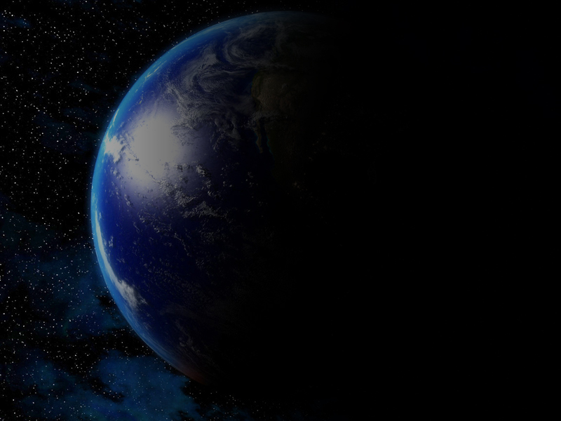
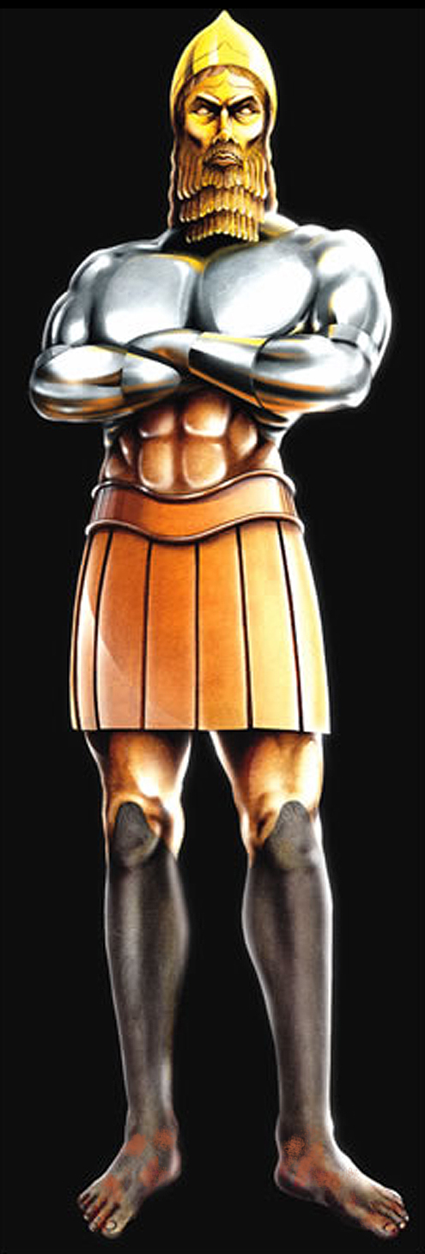
SO HERE COMES THE DREAM!

Slide 41
Daniel 2:31-35 31 Thou, O king, sawest, and behold a great image. This great image, whose brightness was excellent, stood before thee; and the form thereof was terrible.
32 This image's head was of fine gold, his breast and his arms of silver, his belly and his thighs of brass,

Slide 42
Daniel 2:31-35 33 His legs of iron, his feet part of iron and part of clay.
34 Thou sawest till that a stone was cut out without hands, which smote the image upon his feet that were of iron and clay, and brake them to pieces.

Slide 43
Daniel 2:31-35 35 Then was the iron, the clay, the brass, the silver, and the gold, broken to pieces together, and became like the chaff of the summer threshingfloors; and the wind carried them away, that no place was found for them: and the stone that smote the image became a great mountain, and filled the whole earth.

Slide 44
A Great, Huge Image That Has 5 Distinct Parts

Slide 45
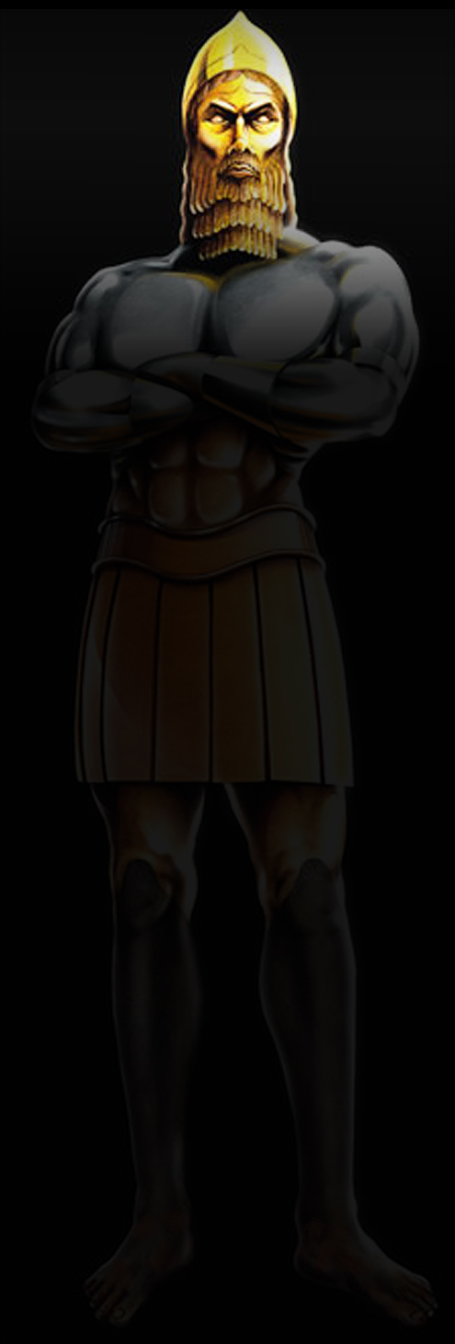
A HEAD OF GOLD

Slide 46
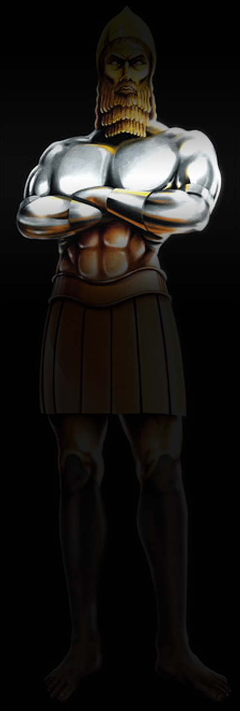
BREAST AND ARMS OF SILVER

Slide 47
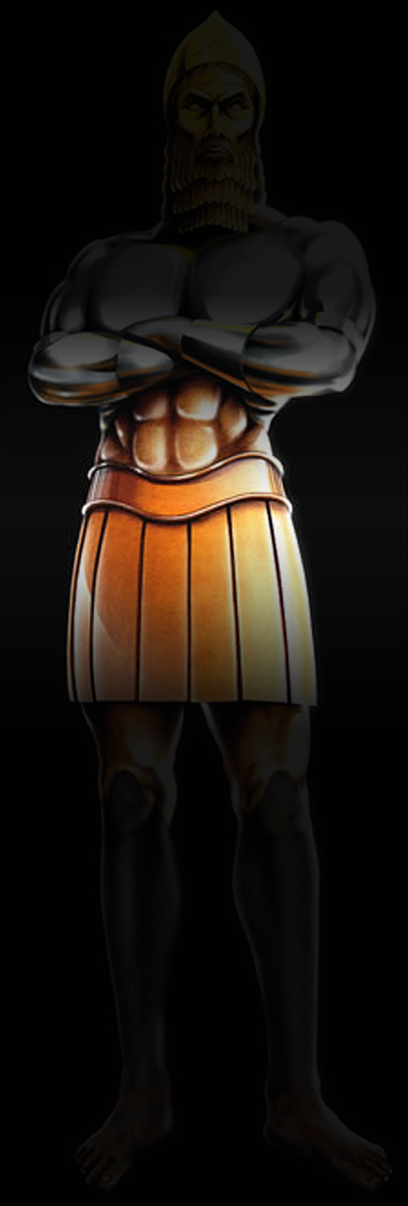
BELLY AND THIGHS OF BRONZE

Slide 48
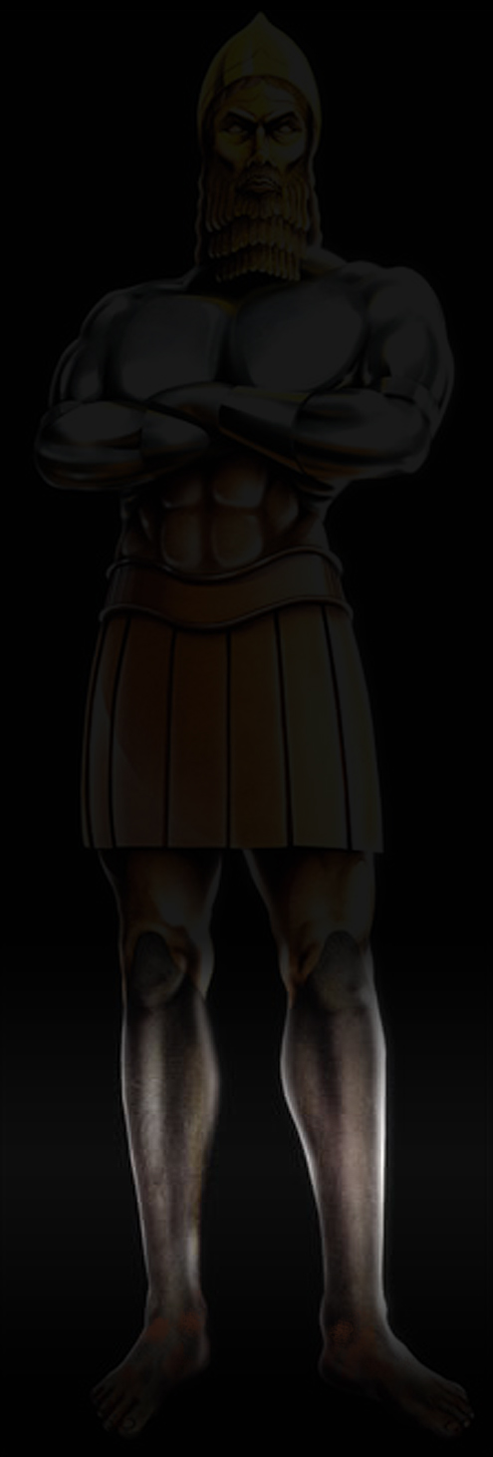
LEGS OF IRON

Slide 49
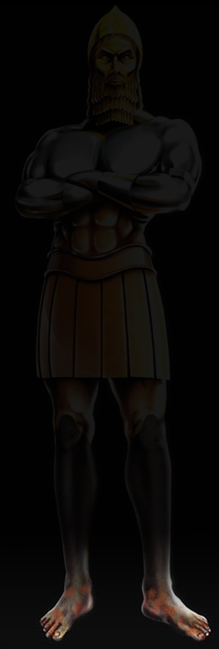
FEET MIXED OF IRON AND CLAY

Slide 50
This Verse Is All About Kingdoms

Slide 51
Look At Verse 21 Again…
Daniel 2:21 And he changeth the times and the seasons: he removeth kings, and setteth up kings: he giveth wisdom unto the wise, and knowledge to them that know understanding:

Slide 52
Here’s The Interpretation Of The Dream

Slide 53
THE KINGDOM
OF GOLD
Daniel 2:37-38 37 Thou, O king, art a king of kings: for the God of heaven hath given thee a kingdom, power, and strength, and glory.

Slide 54
THE KINGDOM
OF GOLD
Daniel 2:37-38 38 And wheresoever the children of men dwell, the beasts of the field and the fowls of the heaven hath he given into thine hand, and hath made thee ruler over them all. Thou art this head of gold.

Slide 55
THE KINGDOM
OF GOLD
BABYLON
606BC – 539BC

Slide 56
THE KINGDOM
OF SILVER
Daniel 2:39a And after thee shall arise another kingdom inferior to thee, and another third kingdom of brass, which shall bear rule over all the earth.

Slide 57
THE KINGDOM
OF SILVER
PERSIA
539BC – 339BC

Slide 58
THE KINGDOM
OF SILVER
Daniel 5:28 PERES; Thy kingdom is divided, and given to the Medes and Persians.

Slide 59
THE KINGDOM
OF SILVER
The Greek Historian Herodotus Tells Us That The Babylonian Armies Moved North At First, To Challenge The Advancing Persian Troops, But Were Soon Driven Back Behind The Walls Of Babylon

Slide 60
THE KINGDOM
OF SILVER
Cyrus Then Proceeded To Divert The Euphrates River From It’s Normal Bed, Under The Walls Of The City, Channeling The Waters To A Nearby Reservoir He Had Dug

Slide 61
THE KINGDOM
OF SILVER
Another Greek Historian, Xenophon, States That Entrance Was Made Into The City At A Time When The Babylonians Were Feasting At A Drunken Orgy

Slide 62
THE KINGDOM
OF SILVER
The Prophet Isaiah Predicted The Fall Of Babylon Over 200 Years In Advance (Isaiah 21:1-10)

Slide 63
THE KINGDOM
OF BRONZE
Daniel 2:39b And after thee shall arise another kingdom inferior to thee, and another third kingdom of brass, which shall bear rule over all the earth.

Slide 64
THE KINGDOM
OF BRONZE
GREECE
339BC – 323BC

Slide 65
THE KINGDOM
OF BRONZE
Alexander Traveled Faster And Conquered More Land Than Any Other Man In All Of Recorded History

Slide 66
THE KINGDOM
OF BRONZE
After His Untimely Death At The Young Age Of 32, His Kingdom Fell To Four Of His Generals

Slide 67
THE KINGDOM
OF IRON
Daniel 2:40 And the fourth kingdom shall be strong as iron: forasmuch as iron breaketh in pieces and subdueth all things: and as iron that breaketh all these, shall it break in pieces and bruise.

Slide 68
THE KINGDOM
OF IRON
ROME
323BC – 400AD

Slide 69
THE KINGDOM
OF IRON & CLAY
Daniel 2:41-43 41 And whereas thou sawest the feet and toes, part of potters' clay, and part of iron, the kingdom shall be divided; but there shall be in it of the strength of the iron, forasmuch as thou sawest the iron mixed with miry clay.

Slide 70
THE KINGDOM
OF IRON & CLAY
Daniel 2:41-43 42 And as the toes of the feet were part of iron, and part of clay, so the kingdom shall be partly strong, and partly broken.

Slide 71
THE KINGDOM
OF IRON & CLAY
Daniel 2:41-43 43 And whereas thou sawest iron mixed with miry clay, they shall mingle themselves with the seed of men: but they shall not cleave one to another, even as iron is not mixed with clay.

Slide 73
THE REBIRTH OF
THE ROMAN EMPIRE
15 FACTS…
1
It Began As Early As 1930, When The French Statesman Aristide Briand Attempted To Enlist 26 Nations In What He Called “The United States Of Europe” And Later Modified It To “The European Union”

Slide 74
THE REBIRTH OF
THE ROMAN EMPIRE
15 FACTS…
1
“The Nations Of Europe Today, Must Unite In Order To Live And Prosper”

Slide 75
THE REBIRTH OF
THE ROMAN EMPIRE
15 FACTS…
2
In 1946, Following The Devastation Of Europe During The Second World War, Winston Churchill Forcefully Asserted That “The Tragedy Of Europe Could Only Be Solved If The Issues Of Ancient Nationalism And Sovereignty Could Give Way To A Sense Of European National Grouping”

Slide 76
THE REBIRTH OF
THE ROMAN EMPIRE
15 FACTS…
2
He Said The Path To European Peace And Prosperity On The World Stage Was Clear: “We Must Build A United States Of Europe”

Slide 77
THE REBIRTH OF
THE ROMAN EMPIRE
15 FACTS…
3
The Benelux Conference Of 1948, Held In Brussels, Belgium, Would Lay The Foundation For A New Organization “To Unite European Countries Economically And Politically To Secure A Lasting Peace”

Slide 78
THE REBIRTH OF
THE ROMAN EMPIRE
15 FACTS…
3
Only Three Tiny Nations Attended The Meeting – The Netherlands, Luxembourg And Belgium

Slide 79
THE REBIRTH OF
THE ROMAN EMPIRE
15 FACTS…
4
Another Step Was Taken In April 1951, When These Three Nations Signed The Treaty Of Paris With Three Additional Nations – Germany, France And Italy, Forming A Common Market For Coal And Steel In An Environment Of Peace And Equality

Slide 80
THE REBIRTH OF
THE ROMAN EMPIRE
15 FACTS…
5
March 25, 1957, Saw A Major Step Toward European Unification When The Treaty Of Rome Was Signed On Capitoline Hill, Of The Seven Famous Hills Of Rome

Slide 81
THE REBIRTH OF
THE ROMAN EMPIRE
15 FACTS…
5
On This Occasion, Italy, France And Germany Joined The Netherlands, Luxembourg And Belgium, Creating The European Economic Community – The Common Market

Slide 82
THE REBIRTH OF
THE ROMAN EMPIRE
15 FACTS…
6
In 1973, The United Kingdom, Ireland And Denmark Joined The EEC, And Greece Was Added In 1981, Making It A Ten-Nation Confederation

Slide 83
THE REBIRTH OF
THE ROMAN EMPIRE
15 FACTS…
7
On January 1, 1986, Spain And Portugal Came Into The Union, And The Agenda Expanded Beyond Economics When The EEC Officially Adopted The Goal Of A Politically Unified Europe

Slide 84
THE REBIRTH OF
THE ROMAN EMPIRE
15 FACTS…
7
In 1987 The Single European Act Was Implemented

Slide 85
THE REBIRTH OF
THE ROMAN EMPIRE
15 FACTS…
8
With The Fall Of The Berlin Wall In 1989, Germany Was Unified And East Germany Was Integrated Into The Membership

Slide 86
THE REBIRTH OF
THE ROMAN EMPIRE
15 FACTS…
9
In December 1992, The Economic Borders Between The Nations Of The European Community Were Removed And A Common Passport Was Issued To Travelers

Slide 87
THE REBIRTH OF
THE ROMAN EMPIRE
15 FACTS…
9
Study In Universities Within The Nations Was Also Permitted Without Any Restrictions

Slide 88
THE REBIRTH OF
THE ROMAN EMPIRE
15 FACTS…
10
Austria, Finland And Sweden Joined The Union In 1995

Slide 89
THE REBIRTH OF
THE ROMAN EMPIRE
15 FACTS…
11
In 2002, Eighty Billion Coins Were Produced For Use In The Twelve Participating Nations Of The Eurozone, Thus Introducing The New Monetary Unit, The Euro

Slide 90
THE REBIRTH OF
THE ROMAN EMPIRE
15 FACTS…
11
The Dollar Is Declining Against The Euro, And Many Experts Believe That Within Five Years, The Euro May Actually Replace The US Dollar As The Standard World Currency

Slide 91
THE REBIRTH OF
THE ROMAN EMPIRE
15 FACTS…
12
The March Toward European Unification Continued On May 1, 2004 When Cyprus, The Czech Republic, Estonia, Hungary, Latvia, Lithuania, Malta, Poland, Slovakia And Slovenia Were Added, Bringing The Total To 25 Nations

Slide 92
THE REBIRTH OF
THE ROMAN EMPIRE
15 FACTS…
12
These Nations Brought 75 Million People Into The European Union, Expanding It’s Population To 450 Million People, And Surpassing North America As The World’s Biggest Economic Zone

Slide 93
THE REBIRTH OF
THE ROMAN EMPIRE
15 FACTS…
13
In January 2007, Romania And Bulgaria Were Admitted Into The EU, Bringing The Total Number Of Nations To 27

Slide 94
THE REBIRTH OF
THE ROMAN EMPIRE
15 FACTS…
14
While Israel Was Part Of The Original Roman Empire, It Is Not Currently A Part Of The European Union. The EU Considers Israel Ineligible For Membership Due To Human Rights Violations, Based On It’s Occupation Of The West Bank, The Gaza Strip, Golan Heights And East Jerusalem

Slide 95
THE REBIRTH OF
THE ROMAN EMPIRE
15 FACTS…
14
It Has Been Proposed, However, That If Israel Would Sign A Peace Treaty With It’s Hostile Neighbors, It Would Be Offered Membership In The EU

Slide 96
THE REBIRTH OF
THE ROMAN EMPIRE
15 FACTS…
15
Gradually, Yet Steadily, The Nations Of Europe Have Come Together, Creating A Modern Replica Of The Ancient Roman Empire

Slide 97
THE REBIRTH OF
THE ROMAN EMPIRE
15 FACTS…
15
Europe Is More Integrated Today Than At Any Time Since The Days Of Ancient Rome

Slide 99


Slide 100
Daniel 2:44-45 44 And in the days of these kings shall the God of heaven set up a kingdom, which shall never be destroyed: and the kingdom shall not be left to other people, but it shall break in pieces and consume all these kingdoms, and it shall stand for ever.

Slide 101
Daniel 2:44-45 45 Forasmuch as thou sawest that the stone was cut out of the mountain without hands, and that it brake in pieces the iron, the brass, the clay, the silver, and the gold; the great God hath made known to the king what shall come to pass hereafter: and the dream is certain, and the interpretation thereof sure.

Slide 102


