Slide 1
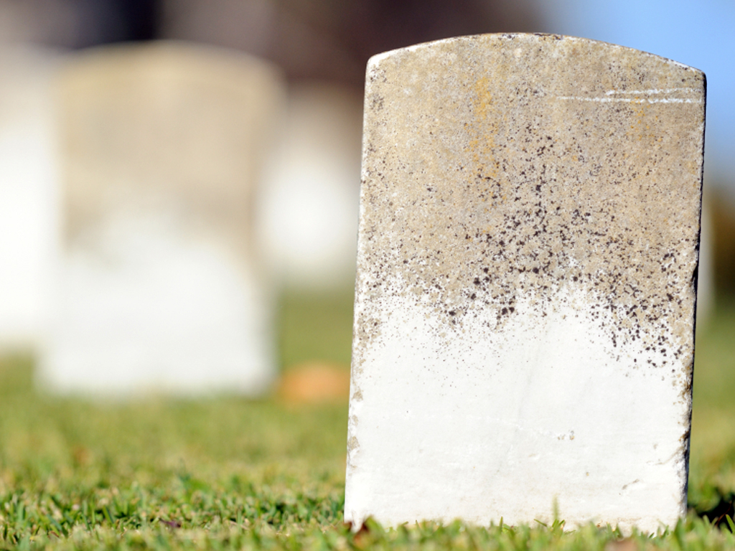

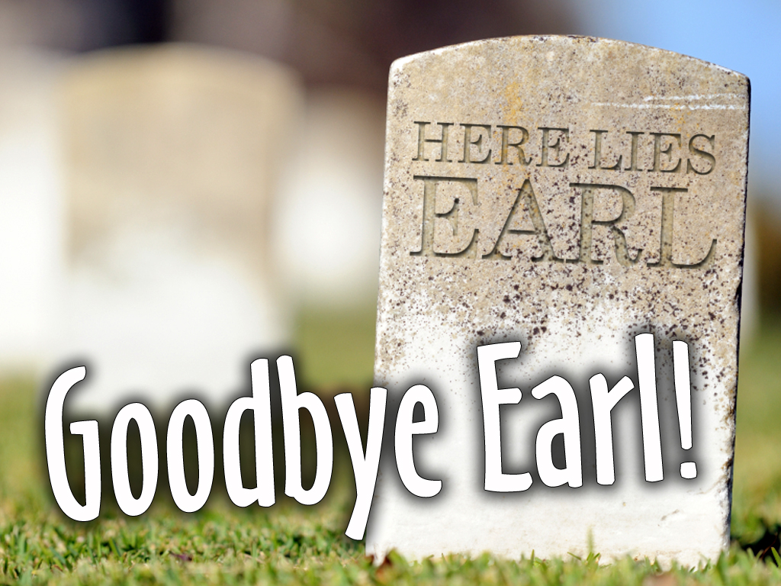
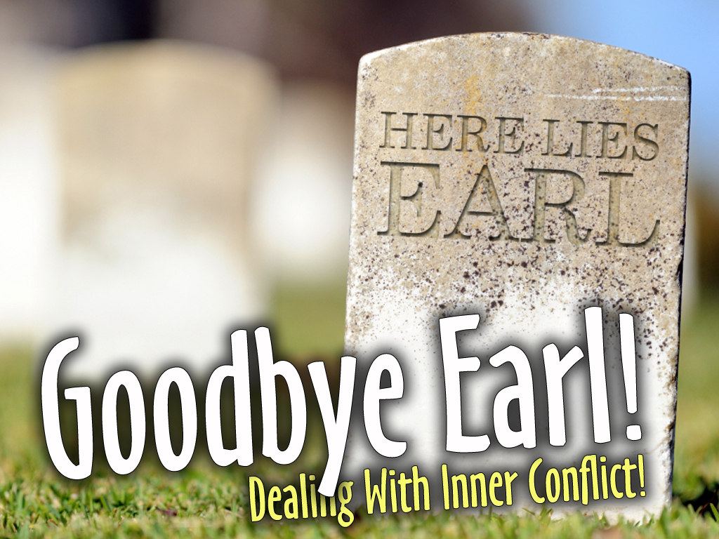

Slide 2
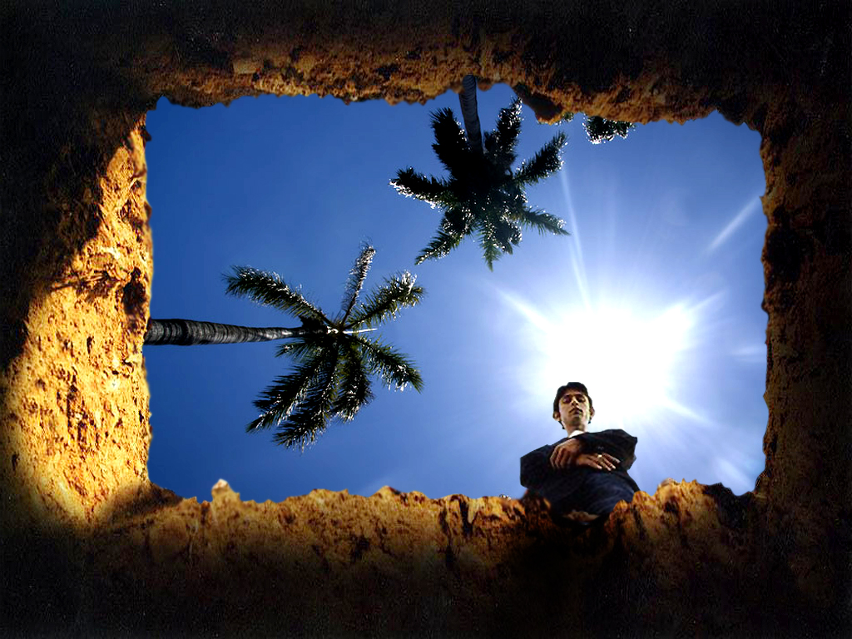
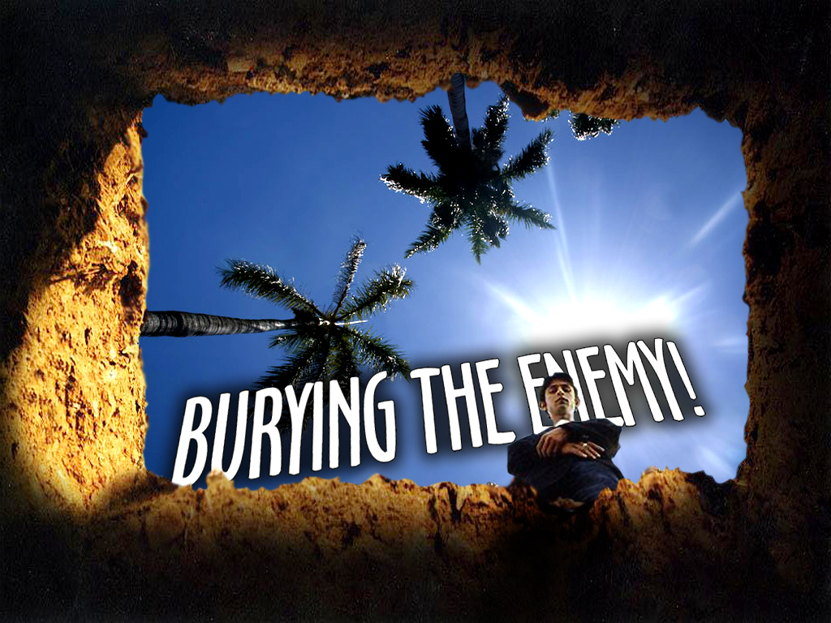

Slide 3
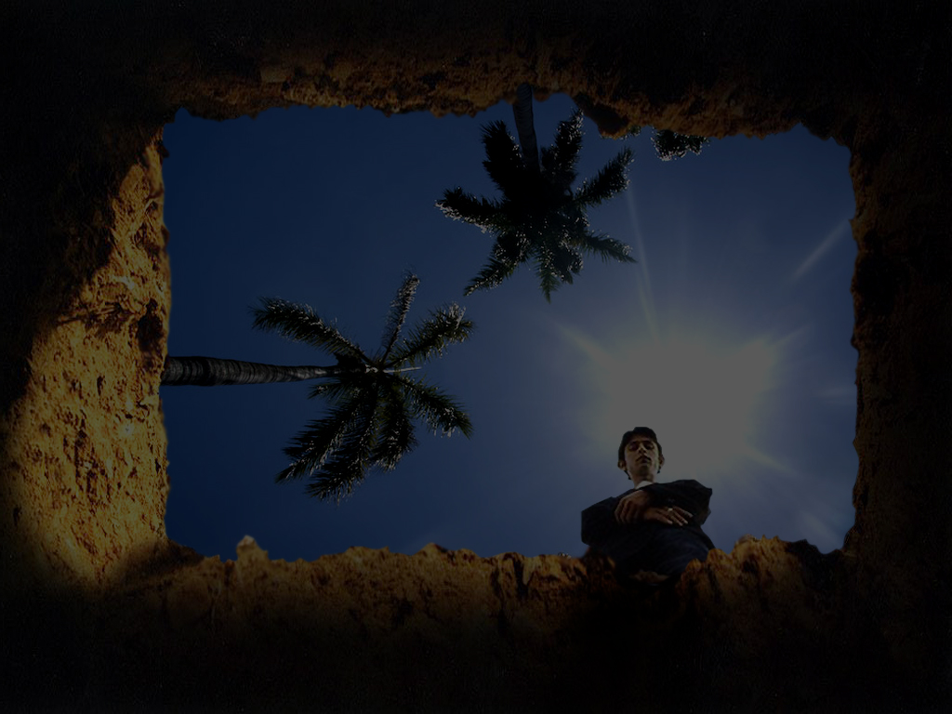

Kill It – Render It Dead
Quit It – Stop Looking At It
Drag It – Off The Road & Cover It
Know It – Open Road Ahead

Slide 4
2 Samuel 20:10b
But Amasa took no heed to the sword that was in Joab's hand: so he smote him therewith in the fifth rib, and shed out his bowels to the ground, and struck him not again; and he died. So Joab and Abishai his brother pursued after Sheba the son of Bichri.

Slide 5
Joab and his brother Abashai, left him (AMASA) lying in the road, and continued after Sheba

Slide 6
JOAB HAD NO PROBLEM MOVING ON!
He left burying the dead to somebody else
He had orders from the King to stop a
rebel and his forces
He knew he had a purpose

Slide 7
Many Don’t Move On To Open Roads Because They Can’t Get Past Their Past!
PAST HURTS
PAST RELATIONSHIPS
PAST FAILURES

Slide 8
KEYWORD
PAST!

Slide 9
Kill It
Quit It
Drag It
Know It

Slide 10

OPEN ROAD AHEAD!

Slide 12
With Amasa’s body out
of the road, and covered
up, EVERYONE WENT ON
WITH JOAB, to hunt down and kill Sheba

Slide 13
2 Samuel 20:14-22
¹⁴ And he went through all the tribes of Israel unto Abel, and to Bethmaachah, and all the Berites: and they were gathered together, and went also after him.
¹⁵ And they came and besieged him in Abel of Bethmaachah, and they cast up a bank against the city, and it stood in the trench: and all the people that were with Joab battered the wall, to throw it down.

Slide 14
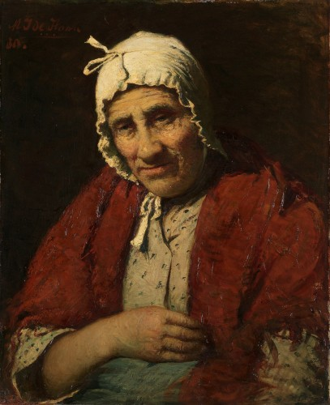
2 Samuel 20:14-22
¹⁶ Then cried a wise woman out of the city, Hear, hear; say, I pray you, unto Joab, Come near hither, that I may speak with thee.
¹⁷ And when he was come
near unto her, the woman
said, Art thou Joab? And he answered, I am he. Then she said unto him, Hear the words of thine handmaid. And he answered, I do hear.

Slide 15
2 Samuel 20:14-22
¹⁸ Then she spake, saying, They were wont to speak in old time, saying, They shall surely ask counsel at Abel: and so they ended the matter.
¹⁹ I am one of them that are peaceable and faithful in Israel: thou seekest to destroy a city and a mother in Israel: why wilt thou swallow up the inheritance of the Lord?

Slide 16
2 Samuel 20:14-22
²⁰ And Joab answered and said, Far be it, far be it from me, that I should swallow up or destroy.
²¹ The matter is not so: but a man of mount Ephraim, Sheba the son of Bichri by name, hath lifted up his hand against the king, even against David: deliver him only, and I will depart from the city. And the woman said unto Joab, Behold, his head shall be thrown to thee over the wall.

Slide 17
2 Samuel 20:14-22
²² Then the woman went unto all the people in her wisdom. And they cut off the head of Sheba the son of Bichri, and cast it out to Joab. And he blew a trumpet, and they retired from the city, every man to his tent. And Joab returned to Jerusalem unto the king.

Slide 18
Future battles and
struggles become much
more manageable when I
get past the inner conflict that has been dogging me!

Slide 19
Joab didn’t worry about the dead!

Slide 20
Joab didn’t
look back!

Slide 21
Joab went on
down the road!

Slide 22
Joab had a purpose!

Slide 23
Joab had a mission!

Slide 24
JOAB ACCOMPLISHED IT WITH EASE!

Slide 25
Not every battle is as tough as the one that is holding you back RIGHT NOW!

Slide 26
I Move Forward
I Get Stength
I Get More
Confident In Christ

Slide 27
Philippians 4:13
I can do all things through Christ which strengtheneth me.

Slide 28
Joab Blew The Trumpet!
(VICTORY)

Slide 29
Joab Went Back Home!
(REST)

Slide 30
Wouldn’t That
Be Nice?

Slide 32
Luke 9:51-62
⁵¹ And it came to pass, when the time was come that he should be received up, he stedfastly set his face to go to Jerusalem,
⁵² And sent messengers before his face: and they went, and entered into a village of the Samaritans, to make ready for him.
⁵³ And they did not receive him, because his face was as though he would go to Jerusalem.

Slide 33
Luke 9:51-62
⁵⁴ And when his disciples James and John saw this, they said, Lord, wilt thou that we command fire to come down from heaven, and consume them, even as Elias did?
⁵⁵ But he turned, and rebuked them, and said, Ye know not what manner of spirit ye are of.
⁵⁶ For the Son of man is not come to destroy men's lives, but to save them. And they went to another village.

Slide 34
Luke 9:51-62
⁵⁷ And it came to pass, that, as they went in the way, a certain man said unto him, Lord, I will follow thee whithersoever thou goest.
⁵⁸ And Jesus said unto him, Foxes have holes, and birds of the air have nests; but the Son of man hath not where to lay his head.
⁵⁹ And he said unto another, Follow me. But he said, Lord, suffer me first to go and bury my father.

Slide 35
Luke 9:51-62
⁶⁰ Jesus said unto him, Let the dead bury their dead: but go thou and preach the kingdom of God.
⁶¹ And another also said, Lord, I will follow thee; but let me first go bid them farewell, which are at home at my house.
⁶² And Jesus said unto him, No man, having put his hand to the plough, and looking back, is fit for the kingdom of God.

Slide 37
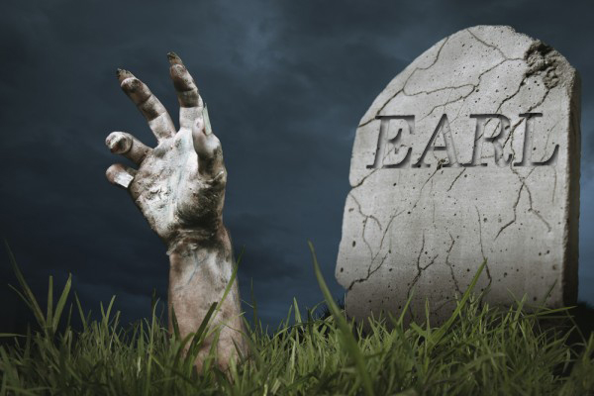
IF I AM REALLY GOING TO...
...Get Past My Past
...Bury My Inner Conflict

Slide 38
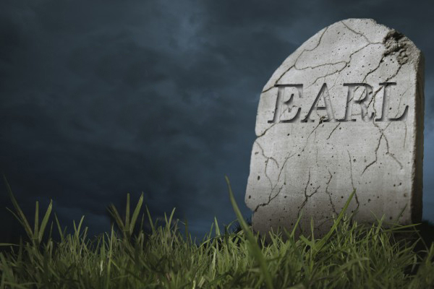
I Must Focus
I Must Follow
I Must Forget

Slide 39
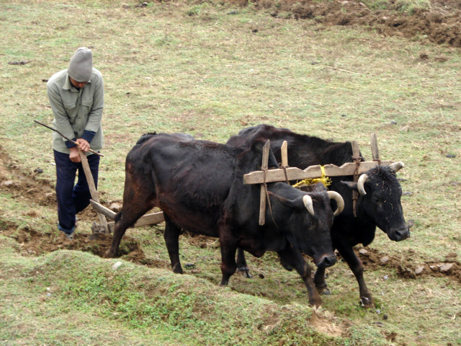
When I Go Back
Or I Look Back
I AM NOT FIT!
I Cannot See Straight
I Cannot Plow Straight
I Cannot Live Straight

Slide 40
I AM ZIG ZAGGY AND ALWAYS SCREWED UP!

Slide 41
Two things the enemy uses to keep us from realizing our PURPOSE and our DESTINY:

Slide 42
1. DEATH
* Of A Loved One
* Of A Relationship
2. FAMILY
* Tension
* Struggle
* Unbalanced Affection

Slide 43
Matthew 10:37-39
³⁷ He that loveth father or mother more than me is not worthy of me: and he that loveth son or daughter more than me is not worthy of me.
³⁸ And he that taketh not his cross, and followeth after me, is not worthy of me.
³⁹ He that findeth his life shall lose it: and he that loseth his life for my sake shall find it.

Slide 44
ABUNDANT LIFE!

Slide 45
John 10:10
The thief cometh not, but for to steal, and to kill, and to destroy: I am come that they might have life, and that they might have it more abundantly.

Slide 46
BURY THE ENEMY AND SURRENDER COMPLETELY TO JESUS CHRIST
Lose The Excuses!

Slide 47
BURY THE ENEMY AND SURRENDER COMPLETELY TO JESUS CHRIST
Lose The Bad Attitude!

Slide 48
BURY THE ENEMY AND SURRENDER COMPLETELY TO JESUS CHRIST
Lose The Poor Decisions!

Slide 49
BURY THE ENEMY AND SURRENDER COMPLETELY TO JESUS CHRIST
DON’T LOOK BACK!

Slide 50
I Will Look Forward
To My Abundant
Life In CHRIST!

Slide 51
Ephesians 3:14-21
¹⁴ For this cause I bow my knees unto the Father of our Lord Jesus Christ,
¹⁵ Of whom the whole family in heaven and earth is named,
¹⁶ That he would grant you, according to the riches of his glory, to be strengthened with might by his Spirit in the inner man;
¹⁷ That Christ may dwell in your hearts by faith; that ye, being rooted and grounded in love,

Slide 52
Ephesians 3:14-21
¹⁸ May be able to comprehend with all saints what is the breadth, and length, and depth, and height;
¹⁹ And to know the love of Christ, which passeth knowledge, that ye might be filled with all the fulness of God.

Slide 53
Ephesians 3:14-21
²⁰ Now unto him that is able to do exceeding abundantly above all that we ask or think, according to the power that worketh in us,
²¹ Unto him be glory in the church by Christ Jesus throughout all ages, world without end. Amen.

