Slide 1
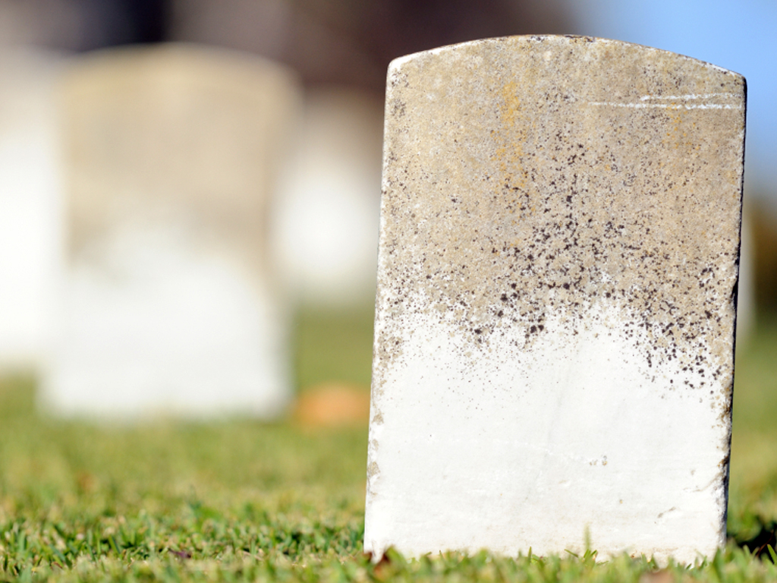

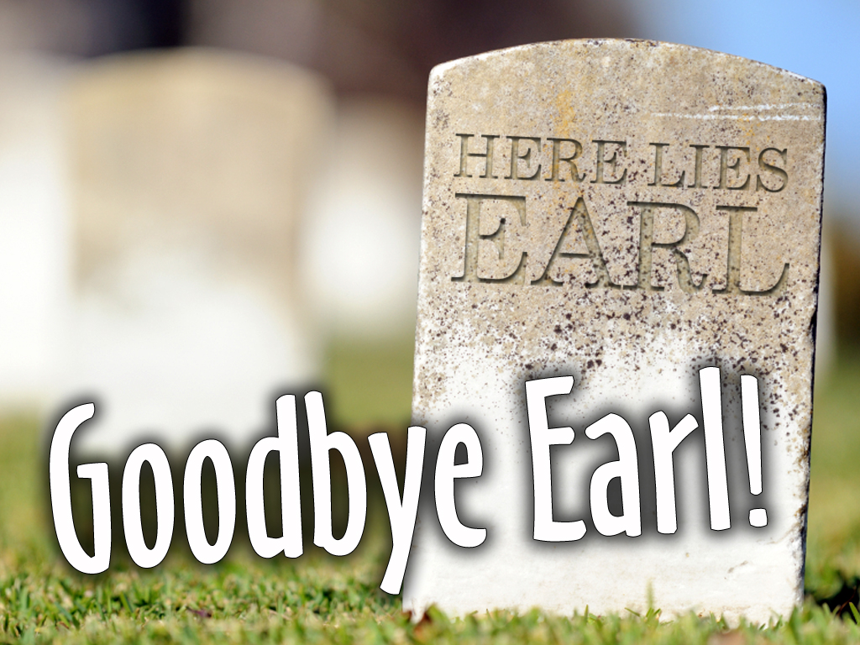
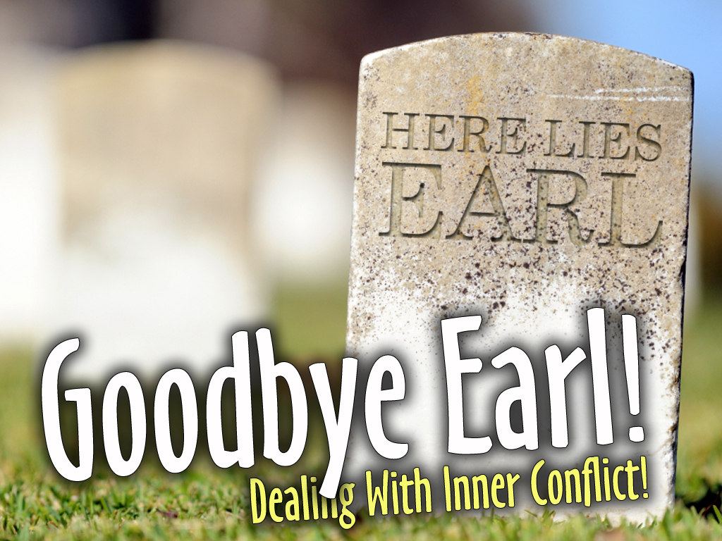
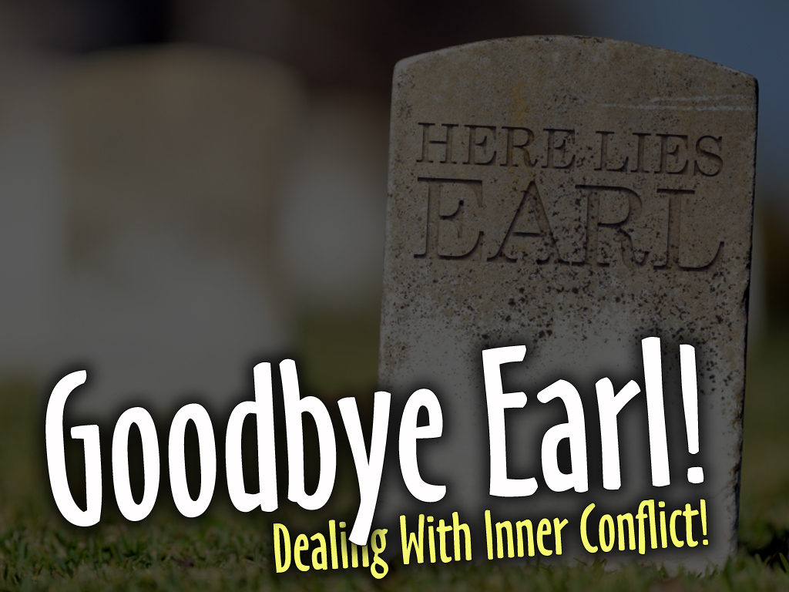

Slide 2
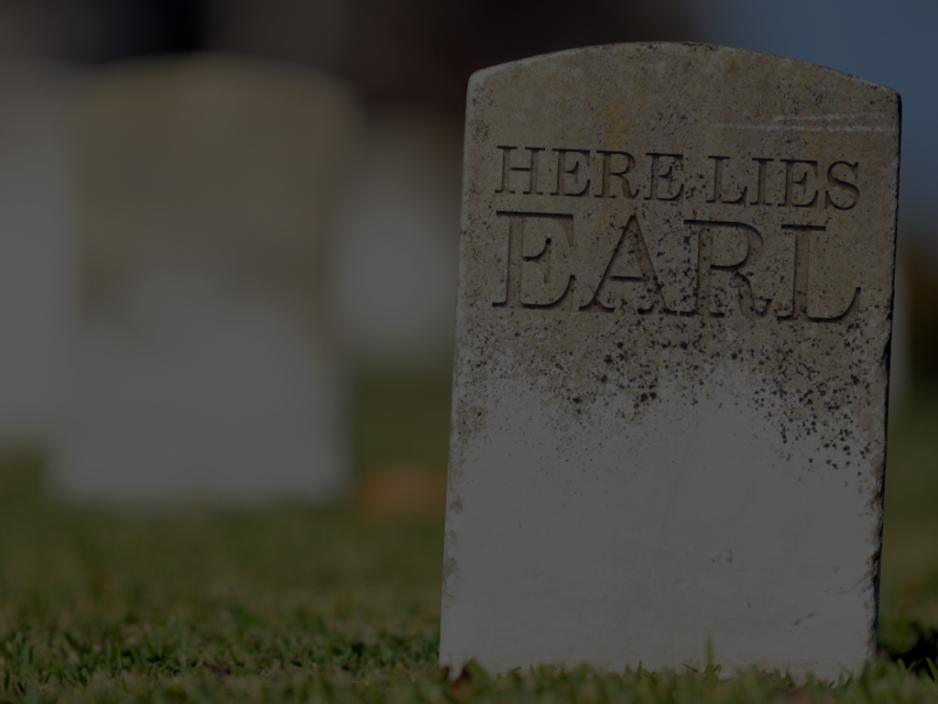
John 10:10
The thief cometh not, but for to steal, and to kill, and to destroy: I am come that they might have life, and that they might have it more abundantly.

Slide 3
PRETENDING I DON’T HAVE INNER CONFLICT IS SURRENDER...
Surrender To Excuse Making
Surrender To Bad Attitudes
Surrender To Poor Decisions

Slide 4
This is NOT living life to the fullest, and this is NOT ACCEPTABLE!

Slide 5
I MUST DEAL WITH
INNER CONFLICT!

Slide 6

Enemy
Attack
Robs
Life

Slide 8
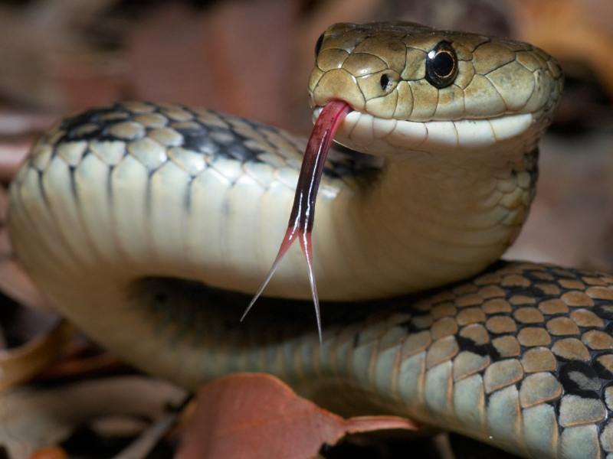
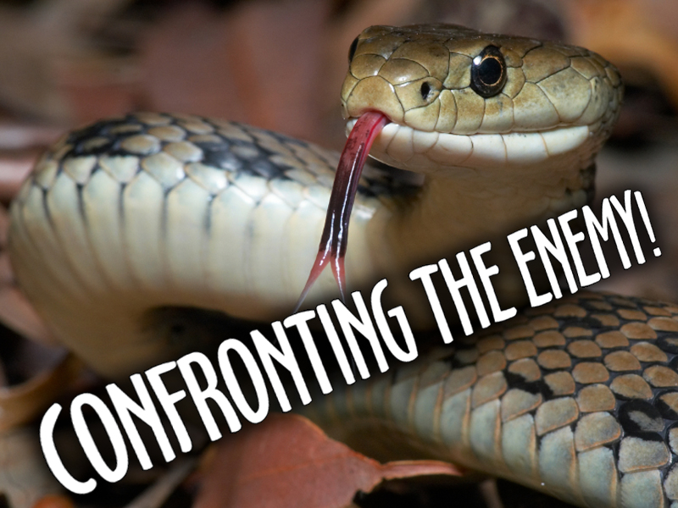
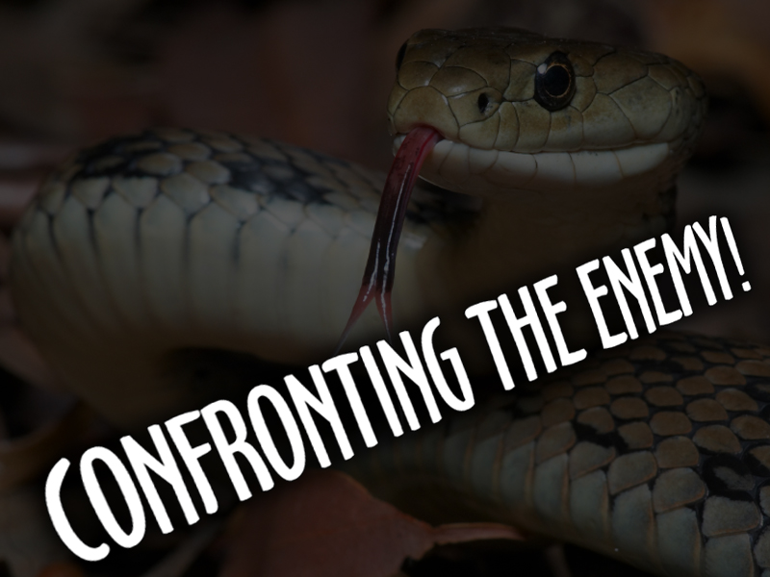
Today...

Slide 9
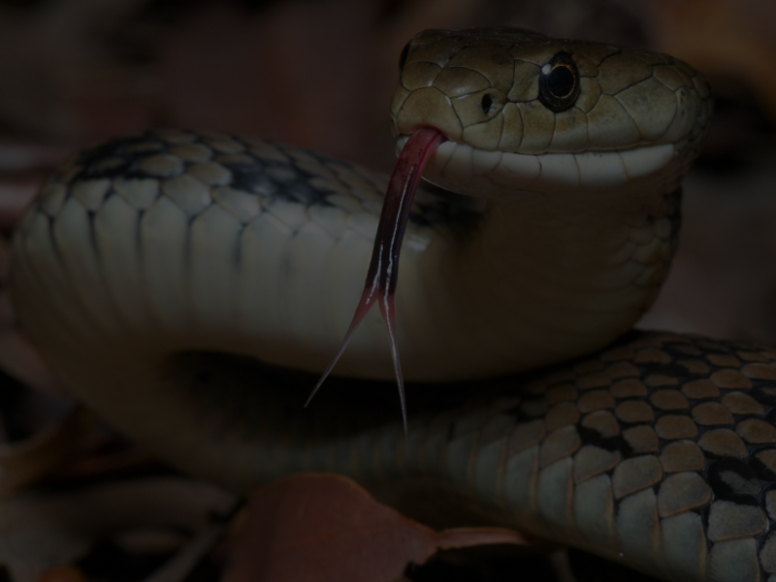

A MOVIE PREVIEW

Slide 10
Shaking Off
The Snake!

Slide 11
Acts 27:41-44
⁴¹And falling into a place where two seas met, they ran the ship aground; and the forepart stuck fast, and remained unmoveable, but the hinder part was broken with the violence of the waves.
⁴²And the soldiers' counsel was to kill the prisoners, lest any of them should swim out, and escape.

Slide 12
Acts 27:41-44
⁴³But the centurion, willing to save Paul, kept them from their purpose; and commanded that they which could swim should cast themselves first into the sea, and get to land:
⁴⁴And the rest, some on boards, and some on broken pieces of the ship. And so it came to pass, that they escaped all safe to land.

Slide 13
Acts 28:1-6
¹And when they were escaped, then they knew that the island was called Melita.
²And the barbarous people shewed us no little kindness: for they kindled a fire, and received us every one, because of the present rain, and because of the cold.

Slide 14
Acts 28:1-6
³And when Paul had gathered a bundle of sticks, and laid them on the fire, there came a viper out of the heat, and fastened on his hand.
⁴And when the barbarians saw the venomous beast hang on his hand, they said among themselves, No doubt this man is a murderer, whom, though he hath escaped the sea, yet vengeance suffereth not to live.

Slide 15
Acts 28:1-6
⁵And he shook off the beast into the fire, and felt no harm.
⁶Howbeit they looked when he should have swollen, or fallen down dead suddenly: but after they had looked a great while, and saw no harm come to him, they changed their minds, and said that he was a god.

Slide 16


And he shook off the snake into the fire, and felt no harm

Slide 17
Wouldn’t That Be Nice?

Slide 18
NOW – The Big Show!

Slide 19
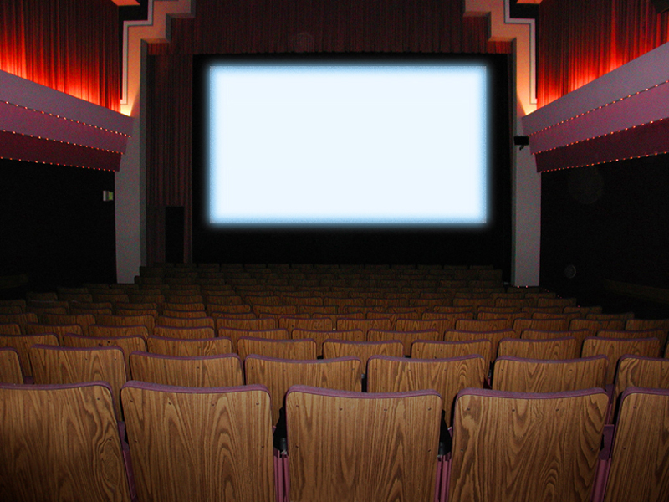


Slide 20
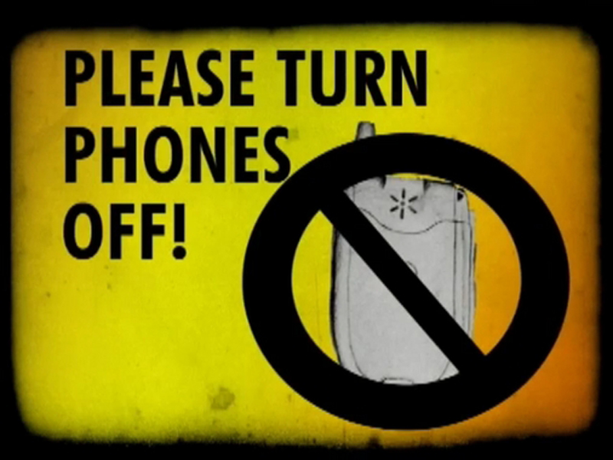

Slide 21
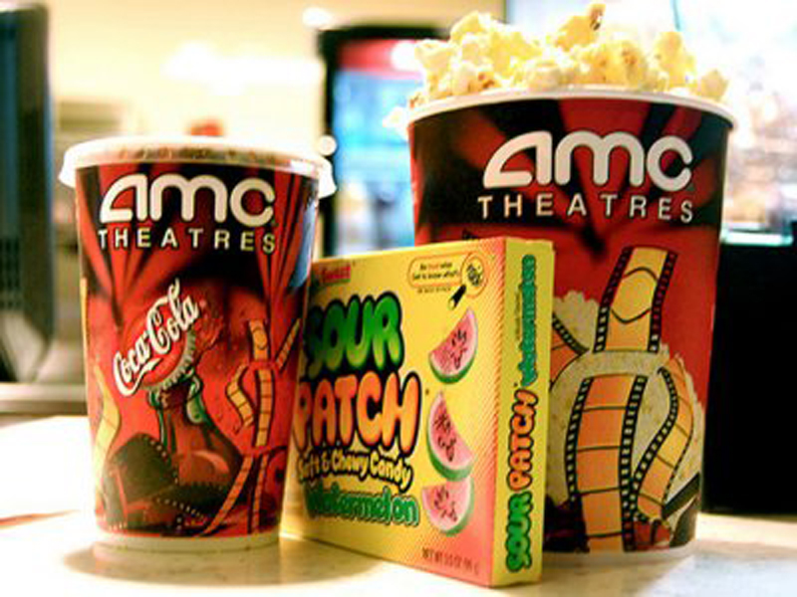

Slide 23
Absalom, King David’s Son, Conspires To Overthrow His Father!

Slide 24
2 Samuel 15:12-14
¹²And Absalom sent for Ahithophel the Gilonite, David's counsellor, from his city, even from Giloh, while he offered sacrifices. And the conspiracy was strong; for the people increased continually with Absalom.

Slide 25
2 Samuel 15:12-14
¹³And there came a messenger to David, saying, The hearts of the men of Israel are after Absalom.
¹⁴And David said unto all his servants that were with him at Jerusalem, Arise, and let us flee; for we shall not else escape from Absalom: make speed to depart, lest he overtake us suddenly, and bring evil upon us, and smite the city with the edge of the sword.

Slide 26
2 Samuel 16:15-22
¹⁵And Absalom, and all the people the men of Israel, came to Jerusalem, and Ahithophel with him.
¹⁶And it came to pass, when Hushai the Archite, David's friend, was come unto Absalom, that Hushai said unto Absalom, God save the king, God save the king.
¹⁷And Absalom said to Hushai, Is this thy kindness to thy friend? why wentest thou not with thy friend?

Slide 27
2 Samuel 16:15-22
¹⁸And Hushai said unto Absalom, Nay; but whom the LORD, and this people, and all the men of Israel, choose, his will I be, and with him will I abide.
¹⁹And again, whom should I serve? should I not serve in the presence of his son? as I have served in thy father's presence, so will I be in thy presence.

Slide 28
2 Samuel 16:15-22
²⁰Then said Absalom to Ahithophel, Give counsel among you what we shall do.
²¹And Ahithophel said unto Absalom, Go in unto thy father's concubines, which he hath left to keep the house; and all Israel shall hear that thou art abhorred of thy father: then shall the hands of all that are with thee be strong.

Slide 29
2 Samuel 16:15-22
²²So they spread Absalom a tent upon the top of the house; and Absalom went in unto his father's concubines in the sight of all Israel.

Slide 30
2 Samuel 17:25
And Absalom made Amasa captain of the host instead of Joab: which Amasa was a man's son, whose name was Ithra an Israelite, that went in to Abigail the daughter of Nahash, sister to Zeruiah Joab's mother.

Slide 31

Say
AMASA
Absalom’s General

Slide 32
2 Samuel 18:5
And the king commanded Joab and Abishai and Ittai, saying, Deal gently for my sake with the young man, even with Absalom. And all the people heard when the king gave all the captains charge concerning Absalom.

Slide 33
Say
JOAB
David’s General

Slide 34
2 Samuel 18:6-10
⁶So the people went out into the field against Israel: and the battle was in the wood of Ephraim;
⁷Where the people of Israel were slain before the servants of David, and there was there a great slaughter that day of twenty thousand men.

Slide 35
2 Samuel 18:6-10
⁸For the battle was there scattered over the face of all the country: and the wood devoured more people that day than the sword devoured.

Slide 36
2 Samuel 18:6-10
⁹And Absalom met the servants of David. And Absalom rode upon a mule, and the mule went under the thick boughs of a great oak, and his head caught hold of the oak, and he was taken up between the heaven and the earth; and the mule that was under him went away.
¹⁰And a certain man saw it, and told Joab, and said, Behold, I saw Absalom hanged in an oak.

Slide 37
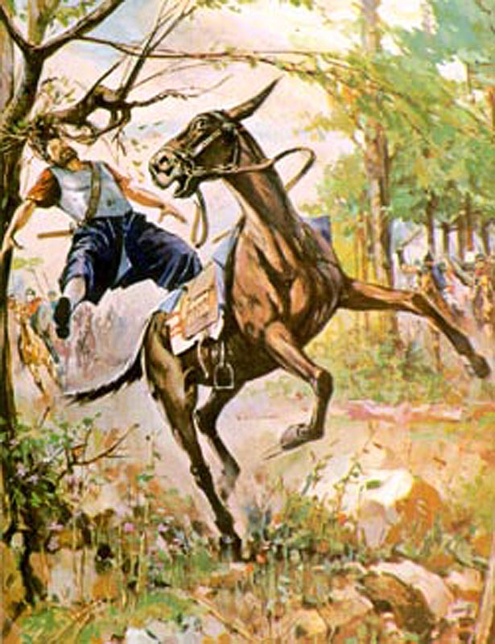
2 Samuel 18:14
Then said Joab, I may not tarry thus with thee. And he took three darts in his hand, and thrust them through the heart of Absalom, while he was yet alive in the midst of the oak.

Slide 38
2 Samuel 19:4-6
⁴But the king covered his face, and the king cried with a loud voice, O my son Absalom, O Absalom, my son, my son!
⁵And Joab came into the house to the king, and said, Thou hast shamed this day the faces of all thy servants, which this day have saved thy life, and the lives of thy sons and of thy daughters, and the lives of thy wives, and the lives of thy concubines;

Slide 39
2 Samuel 19:4-6
⁶In that thou lovest thine enemies, and hatest thy friends. For thou hast declared this day, that thou regardest neither princes nor servants: for this day I perceive, that if Absalom had lived, and all we had died this day, then it had pleased thee well.

Slide 40
2 Samuel 19:9-13
⁹And all the people were at strife throughout all the tribes of Israel, saying, The king saved us out of the hand of our enemies, and he delivered us out of the hand of the Philistines; and now he is fled out of the land for Absalom.

Slide 41
2 Samuel 19:9-13
¹⁰And Absalom, whom we anointed over us, is dead in battle. Now therefore why speak ye not a word of bringing the king back?
¹¹And king David sent to Zadok and to Abiathar the priests, saying, Speak unto the elders of Judah, saying, Why are ye the last to bring the king back to his house? seeing the speech of all Israel is come to the king, even to his house.

Slide 42
2 Samuel 19:9-13
¹²Ye are my brethren, ye are my bones and my flesh: wherefore then are ye the last to bring back the king?
¹³And say ye to Amasa, Art thou not of my bone, and of my flesh? God do so to me, and more also, if thou be not captain of the host before me continually in the room of Joab.

Slide 43
AMASA IS PROMOTED
JOAB IS DEMOTED

Slide 44
Get Ready For
The Message!

Slide 45
2 Samuel 20:1
And there happened to be there a man of Belial, whose name was Sheba, the son of Bichri, a Benjamite: and he blew a trumpet, and said, We have no part in David, neither have we inheritance in the son of Jesse: every man to his tents, O Israel.

Slide 46
2 Samuel 20:4-13
⁴Then said the king to Amasa, Assemble me the men of Judah within three days, and be thou here present.
⁵So Amasa went to assemble the men of Judah: but he tarried longer than the set time which he had appointed him.

Slide 47
2 Samuel 20:4-13
⁶And David said to Abishai, Now shall Sheba the son of Bichri do us more harm than did Absalom: take thou thy lord's servants, and pursue after him, lest he get him fenced cities, and escape us.
⁷And there went out after him Joab's men, and the Cherethites, and the Pelethites, and all the mighty men: and they went out of Jerusalem, to pursue after Sheba the son of Bichri.

Slide 48
2 Samuel 20:4-13
⁸When they were at the great stone which is in Gibeon, Amasa went before them. And Joab's garment that he had put on was girded unto him, and upon it a girdle with a sword fastened upon his loins in the sheath thereof; and as he went forth it fell out.

Slide 49
2 Samuel 20:4-13
⁹And Joab said to Amasa, Art thou in health, my brother? And Joab took Amasa by the beard with the right hand to kiss him.
¹⁰But Amasa took no heed to the sword that was in Joab's hand: so he smote him therewith in the fifth rib, and shed out his bowels to the ground, and struck him not again; and he died. So Joab and Abishai his brother pursued after Sheba the son of Bichri.

Slide 50
2 Samuel 20:4-13
¹¹And one of Joab's men stood by him, and said, He that favoureth Joab, and he that is for David, let him go after Joab.
¹²And Amasa wallowed in blood in the midst of the highway. And when the man saw that all the people stood still, he removed Amasa out of the highway into the field, and cast a cloth upon him, when he saw that every one that came by him stood still.

Slide 51
2 Samuel 20:4-13
¹³When he was removed out of the highway, all the people went on after Joab, to pursue after Sheba the son of Bichri.

Slide 53
CONFRONTING MY INNER CONFLICT
1. I Gotta Kill It!
RENDER IT DEAD!

Slide 54
CONFRONTING MY INNER CONFLICT
1. I Gotta Kill It!
Instead of it killing me, I’ll kill it!

Slide 55
CONFRONTING MY INNER CONFLICT
2. I Gotta Quit It!
STOP LOOKING AT IT!

Slide 56
CONFRONTING MY INNER CONFLICT
2. I Gotta Quit It!
Rubbernecking slows me down and causes a jam up inside of me

Slide 57
CONFRONTING MY INNER CONFLICT
2. I Gotta Quit It!
I am paralyzed emotionally...

Slide 58
CONFRONTING MY INNER CONFLICT
3. I Gotta Drag It!
GET IT OFF THE ROAD AND COVER IT UP

Slide 59
CONFRONTING MY INNER CONFLICT
3. I Gotta Drag It!
I will stop talking
about it!

Slide 60
CONFRONTING MY INNER CONFLICT
3. I Gotta Drag It!
It’s GONE, GONE, GONE
And I’m moving ON, ON, ON

Slide 61
CONFRONTING MY INNER CONFLICT
3. I Gotta Drag It!
It’s GONE, GONE, GONE
And I’m moving ON, ON, ON

Slide 62
CONFRONTING MY INNER CONFLICT
3. I Gotta Drag It!
It’s GONE, GONE, GONE
And I’m moving ON, ON, ON

Slide 63
CONFRONTING MY INNER CONFLICT
4. I Gotta Know It!
WHEN I HAVE PASSED ON THE OTHER SIDE IF IT... THERE IS OPEN ROAD!

Slide 64
CONFRONTING MY INNER CONFLICT
4. I Gotta Know It!
It was not as big as
the enemy had led
me to believe

Slide 65
Kill It
Quit It
Drag It
Know It

Slide 66
Kill It!
Quit It!
Drag It!
Know It!

Slide 67
Render It Dead!

Slide 68
No Rubbernecking!

Slide 69
It’s GONE, GONE, GONE!

Slide 70
I’m Moving ON, ON, ON!

Slide 71
OPEN ROAD AHEAD!

