Slide 1

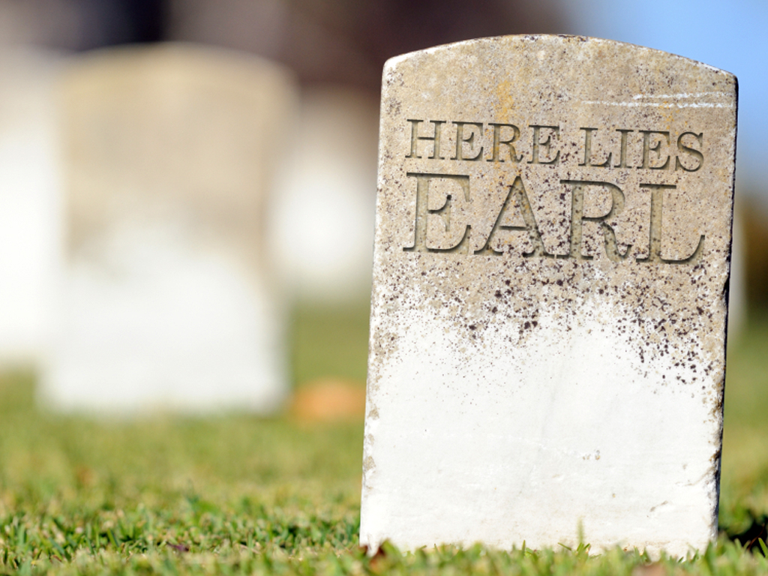
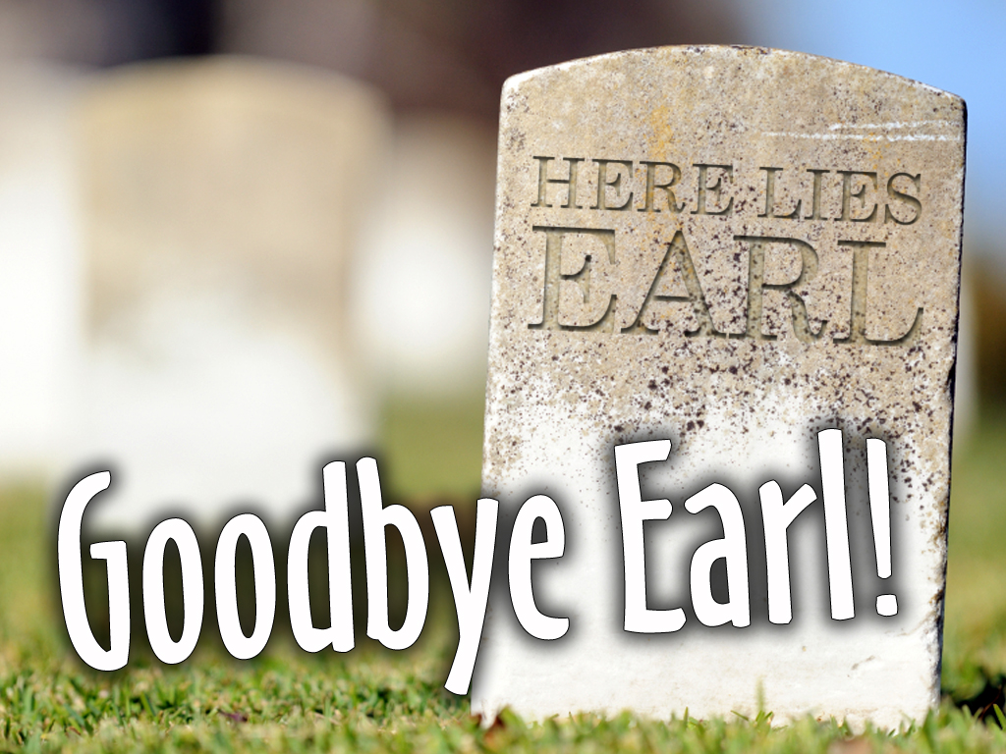


Slide 2

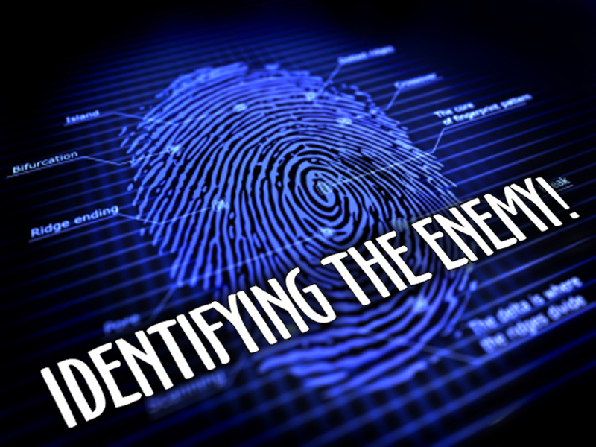
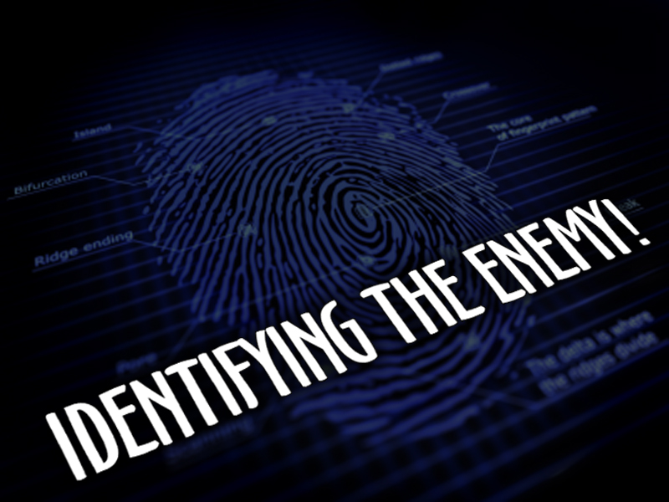

Slide 3

John 10:9-21 ⁹I am the door: by me if any man enter in, he shall be saved, and shall go in and out, and find pasture.
¹⁰The thief cometh not, but for to steal, and to kill, and to destroy: I am come that they might have life, and that they might have it more abundantly.

Slide 4
John 10:9-21 ¹¹I am the good shepherd: the good shepherd giveth his life for the sheep.
¹²But he that is an hireling, and not the shepherd, whose own the sheep are not, seeth the wolf coming, and leaveth the sheep, and fleeth: and the wolf catcheth them, and scattereth the sheep.

Slide 5
John 10:9-21 ¹³The hireling fleeth, because he is an hireling, and careth not for the sheep.
¹⁴I am the good shepherd, and know my sheep, and am known of mine.
¹⁵As the Father knoweth me, even so know I the Father: and I lay down my life for the sheep.

Slide 6
John 10:9-21 ¹⁶And other sheep I have, which are not of this fold: them also I must bring, and they shall hear my voice; and there shall be one fold, and one shepherd.
¹⁷Therefore doth my Father love me, because I lay down my life, that I might take it again.

Slide 7
John 10:9-21 ¹⁸No man taketh it from me, but I lay it down of myself. I have power to lay it down, and I have power to take it again. This commandment have I received of my Father.
¹⁹There was a division therefore again among the Jews for these sayings.

Slide 8
John 10:9-21 ²⁰And many of them said, He hath a devil, and is mad; why hear ye him?
²¹Others said, These are not the words of him that hath a devil. Can a devil open the eyes of the blind?

Slide 9
Jesus Christ Is My Savior And My Lord

Slide 10
He Has Given Me A New Life, And Desires For Me To Live Life With Purpose, And Experience My Full Potential

Slide 11
JESUS IS MY GOOD SHEPHERD, AND WANTS THE VERY BEST FOR ME!

Slide 12
...but there is a problem!

Slide 13
I HAVE AN ENEMY!
Ephesians 6:10-12 ¹⁰Finally, my brethren, be strong in the Lord, and in the power of his might.
¹¹Put on the whole armour of God, that ye may be able to stand against the wiles of the devil.

Slide 14
I HAVE AN ENEMY!
Ephesians 6:10-12 ¹²For we wrestle not against flesh and blood, but against principalities, against powers, against the rulers of the darkness of this world, against spiritual wickedness in high places.

Slide 15

THERE IS A BATTLE, AND IT IS INSIDE OF ME!

Slide 16
We are all different, and the strategy of plan of attack from the ENEMY is unique to our individual personality and past experiences

Slide 17
WE ALL HAVE A BATTLE WE MUST FIGHT!

Slide 18
John 3:30 He must increase, but I must decrease.

Slide 19
1 Corinthians 15:31 I protest by your rejoicing which I have in Christ Jesus our Lord, I die daily.

Slide 20
Matthew 26:41 Watch and pray, that ye enter not into temptation: the spirit indeed is willing, but the flesh is weak.

Slide 21
Though Different... We All Have The Same Goal...

Slide 22
STAND AND FIGHT!

Slide 23
Stand against the WILES of the devil

Slide 24
WILES
Literally means ‘strategy’ or ‘plan of attack!’

Slide 25
To Stand And Fight Effectively And Victoriously, I Must Identify The Enemy

Slide 26

Enemy
Attack
Robs
Who, or What is EARL?
Life

Slide 27
For me, to live life with purpose - and experience my full potential...

Slide 28
I MUST DEAL WITH INNER CONFLICT

Slide 30
1. I MUST BELIEVE THERE IS AN ENEMY WHO IS AT WAR ON THE INSIDE OF ME
...in my *WARD!
Being Ignorant Ain’t Gonna Cut It!

Slide 31
1. I MUST BELIEVE THERE IS AN ENEMY WHO IS AT WAR ON THE INSIDE OF ME
2 Corinthians 2:11 Lest Satan should get an advantage of us: for we are not ignorant of his devices.

Slide 32
2. I MUST REALIZE THAT I DON’T HAVE HOME FIELD ADVANTAGE
Being Unprepared Ain’t Gonna Cut It!

Slide 33
2. I MUST REALIZE THAT I DON’T HAVE HOME FIELD ADVANTAGE
satan is the god of this world, and I am fighting on enemy soil

Slide 34
2. I MUST REALIZE THAT I DON’T HAVE HOME FIELD ADVANTAGE
The world I live in, is the domain of the devil!

Slide 35
2. I MUST REALIZE THAT I DON’T HAVE HOME FIELD ADVANTAGE
Ephesians 6:12 For we wrestle not against flesh and blood, but against principalities, against powers, against the rulers of the darkness of this world, against spiritual wickedness in high places.

Slide 36
2. I MUST REALIZE THAT I DON’T HAVE HOME FIELD ADVANTAGE
PRINCIPALITIES: Head Officers
POWERS: Staff Officers
RULERS: Divisional Commanders
SPIRITUAL WICKEDNESS: Foot Soldiers

Slide 37
2. I MUST REALIZE THAT I DON’T HAVE HOME FIELD ADVANTAGE
All I have to do is look around this world and I can see the brutality and the carnage left by satan’s forces

Slide 38
3. I MUST REALIZE THE INTENSITY OF THE CONFLICT
Being Passive Ain’t Gonna Cut It!

Slide 39
3. I MUST REALIZE THE INTENSITY OF THE CONFLICT
Ephesians 6:12 For we wrestle not against flesh and blood, but against principalities, against powers, against the rulers of the darkness of this world, against spiritual wickedness in high places.

Slide 40
3. I MUST REALIZE THE INTENSITY OF THE CONFLICT
The word ‘wrestle’ speaks of ‘great intensity!’
A Firm Grip
A Pressing Hand

Slide 41
3. I MUST REALIZE THE INTENSITY OF THE CONFLICT
The enemy is straining with every ounce of strength, and using any tactical maneuver to pin me to the ground

Slide 43
THERE IS AN ENEMY
THERE IS A BATTLE
The BATTLE is against me
The BATTLE is fought inside of me
The BATTLE is in enemy territory

Slide 44
THE BATTLE IS INTENSE!
Believing Anything Else Is Surrender And That Ain’t Gonna Cut It!

Slide 45
Ephesians 6:11-12 ¹¹Put on the whole armour of God, that ye may be able to stand against the wiles of the devil. ¹²For we wrestle not against flesh and blood, but against principalities, against powers, against the rulers of the darkness of this world, against spiritual wickedness in high places.
The word AGAINST is repeated 6 times!

Slide 46
Ephesians 6:11-12 ¹¹Put on the whole armour of God, that ye may be able to stand against the wiles of the devil. ¹²For we wrestle not against flesh and blood, but against principalities, against powers, against the rulers of the darkness of this world, against spiritual wickedness in high places.
COUNT THEM!

Slide 48
THE ENEMY’S PERSONALITY
He Deceives...
Revelation 12:9 And the great dragon was cast out, that old serpent, called the Devil, and Satan, which deceiveth the whole world: he was cast out into the earth, and his angels were cast out with him.

Slide 49
THE ENEMY’S PERSONALITY
He Kills...
John 8:44a Ye are of your father the devil, and the lusts of your father ye will do. He was a murderer from the beginning, and abode not in the truth, because there is no truth in him. When he speaketh a lie, he speaketh of his own: for he is a liar, and the father of it.

Slide 50
THE ENEMY’S PERSONALITY
He Lies...
John 8:44b Ye are of your father the devil, and the lusts of your father ye will do. He was a murderer from the beginning, and abode not in the truth, because there is no truth in him. When he speaketh a lie, he speaketh of his own: for he is a liar, and the father of it.

Slide 51
THE ENEMY’S PERSONALITY
He Tempts...
Matthew 4:3 And when the tempter came to him, he said, If thou be the Son of God, command that these stones be made bread.

Slide 52
THE ENEMY’S PERSONALITY
He Destroys...
Revelation 9:11 And they had a king over them, which is the angel of the bottomless pit, whose name in the Hebrew tongue is Abaddon, but in the Greek tongue hath his name Apollyon.

Slide 53
THE ENEMY’S PERSONALITY
He Accuses...
Revelation 12:10 And I heard a loud voice saying in heaven, Now is come salvation, and strength, and the kingdom of our God, and the power of his Christ: for the accuser of our brethren is cast down, which accused them before our God day and night.

Slide 54
THE ENEMY’S PERSONALITY
He Devours...
1 Peter 5:8 Be sober, be vigilant; because your adversary the devil, as a roaring lion, walketh about, seeking whom he may devour:

Slide 55
THE ENEMY’S POWER
Prince Of The World
John 13:31 Therefore, when he was gone out, Jesus said, Now is the Son of man glorified, and God is glorified in him.

Slide 56
THE ENEMY’S POWER
Prince Of The Power Of The Air
Ephesians 2:2 Wherein in time past ye walked according to the course of this world, according to the prince of the power of the air, the spirit that now worketh in the children of disobedience:

Slide 57
THE ENEMY’S POWER
Prince Of Darkness
Ephesians 6:12 For we wrestle not against flesh and blood, but against principalities, against powers, against the rulers of the darkness of this world, against spiritual wickedness in high places.

Slide 58
THE ENEMY’S POWER
god Of This World
2 Corinthians 4:4 In whom the god of this world hath blinded the minds of them which believe not, lest the light of the glorious gospel of Christ, who is the image of God, should shine unto them.

Slide 59
THE ENEMY’S POWER
A Roaring Lion
2 Corinthians 4:4 Be sober, be vigilant; because your adversary the devil, as a roaring lion, walketh about, seeking whom he may devour:

Slide 60
THE ENEMY’S POWER
A Great Dragon
Revelation 12:3 And there appeared another wonder in heaven; and behold a great red dragon, having seven heads and ten horns, and seven crowns upon his heads.

Slide 61
THE ENEMY’S POWER
A Great Dragon
Revelation 12:7 And there was war in heaven: Michael and his angels fought against the dragon; and the dragon fought and his angels,

Slide 62
The enemy is hell-bent on destroying my life, my purpose and my happiness!

Slide 63
The enemy distracts, disrupts and discourages

Slide 65
PRETENDING I DON’T HAVE INNER CONFLICT IS SURRENDER...
Surrender To Excuse Making
Surrender To Bad Attitudes
Surrender To Poor Decisions

Slide 66
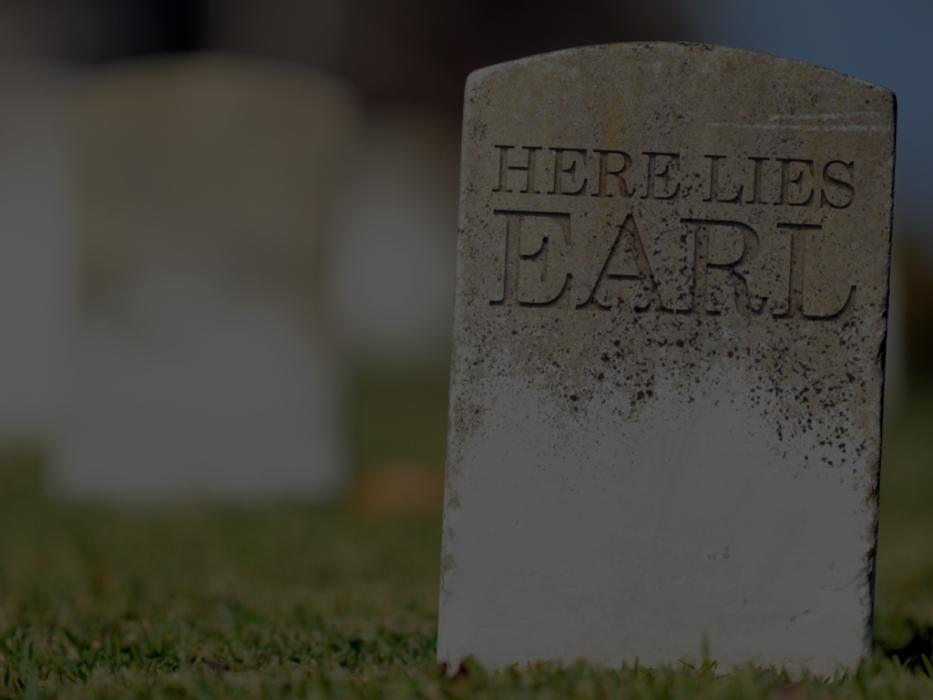
That is not life, and that is not acceptable!

Slide 67
I will never have a life that is overflowing and that I can live to the fullest, unless...

Slide 68
I DEAL WITH INNER CONFLICT!

Slide 69
Enemy
Attack
Robs
Life

